Slide 1
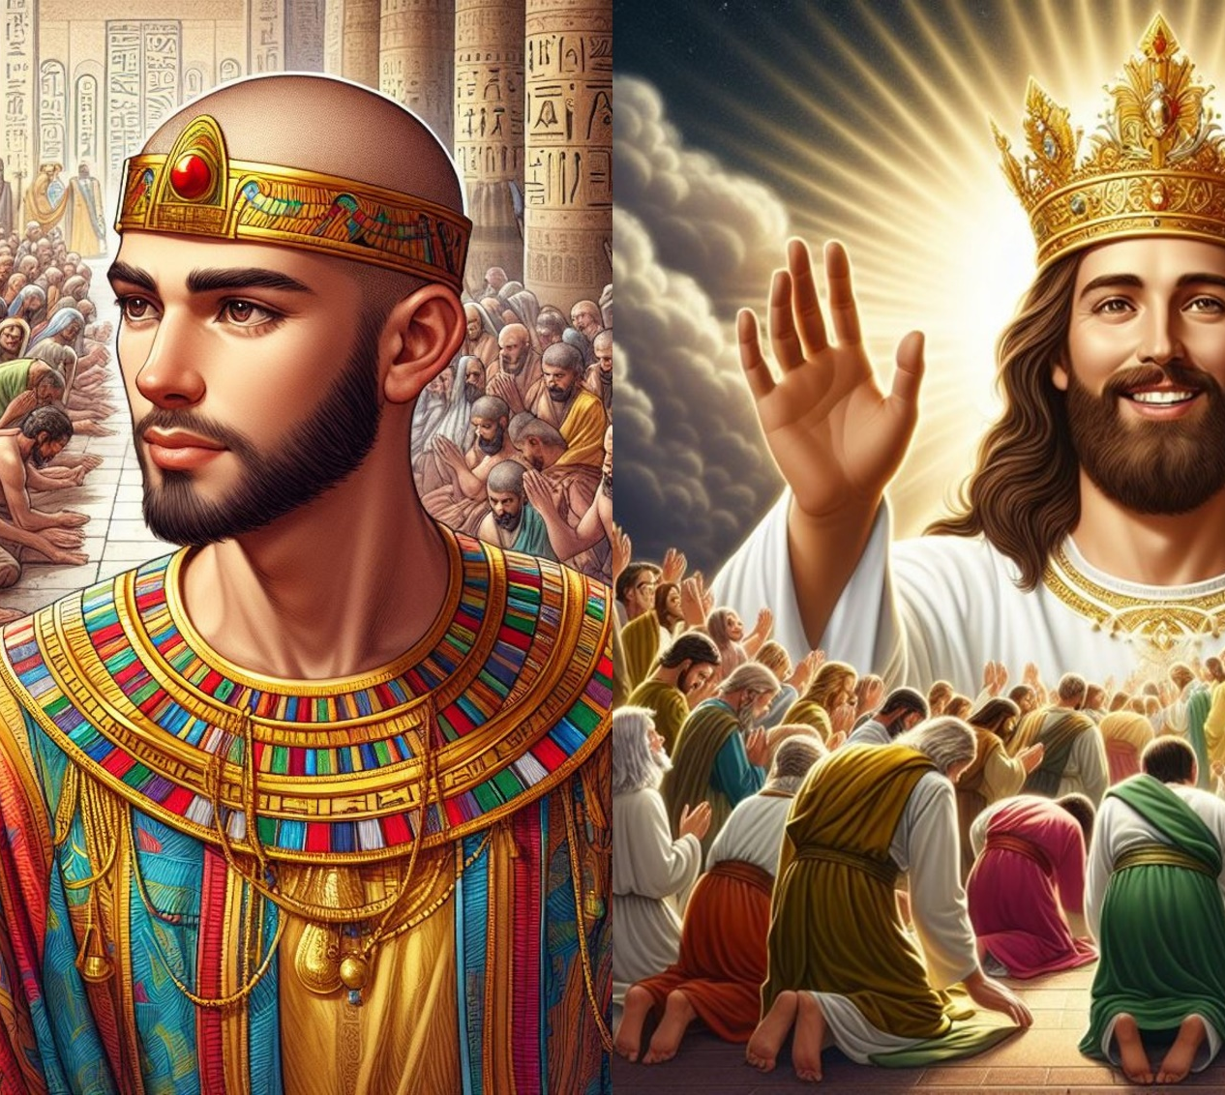
Savior Of The World
Seeing Jesus In The Old Testament
Text:
Genesis 50:20; Mark 10:45
Notes:
By Nathan L Morrison for Sunday 03/03/2024
All Scripture given is from NAS95 unless otherwise stated
For further study, or if questions, please Call: 804-277-1983 or Visit: www.courthousechurchofchrist.com
Adapted from a lesson in Seeing Jesus In The Old Testament by Cloyce Sutton
Logo art provided by www.vecteezy.com
Both images of Joseph and Jesus were created by AI (ChatGPT4)

Slide 2
Intro
Genesis 50:20
20. "As for you, you meant evil against me, but God meant it for good in order to bring about this present result, to preserve many people alive.

Slide 3
Intro
Luke 9:22; Mark 10:45
Luke 9:22 “The Son of Man must suffer many things and be rejected by the elders and chief priests and scribes, and be killed and be raised up on the third day.”
Mark 10:45 “For even the Son of Man did not come to be served, but to serve, and to give His life a ransom for many.”

Slide 4
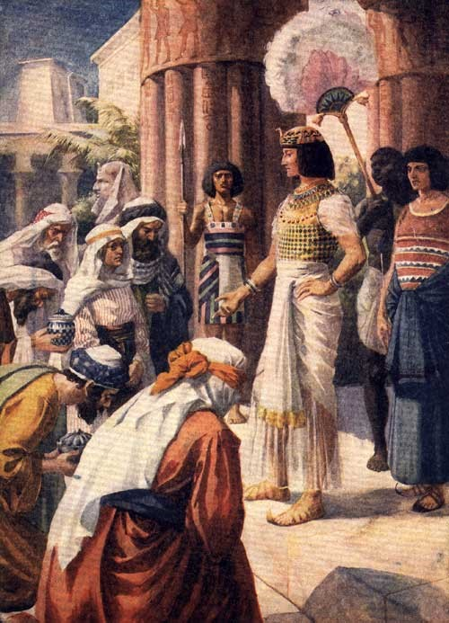
Intro
This is the great message of the Joseph story:
A world-wide catastrophic famine was coming, and God appointed a savior.
By two dreams God showed seventeen-year-old Joseph—and his family—that he was the one!

Slide 5
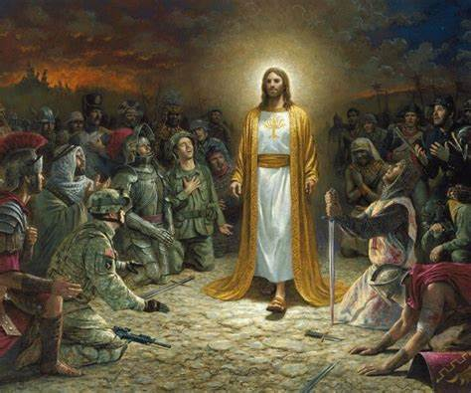
Intro
This is the great message of the gospel:
By one man, Adam, sin entered the world (Romans 5:12-21) and throughout the message of the prophets God showed His people – and the world – that He appointed a Savior, Jesus, (Acts 3:19-24) who would be the cure for sin so that men may not die but have eternal life (Romans 5:12-21)!

Slide 6
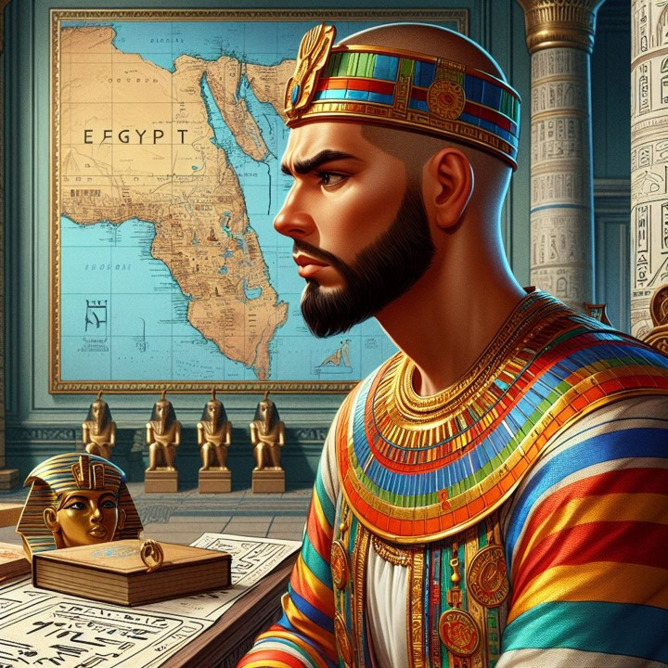
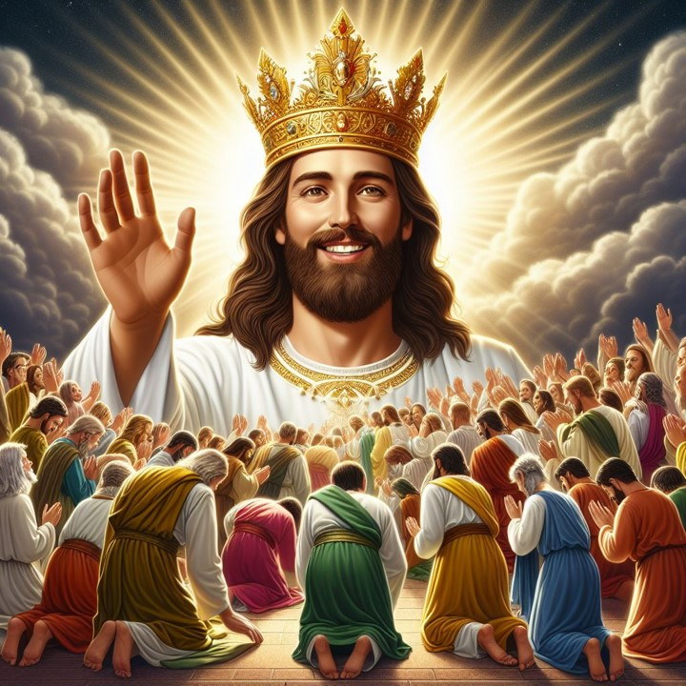
Intro
Let’s look into the Old Testament to see Jesus and focus our eyes and hearts on our Savior!
Notes:
Both images of Joseph and Jesus were created by AI (ChatGPT4)

Slide 7
Joseph & Jesus:
Subject to God’s Plan

Slide 8
Joseph
Especially loved by his father | Genesis 37:3
Predicted to be a ruler | Genesis 37:5-11
Disbelieved by his brothers | Genesis 37:8
Plotted against | Genesis 37:18-20
Stripped of his garment | Genesis 37:23
Sold for price of a slave (20 shekels of silver) | Genesis 37:28
Jesus
Especially loved by His Father | Matthew 3:17
Predicted to be the Ruler | Luke 1:31-33
Disbelieved by his brothers | John 7:1-5
Plotted against | Matthew 26:1-16
Stripped of His garments | Matthew 27:35
Sold for price of a slave (30 pieces of silver) | Matthew 26:15
Privileged son, slave, exaltation | Genesis 37-41
Endowed with wisdom | Genesis 39:1-4
Resisted strong temptation | Genesis 39:7-10
Privileged Son, bond-servant, exaltation | Philippians 2:5-11
Endowed with wisdom | Luke 2:52
Resisted strong temptation | Matthew 4:1-11; Hebrews 4:15

Slide 9
Joseph
Condemned with two criminals | Genesis 40:1-3
One criminal died; one criminal lived | Genesis 40:21-22
Men bowed to him | Genesis 41:43
Not recognized by his brethren | Genesis 42:8
Subject to God’s plan | Genesis 45:5-8; 50:20
Jesus
Condemned with two criminals | Matthew 27:38
One criminal died; one criminal lived (in Paradise) | Luke 23:39-43
Men bowed to him | Philippians 2:10
Not recognized by his brethren | John 1:11
Subject to God’s plan | Acts 2:22-23

Slide 10
Joseph & Jesus: Subject to God’s Plan
Joseph
Twice, Joseph recognized that it was God Who sent him to Egypt and that the purpose was to save many lives!
Genesis 45:5-8
Genesis 50:20: “As for you, you meant evil against me, but God meant it for good in order to bring about this present result, to preserve many people alive.”
Genesis 45:7-8
“God sent me before you to preserve for you a remnant in the earth, and to keep you alive by a great deliverance. Now, therefore, it was not you who sent me here, but God; and He has made me a father to Pharaoh and lord of all his household and ruler over all the land of Egypt.”

Slide 11
Joseph & Jesus: Subject to God’s Plan
Jesus
Jesus said many times that He came to do the will of His father Who sent Him.
John 6:40: “For this is the will of My Father, that everyone who beholds the Son and believes in Him will have eternal life, and I Myself will raise him up on the last day.”
John 12:49: “For I did not speak on My own initiative, but the Father Himself who sent Me has given Me a commandment as to what to say and what to speak.”
Acts 2:22-23: Peter said,
“Men of Israel, listen to these words: Jesus the Nazarene, a man attested to you by God with miracles and wonders and signs which God performed through Him in your midst, just as you yourselves know—this Man, delivered over by the predetermined plan and foreknowledge of God, you nailed to a cross by the hands of godless men and put Him to death.”

Slide 12
Joseph & Jesus: Subject to God’s Plan
God had a plan to save His people in the time of Joseph to keep His promise to Abraham (Genesis 15:13-14), and had a plan to save the whole world from their sins through Jesus! (Matthew 1:20-21; John 1:29)

Slide 13
Joseph & Jesus:
Saviors of the World

Slide 14
Joseph & Jesus: Saviors of the World
Joseph was chosen to be the savior of all the land!
Joseph would save his family, the family of Abraham.
God chose Abraham to be a blessing to all nations (Gen. 12:3), and in Joseph this began to be fulfilled.
Genesis 41:57
In Joseph we see a type—a dim picture—of the coming Savior of the world who would ultimately bring salvation to people from all lands and places across the globe.
Joseph
Genesis 41:57
The people of all the earth came to Egypt to buy grain from Joseph, because the famine was severe in all the earth.

Slide 15
Joseph & Jesus: Saviors of the World
Jesus was chosen to be the Savior of the world.
The salvation that Jesus brought was for people spread all over the earth (Revelation 5:9-10).
John continually raises our eyes to see that Jesus is a worldwide Savior.
John 3:16
I John 2:1-2
I John 4:14
Because of Jesus’ “sacrifice for sins for all time,” He secured all saints’ future with God and to live eternally with Him in Heaven! (I Peter 2:24; 3:18; 1:3-4)
Jesus saves all those who obey Him! (Hebrews 5:8-9)
Jesus
Luke 2:30-32: Simeon said,
“For my eyes have seen Your salvation,
Which You have prepared in the presence of all peoples, A LIGHT OF REVELATION TO THE GENTILES, And the glory of Your people Israel.”

Slide 16
Joseph & Jesus: Saviors of the World
God preserved His people, Israel, from famine through Joseph, a savior from Egypt.
God saved the world from sin, Gentile and Israel, through His own Son, Jesus, the Savior of the world!

Slide 17
Joseph & Jesus:
Preservers of Life

Slide 18
Joseph & Jesus: Preservers of Life
Joseph
Joseph preserved life for a time
While Joseph provided food for a famine lasting seven years, and even a place for his family to relocate, his salvation points to the great salvation of Jesus who will provide an eternal rest of blessedness and goodness for his people forever.
Jospeh didn’t live forever and his role of savior was just for a time.
Genesis 50:20
“As for you, you meant evil against me, but God meant it for good in order to bring about this present result, to preserve many people alive.”

Slide 19
Joseph & Jesus: Preservers of Life
When faithful Jews & Gentiles alike receive the invitation to “Come, you who are blessed of My Father, inherit the kingdom prepared for you from the foundation of the world” (Matthew 25:34), we will see why John is able to call Jesus “the Savior of the world” (John 4:42; I John 4:14).
While Joseph saved “the world” in a limited since, Jesus has gone on to prepare a home in Heaven where all saints from all over the world will be with Him forever (John 14:1-3; I Thessalonians 4:13-18).
Jesus
I John 4:14: John said,
“We have seen and testify that the Father has sent the Son to be the Savior of the world.”

Slide 20
Joseph & Jesus: Preservers of Life
God preserved the world from famine through Joseph, a preserver of life for a limited time and limited place.
God preserves His people, Gentile and Israel, through His own Son, Jesus, Who preserves life for all time!

Slide 21
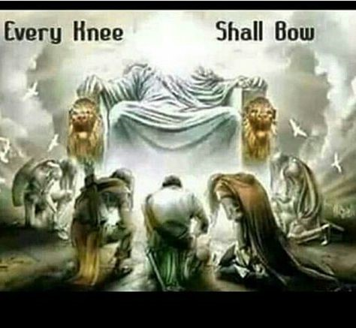
Conclusion
Living Out of Gratitude to the Savior
Just as the people coming into Egypt for food and life submitted to Joseph, so we must remember the Great Savior and submit to Him!
Philippians 2:10
Mark 12:30
“AND YOU SHALL LOVE THE LORD YOUR GOD WITH ALL YOUR HEART, AND WITH ALL YOUR SOUL, AND WITH ALL YOUR MIND, AND WITH ALL YOUR STRENGTH.”

Slide 22
Conclusion
Living Out of Gratitude to the Savior
We must never forget that God appointed Jesus to be the Savior of the World, and the only Savior!
Philippians 2:10
John 14:6
“I am the way, and the truth, and the life; no one comes to the Father but through Me.”

Slide 23
Conclusion
Living Out of Gratitude to the Savior
Jesus has saved us from more than simply dying in this body; he has saved us from captivity to sin, eternal death, and Satan.
The Savior of the world does not adapt Himself to the untold religious and philosophical viewpoints of the world!
Philippians 2:10

Slide 24
Conclusion
Living Out of Gratitude to the Savior
All of our beliefs, actions, and ideas (no matter how popular they may be in the world) must be laid down before Him. We submit entirely to Him!
Philippians 2:10
Romans 8:28-30
And we know that God causes all things to work together for good to those who love God, to those who are called according to His purpose.
For those whom He foreknew, He also predestined to become conformed to the image of His Son, so that He would be the firstborn among many brethren;
and these whom He predestined, He also called; and these whom He called, He also justified; and these whom He justified, He also glorified.”

Slide 25
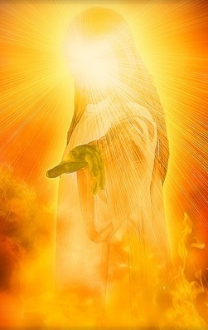
Conclusion
We show our gratitude to Jesus by obeying Him!
(Unbelievers become believers; Believers stay faithful)

Slide 26
“What Must I Do To Be Saved?”
Hear The Gospel (John 5:24; Romans 10:17)
Believe In Christ (John 3:16-18; John 8:24)
Repent Of Sins (Luke 13:3-5; Acts 2:38)
Confess Christ (Matthew 10:32; Romans 10:10)
Be Baptized (Mark 16:16; Acts 22:16)
Remain Faithful (John 8:31; Revelation 2:10)
For The Erring Saint:
Repent (Acts 8:22), Confess (I John 1:9),
Pray (Acts 8:22)

