Slide 1
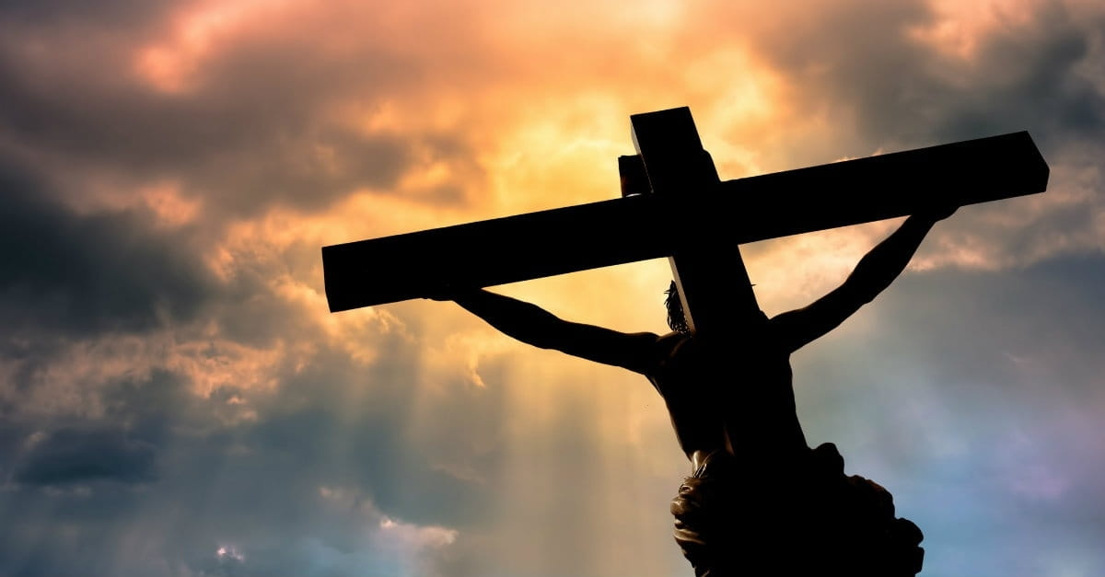
The Free Gift
Text:
Romans 6:23
Notes:
By Nathan L Morrison for Sunday December 31, 2023
All Scripture given is from NASB unless otherwise stated
For further study, or if questions, please Call: 804-277-1983 or Visit www.courthousechurchofchrist.com

Slide 2
Intro
One year is on the cusp of fading away and the prospect and potential of the New Year is just around the corner!
In the midst of all the resolutions and planning, the best thing one can do for their life is make sure they are right with God!
God has offered a “free gift” of eternal life to every individual, paid for by Jesus!

Slide 3
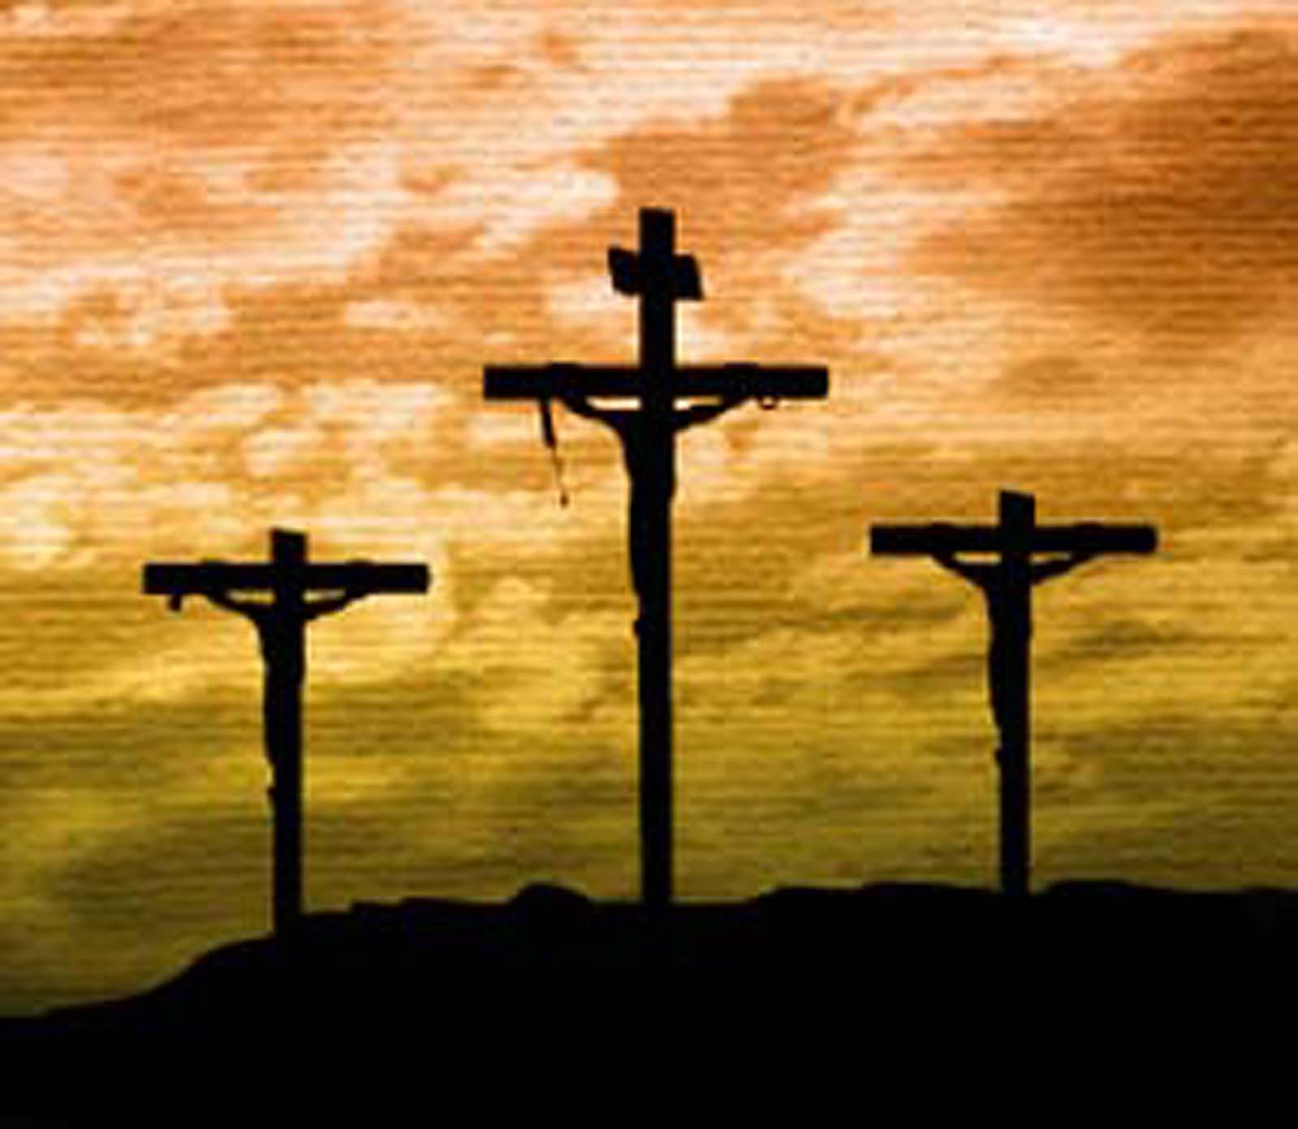
Intro
The gospel is about grace and pardon and forgiveness for sins, a free gift from Jesus

Slide 4
Intro
Romans 6:23; Ephesians 1:7-8a
Romans 6:23: For the wages of sin is death, but the free gift of God is eternal life in Christ Jesus our Lord.
Ephesians 1:7-8a: In Him we have redemption through His blood, the forgiveness of our trespasses, according to the riches of His grace which He lavished on us.

Slide 5
Intro
Jesus made sacrifice for all sins for all time in His own blood (Hebrews 10:10-14)
Why don’t all people take the gift?
Jesus paid for you to have salvation, even if you don’t want it.
The free gift of eternal life is yours if you but take it, paid for in the blood of Jesus.
But most of the people in the world won’t take it.
Jesus described it as two roads: a broad one that the majority find and a narrow one that only a few find (Matthew 7:13-14).
Jesus Himself said He would be rejected but said His words would still judge them on Judgment Day (John 12:48).

Slide 6
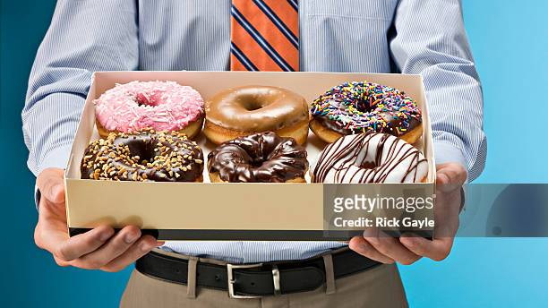
Intro
Let’s see God’s grace, pardon and free gift in a story called, “The Free Gift: Jesus, Grace, Steve & Donuts!”
(AKA The Parable of the Donuts; Author unknown)

Slide 7
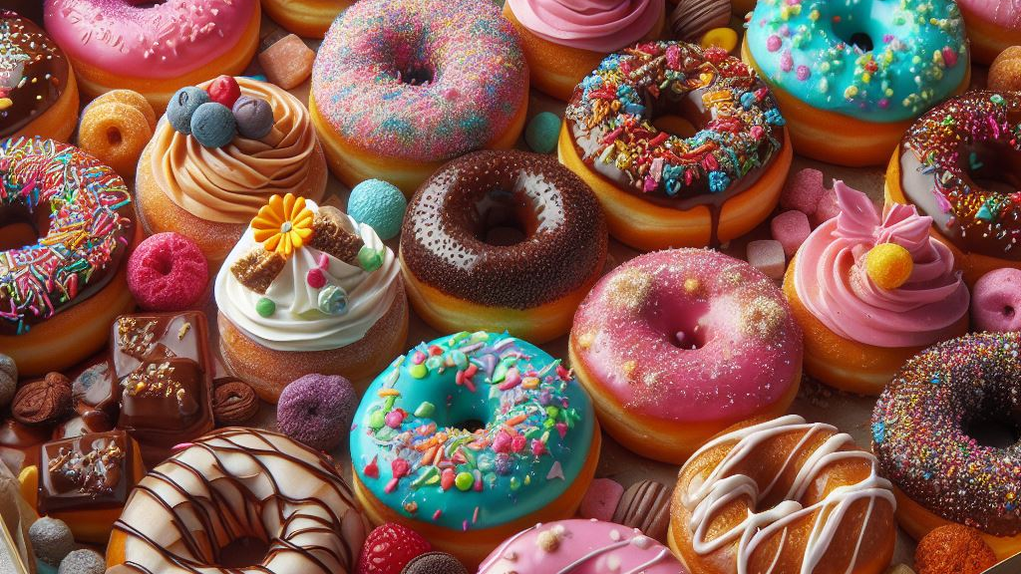
The Free Gift: Jesus, Grace, Steve & Donuts (The Parable of the Donuts)
Notes:
The Free Gift: Jesus, Grace, Steve & Donuts (The Parable of the Donuts)
There was a certain Professor of Religion named Dr. Anderson who taught at a small college in the Western United States.
Dr. Anderson taught the required survey course in Christianity at this particular institution. Every student was required to take this course his or her freshman year regardless of his or her major.
Although Dr. Anderson tried hard to communicate the essence of the gospel in his class, he found that most of his students looked upon the course as nothing but required drudgery. Despite his best efforts, most students refused to take Christianity seriously.
This year, Dr. Anderson had a special student named Steve. Steve was only a freshman but was studying with the intent of going into the ministry.
Steve was popular, he was well liked, and he was an imposing physical specimen. He was now the starting center on the school football team and was the best student in the professor's class.
One day, Dr. Anderson asked Steve to stay after class so he could talk with him. “How many pushups can you do?”
Steve said, “I do about 200 every night.”
“200? That's pretty good, Steve,” Dr. Anderson said. “Do you think you could do 300?”
Steve replied, “I don't know...I've never done 300 at a time.”
“Do you think you could?” again asked Dr. Anderson.
“Well, I can try,” said Steve.
“Can you do 300 in sets of 10? I have a class project in mind, and I need you to do about 300 pushups in sets of ten for this to work. Can you do it? I need you to tell me you can do it,” said the professor.
Steve said, “Well...I think I can...yeah, I can do it.”
Dr. Anderson said, “Good! I need you to do this on Friday. Let me explain what I have in mind.”
Friday came, and Steve got to class early and sat in the front of the room.
When class started, the professor pulled out a big box of donuts. These weren't the normal kinds of donuts, they were the extra fancy BIG kind, with cream centers and frosting swirls.
Everyone was pretty excited it was Friday, the last class of the day, and they were going to get an early start on the weekend with a party in Dr. Anderson's class.
Dr. Anderson went to the first girl in the first row and asked, “Cynthia, do you want to have one of these donuts?”
Cynthia said, “Yes.”
Dr. Anderson then turned to Steve and asked, “Steve, would you do ten pushups so that Cynthia can have a donut?”
“Sure.” Steve jumped down from his desk to do a quick ten. Then Steve again sat in his desk. Dr. Anderson put a donut on Cynthia's desk.
Dr. Anderson then went to Joe, the next person, and asked, “Joe, do you want a donut?”
Joe said, “Yes.”
Dr. Anderson asked, “Steve would you do ten pushups so Joe can have a donut?” Steve did ten pushups, and Joe got a donut.
And so it went, down the first aisle, Steve did ten pushups for every person before they got their donut, and down the second aisle, till Dr. Anderson came to Scott.
Scott was on the basketball team and in as good a condition as Steve. He was very popular and never lacking for female companionship. When the professor asked, “Scott do you want a donut?”
Scott's reply was, “Well, can I do my own pushups?”
Dr. Anderson said, “No, Steve has to do them.”
Then Scott said, “Well, then I don't want one.”
Dr. Anderson shrugged and then turned to Steve and asked, “Steve, would you do ten pushups so Scott can have a donut he doesn't want?” With perfect obedience, Steve started to do ten pushups.
Scott said, “HEY! I said I didn't want one!”
Dr. Anderson said, “Look, this is my classroom, my class, my desks, and these are my donuts. Just leave it on the desk if you don't want it.” And he put a donut on Scott's desk.
Now by this time, Steve had begun to slow down a little. He just stayed on the floor between sets because it took too much effort to be getting up and down. You could start to see a little perspiration coming out around his brow. Dr. Anderson started down the third row. Now the students were beginning to get a little angry.
Dr. Anderson asked Jenny, “Jenny, do you want a donut?”
Sternly, Jenny said, “No.” Then Dr. Anderson asked Steve, “Steve, would you do ten more pushups so Jenny can have a donut that she doesn't want?” Steve did ten, and Jenny got a donut. She left it on her desk.
By now, a growing sense of uneasiness filled the room. The students were beginning to say “No” and there were all these uneaten donuts on the desks. Steve also had to really put forth a lot of extra effort to get these pushups done for each donut. There began to be a small pool of sweat on the floor beneath his face. His arms and brow were beginning to get red because of the physical effort involved.
Dr. Anderson started down the fourth row. During his class “party” others had gone out and told passerby students about the spectacle unfolding in their classroom. The result was some students from other classes had wandered in and sat down on the steps along the radiators that ran down the sides of the room. When the professor realized this, he did a quick count and saw that now there were 34 students in the room.
He started to worry if Steve would be able to make it.
Dr. Anderson went on to the next person and the next and the next. Near the end of that row, Steve was really having a rough time. He was taking a lot more time to complete each set.
A few moments later, Jason, a recent transfer student, came to the room and was about to come in when all the students yelled in one voice, “NO! Don't come in! Stay out!” Jason didn't know what was going on.
Steve picked up his head and said, “No, let him come.”
Professor Anderson said, “You realize that if Jason comes in you will have to do ten pushups for him?”
Steve said, “Yes, let him come in. Give him a donut.”
Dr. Anderson said, “Okay, Steve, I'll let you get Jason's out of the way right now.
Jason, do you want a donut?” Jason, new to the room, hardly knew what was going on.
“Yes,” he said, “give me a donut.”
“Steve, will you do ten pushups so that Jason can have a donut?” Steve did ten pushups very slowly and with great effort. Jason, bewildered, was handed a donut and sat down.
Dr. Anderson finished the fourth row then started on those visitors seated by the heaters. Steve's arms were now shaking with each pushup in a struggle to lift himself against the force of gravity.
Sweat was profusely dropping off of his face and, by this time, there was no sound except his heavy breathing. There was not a dry eye in the room.
The very last two students in the room were two young women, both cheerleaders, and very popular. Dr. Anderson went to Linda, the second to last, and asked, “Linda, do you want a doughnut?”
Linda said, very sadly, “No, thank you.”
Professor Anderson quietly asked, “Steve, would you do ten pushups so that Linda can have a donut that she doesn't want?” Grunting from the effort, Steve did ten very slow pushups for Linda.
Then Dr. Anderson turned to the last girl, Susan. “Susan, do you want a donut?” Susan, with tears flowing down her face, began to cry. “Dr. Anderson, why can't I help him?”
Dr. Anderson, with tears of his own, said, “No, Steve has to do it alone. I have given him this task and he is in charge of seeing that everyone has an opportunity for a donut whether they want it or not. When I decided to have a party this last day of class, I looked at my Grade Book. Steve is the only student with a perfect grade. Everyone else has failed a test, skipped class, or offered me inferior work. Steve told me that when a player messes up in football practice, he must do pushups.
I told Steve that none of you could come to my party unless he paid the price by doing your pushups. He and I made a deal for your sakes. Steve, would you do ten pushups so Susan can have a donut?” As Steve very slowly finished his last pushup, with the understanding that he had accomplished all that was required of him, having done 350 pushups, his arms buckled beneath him and he fell to the floor.
Dr. Anderson turned to the room and quoted from Luke 23:46: “And Jesus, crying out with a loud voice, said, “Father, INTO YOUR HANDS I COMMIT MY SPIRIT.” Having said this, He breathed His last.'” “With the understanding that He had done everything that was required of Him, Jesus yielded up His life. And like some of those in this room, many of us leave the free gift on the desk, uneaten.”
“Steve has done all that I required of him, and now look around at all the uneaten donuts still laying on desks, that have been paid for, your free gifts.”
Two students helped Steve up off the floor and to a seat, physically exhausted, but wearing a thin smile. “Well done, good and faithful servant,” said the professor, adding, “Not all sermons are preached in words.”
Turning to his class the professor said, “My wish is that you might understand and fully comprehend all the riches of grace and mercy that have been given to you through the sacrifice of our Lord and Savior Jesus Christ for us all, now and forever. Whether or not we choose to accept His gift to us, the price has been paid.” He then left the class with Romans 6:23: “For the wages of sin is death, but the free gift of God is eternal life in Christ Jesus our Lord.” He finished with a question, “Wouldn't you be foolish and ungrateful to leave it laying on the desk?”

Slide 8
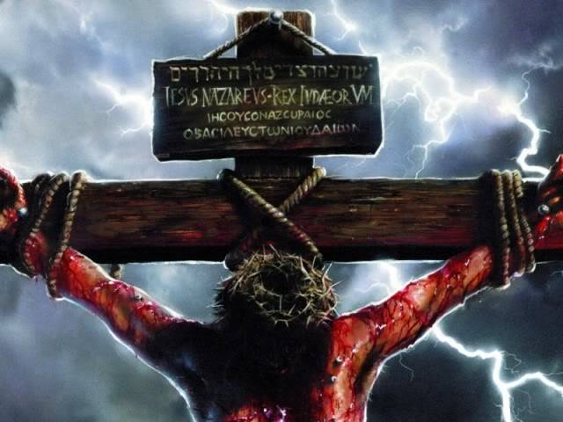
The Free Gift: Jesus, Grace, Steve & Donuts (The Parable of the Donuts)
It is foolish and ungrateful to leave the free gift of God of eternal life, paid for by King Jesus, unused and not taken, for there will be a Judgment Day!

Slide 9
Conclusion
Jesus humbled Himself to take up His cross and lay down His life: For all sins, for all people, for all time, whether anyone wanted it or not!
Hebrews 5:9: And having been made perfect, He became to all those who obey Him the source of eternal salvation.
Hear The Gospel (John 5:24; Romans 10:17)
Believe In Christ (John 3:16-18; John 8:24)
Repent Of Sins (Luke 13:3-5; Acts 2:38)
Confess Jesus as the Son of God (Matthew 10:32; Acts 8:37)
Be Baptized into the Name of Jesus for the Forgiveness of Sins (Mark 16:16; Acts 22:16)
God adds you to the church (Acts 2:47), the body of Jesus, of which He is the Savior (Ephesians 5:23)
Live Faithful lives for God (John 8:31; Revelation 2:10)

Slide 10
Conclusion
Have you taken “The Free Gift?”
Romans 6:23: “For the wages of sin is death, but the free gift of God is eternal life in Christ Jesus our Lord.”
The broad road leads to destruction, the second death, but the narrow road leads to life! (Matthew 7:13-14)

Slide 11
Conclusion
Don’t let the free gift of Jesus get squandered by not taking hold of eternal life!
Obey Jesus NOW and take the free gift that He paid for!

Slide 12
“What Must I Do To Be Saved?”
Hear The Gospel (John 5:24; Romans 10:17)
Believe In Christ (John 3:16-18; John 8:24)
Repent Of Sins (Luke 13:3-5; Acts 2:38)
Confess Christ (Matthew 10:32; Romans 10:10)
Be Baptized (Mark 16:16; Acts 22:16)
Remain Faithful (John 8:31; Revelation 2:10)
For The Erring Saint:
Repent (Acts 8:22), Confess (I John 1:9),
Pray (Acts 8:22)

