Slide 1
Can We Be Saved Like The Thief On The Cross?
Text:
Luke 23:39-43
Notes:
Prepared by Nathan L Morrison for Sunday November 5th, 2023
All Scripture given is from NASB unless otherwise stated
For further study, or if questions, please Call: 804-277-1983 or Visit www.courthousechurchofchrist.com
Adapted from an article by Wes McAdams

Slide 2
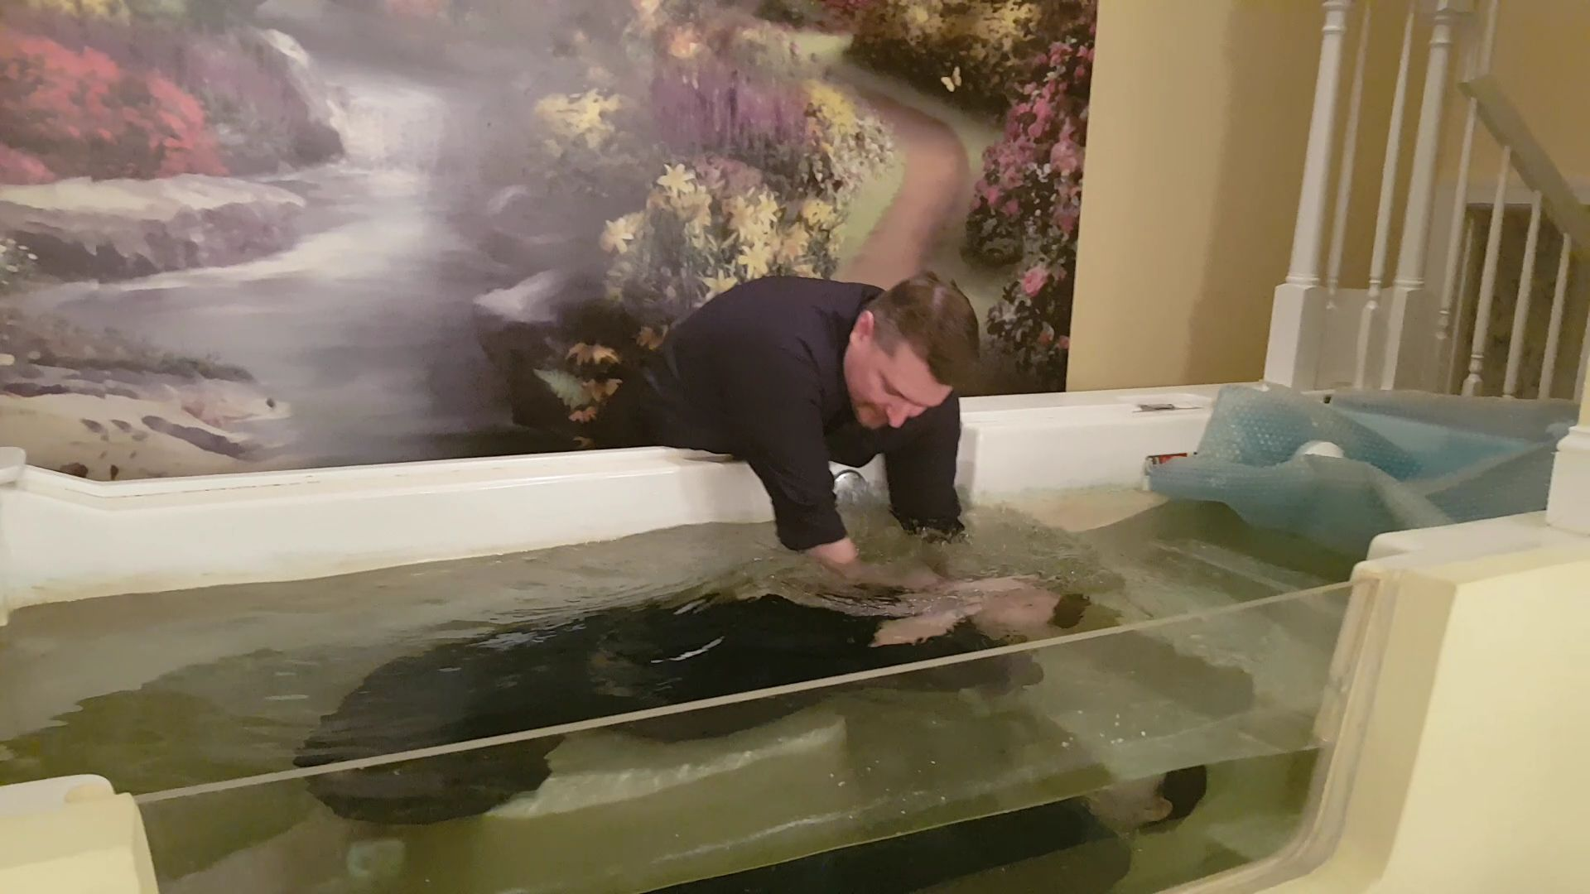
Intro
The Scriptures make clear the conditions for salvation:
Baptism for the forgiveness of sins!
Mark 16:16; Acts 2:38; 22:16; I Pet. 3:21
Is there an exception to this rule?
“But what about the thief on the cross?”

Slide 3
Intro
A post about the thief on the cross is making rounds on social media…
How does the thief on the cross fit into your theology? No baptism, no communion, no confirmation, no speaking in tongues, no mission trip, no volunteerism, no financial gifts, and no church clothes. He couldn't even bend his knees to pray. He didn't say the sinner's prayer and among other things, he was a thief. Jesus didn't take way his pain, heal his body, or smite his scoffers. Yet, it was a thief who walked into paradise the same hour as Jesus simply by BELIEVING.
He had nothing more to offer other than his belief that Jesus was who He said He was. No spin from brilliant theologians. No ego or arrogance. No shiny lights, skinny jeans, or crafty words. No fog machine, donuts, or coffee in the lobby. Just a naked dying man on a cross unable to even fold his hands to pray. “For God so loved the world that He gave His only Son so that whoever BELIEVES in Him shall not perish but have everlasting life.” (John 3:16) That is the good news of the Gospel!

Slide 4
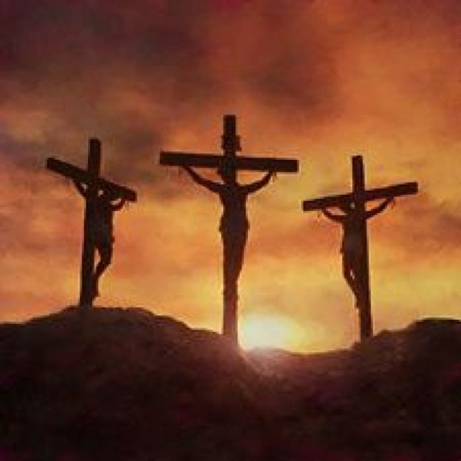
Intro
The thief on the cross is thought by some to be the
EXCEPTION that would justify salvation at the point of
confession of Christ as Lord alone today!
The religious world has elevated the thief to a position to steal the truth of the gospel from the hearts of many men!
There is no doubt that the remorseful thief on the cross was saved, but the question is, “Can people today be saved in the same manner?”

Slide 5
At Calvary
Christ was crucified with two thieves on either side of Him
(Matthew 27:38; Mark 15:27; Luke 23:33; John 19:18)
Both insulted Jesus at one point (Matthew 27:44) like the people (Matthew 27:39-43)
One of them hurled insults like the masses below (Luke 23:39).
One of them rebuked the other, admitted guilt, confessed Christ as innocent, and asked to be remembered in Christ’s kingdom (Luke 23:39-43).

Slide 6
At Calvary
Luke 23:39-43
39. One of the thiefs who were hanged there was hurling abuse at Him, saying, "Are You not the Christ? Save Yourself and us!"
40. But the other answered, and rebuking him said, "Do you not even fear God, since you are under the same sentence of condemnation?
41. "And we indeed are suffering justly, for we are receiving what we deserve for our deeds; but this man has done nothing wrong."
42. And he was saying, "Jesus, remember me when You come in Your kingdom!"
43. And He said to him, "Truly I say to you, today you shall be with Me in Paradise."

Slide 7
At Calvary
We can be overwhelmed with joy at the thought of God's grace and forgiveness bestowed upon that thief!
It is a testament to God's goodness and mercy, a great reminder that His love knows no bounds for those who turn to Him, even as Jesus suffered on the cross.
It is within God's divine right to forgive and set the terms of that forgiveness.
The thief was saved because only Jesus has the power to forgive and save
The question is: “Can We Be Saved Like The Thief On The Cross?”

Slide 8
How is Our Salvation Similar?
He was saved by grace through faith (Ephesians 2:8-9) The thief’s faith is evident:
He rebuked the other thief for mocking Jesus Christ, saying, “Do you not fear God?” (Luke 23:40).
He acknowledged Jesus’ innocence (Luke 23:41).
He acknowledged his own guilt (Luke 23:41).
He acknowledged Jesus’ Kingship (Luke 23:42).
He had faith in Jesus’ resurrection, as well as his own, because he asked Christ to remember him when He came into His kingdom (Luke 23:42).

Slide 9
How is Our Salvation Similar?
We must, like this thief, put our faith in Jesus:
We must acknowledge our own guiltiness and trust in His power to save.
Like the thief, if we are forgiven, it is not because we have earned forgiveness by doing great deeds for God but because of His grace! (Ephesians 2:8-9).
The gospel of Jesus Christ commands believers to be baptized into the name of Jesus for the forgiveness of sins!

Slide 10
Why Do WE Have to be Baptized and He Didn’t?
“But what about the thief on the cross?”
The Law of Moses was still in effect
Hebrews 9:15-17
His words in Mark 16:16 on baptism were after His resurrection, and fully carried out on the day of Pentecost in Acts 2, under the New Covenant
Jesus came to fulfill the Law, the Psalms and the Prophets
Luke 24:44-47
The New Covenant began after His death and resurrection
Hebrews 7:22; 8:6, 13

Slide 11
Why Do WE Have to be Baptized and He Didn’t?
“But what about the thief on the cross?”
The Christian gospel had not yet been preached
Luke 24:47
Forgiveness of sins was preached on the Day of Pentecost
Acts 2:37-38

Slide 12
Why Do WE Have to be Baptized and He Didn’t?
This side of the cross…
Christian baptism is about the death, burial, and resurrection of Jesus
Romans 6:3-7
On the Day of Pentecost in Jerusalem, the Jews were the first converts under the New Covenant
Acts 2:37-38, 41
Forgiveness of sins proclaimed in His name to all the nations, beginning from Jerusalem
Luke 24:44-47
We live under a better covenant with better promises
Hebrews 8:6; 9:15-17
Jesus commanded baptism to be saved of all disciples of all nations
Mark 16:15-16

Slide 13
Why Do WE Have to be Baptized and He Didn’t?
Salvation today is gloriously different than it was for the thief on the cross, because salvation today is based on a more complete picture of what God has done for mankind and it is part of a new and better covenant with God (Hebrews 7:22).
If you want to enter into this new and better covenant, you must be baptized!

Slide 14
Crucified with Christ
Another similarity we share with the thief on the cross is that we must be crucified with Jesus!
The thief was physically crucified with Jesus, an event that cannot be repeated.
Saints are to be spiritually crucified with Jesus!

Slide 15
Crucified with Christ
Baptism, in a way, is being saved exactly like the thief on the cross; Not that he was baptized, but that we, too, must be crucified with Christ:
Galatians 2:20: I have been crucified with Christ.
Galatians 5:24: And those who belong to Christ Jesus have crucified the flesh with its passions and desires.
How can we be crucified with Christ!

Slide 16
Crucified with Christ
Romans 6:3-7
3. Or do you not know that all of us who have been baptized into Christ Jesus have been baptized into His death?
4. Therefore we have been buried with Him through baptism into death, so that as Christ was raised from the dead through the glory of the Father, so we too might walk in newness of life.
5. For if we have become united with Him in the likeness of His death, certainly we shall also be in the likeness of His resurrection,
6. knowing this, that our old self was crucified with Him, in order that our body of sin might be done away with, so that we would no longer be slaves to sin;
7. for he who has died is freed from sin.

Slide 17
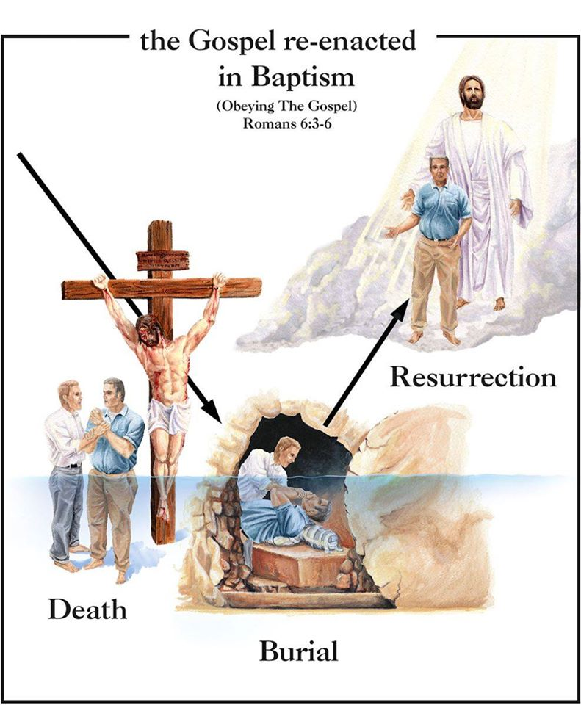
Crucified with Christ
When we decide to follow Jesus, we crucify our old self
We are crucified together with Jesus like the thief on the cross!
Baptism is now required as an act of obedient faith for salvation!
(I Peter 3:21)

Slide 18
Conclusion
The thief on the cross is a great example of God’s forgiveness and grace!
It shows us that it is never too late to come to the Lord in this life.
However, the thief on the cross is not an example of what one must do to be saved today as his salvation was based upon a different covenant, different circumstances, and a different relationship to Jesus.

Slide 19
Conclusion
Instead of the question, “What about the thief on the cross?” it should be asked, “How am I saved today?”
If you trust Jesus, as the thief did, you will do what Jesus said to do!
“He who has believed and has been baptized shall be saved; but he who has disbelieved shall be condemned” (Mark 16:16).
Faith is about trusting God. The thief on the cross trusted Him. Do you?
Jesus said, “He who has believed AND has been baptized shall be saved.” The thief on the cross wasn’t told that, but you are! Do you trust Jesus?
Baptism…now saves you (I Peter 3:21)

Slide 20
Conclusion
Those who attempt to find an exception to baptism in the experience of the thief on the cross do so to try to justify that baptism isn’t required of men today
Those who teach such doctrines ignore the Scriptures and allow the thief on the cross to remain a thief by stealing the truth from the hearts of individuals who are seeking salvation!
When you see posts like this making the rounds on social media by your friends and family, maybe they are seeking forgiveness from sin and need the grace of God.
Show them how to obey the gospel in the way Jesus taught in order to receive His grace and forgiveness!

Slide 21
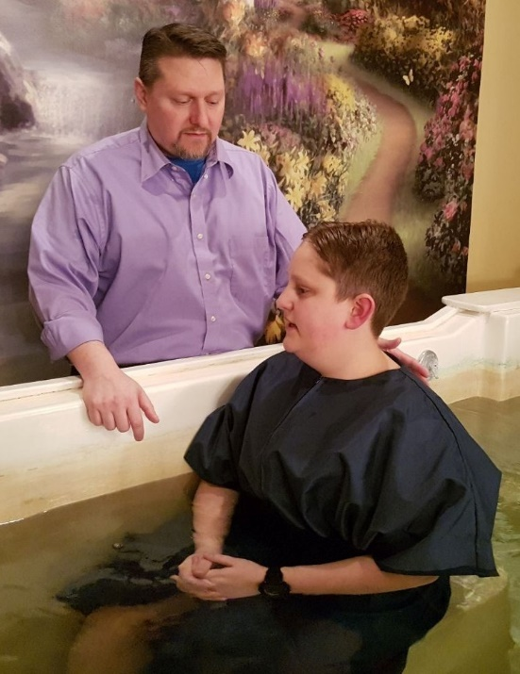
Conclusion
To those with a heart for truth who live on this side of the cross, seeking forgiveness means embracing the teachings begun at Pentecost, where a New Covenant was forged for us to embrace, and the Kingdom established!
Heaven is too wonderful and Hell too terrible for us to risk being misled by false beliefs concerning the thief on the cross!
Obey the gospel today the way Jesus taught His apostles to teach it! (Mark 16:15-16)

Slide 22
“What Must I Do To Be Saved?”
Hear The Gospel (John 5:24; Romans 10:17)
Believe In Christ (John 3:16-18; John 8:24)
Repent Of Sins (Luke 13:3-5; Acts 2:38)
Confess Christ (Matthew 10:32; Romans 10:10)
Be Baptized (Mark 16:16; Acts 22:16)
Remain Faithful (John 8:31; Revelation 2:10)
For The Erring Saint:
Repent (Acts 8:22), Confess (I John 1:9),
Pray (Acts 8:22)

