Slide 1
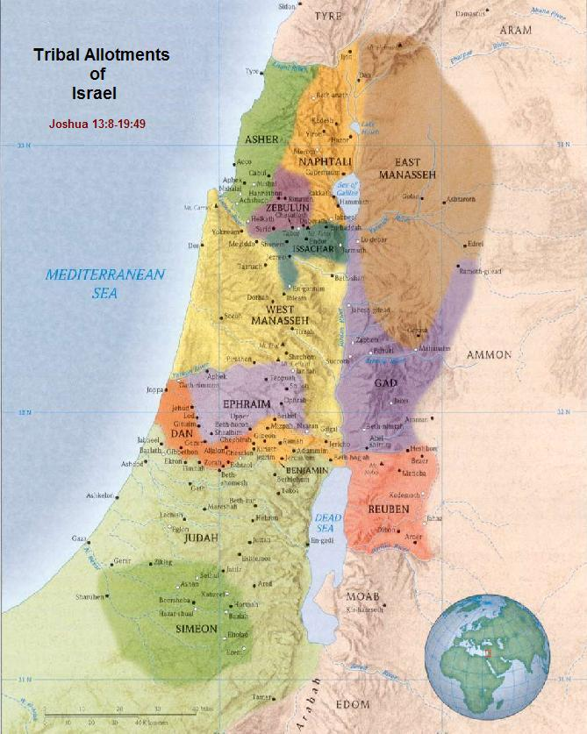
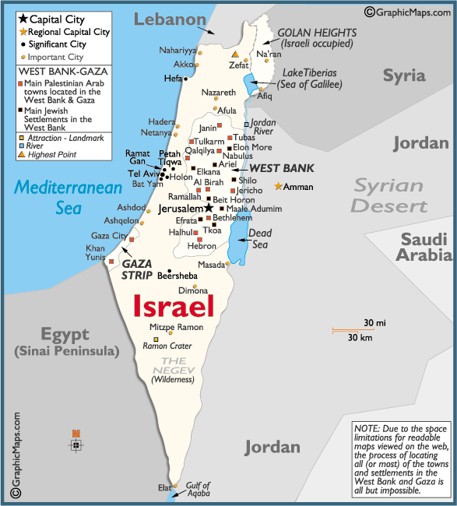
What Promise Is Left To Israel?
Text:
Galatians 3:26-29
Notes:
By Nathan L Morrison for Sunday 10/22/2023
All Scripture is from NASB unless otherwise stated
For further study, or if questions, please Call: 804-277-1983, or Visit: www.courthousechurchofchrist.com
Adapted from an article by Ron Halbrook & many other sources

Slide 2
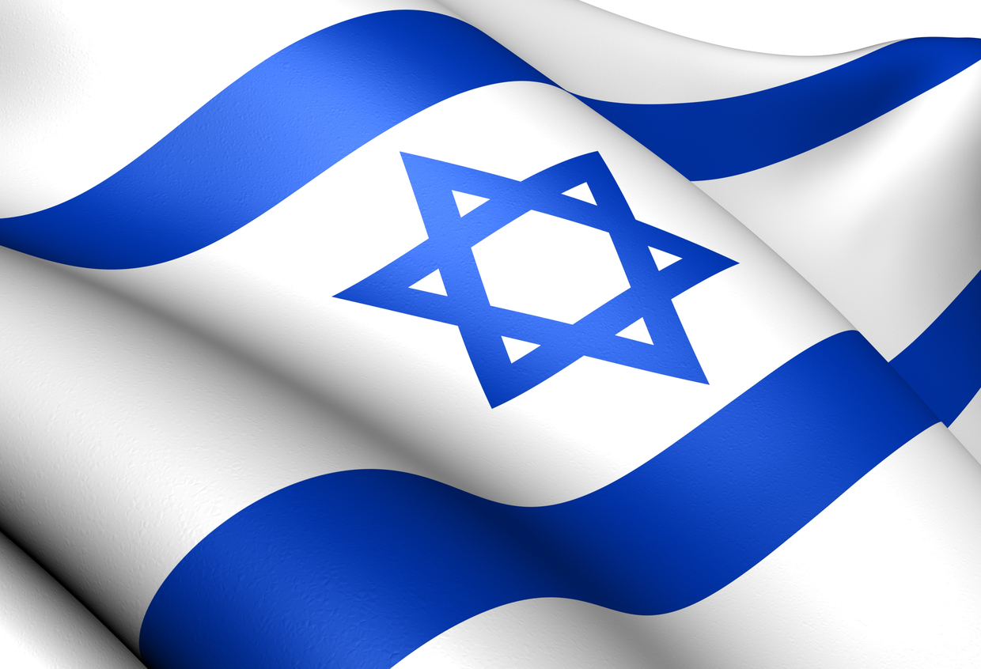
Intro
Whenever Israel is in the news, either being attacked or on the attack, many people ask, “Will Israel be restored to their land?”
Israel restored to their land is part of the Premillennial doctrine
“Will Israel rise again?”

Slide 3
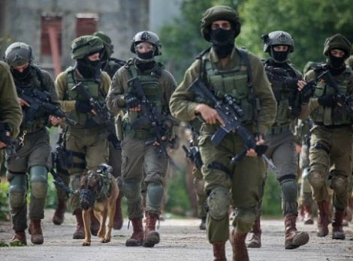
Intro
Current events get people excited that Israel will be restored to their land…
1948 State of Israel formed: Many claimed prophecy was being fulfilled!
1967 6-Days War with Egypt & their Arab Alliance: Tripled their land area
2008-2009 The Gaza War with Hamas: Ended with many claiming Israel won the war but Hamas won the Public Relations War
2014 50-Days War with Hamas: Brought about a tenuous peace with Palestine
2021 11-Days War with Hamas: Ended with heavy casualties on the Gaza Strip and a Cease Fire
2023 On Saturday morning, October 7, 2023, Hamas attacked Israel. Conflict still ongoing…
Notes:
In 1948 State of Israel formed – Many claimed prophecy was being fulfilled!
The 1967 6-Days War with Egypt & their Arab Alliance tripled their land area.
https://www.jewishhistory.org/the-six-day-war/#:~:text=On%20Monday%20morning%2C%20June%205%2C%201967%2C%20the%20war,and%20Jerusalem%2C%20destroying%20the%20enemy%20with%20impunity%2C%20etc.
The Gaza War of 2008-2009 with Hamas (a terrorist group who took control of the Gaza Strip in 2007) ended with many claiming Israel won the war but Hamas won the Public Relations War.
https://fas.org/sgp/crs/mideast/R40101.pdf
The 2014 50-Days War with Hamas brought about a tenuous peace with Palestine.
https://jcpa.org/the-gaza-war-2014/timeline-key-moments-gaza-war/
The 2021 11-Days War with Hamas ended with heavy casualties on the Gaza Strip and a Cease Fire.
https://abcnews.go.com/International/wireStory/israel-unleashes-strikes-vowing-press-gaza-77796552
Hamas attacked Israel Saturday morning, October 7, 2023. Conflict still ongoing…
https://www.npr.org/2023/10/12/1204881032/hamas-israel-attack-palestinians
Whenever these current events were happening many preachers and world leaders were teaching that prophecies concerning Israel were about to be fulfilled and they would be restored to their ancestral land! They say, “Stand with Israel,” “End times are near!”

Slide 4
Intro
Galatians 3:26-29
For you are all sons of God through faith in Christ Jesus. For all of you who were baptized into Christ have clothed yourselves with Christ. There is neither Jew nor Greek, there is neither slave nor free man, there is neither male nor female; for you are all one in Christ Jesus. And if you belong to Christ, then you are Abraham's descendants, heirs according to promise.
The promises to Israel were fulfilled and the nations were blessed in Jesus Christ!

Slide 5
God Fulfilled the Covenant to Abraham, Isaac & Jacob
Genesis 12:1-3
1. Now the LORD said to Abram, "Go forth from your country, And from your relatives And from your father's house, To the land which I will show you;
2. And I will make you a great nation, And I will bless you, And make your name great; And so you shall be a blessing;
3. And I will bless those who bless you, And the one who curses you I will curse. And in you all the families of the earth will be blessed."
God’s Covenant Included Three Promises to Abraham’s Descendants…
Vs. 1: Land Promise: Canaan
Vs. 2: Nation promise: Israel
Vs. 3: Seed promise (Gen. 22:18): Bless men of all nations (fulfilled in Christ)

Slide 6
God Fulfilled the Covenant to Abraham, Isaac & Jacob
Genesis 26:3-5
3. "Sojourn in this land and I will be with you and bless you, for to you and to your descendants I will give all these lands, and I will establish the oath which I swore to your father Abraham.
4. "I will multiply your descendants as the stars of heaven, and will give your descendants all these lands; and by your descendants all the nations of the earth shall be blessed;
5. because Abraham obeyed Me and kept My charge, My commandments, My statutes and My laws."
God repeated His covenant with Abraham to Isaac, Abraham’s son…
Vs. 3: Land Promise: Canaan
Vs. 4: Nation promise: Israel
Vs. 4: Seed promise (Gen. 22:18): Bless men of all nations (fulfilled in Christ)

Slide 7
God Fulfilled the Covenant to Abraham, Isaac & Jacob
Genesis 28:13-14
13. And behold, the LORD stood above it and said, "I am the LORD, the God of your father Abraham and the God of Isaac; the land on which you lie, I will give it to you and to your descendants.
14. "Your descendants will also be like the dust of the earth, and you will spread out to the west and to the east and to the north and to the south; and in you and in your descendants shall all the families of the earth be blessed."
God repeated His covenant with Abraham & Isaac to Jacob, Isaac’s son…
Vs. 13: Land Promise: Canaan
Vs. 14: Nation promise: Israel
Vs. 14: Seed promise (Gen. 22:18): Bless men of all nations (fulfilled in Christ)

Slide 8
God Fulfilled the Covenant to Abraham, Isaac & Jacob
Joshua 21:43-45: Land Promised Fulfilled
God GAVE the land (21:43)
Israel POSSESSED the land (21:43)
Israel LIVED in the land (21:43)
Not one of the good promises which the LORD had made to the house of Israel failed (21:45)
God gave them the land UNCONDITIONALLY because of the faithfulness of Abraham (Genesis 18:19; 22:18; 26:5; Exodus 33:1; Deuteronomy 9:1-6)
Staying in the Land was CONDITIONAL (Deuteronomy 28-30; Joshua 23:14-16)

Slide 9
God Fulfilled the Covenant to Abraham, Isaac & Jacob
Exodus 19:6: Nation Promise Fulfilled – “A kingdom of priests, a holy nation”
God gave them His laws at Sinai, He established them as a nation!
A nation came out of Egypt and crossed the Jordan River into Canaan (Joshua 3:17; 5:6)
Israel as a nation transgressed God’s covenant and would be judged (Judges 2:20)
Paul said he was “circumcised the eighth day, of the nation of Israel, of the tribe of Benjamin, a Hebrew of Hebrews; as to the Law, a Pharisee;” (Philippians 3:5)
A nation before & after exile!
David asked,
“And what one nation in the earth is like Your people Israel, whom God went to redeem for Himself as a people, to make You a name by great and terrible things, in driving out nations from before Your people, whom You redeemed out of Egypt?”
(I Chronicles 17:21)

Slide 10
God Fulfilled the Covenant to Abraham, Isaac & Jacob
Joshua 21:43-45: Land Promised Fulfilled
Exodus 19:6: Nation Promise Fulfilled
The first two promises made to Abraham were fulfilled by the time of Joshua!

Slide 11
Christ Is the Ultimate Fulfillment of the Covenant with Abraham
The Seed Promise
The seed of woman (Gen. 3:15)
The seed of Abraham (Gen. 12:1-3; 22:18)
The seed of David (II Sam. 7:11-14)
Galatians 3:16
Now the promises were spoken to Abraham and to his seed. He does not say, "And to seeds," as referring to many, but rather to one, "And to your seed," that is, Christ.
Christ Is Abraham’s Seed
The gospel of Matthew begins by telling us Jesus is the fulfillment of the seed (son) of David and the seed (son) of Abraham (Matthew 1:1)
Matthew further tells us Jesus is the seed of woman by a virgin birth by the Holy Spirit, fulfilling prophecy of Isaiah 7:14 (Matthew 1:18-25; Galatians 4:4)

Slide 12
Christ Is the Ultimate Fulfillment of the Covenant with Abraham
Galatians 3:26-29
United with Christ, saints Become Abraham’s Seed!
Children of promise!
Galatians 6:15-16
For neither is circumcision anything, nor uncircumcision, but a new creation. And those who will walk by this rule, peace and mercy be upon them, and upon the Israel of God.
Jesus fulfilled the seed promise, and saints that put on Jesus through baptism are the heirs of the promise to Abraham!

Slide 13
Timeline Of Israel as a Nation
539 BC: Persians conquer the Babylonians and take control of Israel
800s BC: The rise of the prophets, God's messengers
722 BC: Kingdom of Israel is conquered by Assyrians
970 BC: King Solomon, son of David, builds the first temple structure in Jerusalem
1400 BC: Moses leads the people out of Egypt and back to Israel
516 BC: The Temple is rebuilt
As foretold (Daniel 2:39: Chest & Arms of Silver; 8:1-4, 20: Ram)
Israel, the Northern Kingdom, promised to lose their land – Isaiah 8:4; Hosea 5:9-14; 9:3; 10:5-6 – NO Remnant promised to return!
As foretold (II Kings 17)
930 BC: Israel is divided into two kingdoms: the Kingdom of Israel (Northern 10 Tribes) and the Kingdom of Judah (Southern Kingdom)
Judah, the Southern Kingdom, promised to lose their land but a remnant to return in 70 years – Isaiah 39:5-7; Habakkuk 1:9, 16; 2:8; 3:16; Jeremiah 20:4-6; 25:8-11; 32:28-29; Ezekiel 12:10-13
538 BC: The Jews return to Israel from exile
605 BC: Kingdom of Judah is conquered by the Babylonians
586 BC: Solomon's Temple is destroyed by the Babylonians
1010 BC: King David unites the 12 tribes into one nation
As foretold (Isaiah 39; Jeremiah 52)
As foretold (Ezra 1)
As foretold (Daniel 2:38: Head of Gold)
What Promise Is Left To Israel?

Slide 14
Timeline Of Israel as a Nation
AD 29-33: Jesus is crucified by the Romans and rises the 3rd day
AD 132-135: Jewish revolt under Emperor Hadrian: Jerusalem destroyed, earth salted, Jews dispersed, the whole land of Judea renamed to Palestine (Land of the Philistines)
323 BC: The Egyptian (Ptolemaic) and Syrian (Seleucid) Empires take over Israel
63 BC: Romans conquer Israel
425 BC: Nehemiah & Malachi are at the end of the prophetic age
450 BC: Reforms made by Ezra and Nehemiah
As foretold! (Daniel 2:40-43: Legs of Iron, its feet partly of iron and partly of clay; 11:30: Ships from Kittim, or Cyprus)
As foretold (Isaiah 53; Luke 24:44-47; I Corinthians 15:3-4)
As foretold (Amos 8:11-12). The Period of Silence begins!
As foretold (Daniel 11)
333 BC: The Greeks conquer the Persian empire
167 BC: Hasmonean's recapture Israel, and the Jews are ruled independently
20 BC: King Herod builds the “third” temple (Really, an expansion of the already existing 2nd Temple)
AD 66-73: Jewish Revolt against Rome –
Temple destroyed AD 70
6-5 BC: Jesus Christ is born in Bethlehem
432 BC: The last group of Jews return from exile
As foretold (Daniel 2:39: Belly & Thighs of Bronze; 7:6; 8:5-14, 21-22: Swift male goat & four horns)
As foretold (Micah 5:2)
As foretold (Daniel 11:32-35)
As foretold by Jesus (Matthew 21:43; 24:1-2)
What Promise Is Left To Israel?

Slide 15
Timeline Of Israel as a Nation
AD 1099-1291: 1st through 3rd Crusades. The kings of Jerusalem were French
U.N. treaty of 1948: A small portion of the land given back to Israel
Israel’s land, nation and seed promises were fulfilled as was the promise to lose their land and a remnant to return, and for the temple to finally be destroyed. What other promises remain?

Slide 16
What Promise is Left to Israel?
Some teach the Premillennial doctrine that Jesus will return and rule from Jerusalem so Israel still plays a part in God’s plan for the future
Jeremiah 19:10-15
Physical Israel Cannot Be Restored – Shattered like a jar
A remnant would return, but not a physical ruler from the line of David in Judah! (Ezra 1:1-3: Cyrus the Persian)
In the Intertestament period, the Maccabees ruled, but were of the tribe of Levi!

Slide 17
What Promise is Left to Israel?
Jeremiah 22:28-30
God told Jeremiah to write King Jeconiah (Coniah) “childless”
He did have children (I Chr. 3:17-18) but they would not rule or prosper on the throne of David in Judah!
Jesus is of the line of David through Jeconiah! (Matthew 1:11-12)
Jesus has the right to rule from the throne of David, but He cannot rule in Judah and prosper!
Jesus rules now from the Throne of David over a spiritual kingdom from a Heavenly Rule! (Luke 1:32-33; Acts 2:29-36)

Slide 18
What Promise is Left to Israel?
Galatians 3:26-29
For you are all sons of God through faith in Christ Jesus. For all of you who were baptized into Christ have clothed yourselves with Christ. There is neither Jew nor Greek, there is neither slave nor free man, there is neither male nor female; for you are all one in Christ Jesus. And if you belong to Christ, then you are Abraham's descendants, heirs according to promise.
Galatians 3:26-29
The blessings promised to Abraham have been fulfilled, the nation and land promise fulfilled long ago, and the seed promise fulfilled in Jesus!
No other promises to be fulfilled!
Jews Restored to God in Jesus Christ! Citizens of Jesus’ spiritual kingdom

Slide 19
What Promise is Left to Israel?
Romans 11:17-24
The Jews and Gentiles who obey the gospel are both grafted into the olive tree.
Figurative language meaning the Jews, the natural branches, were cut off for disobedience but by their obedience, like the Gentiles, can be grafted back in!
Acts 13:46: Paul told the Jews the message of the gospel, the message of eternal life, was preached to them first but because they judged themselves of unworthy of eternal life he would preach to the Gentiles
The promise left to the Jews is eternal life! The same promise to Gentiles!
Romans 11:24
For if you were cut off from what is by nature a wild olive tree, and were grafted contrary to nature into a cultivated olive tree, how much more will these who are the natural branches be grafted into their own olive tree?

Slide 20
What Promise is Left to Israel?
Jeremiah 19:10-15
Jeremiah 22:28-30
Galatians 3:26-29
Romans 11:11-24
Jews that are saved are made up of those that have obeyed the gospel through faith, been baptized into Christ for forgiveness of sins, the same as the Gentiles!
(Acts 2:37-38, 41; Acts 10:48; 11:18)

Slide 21
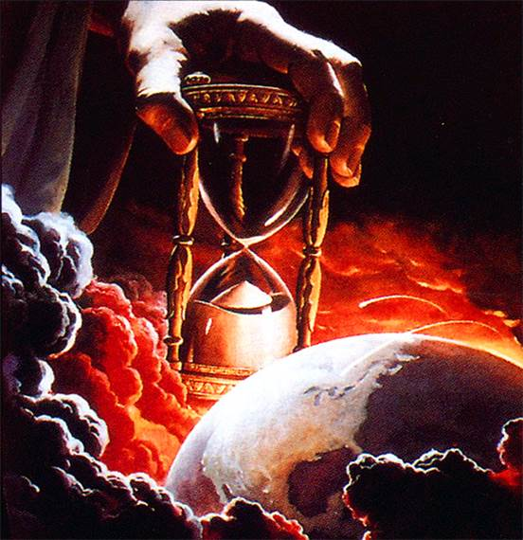
Conclusion
Both Jew and Gentile alike are called by the gospel and
saved by faith through grace (Eph. 2:8-9; Gal. 3:8-9), are
called Christians (Acts 11:26) and are in the church!
(Eph. 3:6)
One last promise:
Both Jew & Gentile wait for the promise of Jesus to return again for judgment & reward (Matthew 25:31-46; Hebrews 9:27-28) – Christians need to be prepared!
Ephesians 2:11-16: Both Jew and Gentile made into “one new man” in “one body” through Jesus.
All men need to be in that “one body” (Ephesians 4:4) to be saved! (Ephesians 5:23)

Slide 22
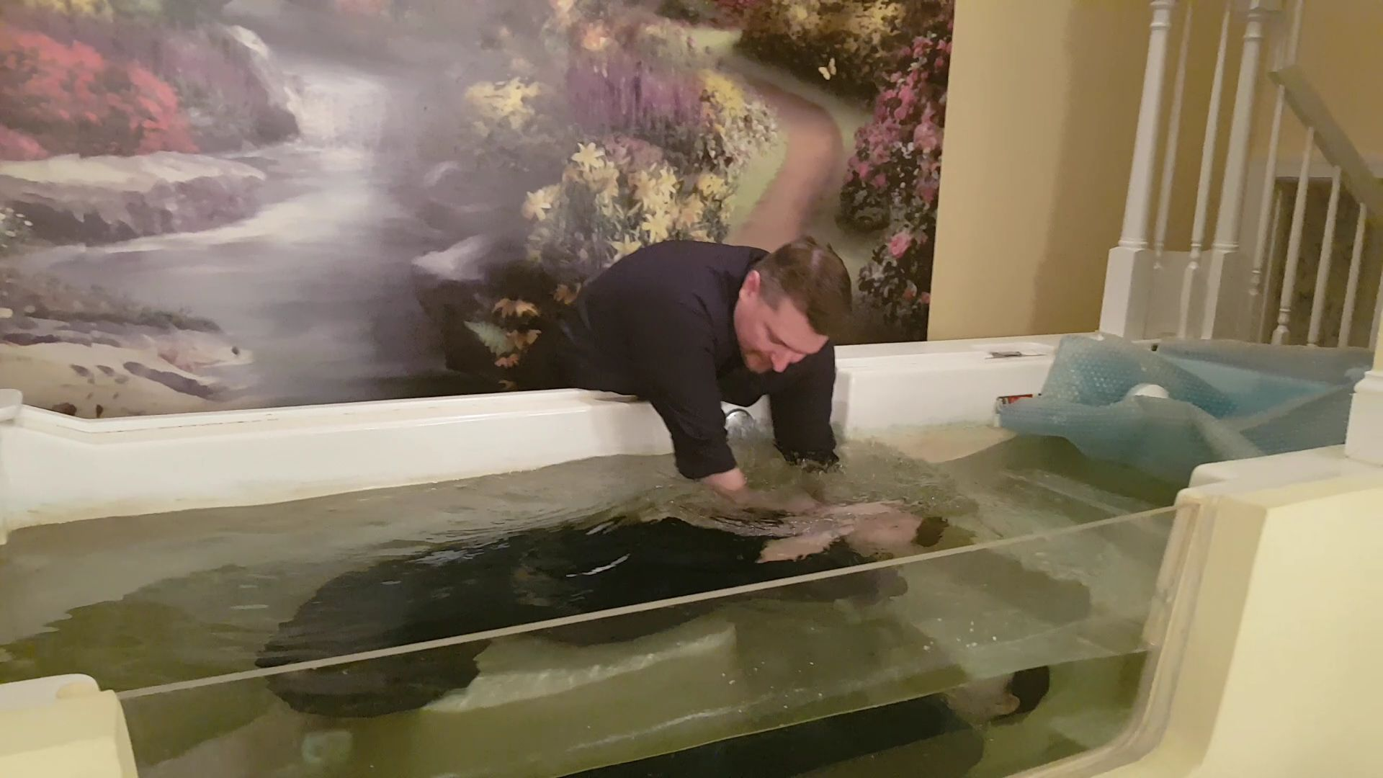
Conclusion
All mankind must seek to be a part of the church (Ephesians 5:23: Jesus saves those in His body) in this life: God’s chosen people, royal priesthood, and holy nation! (I Peter 2:9-10) – Are you ready?

Slide 23
“What Must I Do To Be Saved?”
Hear The Gospel (John 5:24; Romans 10:17)
Believe In Christ (John 3:16-18; John 8:24)
Repent Of Sins (Luke 13:3-5; Acts 2:38)
Confess Christ (Matthew 10:32; Romans 10:10)
Be Baptized (Mark 16:16; Acts 22:16)
Remain Faithful (John 8:31; Revelation 2:10)
For The Erring Saint:
Repent (Acts 8:22), Confess (I John 1:9),
Pray (Acts 8:22)

