Slide 1
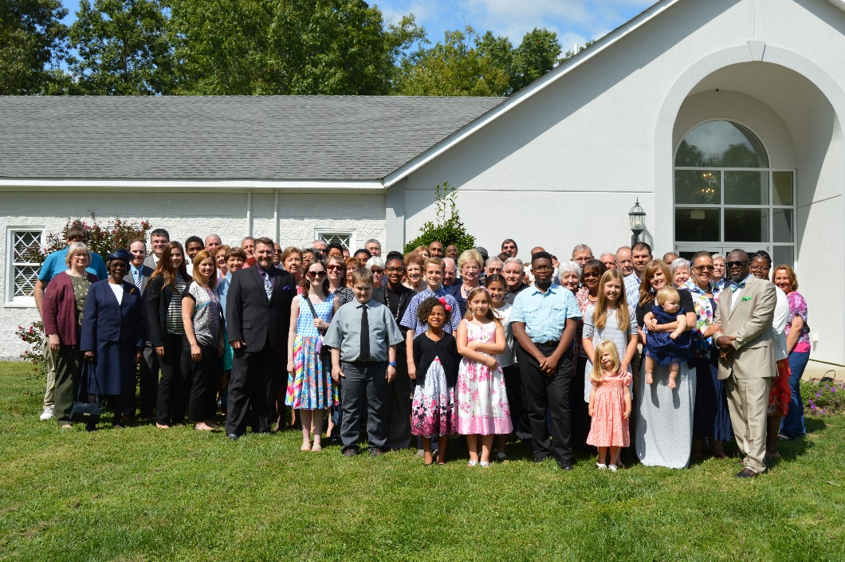
NT Greetings! Text: I Corinthians 15:58
Courthouse
church of Christ
To the
Notes:
By Nathan L Morrison
All Scripture given is from NASB unless otherwise stated
For further study or if questions, Call: 804-277-1983, or Visit: www.courthousechurchofchrist.com
Based on a lesson by Richie Thetford

Slide 2
Intro
Greetings are important!
Acts 2
After the first people baptized into Christ as a result of “gladly receiving the word” (NKJ: Acts 2:41) we see them added to the church and develop spiritually! (Acts 2:42, 44-47)
In time, the first converts went back to their home territories where churches were eventually established by the help of the apostles.
These various churches gained reputations based on the influence of the brethren that made up each particular church.
Churches still today gain reputations based on
the influence of their members!

Slide 3
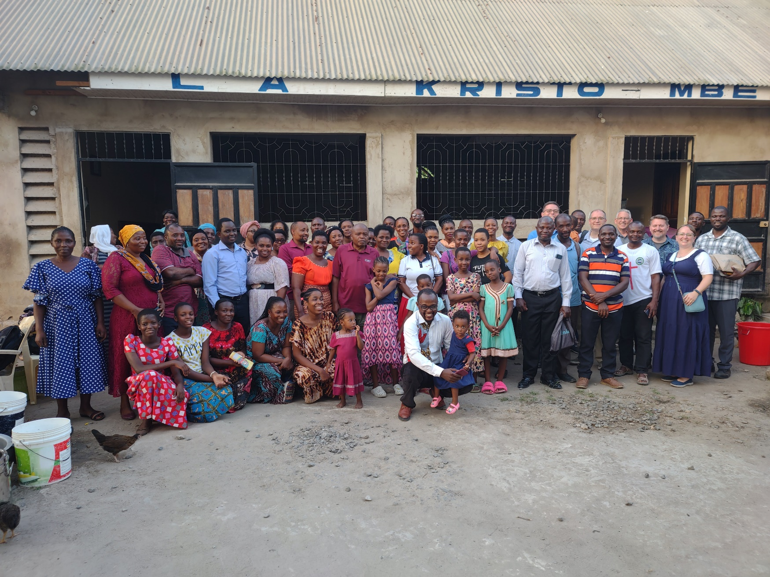
Greetings From…
The church in Mbezi…

Slide 4
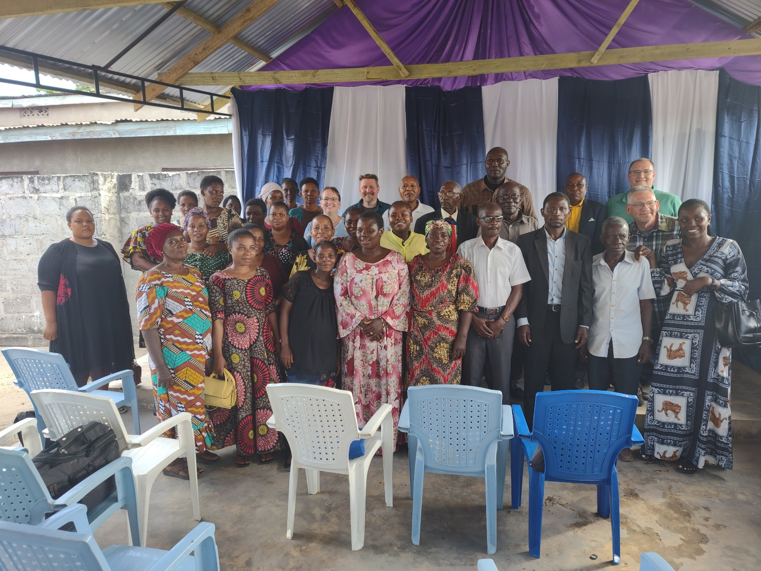
Greetings From…
The church in Tabata…

Slide 5
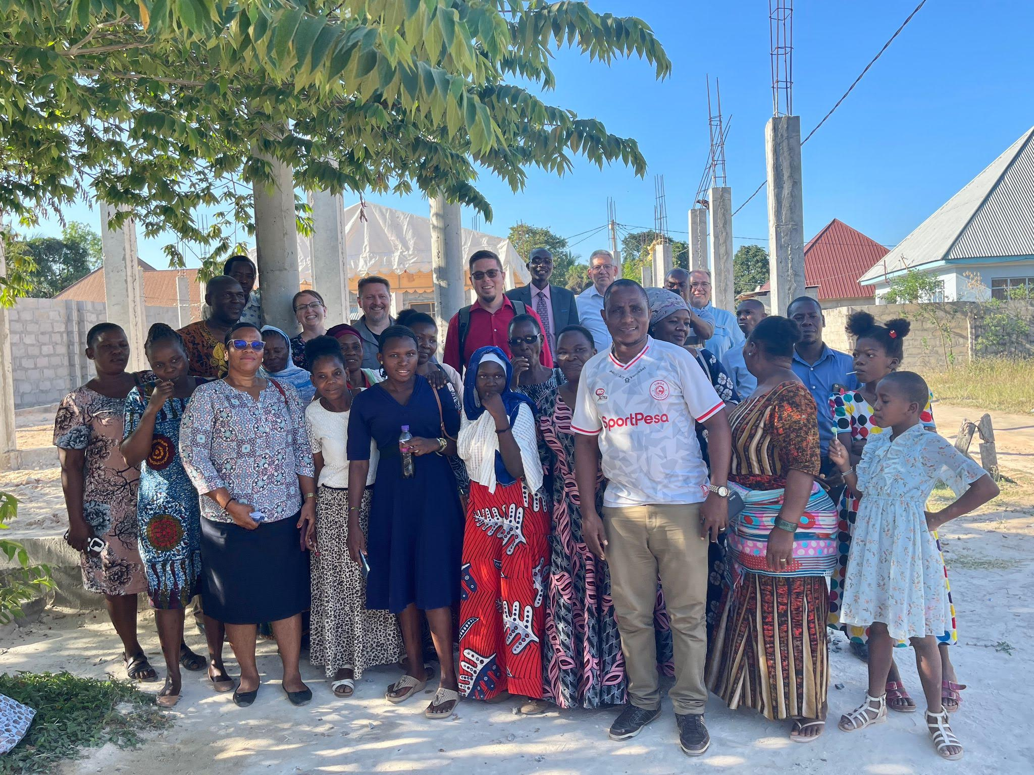
Greetings From…
The church in Chanika…

Slide 6
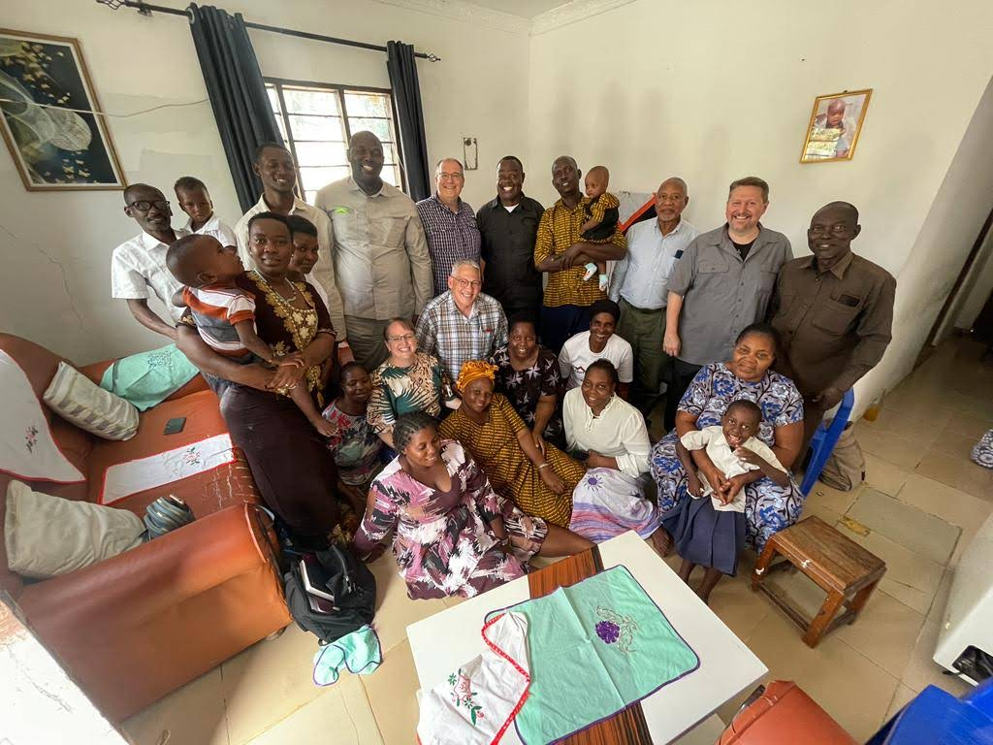
Greetings From…
The church in Kizuiani & the Dihigo Household…

Slide 7
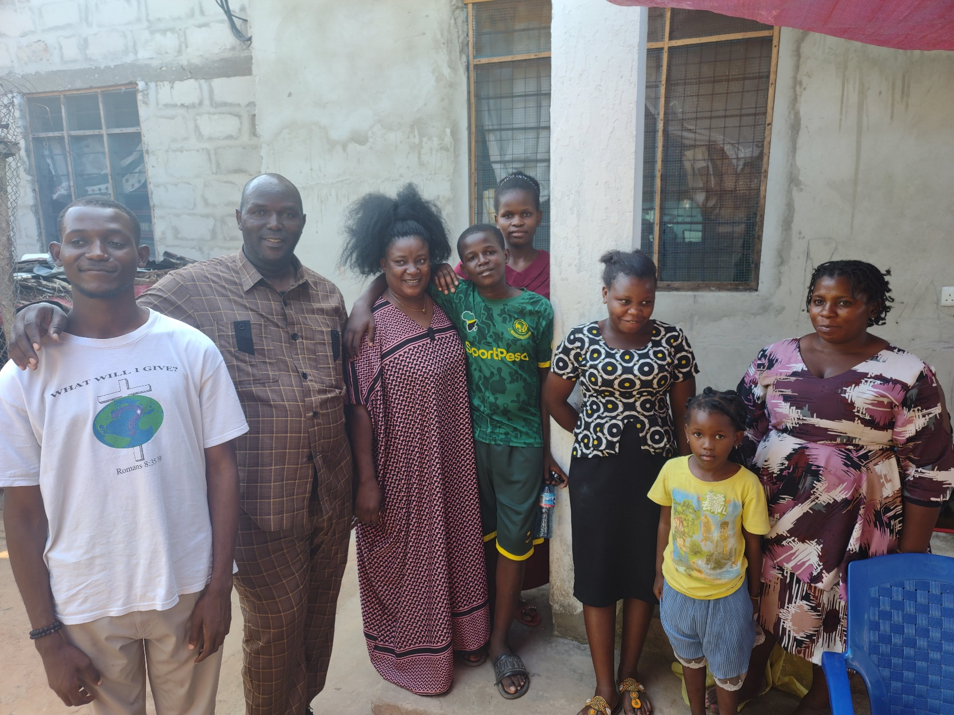
Greetings From…
The church in Mwanambya & the Mwakyami Household…

Slide 8
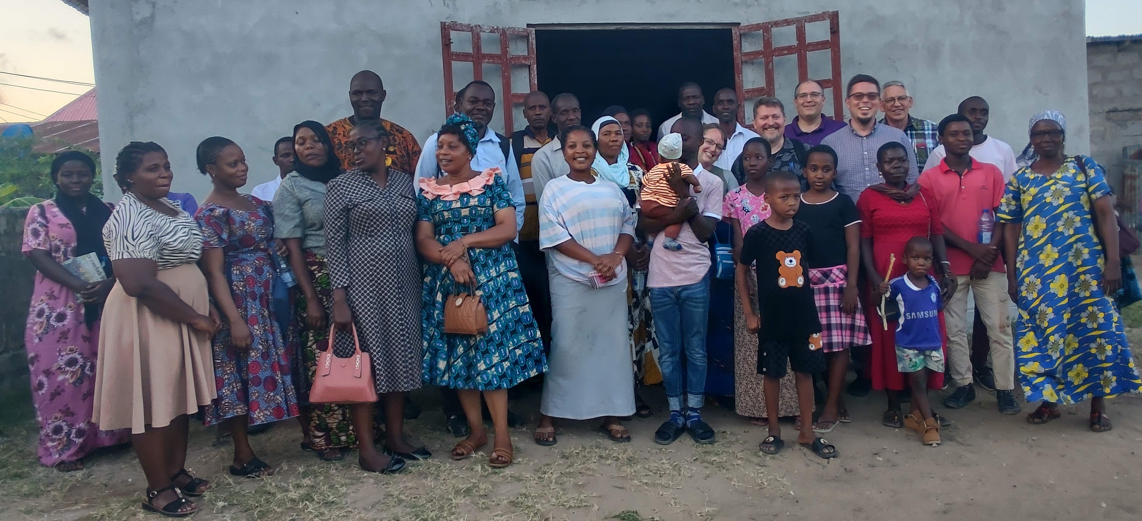
Greetings From…
The church in Kingugi…

Slide 9
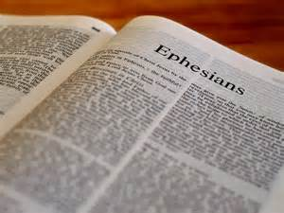
N.T. Greetings
N.T. Greetings are a tribute of character and can teach us the importance of the local church being a recipient of
good, positive, and faithful greetings!

Slide 10
New Testament Greetings
To the church in Rome…
Romans 1:8 (I Jn. 5:4)
8. First, I thank my God through Jesus Christ for you all, because your faith is being proclaimed throughout the whole world.
To the church in Corinth…
I Corinthians 1:11 (Js. 4:1-4)
11. For I have been informed concerning you, my brethren, by Chloe's people, that there are quarrels among you.
Notes:
Emphasis in Scripture Mine!
A. To the church in Rome…
1. Romans 1:8: “First, I thank my God through Jesus Christ for you all, because your faith is being proclaimed throughout the whole world.”
What a commendation and compliment to their faithfulness (I Jn. 5:4: Faith is the victory that overcomes the world)
B. To the church in Corinth…
1. I Corinthians 1:11: “For I have been informed concerning you, my brethren, by Chloe's people, that there are quarrels among you.”
2. Not a glowing report of the Lord’s body, or a good start to a letter!
3. To quarrel is to be fleshly, not spiritual (Js. 4:1-4: Quarrels and conflicts)

Slide 11
New Testament Greetings
To the church in Galatia…
NKJV: Galatians 1:6 (II Tim. 4:3-4)
6. I marvel that you are turning away so soon from Him who called you in the grace of Christ, to a different gospel,
Notes:
Emphasis in Scripture Mine!
C. To the church in Galatia…
1. Galatians 1:6 (NKJ): “I marvel that you are turning away so soon from Him who called you in the grace of Christ, to a different gospel,”
2. It’s frustrating and sad to see faithful brethren turn to apostasy! (II Tim. 4:3-4: From inside the faith will turn from truth to myths)

Slide 12
New Testament Greetings
To the church in Ephesus (from Paul)…
Ephesians 1:15-16 (John 13:35; I John 4:19)
15. For this reason I too, having heard of the faith in the Lord Jesus which exists among you and your love for all the saints,
16. do not cease giving thanks for you, while making mention of you in my prayers;
Notes:
Emphasis in Scripture Mine!
D. The church in Ephesus…
1. Ephesians 1:15-16 (AD 61-62 from Paul): “For this reason I too, having heard of the faith in the Lord Jesus which exists among you and your love for all the saints, do not cease giving thanks for you, while making mention of you in my prayers;”

Slide 13
New Testament Greetings
Later to the church in Ephesus (from Jesus through John)
Revelation 2:2-5
2. 'I know your deeds and your toil and perseverance, and that you cannot tolerate evil men, and you put to the test those who call themselves apostles, and they are not, and you found them to be false;
3. and you have perseverance and have endured for My name's sake, and have not grown weary.
4. 'But I have this against you, that you have left your first love.
5. 'Therefore remember from where you have fallen, and repent and do the deeds you did at first; or else I am coming to you and will remove your lampstand out of its place--unless you repent.
Notes:
Emphasis in Scripture Mine!
2. Revelation 2:2-5 (AD 95-96 from Jesus): “But I have this against you, that you have left your first love” (2:4)
3. Our love for one another is the demonstration of our belonging to Jesus (Jn. 13:35: Love each other as Christ loved us).
4. Our love for God is our motivation for obedience! (I Jn. 4:19: “We love, because He first loved us”)

Slide 14
New Testament Greetings
To the church in Philippi…
Philippians 1:3-6 (I Corinthians 15:58)
3. I thank my God in all my remembrance of you,
4. always offering prayer with joy in my every prayer for you all,
5. in view of your participation in the gospel from the first day until now.
6. For I am confident of this very thing, that He who began a good work in you will perfect it until the day of Christ Jesus.
Notes:
Emphasis in Scripture Mine!
E. To the church in Philippi…
1. Philippians 1:3-6: “…in view of your participation in the gospel from the first day until now.” (1:5)
2. At the time of Paul’s letter the church was faithful! (I Corinthians 15:58: Always abounding in the work of the Lord, being steadfast and immovable)

Slide 15
New Testament Greetings
To the church in Colossae…
Colossians 1:4-6 (Matthew 13:23)
4. since we heard of your faith in Christ Jesus and the love which you have for all the saints;
5. because of the hope laid up for you in heaven, of which you previously heard in the word of truth, the gospel
6. which has come to you, just as in all the world also it is constantly bearing fruit and increasing, even as it has been doing in you also since the day you heard of it and understood the grace of God in truth;
Notes:
Emphasis in Scripture Mine!
F. To the church in Colossae…
1. Colossians 1:4-6: “since we heard of your faith in Christ Jesus and the love which you have for all the saints; because of the hope laid up for you in heaven, of which you previously heard in the word of truth, the gospel which has come to you, just as in all the world also it is constantly bearing fruit and increasing, even as it has been doing in you also since the day you heard of it and understood the grace of God in truth;”
2. The church here was known for its faith, love, hope, and productiveness! (Matthew 13:23: Good Soil Saints)

Slide 16
New Testament Greetings
To the church in Thessalonica…
I Thessalonians 1:2-3, 6-9 (Matthew 5:16)
2. We give thanks to God always for all of you, making mention of you in our prayers;
3. constantly bearing in mind your work of faith and labor of love and steadfastness of hope in our Lord Jesus Christ in the presence of our God and Father,
6. You also became imitators of us and of the Lord, having received the word in much tribulation with the joy of the Holy Spirit,
7. so that you became an example to all the believers in Macedonia and in Achaia.
8. For the word of the Lord has sounded forth from you, not only in Macedonia and Achaia, but also in every place your faith toward God has gone forth, so that we have no need to say anything.
9. For they themselves report about us what kind of a reception we had with you, and how you turned to God from idols to serve a living and true God,
Notes:
Emphasis in Scripture Mine!
G. To the church in Thessalonica…
1. I Thessalonians 1:2-9; II Thessalonians 1:3-4: Their faith, love, and steadfastness in hope spread far and wide, and they were known for their love for one another and for bearing through trials!
2. They had a positive influence far and wide (Matthew 5:16: Let their light shine)

Slide 17
New Testament Greetings
To the church in Thessalonica…
II Thessalonians 1:3-4
3. We ought always to give thanks to God for you, brethren, as is only fitting, because your faith is greatly enlarged, and the love of each one of you toward one another grows ever greater;
4. therefore, we ourselves speak proudly of you among the churches of God for your perseverance and faith in the midst of all your persecutions and afflictions which you endure.
Notes:
Emphasis in Scripture Mine!
G. To the church in Thessalonica…
1. I Thessalonians 1:2-9; II Thessalonians 1:3-4: Their faith, love, and steadfastness in hope spread far and wide, and they were known for their love for one another and for bearing through trials!
2. They had a positive influence far and wide (Mt. 5:16: Let their light shine)

Slide 18
New Testament Greetings
To the churches of Asia…
To the church in Smyrna – Rev. 2:9-10: Commended for their faith.
To the church in Pergamum – Rev. 2:13-16: Some faithful, some not.
To the church in Thyatira – Rev. 2:19-21: Steadfast love & faith, but also tolerance of sin.
To the church in Sardis – Rev. 3:1-2: Hypocrites! (Have an alive name, but are dead)
To the church in Philadelphia – Rev. 3:8: Kept God’s word, had not denied Him!
To the church in Laodicea – Rev. 3:15-17: Compromise had made them spiritual paupers!

Slide 19
New Testament Greetings
In all cases, each church became known individually based on the collective faithfulness or unfaithfulness of
the saints within!

Slide 20
To the Courthouse church of Christ…
The N.T. greetings revealed the reputation of many 1st century churches
The character of a congregation is very important to the community and to Christ!
Learning from the N.T. churches, there are ways the local church can possess a good character!

Slide 21
To the Courthouse church of Christ…
Ways we can possess a good character…
Develop faith – Rom. 10:17; II Tim. 2:15; II Pet. 3:18
Have a sincere love of the brethren – Gal. 6:2; I Pet. 1:22; I Jn. 4:7, 11-12
Remain steadfast in God and His work – I Cor. 15:58; Titus 2:14; Heb. 3:14
Be supportive of preachers and teachers of the gospel – I Thess. 5:11-13

Slide 22
To the Courthouse church of Christ…
Ways we can possess a good character…
Teach the gospel to others – II Tim. 2:24; I Pet. 3:15
Be encouraging & edifying to one another – Rom. 14:19; I Thess. 5:11; Heb. 10:24
Show others that Christ is important to your life – Mt. 6:33; Heb. 10:24-25
Be hospitable – Heb. 13:2; I Pet. 4:8-9
Notes:
5. Teach the gospel to others – II Tim. 2:24; I Pet. 3:15
6. Be encouraging & edifying to one another – Rom. 14:19; I Thess. 5:11; Heb. 10:24
i. Send cards, letters, make phone calls…let others know you appreciate them!
Show others that Christ is important to your life – Mt. 6:33; Heb. 10:24-25
i. Wanting to be at every assembly when possible
ii. Wanting to be in Bible class
iii. Being friendly to all assembled
iv. Greeting not only the brethren but visitors alike!
8. Be hospitable – Heb. 13:2; I Pet. 4:8-9

Slide 23
To the Courthouse church of Christ…
What report is heard of us? (The local church)
What greeting would the apostle Paul or Jesus Himself send to us?

Slide 24
Conclusion
Everyone likes to hear good things said about them
The Lord’s church is no different!
We must strive together to be found faithful, abiding in His doctrine (John 15:4), abounding in the work we are tasked to do, loving and encouraging one another, and bearing each other’s burdens!

Slide 25
Conclusion
Not every congregation is only defined by one characteristic, such as many of the churches in Asia had something positive said of them before Jesus rebuked them (Revelation 2-3)
III John was written to an unnamed group and John had both positive and negative things to say…
They walked in the truth – III John 4
They acted faithfully and showed love to strangers (hospitality) – III John 5-6
But…Diotrephes was there, a one-man ruler who didn’t accept the apostles & put people out of the church as he wished – III John 9-10

Slide 26
Conclusion
Greetings are important – they are a tribute of character!
Courthouse
church of Christ
To the
The church is as strong and faithful as its members!

Slide 27
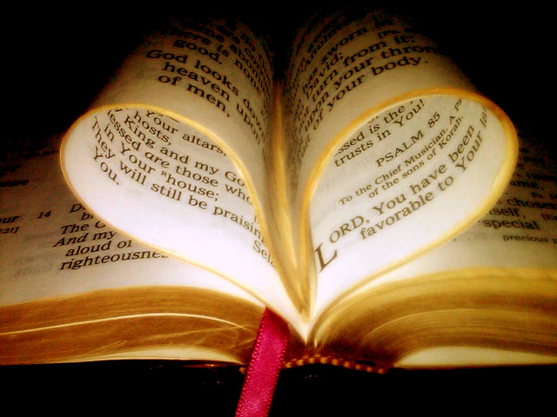
Conclusion
As we invite our friends and family to hear the gospel, let us strive together to receive a positive greeting from Christ and to be an influence for good to those around us!

Slide 28
“What Must I Do To Be Saved?”
Hear The Gospel (John 5:24; Romans 10:17)
Believe In Christ (John 3:16-18; John 8:24)
Repent Of Sins (Luke 13:3-5; Acts 2:38)
Confess Christ (Matthew 10:32; Romans 10:10)
Be Baptized (Mark 16:16; Acts 22:16)
Remain Faithful (John 8:31; Revelation 2:10)
For The Erring Saint:
Repent (Acts 8:22), Confess (I John 1:9),
Pray (Acts 8:22)

