Slide 1
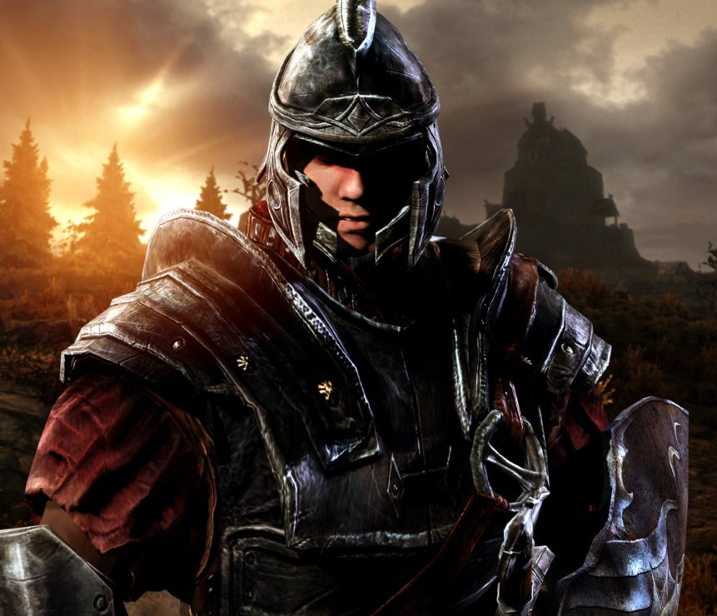
The Good Soldier
Text:
II Timothy 2:3-4
Notes:
By Nathan L Morrison for Sunday August 20th, 2023
All Scripture given is from NASU unless otherwise stated
For further study, or if questions, please Call: 804-277-1983 or Visit www.courthousechurchofchrist.com
Image: Imperial Legionnaire from the video game Skyrim
The logo art was used by permission by www.vecteezy.com

Slide 2
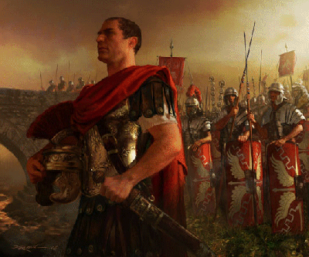
Intro
Near the end of his life, Paul was constantly surrounded by Roman soldiers:
He lived in the presence of the greatest military power ever known.
Night and day a soldier was with Paul to ensure he would not escape (Eph. 6:20; II Timothy 1:16: Paul was in chains!)
The Roman Legion is considered to be the world's first professional army.
Their armor was distinctive, and with it they subdued the world!

Slide 3
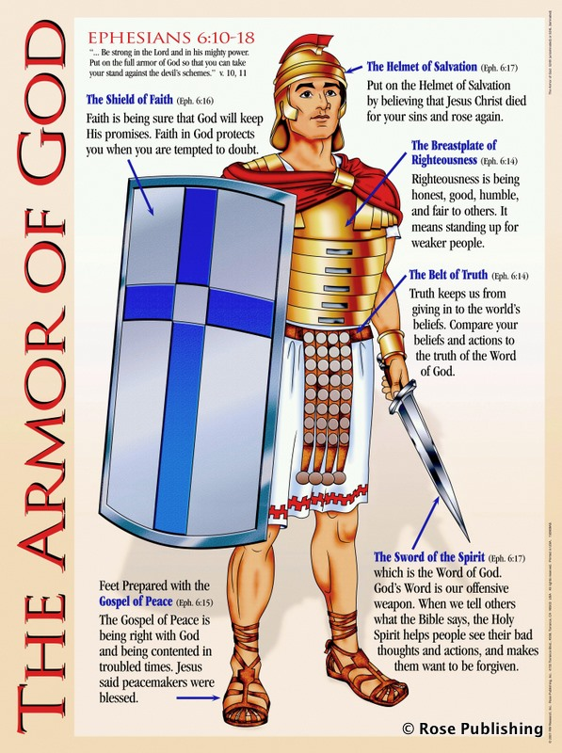
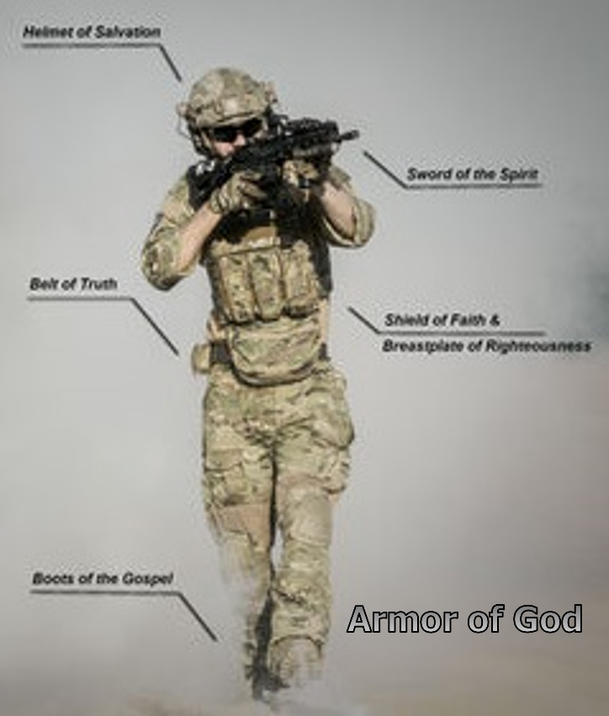
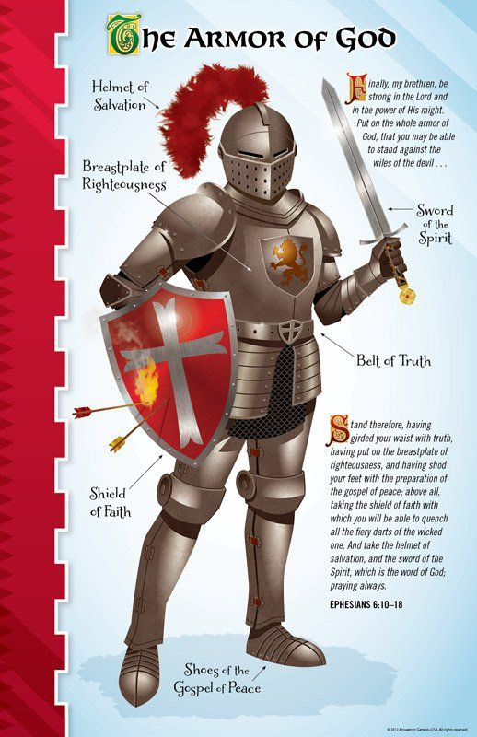
Intro
Paul used figures of speech to describe the saint’s walk with God:
“Fight the good fight” (I Timothy 1:18).
“Suffer hardship as a good soldier of Christ Jesus” (II Timothy 2:3).
Paul likened the life of a Christian to that of a soldier’s (II Timothy 2:4).
The soldiers of Paul’s day wore distinctive armor, so does the Christian!

Slide 4
Intro
Ephesians 6:10-11
10. Finally, be strong in the Lord and in the strength of His might.
11. Put on the full armor of God, so that you will be able to stand firm against the schemes of the devil.
II Timothy 2:3-4
3. Suffer hardship with me, as a good soldier of Christ Jesus.
4. No soldier in active service entangles himself in the affairs of everyday life, so that he may please the one who enlisted him as a soldier.
Saints are to be
“good soldiers” of Christ!

Slide 5
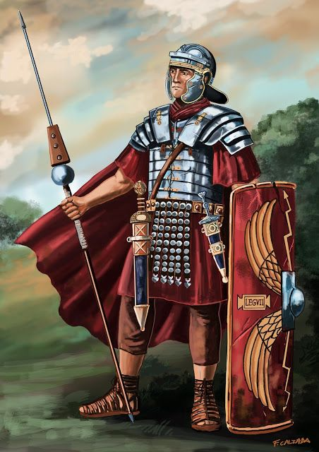
The Good Soldier
Endures Hardship – II Timothy 2:3
II Timothy 2:3
3. Suffer hardship with me, as a good soldier of Christ Jesus.
Notes:
The Good Soldier Endures Hardship – II Timothy 2:3
To be a good soldier requires one to endure hardships:
Hostility of the enemy
Travel
Strain on the family
Sacrifice
Soldiers of Christ are to endure hardships (II Timothy 2:3):
We may suffer because we are Christians! (I Pet. 2:20; 4:15-16)
Soldiers know the danger and volunteer anyways (Mt. 10:22-28; Jn. 15:18-21)
Willing to endure and sacrifice (Js. 1:2-3).
Jesus endured hardship and sacrificed – Heb. 12:2-3 (Ex. 15:3: God is a Warrior!)
Paul also endured hardship and sacrificed (II Cor. 11).
He asks Timothy to suffer with him as a “good soldier of Christ.”
We know the danger (Mt. 10) and must be willing to endure and sacrifice if called to do so!
Christian Soldiers expect hardships and must endure them!

Slide 6
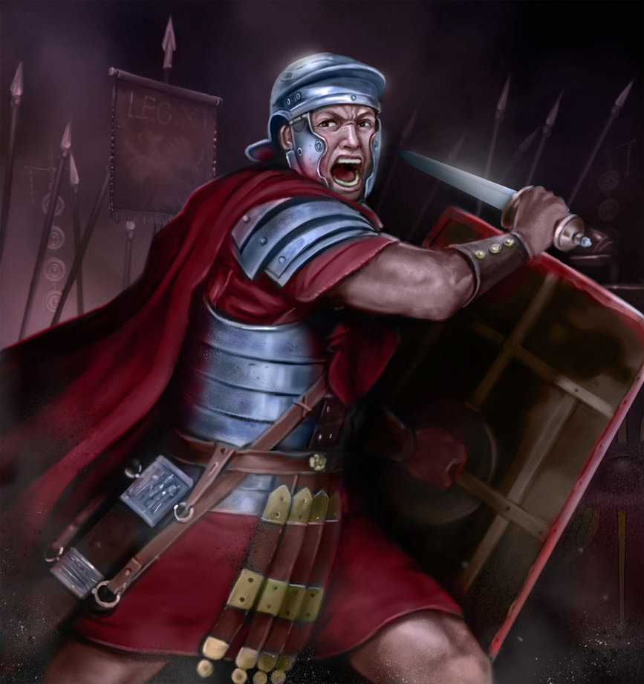
The Good Soldier
Endures Hardship – II Timothy 2:3
Christian Soldiers expect hardships and must endure them!

Slide 7
The Good Soldier
Endures Hardship – II Timothy 2:3
Joins the Battle – I Timothy 6:12
I Timothy 6:12
12. Fight the good fight of faith; take hold of the eternal life to which you were called, and you made the good confession in the presence of many witnesses.
Notes:
The Good Soldier Endures Hardship – II Timothy 2:3
The Good Soldier Joins the Battle – I Timothy 6:12
The soldier’s life is spent on duty, ready for service.
Christian soldiers are called to join the fray – II Timothy 2:4; I Timothy 6:12
Not to get entangled in the affairs of the world but to “Fight the good fight of faith.”
Eph. 6:10-12: We are to put on the “full armor of God” to join the battle against evil.
Soldiers strap on armor (take up arms) to go to battle.
Christians are engaged in spiritual warfare (II Cor. 10:3-4; Eph. 6:12):
We often have to battle ourselves to overcome fleshly desires – Rom. 7:22-23
A constant battle between the Spirit and the flesh – Gal. 5:17
Fight against false doctrines and immorality – I Timothy 6:3-5,13-14,20-21; Jude 3
Paul was able to say, “I have fought the good fight…” – II Timothy 4:7
Christian Soldiers are to be on duty – ready to fight!

Slide 8
The Good Soldier
Endures Hardship – II Timothy 2:3
Joins the Battle – I Timothy 6:12
Christian Soldiers are to be on duty – ready to fight!

Slide 9
The Good Soldier
Endures Hardship – II Timothy 2:3
Joins the Battle – I Timothy 6:12
Is Not Entangled – II Timothy 2:4
II Timothy 2:4
4. No soldier in active service entangles himself in the affairs of everyday life, so that he may please the one who enlisted him as a soldier.
Notes:
The Good Soldier Endures Hardship – II Timothy 2:3
The Good Soldier Joins the Battle – I Timothy 6:12
The Good Soldier Is Not Entangled – II Timothy 2:4
Soldiers on duty must concentrate on being in battle.
While soldiers get involved in battle, there are some things they are not to get involved in.
Soldiers of Christ are not to get “entangled in the affairs of everyday life” (II Timothy 2:4)
The affairs of everyday life are not bad in themselves.
Key word: “Entangled” – We can get too involved.
Jesus calls these things “worries” (NKJV: “cares”)
Lk. 8:14: Soldiers of Christ who get “entangled” are the “thorny ground” who allows “worries” of the world to choke out the word.
Such an individual becomes “unfruitful” (Useless to God – John 15:2, 6).
“Entangled” soldiers disobey orders, go AWOL, and desert their duty!
“Entangled” soldiers of Christ do the same:
Will not let light shine (Mt. 5:16)
Will not please the Commander (Rom. 8:6-8)
Will not be an example of righteousness (Phil. 1:27)
Will not fight against false doctrine (II Timothy 3:16-17)
Christian Soldiers are not to get “entangled” in the world but serve God!

Slide 10
The Good Soldier
Endures Hardship – II Timothy 2:3
Joins the Battle – I Timothy 6:12
Is Not Entangled – II Timothy 2:4
Christian Soldiers are not to get “entangled” in the world but serve God!

Slide 11
The Good Soldier
Endures Hardship – II Timothy 2:3
Joins the Battle – I Timothy 6:12
Is Not Entangled – II Timothy 2:4
Pleases the Commander – II Timothy 2:4
II Timothy 2:4
4. No soldier in active service entangles himself in the affairs of everyday life, so that he may please the one who enlisted him as a soldier.
Notes:
The Good Soldier Endures Hardship – II Timothy 2:3
The Good Soldier Joins the Battle – I Timothy 6:12
The Good Soldier Is Not Entangled – II Timothy 2:4
Soldiers on duty must concentrate on being in battle.
While soldiers get involved in battle, there are some things they are not to get involved in.
Soldiers of Christ are not to get “entangled in the affairs of everyday life” (II Timothy 2:4)
The affairs of everyday life are not bad in themselves.
Key word: “Entangled” – We can get too involved.
Jesus calls these things “worries” (NKJV: “cares”)
Lk. 8:14: Soldiers of Christ who get “entangled” are the “thorny ground” who allows “worries” of the world to choke out the word.
Such an individual becomes “unfruitful” (Useless to God – John 15:2, 6).
“Entangled” soldiers disobey orders, go AWOL, and desert their duty!
“Entangled” soldiers of Christ do the same:
Will not let light shine (Mt. 5:16)
Will not please the Commander (Rom. 8:6-8)
Will not be an example of righteousness (Phil. 1:27)
Will not fight against false doctrine (II Timothy 3:16-17)
Christian Soldiers are not to get “entangled” in the world but serve God!

Slide 12
The Good Soldier
Endures Hardship – II Timothy 2:3
Joins the Battle – I Timothy 6:12
Is Not Entangled – II Timothy 2:4
Pleases the Commander – II Timothy 2:4
Christian Soldiers are to be obedient to God to please the Commander!

Slide 13
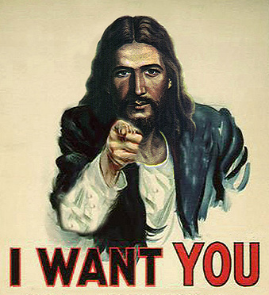
Conclusion
II Timothy 2:3-4; I Timothy 6:12: Paul says the “good soldier of Christ Jesus” does these things:
Endures Hardship – II Timothy 2:3
Joins the Battle – I Timothy 6:12
Is Not Entangled – II Timothy 2:4
Pleases the Commander – II Timothy 2:4

Slide 14
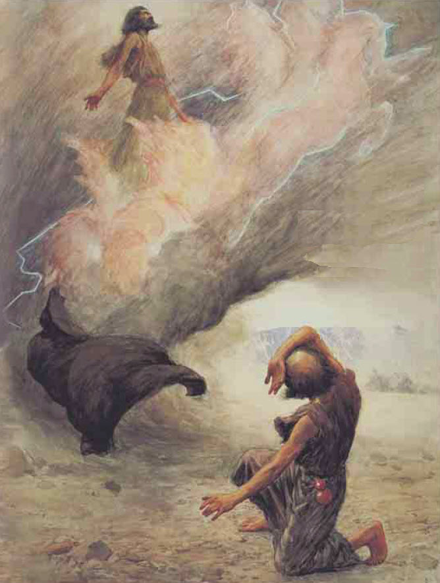
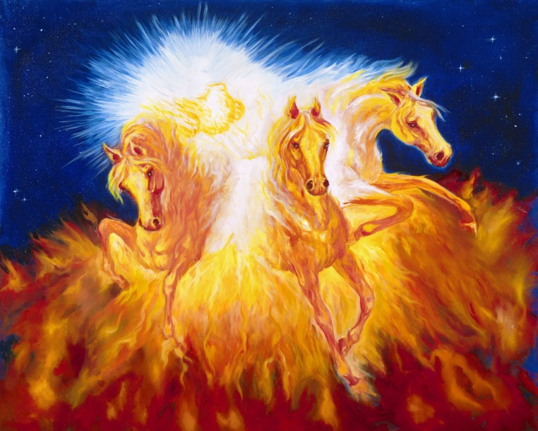
Conclusion
An O.T. example: Elijah (II Kings 2:11-12):
He had fought
Ungodly politicians
False prophets
Received the reward: taken up into heaven without tasting death!

Slide 15
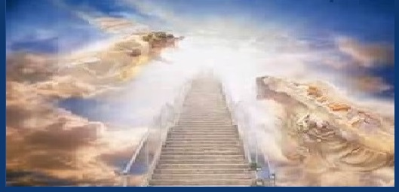
Conclusion
Faithful Christians are those who fight! (I Timothy 1:18; 6:12)
In any battle there are casualties and injured – what shall be done with the wounded?
“Restore” – Galatians 6:1
“Encourage” – I Thessalonians 5:14
“Turn them back” – James 5:19-20
There is an eternal reward for the one who remains faithful until death! (Revelation 2:10)

Slide 16
Conclusion
Will you serve God as a “good soldier of Christ?”

Slide 17
“What Must I Do To Be Saved?”
Hear The Gospel (John 5:24; Romans 10:17)
Believe In Christ (John 3:16-18; John 8:24)
Repent Of Sins (Luke 13:3-5; Acts 2:38)
Confess Christ (Matthew 10:32; Romans 10:10)
Be Baptized (Mark 16:16; Acts 22:16)
Remain Faithful (John 8:31; Revelation 2:10)
For The Erring Saint:
Repent (Acts 8:22), Confess (I John 1:9),
Pray (Acts 8:22)

