Slide 1
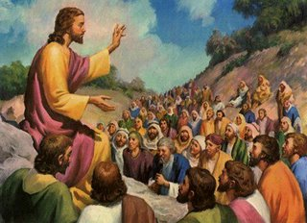
Blessed Are… Text: Matthew 5:3-12
Notes:
By Nathan L Morrison for Sunday 08/27/2023
All Scripture given is from NASB unless otherwise stated
For further study, or if questions, please Call: 804-277-1983 or Visit: www.courthousechurchofchrist.com
Additional helps at the end of the presentation
The logo art was used by permission by www.vecteezy.com

Slide 2
Intro
Matthew 5:3-12:
The “Beatitudes of Jesus,” as they are commonly called, define 8 characteristics Jesus’ followers are to have.
What is a “Beatitude?”
The word “beatitude” is transliterated from the Latin “beatus” which is equivalent to the English word “blessed,” translated from the Greek word makarios (G3107)

Slide 3
Intro
Jesus, the Master Teacher, taught the sermon on the mount and at the end of it His audience recognized true authority (Matthew 7:28-29)
These are not merely lofty ideals, but they have been lived in the past, expected of Jesus’ followers today, and exemplified by Jesus Himself.
We will focus on how they were lived in the past and how we are expected to live them today!

Slide 4
Scripture | Beatitudes | King David | YOU | Results
Matthew 5:3
Blessed are the poor in spirit (empty)
II Samuel 12:13; Psalm 51:16-17
II Corinthians 7:9-11;
I Timothy 1:15
…for theirs is the kingdom of heaven (Colossians 1:13)
Matthew 5:4
Blessed are those who mourn (shame)
II Samuel 12:13; Psalm 38:18; 51:3-4, 11
James 4:8-10
…for they shall be comforted
(II Corinthians 1:3-7)
Matthew 5:5
Blessed are the gentle (meek/humble)
Psalm 37:11, 29
Colossians 3:12; Philippians 4:5; James 4:6
…for they shall inherit the earth (Ecclesiastes 5:19-6:2)
Matthew 5:6
Blessed are those who hunger and thirst for righteousness (starving)
Psalm 19:9-14; 63:1
Philippians 3:8-11
… for they shall be satisfied (Psalm 34:10)
Matthew 5:7
Blessed are the merciful (compassion)
II Samuel 9:1-13
Colossians 3:12-14; Jude 21-23
…for they shall receive mercy (Psalm 103:8-13; James 2:13)
Matthew 5:8
Blessed are the pure in heart (sincerity)
I Samuel 13:14; Psalm 24:3-4; 51:10
I John 3:3;
I Timothy 1:5;
II Timothy 2:22
… for they shall see God
(I John 3:2-3)
Matthew 5:9
Blessed are the peacemakers (peaceful)
II Samuel 3:12-21; 19:13-14
Romans 12:18; Hebrews 12:14;
II Timothy 2:22
… for they shall be called sons of God (Romans 8:14; Galatians 3:26)
Matthew
5:10-12
Blessed are those who have been persecuted
(persecuted)
I Sam.17:26-29;18:9-12; II Sam. 3:37-39; 15:10-14;16:5-8; Ps.9:13;25:19
II Timothy 3:12;
I Peter 4:12-19
… for theirs is the kingdom of heaven… (Romans 8:18; Revelation 21:7)

Slide 5
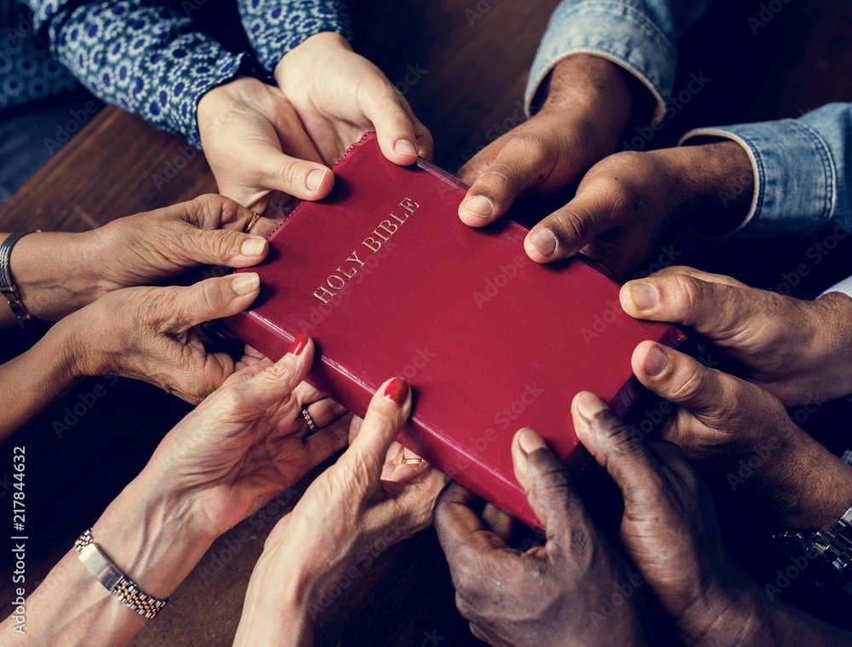
Conclusion
Is the kingdom of heaven worth the effort to develop such qualities of character?
Is the kingdom of heaven worth whatever persecution we might endure?
Paul says a resounding, “YES!” Obtaining Christ is worth whatever price we must pay in this life
(Philippians 3:7-11)

Slide 6
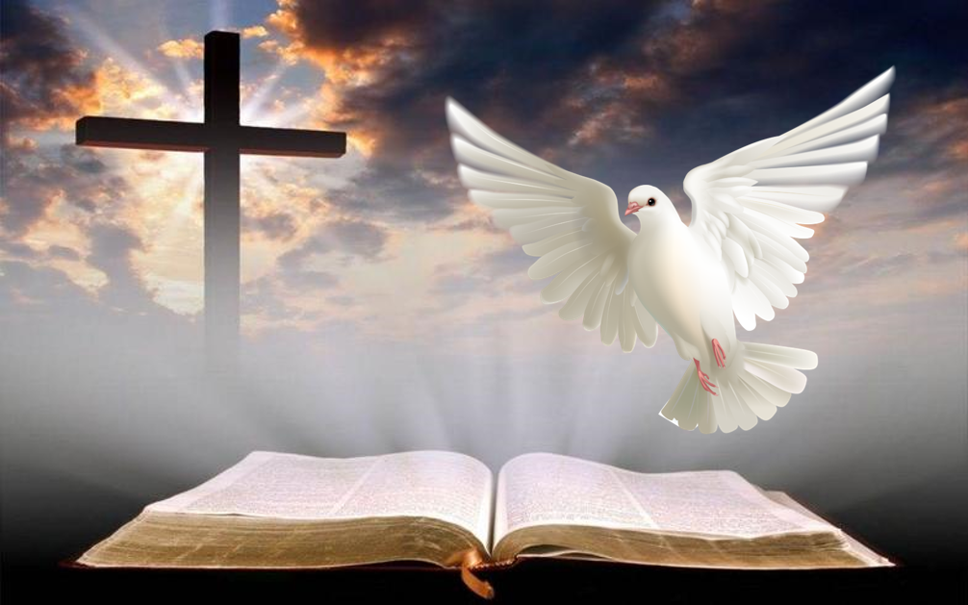
Conclusion
The Lord has provided the necessary instruction for us to grow!
Let us strive to be the ideal citizen of the kingdom of heaven!

Slide 7
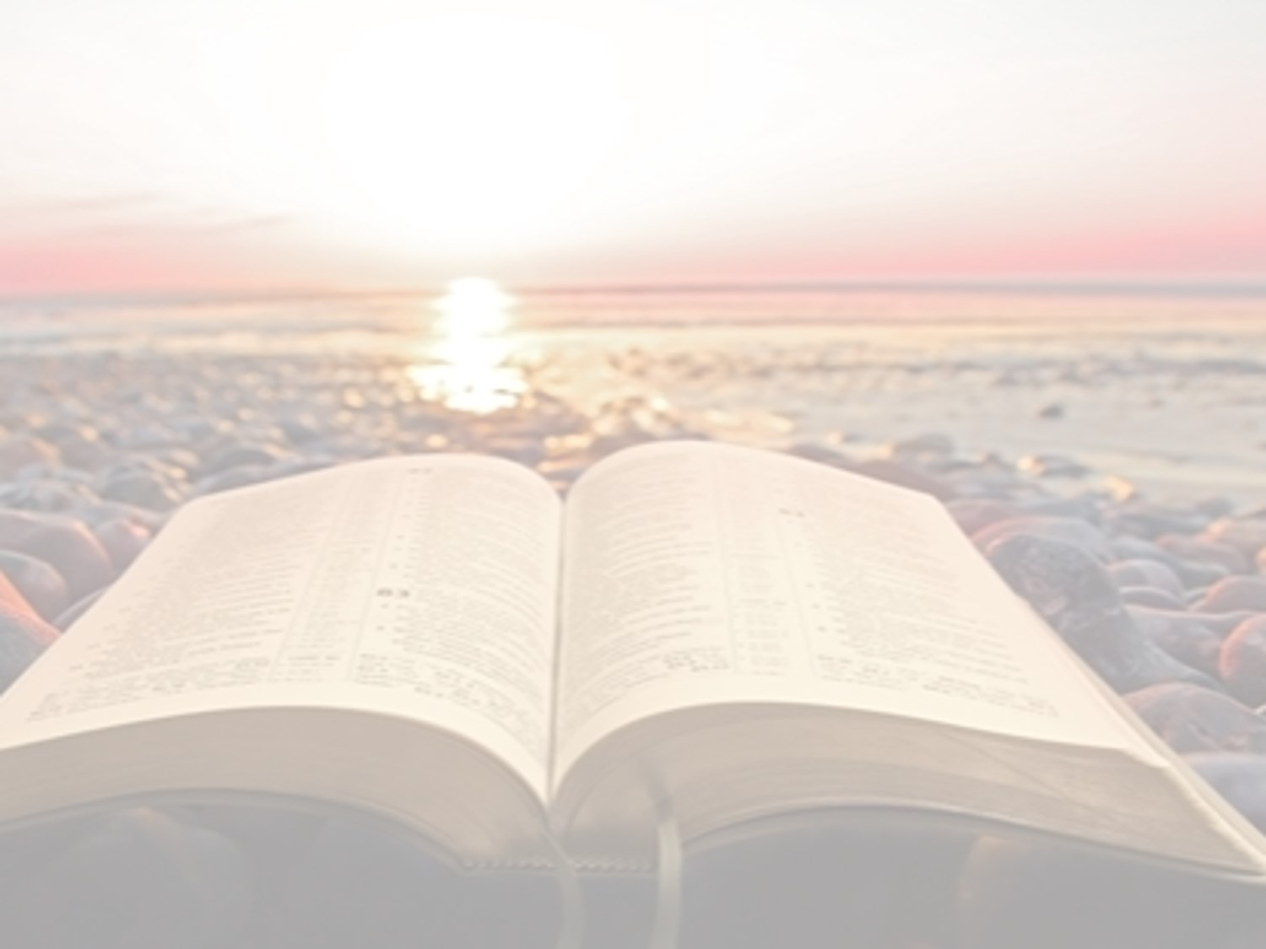
“What Must I Do To Be Saved?”
Hear The Gospel (John 5:24; Romans 10:17)
Believe In Christ (John 3:16-18; John 8:24)
Repent Of Sins (Luke 13:3-5; Acts 2:38)
Confess Christ (Matthew 10:32; Romans 10:10)
Be Baptized (Mark 16:16; Acts 22:16)
Remain Faithful (John 8:31; Revelation 2:10)
For The Erring Saint:
Repent (Acts 8:22), Confess (I John 1:9),
Pray (Acts 8:22)

Slide 8
Table of Blessed Are…

Slide 9
Scripture | Beatitudes | King David | YOU | Results
Matthew 5:3 | Blessed are the poor in spirit (empty) | II Samuel 12:13; Psalm 51:16-17 | II Corinthians 7:9-11; I Timothy 1:15 | …for theirs is the kingdom of heaven (Colossians 1:13)
Matthew 5:4 | Blessed are those who mourn (shame) | II Samuel 12:13; Psalm 38:18; 51:3-4, 11 | James 4:8-10 | …for they shall be comforted (II Corinthians 1:3-7)
Matthew 5:5 | Blessed are the gentle (meek/humble) | Psalm 37:11, 29 | Colossians 3:12; Philippians 4:5; James 4:6 | …for they shall inherit the earth (Ecclesiastes 5:19-6:2)
Matthew 5:6 | Blessed are those who hunger and thirst for righteousness (starving) | Psalm 19:9-14; 63:1 | Philippians 3:8-11 | … for they shall be satisfied (Psalm 34:10)
Matthew 5:7 | Blessed are the merciful (compassion) | II Samuel 9:1-13 | Colossians 3:12-14; Jude 21-23 | …for they shall receive mercy (Psalm 103:8-13; James 2:13)
Matthew 5:8 | Blessed are the pure in heart (sincerity) | I Samuel 13:14; Psalm 24:3-4; 51:10 | I John 3:3; I Timothy 1:5; II Timothy 2:22 | … for they shall see God (I John 3:2-3)
Matthew 5:9 | Blessed are the peacemakers (peaceful) | II Samuel 3:12-21; 19:13-14 | Romans 12:18; Hebrews 12:14; II Timothy 2:22 | … for they shall be called sons of God (Romans 8:14; Galatians 3:26)
Matthew 5:10-12 | Blessed are those who have been persecuted for the sake of righteousness (persecuted) | I Samuel 17:26-29; 18:9-12; II Samuel 3:37-39; 15:10-14; 16:5-8; Psalm 9:13; 25:19 | II Timothy 3:12; I Peter 4:12-19 | … for theirs is the kingdom of heaven… (Romans 8:18; Revelation 21:7)

Slide 10
Picture of Blessed Are…

Slide 11
By Nathan L Morrison
Notes:
I used the printed out picture as a handout during the lesson

