Slide 1
Know Your Enemy: NOT Deceived!
Text:
II Corinthians 2:10-11
Notes:
By Nathan L Morrison
All Scripture given is from NASB unless otherwise stated
For further study, or if questions, please Call: 804-277-1983 or Visit: www.courthousechurchofchrist.com

Slide 2
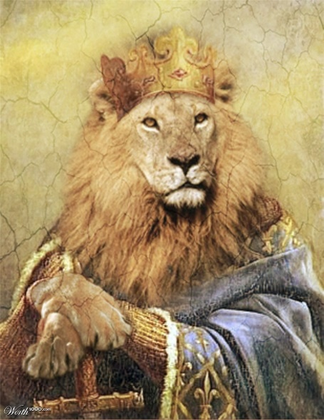
Intro
“The wise warrior knows the enemy as well as they know themselves” (J.R.R. Tolkien)
The Scriptures tell us we have an enemy: Satan!
I Peter 5:8 (John 8:44)
8. Be of sober spirit, be on the alert. Your adversary, the devil, prowls around like a roaring lion, seeking someone to devour.
There are two figures in the Scriptures that are described as lions but have distinct and different traits from each other:
Jesus and Satan

Slide 3
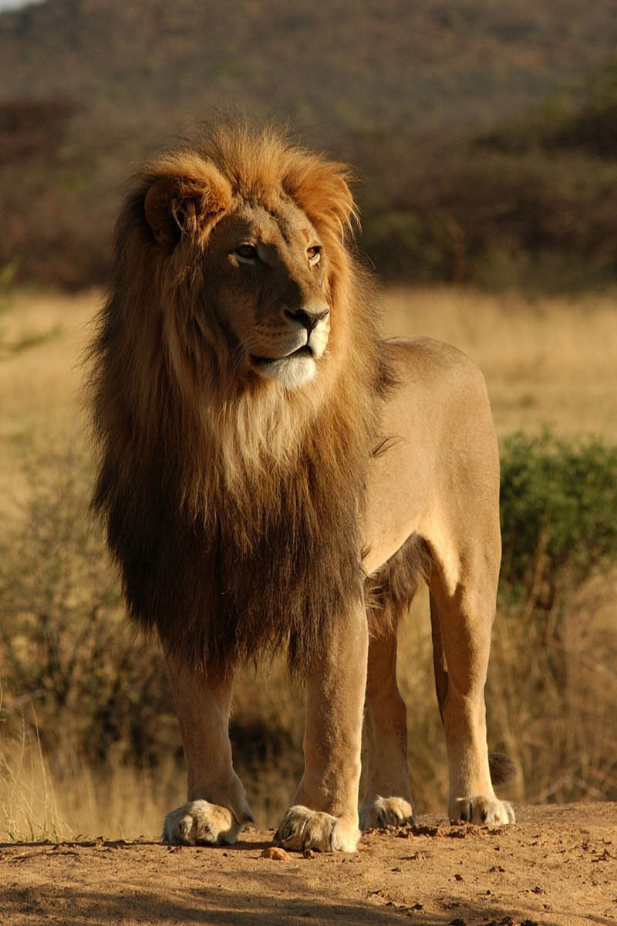
Intro
Lions in the Wild
Alpha male lions own a pride and are very territorial.
If another male challenges the alpha lion, the lion king must fight to hold on to his pride.
If the challenger succeeds, he usually kills the cubs and other young males of the alpha.
For a lion king, there is no such thing as retirement – He must fight for his throne or be cast aside.
A lion's roar can be heard up to five miles away and is done marking territory, talking to pride members, and for catching prey.
The sound of the roar confuses and scares the prey: the result is that the prey becomes easily trapped and caught by the lion.
Notes:
Sources:
http://web.archive.org/web/20120415054339/http://www.phoenixzoo.org/learn/animals/animal_detail.aspx?FACT_SHEET_ID=100001
http://video.nationalgeographic.com/video/worlds-deadliest/deadliest-lions-vs
http://www.barkingzebratours.com/roaring-lions/

Slide 4
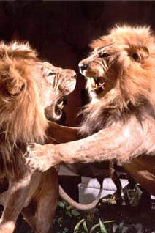
Intro
The Scriptures present to us a “Battle of Lions!”
Jesus, also seen as a lamb of sacrifice to save the world from sin (John 1:29), is the King from the line of David, and the Lion of Judah (Mt. 25:31, 34; Heb. 9:28; Rev. 5:5).
Jesus’ roar is to His bride and is reassuring and one of hope and peace!
Satan, though described in various ways and creatures, is also described as a roaring lion seeking someone to devour (I Peter 5:8).
Satan’s roar is to confuse, frighten and deceive!

Slide 5
Intro
The Scriptures also tell us Satan has an agenda
II Cor. 11:3: To control the heart (minds) of man.
II Cor. 11:13-15: He works through agents.
Eph. 4:14: His doctrines are to deceive men (to hold to a form of godliness; II Tim. 3:1-5)

Slide 6
Intro
II Corinthians 2:10-11
10. But one whom you forgive anything, I forgive also; for indeed what I have forgiven, if I have forgiven anything, I did it for your sakes in the presence of Christ,
11. so that no advantage would be taken of us by Satan, for we are not ignorant of his schemes.

Slide 7
Intro
II Corinthians 4:3-4
3. And even if our gospel is veiled, it is veiled to those who are perishing,
4. in whose case the god of this world has blinded the minds of the unbelieving so that they might not see the light of the gospel of the glory of Christ, who is the image of God.

Slide 8
Intro
Part of knowing our enemy is to know his schemes and to NOT be deceived by them!

Slide 9
Subvert the Word of God
Genesis 3:1-19: Adam and Eve fell from God’s grace because of deceit! (II Cor. 11:3).
II Cor. 11:14-15: Satan, through his servants, perverts God’s word.
II Cor. 3:12-16; I Tim. 1:3-4: Mixing the gospel with the Old Law (Acts 15)
Gal. 1:6-9: Perverting the gospel
Many problems today result from same kind of perversion!
By subverting the word and people believing the lie, Satan wins; all the while people think they are saved so why should they change? (Matthew 7:21-23).
The Truth is in Jesus & His word – we must not only know it but practice it!
Notes:
I. Subvert the Word of God
A. Many problems today result from same kind of perversion:
1. Plan of Salvation: (“What about the thief on the cross?;” Say Sinner’s Prayer)
2. Acceptable worship: (Sabbath; Instrumental music; Communion on Friday, or other special events)
3. Identifying God’s people: (Premillennialism – Jews still God’s people; Mt. 21:43; Rom. 2:28-29; Gal. 3:27-29)
4. Giving to God: (Materialism – Bazaars to raise money, etc. – Lk. 12:15-21:Beware of every form of greed; Life doesn’t consist of possessions)
5. One church (Eph. 4:4-6: “One body”): (“One church is as good as another”)

Slide 10
Set Mind on Things on Earth
Colossians 3:2: Saints are not to set their minds on the things of earth, but above to Heaven.
II Cor. 4:3-4: Satan is called the “god of this world (age).”
He tempts saints to focus on the things of the earth! (Mt. 13:22; Lk. 8:14: Unfruitful!)
The “Prosperity Gospel” is very popular!
God’s people live for present and future!
II Peter 1:3; Heb. 6:9-20: Intend to obtain God’s promises.
II Tim. 4:7-8; Js. 1:12: The “Crown of life” waits.
Colossians 3:1-3: Seek things above.
Those seeking immediate gratification in life (their reward now) will have the reward they seek but miss out on the eternal reward!

Slide 11
Seduce the Saints
Satan wants souls (YOU!) – I Pet. 5:8: “Someone to devour”
Luke 22:3-6: An apostle of Christ (Judas) was seduced by his greed (material things).
Luke 22:54-62; Galatians 2:11-14: An apostle of Christ (Peter) denied Jesus and was a hypocrite.
Acts 5:3: A Christian couple was seduced to lie for the praise of men.
I Corinthians 5:1-2: A Christian at Corinth involved in adultery.
II Timothy 4:10: A Christian was seduced into forsaking Christ and Paul for the world.
Revelation 2:20-23: A church of Christ in Thyatira tolerated members who were seduced into various acts of immorality by one of its members! (Not all participated – Rev. 2:24-25)

Slide 12
Seduce the Saints
I Corinthians 10:12
Therefore let him who thinks he stands take heed that he does not fall.

Slide 13
Seduce the Saints
Satan wants souls (YOU!) – I Pet. 5:8: “Someone to devour”
Luke 22:3-6: An apostle of Christ (Judas) was seduced by his greed (material things).
Luke 22:54-62; Galatians 2:11-14: An apostle of Christ (Peter) denied Jesus and was a hypocrite.
Acts 5:3: A Christian couple was seduced to lie for the praise of men.
I Corinthians 5:1-2: A Christian at Corinth involved in adultery.
II Timothy 4:10: A Christian was seduced into forsaking Christ and Paul for the world.
Revelation 2:20-23: A church of Christ in Thyatira tolerated members who were seduced into various acts of immorality by one of its members! (Not all participated – Rev. 2:24-25)
Many Christians today become unfaithful to Christ -- seduced by Satan!

Slide 14
Conclusion
Important to know one’s enemy: Satan is strong, even powerful, but only as powerful as you let him be in your life! (I Cor. 10:13; James 1:14-16: Spiritual L.S.D.)
Christ already defeated him!
Satan is strong, but not victorious! (Heb. 2:14-15)

Slide 15
Conclusion
Christians can resist Satan
The armor of God is given to prepare the Christian for battle
Ephesians 6:10-13: The saint is to stand against the schemes of the devil!
II Timothy 2:24-26: The challenge or work of the Lord’s bond-servant is to recover/rescue those overtaken by the devil
James 4:7; I Peter 5:9: Power to resist comes from God’s word (Matthew 4: “It is written”): “Submit therefore to God. Resist the devil and he will flee from you!”
Stand firm! (Ephesians 6:11, 13)

Slide 16
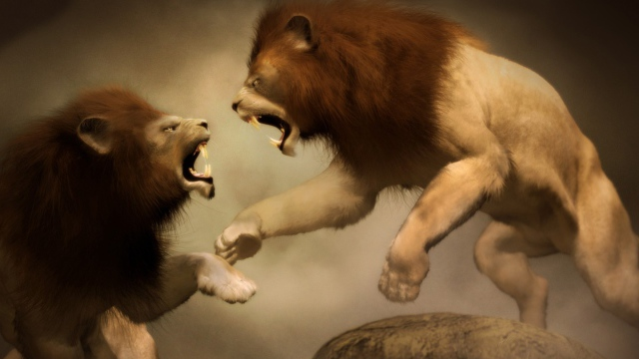
Conclusion
The Battle of Lions rages on:
One roar is a call to obey and be blessed for eternity (Jesus)
The other roar is to confuse and deceive you into staying in sin (Satan)
Whose roar will you listen to?

Slide 17
Conclusion
Don’t be deceived by Satan’s schemes but “Resist him, firm in your faith!” (I Peter 5:9) and obey Jesus, the Lion of Judah who died to make you alive!

Slide 18
“What Must I Do To Be Saved?”
Hear The Gospel (Jn. 5:24; Rom. 10:17)
Believe In Christ (Jn. 3:16-18; Jn. 8:24)
Repent Of Sins (Lk. 13:3-5; Acts 2:38)
Confess Christ (Mt. 10:32; Rom. 10:10)
Be Baptized (Mk. 16:16; Acts 22:16)
Remain Faithful (Jn. 8:31; Rev. 2:10)
For The Erring Saint:
Repent (Acts 8:22), Confess (I Jn. 1:9),
Pray (Acts 8:22)

