Slide 1
Faith In Christ Results In Baptism Text: Romans 6:1-7
Notes:
Prepared by Nathan L Morrison for July 2, 2023
All Scripture given is from NASU unless otherwise stated
For further study, or if questions, please Call: 804-277-1983 or Visit www.courthousechurchofchrist.com
The logo art was used by permission by www.vecteezy.com

Slide 2
Intro
The subject of baptism, an important topic, divides the Lord’s church from denominations
Matthew 28:19-20; Mark 16:15-16
II Thessalonians 1:7-9
There are those who teach a separation of faith and baptism
There are even those who claim Paul never taught baptism because he wasn’t sent to baptize from I Cor. 1:17 but ignore I Cor. 1:12-16
In Romans 6, Galatians 3, & Ephesians 4 Paul clearly taught baptism.
Some also teach Paul went to Gentiles so commands to be baptized were for Jews only
Acts 10:44-48

Slide 3
Intro
Romans 6:1-7
1. What shall we say then? Are we to continue in sin so that grace may increase?
2. May it never be! How shall we who died to sin still live in it?
3. Or do you not know that all of us who have been baptized into Christ Jesus have been baptized into His death?
4. Therefore we have been buried with Him through baptism into death, so that as Christ was raised from the dead through the glory of the Father, so we too might walk in newness of life.
5. For if we have become united with Him in the likeness of His death, certainly we shall also be in the likeness of His resurrection,
6. knowing this, that our old self was crucified with Him, in order that our body of sin might be done away with, so that we would no longer be slaves to sin;
7. for he who has died is freed from sin.

Slide 4
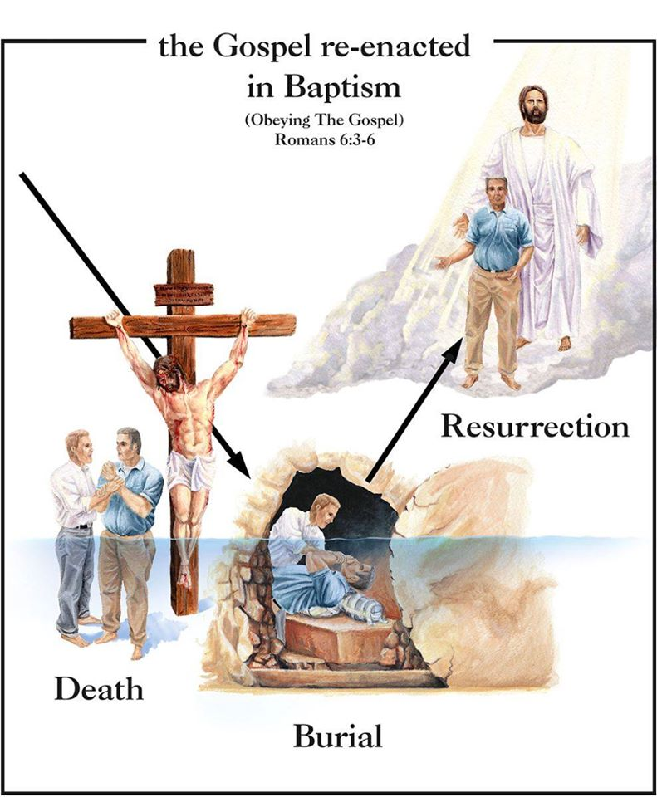
Intro
Romans 6:1-7: Paul plainly teaches on baptism and its importance
Jesus connected faith and baptism – Mark 16:16: To faith and being saved.
Paul connected faith and baptism – Colossians 2:12: To burial and faith.
Baptism is the gospel of Jesus’ death, burial and resurrection symbolized.

Slide 5
Intro
Faith in Jesus is to have faith in His plan: resulting in baptism!

Slide 6
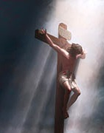
Faith In the Blood of Christ
To believe (have faith) in Christ is to have faith in His blood
Rom. 3:23-26: Propitiation
Rom. 5:6-10: Justification
Rom. 5:10: Reconciliation
Rom. 3:23-24: Redemption
How do we have contact with it? (Rom. 6:3-6)
Revelation 1:5 (NKJV): Sins are washed away
Acts 22:16: “Be baptized and wash away your sins.”
Matthew 26:28: His blood was shed for “forgiveness of sins.”
Acts 2:38: “Repent and be baptized for the forgiveness of sins.”

Slide 7
Faith In the Blood of Christ
What is the correlation of baptism and the blood of Christ? (Rom. 6:3-6)
Baptism is the obedient act of obtaining the saving power of Christ’s blood!
To deny the saving power of baptism is to deny the saving power of His blood!

Slide 8
Faith In the Blood of Christ
One must be baptized to “wash away” sin and obtain “forgiveness of” sins!

Slide 9
Faith In A New Life
Those baptized into Christ (Rom. 6:3), are raised to a new life (Rom. 6:4)
“Born again” through water and the Spirit (John 3:3-5).
Spiritual state is changed (Colossians 1:12-14).
Walk in “newness of life” (Romans 6:4), in a manner “worthy of the Lord” (Colossians 1:9-10).
This new life refuses to let sin:
“Reign” in our new life – Rom. 6:12
Have control or be master over our lives – Rom. 6:14
Keep us in bondage – Rom. 6:6, 16

Slide 10
Faith In A New Life
Baptism into Christ frees us from sin so that we may become slaves to righteousness! (Romans 6:3, 17-18)
Baptism into Christ manifests our faith and puts us into Christ (Galatians 3:26-27).
Baptism into Christ puts us into the body (the church – Ephesians 1:22-23; Colossians 1:18) of Christ (I Corinthians 12:13; Ephesians 4:4-6).

Slide 11
Faith In A New Life
Through baptism we are “born again” unto a “newness of life!”

Slide 12
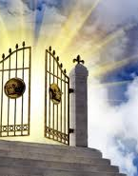
Faith In the Reward of the New Life
Results (fruit) of old life: Death – Romans 6:20-21, 23
The old way of life was futile and its outcome was death
Results (fruit) of new life: Eternal life – Romans 6:22-23
The free gift of God is eternal life found in Christ (Rom. 6:8-10)
I Peter 1:3-5: We were “born again” to receive an imperishable inheritance, a reservation in Heaven!

Slide 13
Faith In the Reward of the New Life
Contrast the results of before and after baptism:
Old life (disobedient to gospel): Death (Rom. 6:21) & eternal separation from God (II Thess. 1:7-9).
New life (obedient to gospel): Eternal life (Rom. 6:22-23) & “always with the Lord” (I Thess. 4:17).

Slide 14
Faith In the Reward of the New Life
Baptism into His death is the hope of resurrection to eternal life! (Romans 6:5)

Slide 15
Conclusion
Galatians 3:26-29
26. For you are all sons of God through faith in Christ Jesus.
27. For all of you who were baptized into Christ have clothed yourselves with Christ.
28. There is neither Jew nor Greek, there is neither slave nor free man, there is neither male nor female; for you are all one in Christ Jesus.
29. And if you belong to Christ, then you are Abraham's descendants, heirs according to promise.

Slide 16
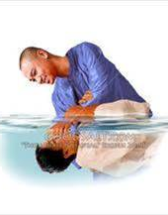
Conclusion
True baptism comes from an obedient heart (Romans 6:17) for the forgiveness of sins (Acts 2:38) into the name of the Father, Son and Holy Spirit (Matthew 28:18-20)
Baptism without faith is meaningless (James 2:26: Faith without works is dead).
Baptism without faith is just getting wet (James 2:19: Even the demons just believe).
Baptism from faith is God’s means of repentant sinners to receive “newness of life” (Romans 6:4).
To deny baptism saves is to deny the saving power of Christ’s blood!

Slide 17
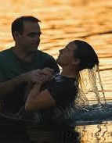
Conclusion
If you haven’t, won’t you be obedient to the gospel that you may have eternal life?
Repent – Rom. 2:4-8
Confess the Lord as the Son of God – Rom. 10:9-10; Acts 8:37
Be baptized – Rom. 6:3-7; Acts 2:38
Walk in obedience – Rom. 6:4; Jn. 8:31-32; 15:10

Slide 18
Conclusion
Demonstrate your faith in Christ (in His blood) by obedience to the gospel through baptism!

Slide 19
“What Must I Do To Be Saved?”
Hear The Gospel (Jn. 5:24; Rom. 10:17)
Believe In Christ (Jn. 3:16-18; Jn. 8:24)
Repent Of Sins (Lk. 13:3-5; Acts 2:38)
Confess Christ (Mt. 10:32; Rom. 10:10)
Be Baptized (Mk. 16:16; Acts 22:16)
Remain Faithful (Jn. 8:31; Rev. 2:10)
For The Erring Saint:
Repent (Acts 8:22), Confess (I Jn. 1:9),
Pray (Acts 8:22)

