Slide 1
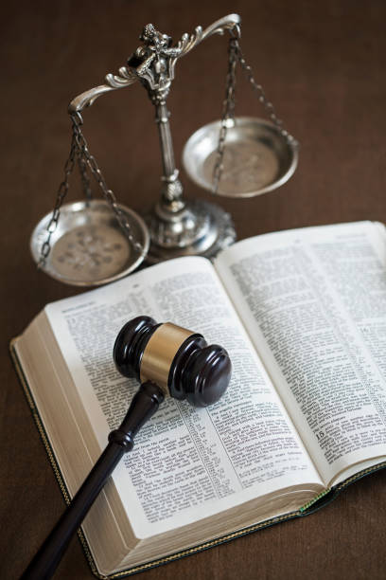
Thankful For God's Righteous Judgment
Text:
II Timothy 4:7-8
Notes:
By Nathan L Morrison for Sunday 03/05/2023
All Scripture given is from NASB unless otherwise stated
For further study, or if questions, please Call: 804-277-1983 or Visit: www.courthousechurchofchrist.com

Slide 2
Intro
The Northern Kingdom of Israel was destroyed, and her people carried away into captivity by the Assyrians in 721 B.C.
II Kings 17
The Southern Kingdom of Judah was destroyed, and her people carried away into captivity by the Babylonians in 586 B.C.
II Chronicles 36
God foretold all of this by Moses in Deuteronomy 28-30!

Slide 3
Intro
Deuteronomy 30:15-20
15. “See, I have set before you today life and prosperity, and death and adversity;
16. in that I command you today to love the LORD your God, to walk in His ways and to keep His commandments and His statutes and His judgments, that you may live and multiply, and that the LORD your God may bless you in the land where you are entering to possess it.
17. “But if your heart turns away and you will not obey, but are drawn away and worship other gods and serve them,
18. I declare to you today that you shall surely perish. You will not prolong your days in the land where you are crossing the Jordan to enter and possess it.
19. “I call heaven and earth to witness against you today, that I have set before you life and death, the blessing and the curse. So choose life in order that you may live, you and your descendants,
20. by loving the LORD your God, by obeying His voice, and by holding fast to Him; for this is your life and the length of your days, that you may live in the land which the LORD swore to your fathers, to Abraham, Isaac, and Jacob, to give them.”

Slide 4
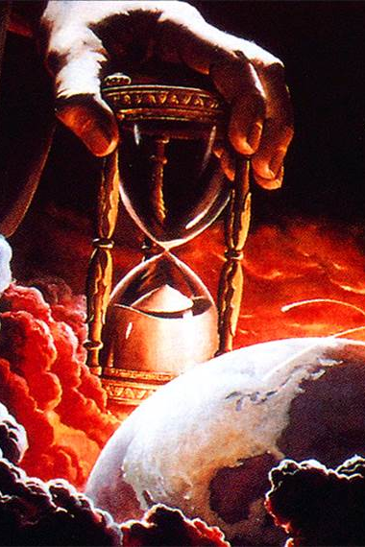
Intro
There is still a Day of Judgment set for all people in an hour only He knows
(II Corinthians 5:10)

Slide 5
Intro
Christians should be thankful for God’s judgments for these reasons:
He is Righteous
His laws are clearly defined
The wicked will be punished
The faithful will find mercy & compassion

Slide 6
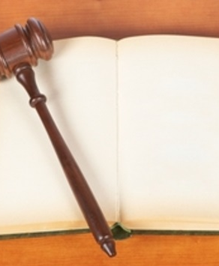
Thankful For God's Righteous Judgment
II Timothy 4:7-8
7. I have fought the good fight, I have finished the course, I have kept the faith;
8. in the future there is laid up for me the crown of righteousness, which the Lord, the righteous Judge, will award to me on that day; and not only to me, but also to all who have loved His appearing.
God’s Judgment is Righteous
Notes:
God’s Judgment is Righteous
In the world we see the miscarriage of justice all the time.
We hear of someone in prison for 20+ years and then found to be innocent by new DNA evidence…
October 2000: 75 prisoners — including eight on death row — have been freed nationwide because of DNA testing. https://thedailyrecord.com/2000/10/26/even-as-prisoners-go-free-law-and-science-of-dna-remain-at-odds/
October 2018: DNA Evidence Exonerates a Man of Murder After 20 Years in Prison: Horace Roberts, 60, was freed from a California prison this month after DNA evidence showed that he had been wrongfully convicted of murder nearly two decades ago. https://www.nytimes.com/2018/10/16/us/20-years-exonerated-dna-prison.html
October 2022: Maurice Hastings, 69, in prison for 38 years freed by new DNA evidence: https://www.bbc.com/news/world-us-canada-63437208
Our justice system is flawed because we are flawed people, but God is perfect.
Isaiah 11:4: God judges with righteousness.
Revelation 19:11: God judges in righteousness.
II Timothy 4:7-8: God is the Righteous Judge.
God doesn’t make mistakes: The Day of Judgment will see reward and punishment dealt out to those who are faithful who He has compassion on and to those who are wicked and deserving of an eternal punishment (Matthew 25:31-46).
Let us give thanks for God’s righteous judgment for we can confidently say He knows who the faithful are and who the faithless are!

Slide 7
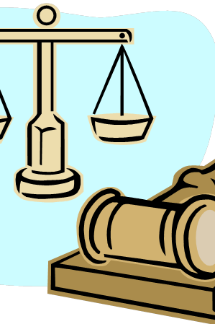
Thankful For God's Righteous Judgment
Let us give thanks for God’s righteous judgment for we can confidently say He knows who the faithful are and who the faithless are!

Slide 8
Thankful For God's Righteous Judgment
John 12:48
He who rejects Me and does not receive My sayings, has one who judges him; the word I spoke is what will judge him at the last day.
God’s Judgment is Righteous
God’s Laws are Clearly Defined
Notes:
God’s Judgment is Righteous
God’s Laws are Clearly Defined
How often do we hear of a traveler (often American) locked up in a foreign jail because they broke a law they didn’t know about?
CBS reported back in February 2022 that about 40 Americans are imprisoned abroad, not by terrorists, but by foreign governments and are considered “wrongful detainees.” https://www.cbsnews.com/news/wrongful-detainees-american-hostages-60-minutes-2022-02-27/
This is not the case with God. He has clearly laid out what He expects of all people.
Acts 17:30-31: God commands all people everywhere to repent!
Ephesians 3:4: God’s word, the mystery, can be understood when read!
God’s word has been preserved and given to all the world.
Romans 10:18: Gospel has gone to the ends of the world.
Isaiah 40:8: Word of God stands forever.
Titus 2:11-14: Just as Israel was once forewarned of all the calamity that would befall them if they rejected God’s word, so the gospel has gone out teaching all men to “deny ungodliness and worldly desires and to live sensibly, righteously and godly in the present age” (Titus 2:12).
John 12:48: Jesus said, “He who rejects Me and does not receive My sayings, has one who judges him; the word I spoke is what will judge him at the last day.”
There are no secret rules with God – All men will be judged according to the standard of Christ! (Romans 2:16)

Slide 9
God’s Laws are Clearly Defined
There are no secret rules with God – All men will be judged according to the standard of Christ! (Romans 2:16)

Slide 10
Thankful For God's Righteous Judgment
Romans 12:19
Never take your own revenge, beloved, but leave room for the wrath of God, for it is written, “VENGEANCE IS MINE, I WILL REPAY,” says the Lord.
God’s Judgment is Righteous
God’s Laws are Clearly Defined
The Wicked Will Be Punished
Notes:
God’s Judgment is Righteous
God’s Laws are Clearly Defined
The Wicked Will Be Punished
Today we are often bothered by all the people who break the law or commit evil acts and get away with it. (“Where are the police when you need them?”)
The wicked are not punished for their evil deeds due to: money, corruption, political power, etc..This has been a problem since ancient times.
Psalm 73:3-13: Wicked are at ease.
Job 21:7: Wicked are powerful.
Ecclesiastes 7:15: Wicked live long life.
Amos 5:7, 12: Israel’s rulers accepted bribes and oppressed the poor and rejected justice.
Isaiah 1:23; 5:23: The rulers of Judah accepted bribes from the rich and powerful and justice was perverted (Habakkuk 1:4).
But with God, the wicked will be punished, for He cannot be bribed or distracted.
Hebrews 10:29-31: Terrifying to fall into God’s judgment.
Revelation 20:11-15: All men will be judged by their deeds. No excuses, no bribes, no fall guys or framing an innocent person, but the guilty will face their sins.
Those who have persecuted, and harmed God’s people will be judged.
Luke 18:1-8: Jesus told a parable to teach His disciples not to lose heart and to pray often. He told the story of a wicked judge who wouldn’t give justice to a widow but finally after her persistence he granted it. The moral of the story was this: “will not God bring about justice for His elect who cry to Him day and night, and will He delay long over them? I tell you that He will bring about justice for them quickly” (Luke 18:7-8).
II Thessalonians 1:6-9: God will repay.
Romans 12:19: Vengeance belongs to God.
God “knows how to rescue the godly from temptation, and to keep the unrighteous under punishment for the day of judgment!” (II Peter 2:9)

Slide 11
The Wicked Will Be Punished
God “knows how to rescue the godly from temptation, and to keep the unrighteous under punishment for the day of judgment!” (II Peter 2:9)

Slide 12
Thankful For God's Righteous Judgment
I John 1:9
If we confess our sins, He is faithful and righteous to forgive us our sins and to cleanse us from all unrighteousness.
God’s Judgment is Righteous
God’s Laws are Clearly Defined
The Wicked Will Be Punished
The Faithful Receive Mercy
Notes:
God’s Judgment is Righteous
God’s Laws are Clearly Defined
The Wicked Will Be Punished
The Faithful Receive Mercy
We all slip up from time to time. How many have never gotten a ticket? (Speeding, parking, moving violation, fix-it, etc.)
We will never be able to follow God’s law perfectly, but God has mercy and grace for those who love Him.
Romans 3:23-25: God’s grace forgives our sins.
Ephesians 2:4-5, 8-9: Made alive by God’s mercy & grace through faith.
Titus 3:5: Saved by God’s mercy through baptism.
Hebrews 4:16: We can receive mercy and grace in our time of need!
I Peter 1:3: Born again to a living hope from God’s mercy.
Hebrews 10:10-18: Because of Jesus’ offering for sin, once for all, It is fulfilled what was written in Jeremiah 31:34, where God says, “AND THEIR SINS AND THEIR LAWLESS DEEDS I WILL REMEMBER NO MORE.” “Now where there is forgiveness of these things, there is no longer any offering for sin” (Hebrews 10:17-18).
We do not need to fear punishment if we love Him.
1 John 4:18: Perfect love casts out fear.
Even those who feel they have sinned greatly can find grace and mercy.
When we are in sin, we don’t want the “justice” of God but His “mercy!”
I Timothy 1:13-16: Paul, a blasphemer and persecutor, found abundant grace and mercy in Christ.
I John 1:9: If we confess our sins and repent, God will forgive!
In Jesus there is grace, compassion, mercy and pardon for those who are obedient to Him (John 14:15; Hebrews 5:9)!
The Righteous Judge will award the “crown of righteousness” to those who love Him (II Timothy 4:7-8)!

Slide 13
The Faithful Receive Mercy
The Righteous Judge will award the “crown of righteousness” to those who love Him! (II Timothy 4:7-8)

Slide 14
Conclusion
There is no perfect system of justice in this world, but God is the Righteous Judge
Romans 14:10-12; II Corinthians 5:10: Every knee will bow before the judgment seat of Christ and each one will give an account of what they have done, whether good or bad!
Luke 8:17: Every secret thing will be known

Slide 15
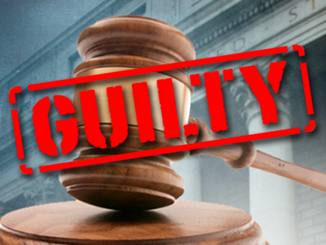
Conclusion
God says, “Vengeance is mine. I will repay” (Romans 12:19) because He can punish the guilty far better than any earthly court can!
James 4:6-10: God gives grace to the humble

Slide 16
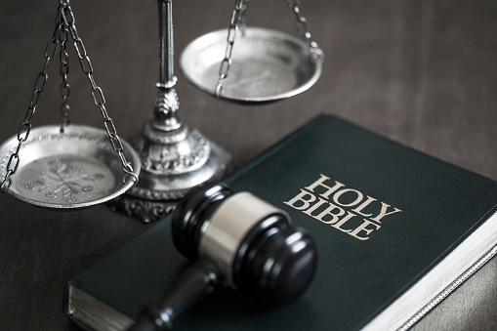
Conclusion
Let us be thankful for God’s judgments: Saints will one day be vindicated to the world as God exalts the humble (James 4:10) and punishes the wicked (Matthew 25:41, 46)!

Slide 17
“What Must I Do To Be Saved?”
Hear The Gospel (Jn. 5:24; Rom. 10:17)
Believe In Christ (Jn. 3:16-18; Jn. 8:24)
Repent Of Sins (Lk. 13:3-5; Acts 2:38)
Confess Christ (Mt. 10:32; Rom. 10:10)
Be Baptized (Mk. 16:16; Acts 22:16)
Remain Faithful (Jn. 8:31; Rev. 2:10)
For The Erring Saint:
Repent (Acts 8:22), Confess (I Jn. 1:9),
Pray (Acts 8:22)

