Slide 1
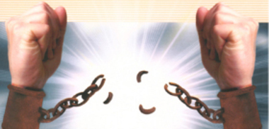
Out Of Bondage
Text:
Romans 6:16-23
Notes:
By Nathan L Morrison for Sunday 03/26/2023
All Scripture given is from NASB unless otherwise stated
For further study, or if questions, please Call: 804-277-1983 or Visit: www.courthousechurchofchrist.com
Adapted from a Social Media post by Zackary Olson

Slide 2
Intro
Ecclesiastes 1:9: “There is nothing new under the sun.”
History can be seen as cycles, where common themes are seen in different ways.
“History Repeats itself”

Slide 3
Intro
The Scriptures are full of stories of people in bondage and then freed from bondage…
Israel in the Exodus, the Israelites returning from Babylon, and Jews and Gentiles freed from the bondage of sin.
History is full of people in bondage and the celebration of being freed
From the captives of Egypt, Syria, Assyria, Babylon, the Persians, the Greeks, Romans, all the way to our own country.

Slide 4
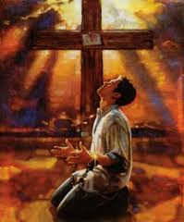
Intro
God wants men to be free…
He created man with free-will thinking
He wants men to serve Him from their hearts
He sent His Son, Jesus, to free mankind from the bondage of sin and to be free!

Slide 5
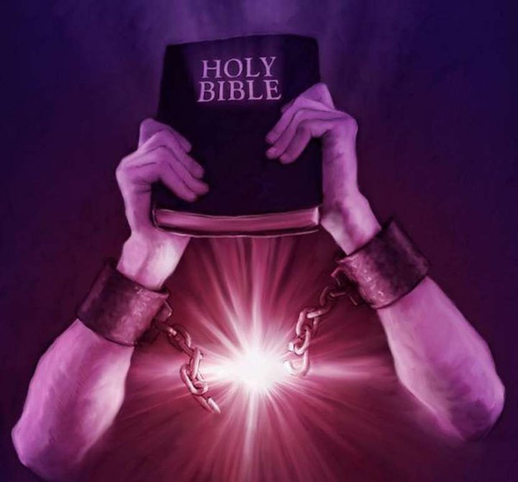
Intro
Christians have come out of bondage… don’t seek to go back into the world!

Slide 6
Hagar
Genesis 16:1-6
1. Now Sarai, Abram's wife had borne him no children, and she had an Egyptian maid whose name was Hagar.
2. So Sarai said to Abram, "Now behold, the LORD has prevented me from bearing children. Please go in to my maid; perhaps I will obtain children through her." And Abram listened to the voice of Sarai.
3. After Abram had lived ten years in the land of Canaan, Abram's wife Sarai took Hagar the Egyptian, her maid, and gave her to her husband Abram as his wife.
4. He went in to Hagar, and she conceived; and when she saw that she had conceived, her mistress was despised in her sight.
5. And Sarai said to Abram, "May the wrong done me be upon you. I gave my maid into your arms, but when she saw that she had conceived, I was despised in her sight. May the LORD judge between you and me."
6. But Abram said to Sarai, "Behold, your maid is in your power; do to her what is good in your sight." So Sarai treated her harshly, and she fled from her presence.

Slide 7
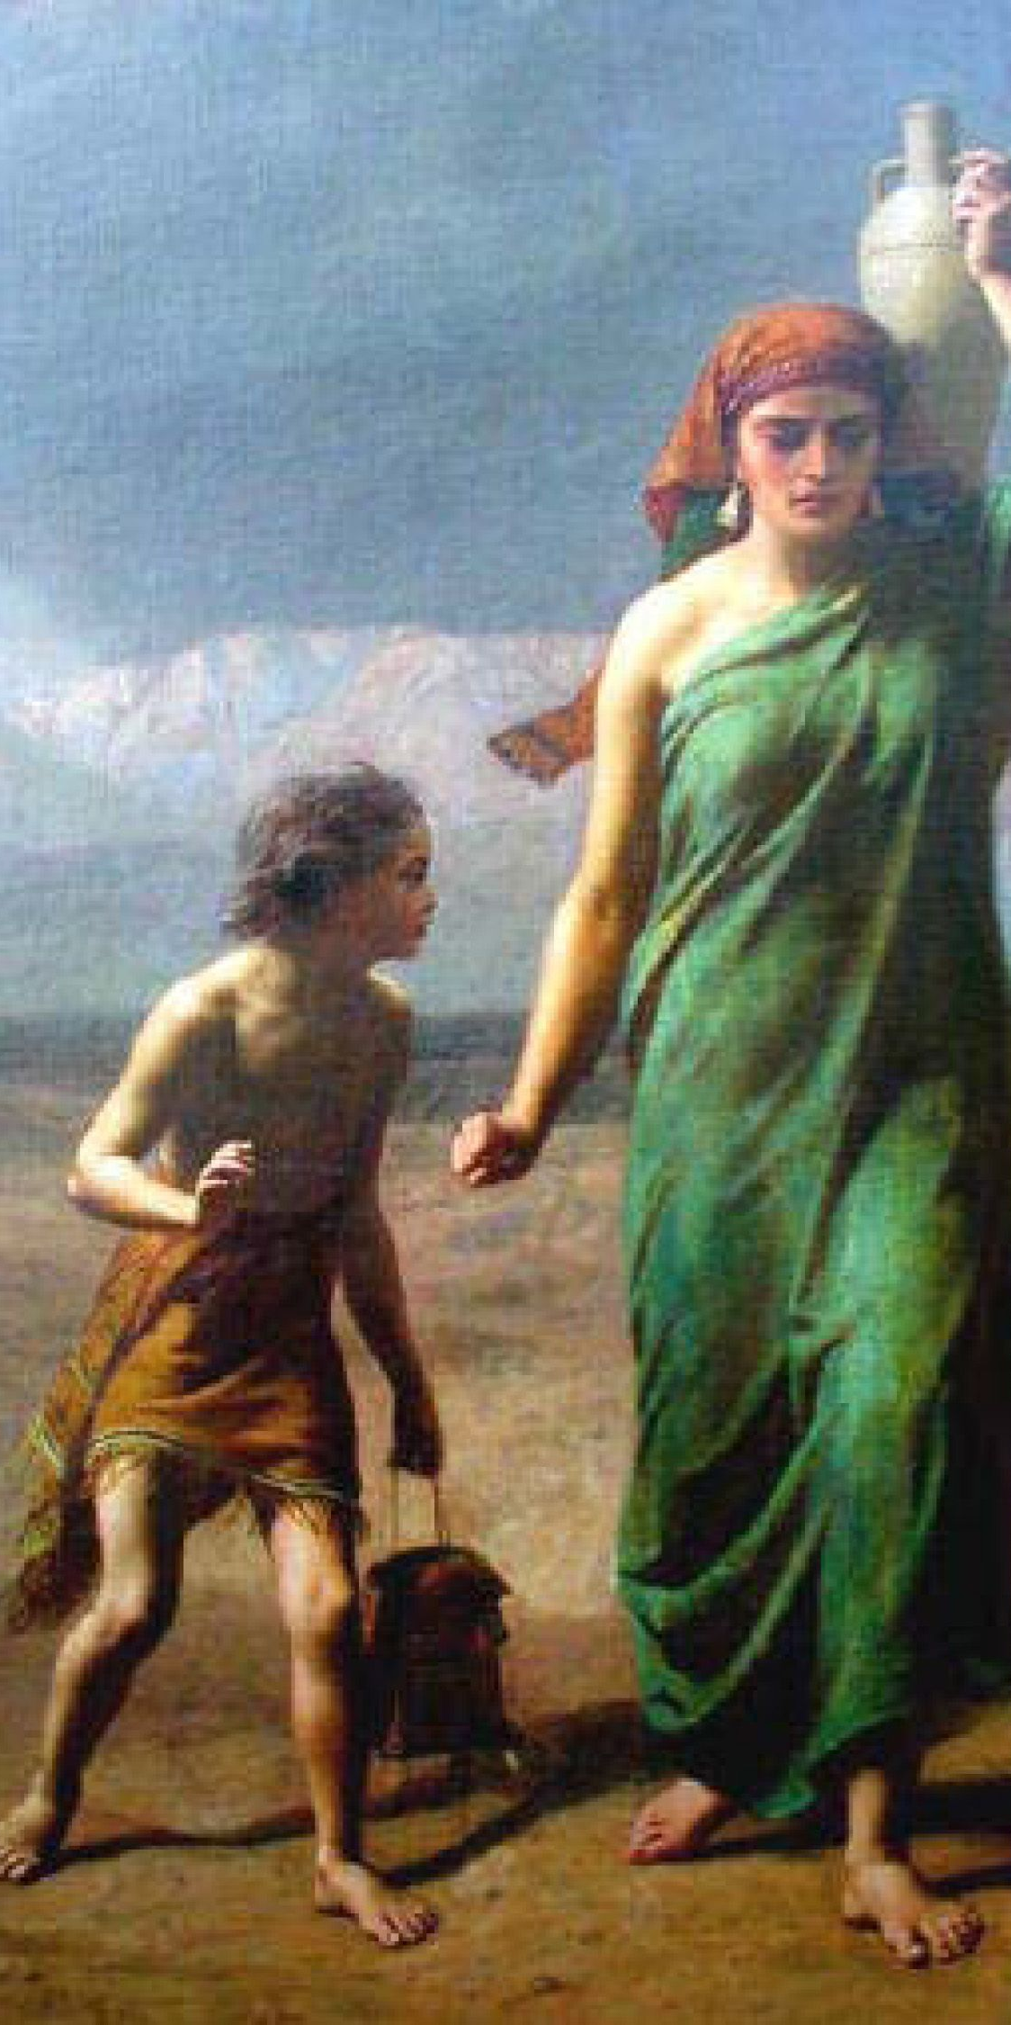
Hagar
The Hagar story prefigures the Exodus, only in reverse
An Egyptian is the slave of Abraham and Sarah, Semites (Genesis 16:1-4; Galatians 4:24-25).
She is used & mistreated because of envy (Genesis 16:4-6; 21:8-11).
God sees & hears her oppression (Genesis 16:7-11; 21:17).
God promises to make her son into a great nation (Genesis 16:10-14; 21:17-18).
He commands Abraham to let her go (Genesis 21:11-13).
Abraham sent Hagar out with bread & a single water bottle into the desert (Genesis 21:14).
Freed, she wanders through the wilderness and fears that she & her son will die until God provides water from the desert (Genesis 21:15-19).
God took care of Hagar and her son, Ishmael (Genesis 17:20; 21:20-21; 25:12-18).

Slide 8
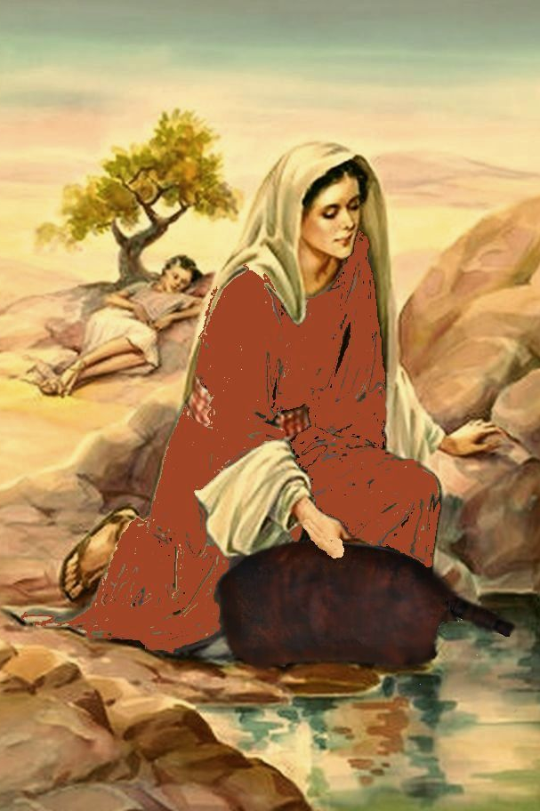
Hagar
Hagar came out of bondage to freedom and God cared for her & her son!

Slide 9
Israel
Exodus 3:6-10
6. He said also, "I am the God of your father, the God of Abraham, the God of Isaac, and the God of Jacob." Then Moses hid his face, for he was afraid to look at God.
7. The LORD said, "I have surely seen the affliction of My people who are in Egypt, and have given heed to their cry because of their taskmasters, for I am aware of their sufferings.
8. "So I have come down to deliver them from the power of the Egyptians, and to bring them up from that land to a good and spacious land, to a land flowing with milk and honey, to the place of the Canaanite and the Hittite and the Amorite and the Perizzite and the Hivite and the Jebusite.
9. "Now, behold, the cry of the sons of Israel has come to Me; furthermore, I have seen the oppression with which the Egyptians are oppressing them.
10. "Therefore, come now, and I will send you to Pharaoh, so that you may bring My people, the sons of Israel, out of Egypt."

Slide 10
Israel
The Exodus of Israel from Egypt parallels Hagar’s…
The sons of Israel become the slaves of the Egyptians (Exodus 1:8-14).
They are used & mistreated because of envy and fear (Exodus 1:9-10, 12; Psalm 105:24-25, 38).
God sees & hears their oppression (Exodus 3:6-9).
God had promised to make Abraham’s descendants into a great nation (Genesis 12:1-3; 22:18; Psalm 105:8-11).
God by Moses commands Pharoah to let Israel go (Exodus 3:10; Psalm 105:26-36).
The Egyptians send Israel away with rich gifts (Genesis 15:13-14; Exodus 3:19-22; 12:35-36; Psalm 105:37-38).
Freed, they wandered through the wilderness and feared that they would die until God provides water from the desert (Exodus 15:22-25) as well as manna (Exodus 16:1-4, 35) and quail (Numbers 11:4-6, 31-34; Psalm 105:40).
God took care of Israel and brought them to the Promised Land (Psalm 105:42-45).

Slide 11
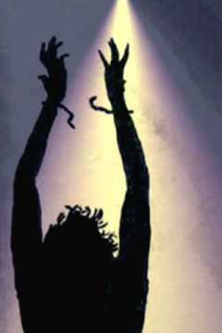
Israel
The sons of Israel came out of bondage to freedom and God cared for them & their sons!

Slide 12
Christians
Romans 6:16-23
16. Do you not know that when you present yourselves to someone as slaves for obedience, you are slaves of the one whom you obey, either of sin resulting in death, or of obedience resulting in righteousness?
17. But thanks be to God that though you were slaves of sin, you became obedient from the heart to that form of teaching to which you were committed,
18. and having been freed from sin, you became slaves of righteousness.
19. I am speaking in human terms because of the weakness of your flesh. For just as you presented your members as slaves to impurity and to lawlessness, resulting in further lawlessness, so now present your members as slaves to righteousness, resulting in sanctification.
20. For when you were slaves of sin, you were free in regard to righteousness.
21. Therefore what benefit were you then deriving from the things of which you are now ashamed? For the outcome of those things is death.
22. But now having been freed from sin and enslaved to God, you derive your benefit, resulting in sanctification, and the outcome, eternal life.
23. For the wages of sin is death, but the free gift of God is eternal life in Christ Jesus our Lord.

Slide 13
Christians
Becoming a Christian parallels the Hagar and Exodus story…
Sinners are slaves to sin, (Romans 6:16-18, 20; Titus 3:3; II Peter 2:18-19).
Jesus freed mankind from their sins (John 3:16) so obedience to Jesus makes one free from sin and a slave to righteousness (Romans 6:16-23).
The world will hate, abuse and persecute Christians (Luke 6:22; 21:16-17; John 15:18; 17:14).
God sees the oppression of His people (Acts 7:54-60; II Thessalonians 1:5-10).
Through Jesus saints enter the family of God and become fellow heirs with Jesus (Romans 8:14-17; II Corinthians 6:14-18).
Freed from sin, Jesus gave gifts to saints to get them through life (Ephesians 4:11-13; I Thessalonians 4:13-18; Revelation 2:10; 14:13).
He has provided the Bread and Water of Life (John 4:13-14; 6:35).
Jesus has provided the hope of Heaven, the home of God Almighty! (Matthew 6:25-33; John 14:1-6; Revelation 14:13; 21:3-7).

Slide 14
Christians
Christians have come out of bondage of sin to freedom in Jesus, and God cares for us and has prepared His home for us to live with Him forever!

Slide 15
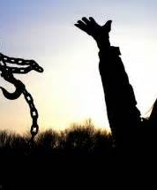
Conclusion
God wants men to be free…
He created man with free-will thinking
He wants men to serve Him from their hearts
He sent His Son, Jesus, to free mankind from the bondage of sin and to be free!

Slide 16
Conclusion
I Peter 2:9-10
But you are A CHOSEN RACE, A royal PRIESTHOOD, A HOLY NATION, A PEOPLE FOR God's OWN POSSESSION, so that you may proclaim the excellencies of Him who has called you out of darkness into His marvelous light; for you once were NOT A PEOPLE, but now you are THE PEOPLE OF GOD; you had NOT RECEIVED MERCY, but now you have RECEIVED MERCY.

Slide 17
Conclusion
Hebrews 11:13-16
13. All these died in faith, without receiving the promises, but having seen them and having welcomed them from a distance, and having confessed that they were strangers and exiles on the earth.
14. For those who say such things make it clear that they are seeking a country of their own.
15. And indeed if they had been thinking of that country from which they went out, they would have had opportunity desire a better country, that is, a heavenly one. Therefore God is not ashamed to be called their Godto return.
16. But as it is, they ; for He has prepared a city for them.

Slide 18
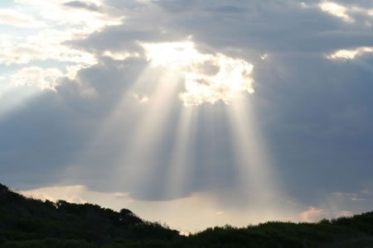
Conclusion
Jesus said once you take hold of the plow don’t look back! (Luke 9:62)
In Hagar, Israel’s Exodus, and our story as Christians we can see that no matter how much time has passed, God fulfills His promises!

Slide 19
Christians have come out of bondage to sin to freedom in Jesus Christ – Don’t look back!
Be fruitful for the Kingdom of Christ!

Slide 20
“What Must I Do To Be Saved?”
Hear The Gospel (Jn. 5:24; Rom. 10:17)
Believe In Christ (Jn. 3:16-18; Jn. 8:24)
Repent Of Sins (Lk. 13:3-5; Acts 2:38)
Confess Christ (Mt. 10:32; Rom. 10:10)
Be Baptized (Mk. 16:16; Acts 22:16)
Remain Faithful (Jn. 8:31; Rev. 2:10)
For The Erring Saint:
Repent (Acts 8:22), Confess (I Jn. 1:9),
Pray (Acts 8:22)

