Slide 1
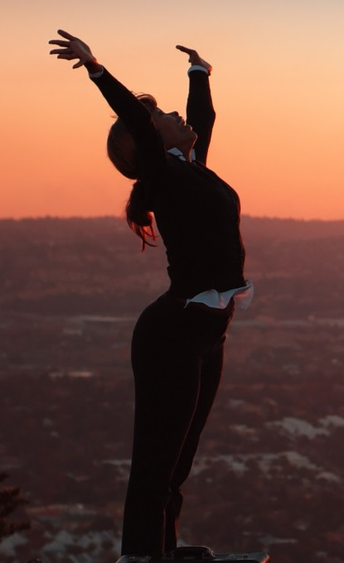
Joyful, Joyful! Text: Jude 24-25
Notes:
By Nathan L Morrison for Sunday March 12, 2023
All Scripture given is from NASB unless otherwise stated
For further study, or if questions, please Call: 804-277-1983 or Visit www.courthousechurchofchrist.com
Hymn: “Joyful, Joyful, We Adore Thee” (1907) by Henry Jackson VanDyke (1852-1933)

Slide 2
Intro
Jude 24-25
24. Now to Him who is able to keep you from stumbling, and to make you stand in the presence of His glory blameless with great joy,
25. to the only God our Savior, through Jesus Christ our Lord, be glory, majesty, dominion and authority, before all time and now and forever. Amen.

Slide 3
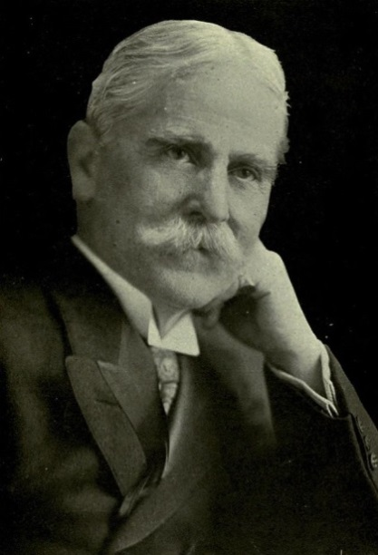
Intro
Henry Jackson VanDyke (1852-1933)
“Joyful, Joyful, We Adore Thee” (1907)
A Presbyterian preacher and professor of English literature at Princeton University.
An author of many books, including “The Other Wise Man” (1896).
Wrote the text of the hymn in 1907 while guest-speaking at Williams College and set it to the music of Beethoven’s 9th Symphony’s “Ode to Joy” (aka “Hymn to Joy”).
Notes:
Sources:
https://hymnstudiesblog.wordpress.com/2008/09/04/quotjoyful-joyful-we-adore-theequot/ (Wayne S. Walker)
http://en.wikipedia.org/wiki/Henry_van_Dyke
Then Sings My Soul, p. 265, by Robert J Morgan

Slide 4
Intro
Saints are to “rejoice always” and this hymn reminds us of the joy found in knowing God!

Slide 5
God is Lord of Creation and the Hearts of Men
Joyful, Joyful, WE adore Thee!
Stanza 1:
“Joyful, joyful, we adore thee, God of glory, Lord of love; Hearts unfold like flowers before Thee, Opening to the sun above. Melt the clouds of sin and sadness; Drive the dark of doubt away; Giver of immortal gladness, Fill us with the light of day.”

Slide 6
God is Lord of Creation and the Hearts of Men
Malachi 4:2
2. "But for you who fear My name, the sun of righteousness will rise with healing in its wings; and you will go forth and skip about like calves from the stall.
Mark 12:30
II Peter. 1:5-11
Malachi 4:2
I John 1:5-7
John 8:12

Slide 7
God is Lord of Creation and the Hearts of Men
God is the Great I Am, the Creator of heaven and earth, and should be Lord of our hearts!

Slide 8
God Created and Upholds All Things
Joyful, Joyful, WE adore Thee! Stanza 2:
“All Thy works with joy surround Thee, Earth and heaven reflect Thy rays; Stars and angels sing around Thee, Center of unbroken praise. Field and forest, vale and mountain, Flowery meadow, flashing sea, Chanting bird, and flowing fountain Call us to rejoice in Thee.”

Slide 9
God Created and Upholds All Things
Psalm 145:10-12
10. All Your works shall give thanks to You, O LORD, And Your godly ones shall bless You.
11. They shall speak of the glory of Your kingdom And talk of Your power;
12. To make known to the sons of men Your mighty acts And the glory of the majesty of Your kingdom.
Psalm 145:10-12; 148
Romans 1:20
Psalm 19:1-4; 24:1-2
Hebrews 1:1-3; Colossians 1:15-17

Slide 10
God Created and Upholds All Things
God created, and the works of His mighty hand shout His praises!

Slide 11
God Blesses Man
Joyful, Joyful, WE adore Thee! Stanza 3:
“Thou art giving and forgiving, Ever blessing, ever blessed, Well-spring of the joy of living, Ocean-depth of happy rest! Thou our Father, Christ our brother, All who live in love are Thine; Teach us how to love each other, Lift us to the joy divine.”

Slide 12
God Blesses Man
I John 3:23-24
23. This is His commandment, that we believe in the name of His Son Jesus Christ, and love one another, just as He commanded us.
24. The one who keeps His commandments abides in Him, and He in him. We know by this that He abides in us, by the Spirit whom He has given us.
Psalm 103:8-14 Matthew 11:28-30
Luke 19:10
Ephesians 1:7
I John 3:23-24
John 13:34-35

Slide 13
God Blesses Man
God sent Christ to teach us how to love one another, and to forgive all of mankind their sins!

Slide 14
God Grants the Victory
Joyful, Joyful, WE adore Thee! Stanza 4:
“Mortals, join the mighty chorus Which the morning stars began; Father love is reigning o’er us, Brother love binds man to man. Ever singing, march we onward, Victors in the midst of strife; Joyful music leads us sunward In the triumph song of life.”

Slide 15
God Grants the Victory
I John 5:4
4. For whatever is born of God overcomes the world; and this is the victory that has overcome the world—our faith.
Job 38:4-7
Luke 19:40
Philippians 3:20
Romans 8:37-39
I John 5:4
I Peter 1:3-4

Slide 16
God Grants the Victory
God is the author of salvation and has provided a means to live with Him forever more!

Slide 17
Conclusion
God’s word has a lot to say about the importance of genuine joy in the life of each Christian
Life is filled with trials, heartaches, disappointments, tragedy and strife
With trust and hope in God we can see the beauty of life through the trials and storms of life, and we can certainly find many good aspects of life which should bring us joy
“Rejoice always”
I Thess. 5:16

Slide 18
Conclusion
It starts by remembering that every good gift comes from God (James 1:17)
If we abide in Christ and remain faithful we will “stand in the presence of His glory blameless with great joy!” (Jude 24)
“Every good thing given and every perfect gift is from above, coming down from the Father of lights, with whom there is no variation or shifting shadow”

Slide 19
Conclusion
Just as creation itself praises God (Psalm 148), may we ever express our praise to Him as we sing, “Joyful, Joyful, We Adore Thee!”

Slide 20
“What Must I Do To Be Saved?”
Hear The Gospel (Jn. 5:24; Rom. 10:17)
Believe In Christ (Jn. 3:16-18; Jn. 8:24)
Repent Of Sins (Lk. 13:3-5; Acts 2:38)
Confess Christ (Mt. 10:32; Rom. 10:10)
Be Baptized (Mk. 16:16; Acts 22:16)
Remain Faithful (Jn. 8:31; Rev. 2:10)
For The Erring Saint:
Repent (Acts 8:22), Confess (I Jn. 1:9),
Pray (Acts 8:22)

