Slide 1
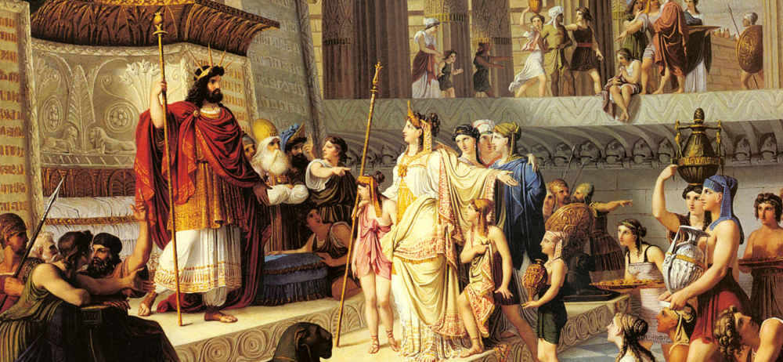
The Last King Of Judah
Text:
II Chronicles 36:11-16
Notes:
By Nathan L Morrison for Sunday 02/26/2023
All Scripture given is from NASB unless otherwise stated
For further study, or if questions, please Call: 804-277-1983 or Visit: www.courthousechurchofchrist.com

Slide 2
Intro
Romans 11:19-22
19. You will say then, “Branches were broken off so that I might be grafted in.”
20. Quite right, they were broken off for their unbelief, but you stand by your faith. Do not be conceited, but fear;
21. for if God did not spare the natural branches, He will not spare you, either.
22. Behold then the kindness and severity of God; to those who fell, severity, but to you, God's kindness, if you continue in His kindness; otherwise you also will be cut off.

Slide 3
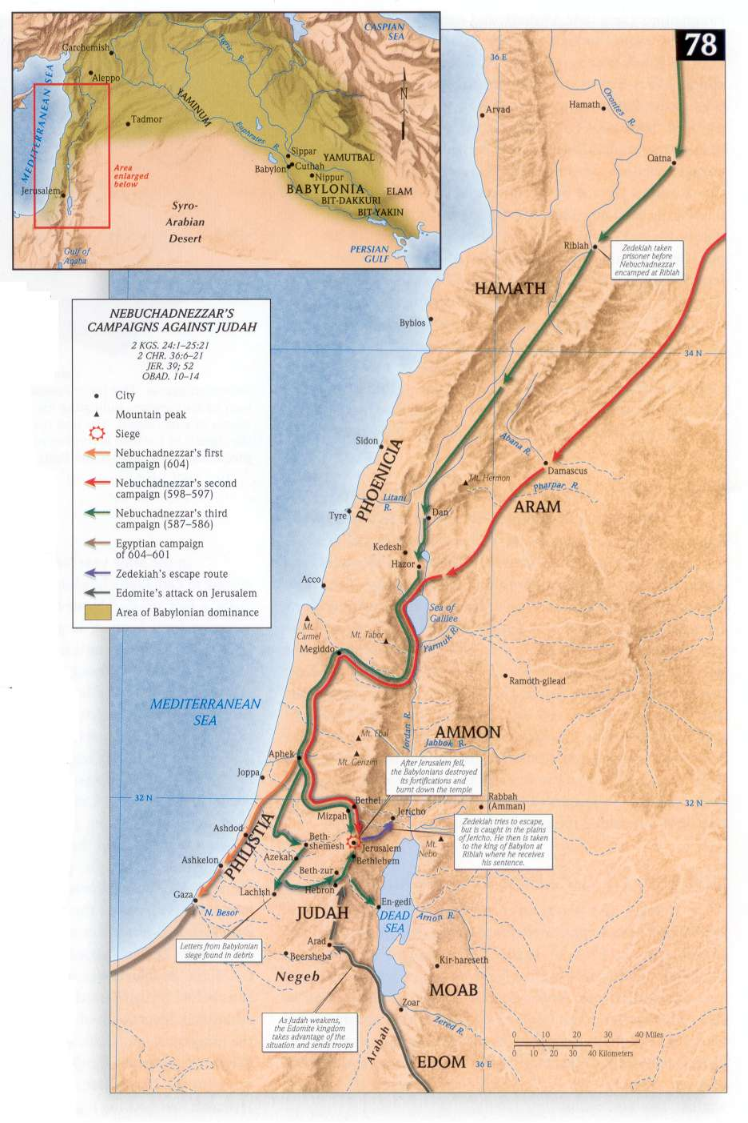
Intro
After King Josiah’s death, Judah’s last kings were a downhill ride of wickedness (II Chronicles 36:1-11)…
Jehoahaz (23 years old at ascension, reigned 3 months in 609 BC)
Jehoiakim (25 years old at ascension, reigned 11 years in 609-598 BC)
Jehoiachin (18 years old at ascension, reigned 3 months in 598: II Kings 24:8)
Zedekiah (21 years old at ascension, reigned 11 years in 597-586 BC)

Slide 4
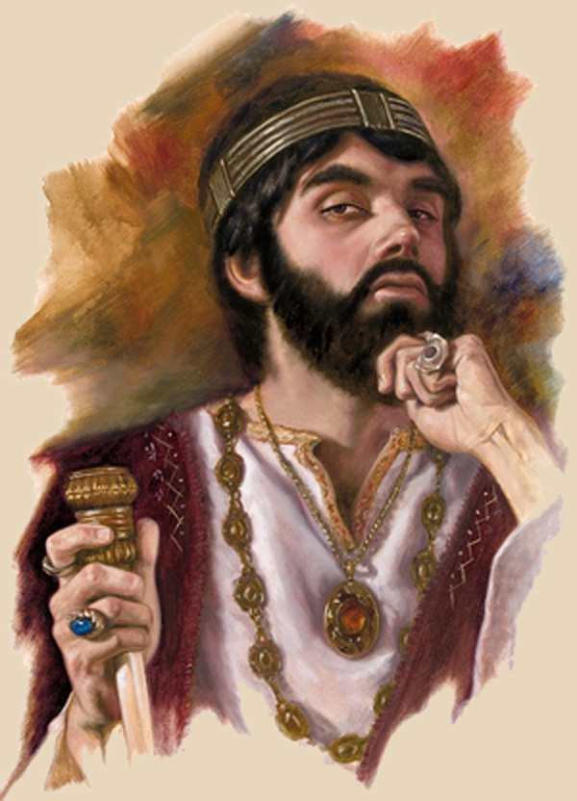
Intro
We want to focus on King Zedekiah: the man who should not have been king, the king fit for the people, the last king of Judah!

Slide 5
King Zedekiah
In the line of David
The 3rd son of King Josiah (should not be king)
He had two brothers and one nephew ahead of him!
He only became king because a foreign invader needed a puppet on the throne!
But with Jeremiah the prophet guiding him there was potential and a chance for greatness!
Notes:
King Zedekiah
Imagine the potential and honor of being the 3rd son to the king and against all odds becoming king! There should have been hope for Zedekiah.
A king in the line of David, with many righteous kings to be his example, including his father, King Josiah, of whom it was said, “Before him there was no king like him who turned to the LORD with all his heart and with all his soul and with all his might, according to all the law of Moses; nor did any like him arise after him” (II Kings 23:25).
He was the 3rd son of King Josiah so by all rights, Zedekiah should have never been king. He should really be one of those names in the genealogies of the kings in I Chronicles that nobody knows!
He had two brothers and one nephew ahead of him.
He only became king because a foreign invader needed a puppet on the throne!
But with Jeremiah the prophet guiding him there was potential and a chance for greatness!
Now, imagine having your entire existence summed up with these words:
“Zedekiah was twenty-one years old when he became king, and he reigned eleven years in Jerusalem. He did evil in the sight of the LORD his God; he did not humble himself before Jeremiah the prophet who spoke for the LORD. He also rebelled against King Nebuchadnezzar who had made him swear allegiance by God. But he stiffened his neck and hardened his heart against turning to the LORD God of Israel” (II Chronicles 36:11-13, NASU)
Zedekiah was a king fit for the people.
Time and time again he was given chances by God and by King Nebuchadnezzar, but he rebelled each time.
Zedekiah in many ways symbolizes the sins of the people over whom he reigned, reminding us that nations often get the leaders they deserve.
II Chronicles 36:14-16
King Nebuchadnezzar of Babylon installed him as king and forced him to take an oath of allegiance, swearing to never rebel against him.
For nine years, Jeremiah told Zedekiah to return to the Lord, stop worshipping idols, and make the people stop worshipping idols as well.
He told the king to remain faithful to Babylon and pay tribute. God would establish Zedekiah if he obeyed. Zedekiah refused.
The people refused…”until there was no remedy” (II Chron. 36:16)

Slide 6
King Zedekiah
II Chronicles 36:11-13
Zedekiah was twenty-one years old when he became king, and he reigned eleven years in Jerusalem. He did evil in the sight of the LORD his God; he did not humble himself before Jeremiah the prophet who spoke for the LORD. He also rebelled against King Nebuchadnezzar who had made him swear allegiance by God. But he stiffened his neck and hardened his heart against turning to the LORD God of Israel.

Slide 7
King Zedekiah
Zedekiah was a king fit for the people
Zedekiah in many ways symbolizes the sins of the people over whom he reigned, reminding us that nations often get the leaders they deserve!
Notes:
King Zedekiah
Imagine the potential and honor of being the 3rd son to the king and against all odds becoming king! There should have been hope for Zedekiah.
A king in the line of David, with many righteous kings to be his example, including his father, King Josiah, of whom it was said, “Before him there was no king like him who turned to the LORD with all his heart and with all his soul and with all his might, according to all the law of Moses; nor did any like him arise after him” (II Kings 23:25).
He was the 3rd son of King Josiah so by all rights, Zedekiah should have never been king. He should really be one of those names in the genealogies of the kings in I Chronicles that nobody knows!
He had two brothers and one nephew ahead of him.
He only became king because a foreign invader needed a puppet on the throne!
But with Jeremiah the prophet guiding him there was potential and a chance for greatness!
Now, imagine having your entire existence summed up with these words:
“Zedekiah was twenty-one years old when he became king, and he reigned eleven years in Jerusalem. He did evil in the sight of the LORD his God; he did not humble himself before Jeremiah the prophet who spoke for the LORD. He also rebelled against King Nebuchadnezzar who had made him swear allegiance by God. But he stiffened his neck and hardened his heart against turning to the LORD God of Israel” (II Chronicles 36:11-13, NASU)
Zedekiah was a king fit for the people.
Time and time again he was given chances by God and by King Nebuchadnezzar, but he rebelled each time.
Zedekiah in many ways symbolizes the sins of the people over whom he reigned, reminding us that nations often get the leaders they deserve.
II Chronicles 36:14-16
King Nebuchadnezzar of Babylon installed him as king and forced him to take an oath of allegiance, swearing to never rebel against him.
For nine years, Jeremiah told Zedekiah to return to the Lord, stop worshipping idols, and make the people stop worshipping idols as well.
He told the king to remain faithful to Babylon and pay tribute. God would establish Zedekiah if he obeyed. Zedekiah refused.
The people refused…”until there was no remedy” (II Chron. 36:16)

Slide 8
King Zedekiah
II Chronicles 36:14-16
Furthermore, all the officials of the priests and the people were very unfaithful following all the abominations of the nations; and they defiled the house of the LORD which He had sanctified in Jerusalem. The LORD, the God of their fathers, sent word to them again and again by His messengers, because He had compassion on His people and on His dwelling place; but they continually mocked the messengers of God, despised His words and scoffed at His prophets, until the wrath of the LORD arose against His people, until there was no remedy.

Slide 9
King Zedekiah
Warnings for saints today:
Romans 8:14-17; I Timothy 3:15
Ephesians 5:15-16
Hebrews 3:12-15
Notes:
King Zedekiah
Imagine the potential and honor of being the 3rd son to the king and against all odds becoming king! There should have been hope for Zedekiah.
A king in the line of David, with many righteous kings to be his example, including his father, King Josiah, of whom it was said, “Before him there was no king like him who turned to the LORD with all his heart and with all his soul and with all his might, according to all the law of Moses; nor did any like him arise after him” (II Kings 23:25).
He was the 3rd son of King Josiah so by all rights, Zedekiah should have never been king. He should really be one of those names in the genealogies of the kings in I Chronicles that nobody knows!
He had two brothers and one nephew ahead of him.
He only became king because a foreign invader needed a puppet on the throne!
But with Jeremiah the prophet guiding him there was potential and a chance for greatness!
Now, imagine having your entire existence summed up with these words:
“Zedekiah was twenty-one years old when he became king, and he reigned eleven years in Jerusalem. He did evil in the sight of the LORD his God; he did not humble himself before Jeremiah the prophet who spoke for the LORD. He also rebelled against King Nebuchadnezzar who had made him swear allegiance by God. But he stiffened his neck and hardened his heart against turning to the LORD God of Israel” (II Chronicles 36:11-13, NASU)
Zedekiah was a king fit for the people.
Time and time again he was given chances by God and by King Nebuchadnezzar, but he rebelled each time.
Zedekiah in many ways symbolizes the sins of the people over whom he reigned, reminding us that nations often get the leaders they deserve.
II Chronicles 36:14-16
King Nebuchadnezzar of Babylon installed him as king and forced him to take an oath of allegiance, swearing to never rebel against him.
For nine years, Jeremiah told Zedekiah to return to the Lord, stop worshipping idols, and make the people stop worshipping idols as well.
He told the king to remain faithful to Babylon and pay tribute. God would establish Zedekiah if he obeyed. Zedekiah refused.
The people refused…”until there was no remedy” (II Chron. 36:16)
Warnings for Christians today:
Romans 8:14-17; I Timothy 3:15: There is honor in being a child of God, a member of God’s household, which is the church.
The apostle Paul wrote, “Therefore be careful how you walk, not as unwise men but as wise, making the most of your time (NKJ: “redeeming”), because the days are evil” (Ephesians 5:15-16).
Hebrews 3:12-15:
Take care, brethren, that there not be in any one of you an evil, unbelieving heart that falls away from the living God. But encourage one another day after day, as long as it is still called “Today,” so that none of you will be hardened by the deceitfulness of sin. For we have become partakers of Christ, if we hold fast the beginning of our assurance firm until the end, while it is said, “TODAY IF YOU HEAR HIS VOICE, DO NOT HARDEN YOUR HEARTS, AS WHEN THEY PROVOKED ME.”

Slide 10
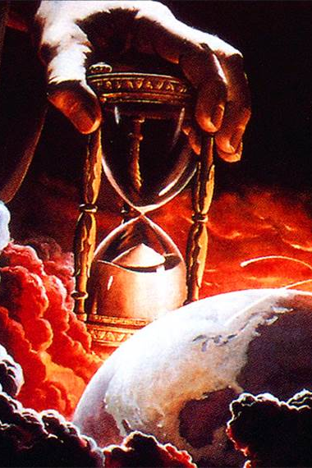
King Zedekiah
How do you want to be remembered?
Zedekiah will always be remembered as the king who let Judah fall. You can be remembered as a righteous child of God or as one who fell away!

Slide 11
King Zedekiah’s Failings
Idolatry (II Chron. 36:11-14)
Warnings for Christians today:
Colossians 3:5, Ephesians 5:3
Notes:
King Zedekiah
King Zedekiah’s Failings
Idolatry: II Chronicles 36:11-14
Zedekiah didn’t turn to God, but kept right on doing the evil things his brothers did.
The people went along with it and “were very unfaithful following all the abominations of the nations; and they defiled the house of the LORD which He had sanctified in Jerusalem” (36:14).
Note: They still worshiped in the Temple, but the wrong gods.
Warnings for Christians today:
Be honest about our own idolatry.
The people of Judah thought they could mix worshipping other gods with YHWH, God Almighty. They were wrong.
That hasn’t changed. Our worship of other things in this world (idols of time, money, popularity, power, greed, self) will cause our soul to be cast off (Romans 11:22).
Paul explicitly mentions greed as idolatry, warning to not give in to that temptation (Colossians 3:5, Ephesians 5:3).
Trusted the wrong people:
In the 4th year of Zedekiah’s reign, Jeremiah warned Zedekiah and the kings of the surrounding nations not to rebel against Nebuchadnezzar, but to “put their necks under his yoke” (Jeremiah 21, 27): surrender to Babylon.
Trusted people who God specifically forbade him to trust – Egypt.
First, he trusted envoys who encouraged him to rebel against Babylon and break his oath to Nebuchadnezzar (Ezekiel 17:11-21)
They sent an army to rescue them from Babylon but God said it would fail (Jeremiah 37:5-10).
Pharaoh and Nebuchadnezzar clashed, and Pharaoh was crushed. The Egyptians fled back to Egypt, and the Babylonians returned to besiege Jerusalem. Zedekiah could find no one to deliver the Jews now. He had been discontent with God’s plan for him and wanted more. Now he was in danger of losing what he had.
Trusted false prophets saying what he wanted to hear (Jeremiah 27:14-15; 37:19): Told the people & king that captivity would last only 2 years.
Trusted the princes who were more concerned about themselves (Jeremiah 38:1-5): Asked to execute Jeremiah and the king gave consent
He said, “Behold, he is in your hands; for the king can do nothing against you” (Jer. 38:5)
He allowed them to put Jeremiah in a cistern to die. He later sent a servant to set him free. King Zedekiah’s mind changed with the wind.
Warnings for Christians today:
Be careful who your friends are!
We can be guilty of the same thing when we:
only listen to those who speak smooth things to us – We like!
reject those who correct and rebuke us – We avoid!
show favor only to those who agree with us – We seek out!
I Corinthians 15:33: “Do not be deceived: "Bad company corrupts good morals.”
Where do we go for help? Do we consider not only peoples’ technical skill but also their character?
Do we actively seek out faithful believers? Do we share our needs with them?
Whose voice do we listen to?
Feared the wrong things:
He struggled to hold onto his position in a conquered kingdom, serving at the whim of a foreign oppressor.
He would have been successful in his position had he simply followed God and done his job in serving the people. (Jeremiah 21:11-12)
We should strive to simply be servants and forget about any imagined “position” we might think we have attained.
We want people to respect our “office”, “experience”…
See Paul’s attitude (I Corinthians 3:5-9; II Corinthians 12:15: We are God’s fellow workers and serve to be spent for others)
In his lust for affirmation, he tried to please people as fickle as himself instead of pleasing an unchanging God.
There is no pleasing fickle people.
Just do what’s right!
He let the unfounded fears of his imagination stifle him from doing what he knew was right (Jeremiah 34:4; 38:19-20): Jeremiah pleaded with him to listen and obey God, but he refused (II Chronicles 36:12-13)
He should have been more afraid of God, and even Nebuchadnezzar, who God called, “My servant.”
Now I have given all these lands into the hand of Nebuchadnezzar king of Babylon, My servant, and I have given him also the wild animals of the field to serve him. (Jeremiah 27:6)
It will be, that the nation or the kingdom which will not serve him, Nebuchadnezzar king of Babylon, and which will not put its neck under the yoke of the king of Babylon, I will punish that nation with the sword, with famine and with pestilence," declares the LORD, "until I have destroyed it by his hand.” (Jeremiah 27:8)
Warnings for Christians today:
We often let the same kind of unfounded fears stop us from being the preachers, servants, husbands & wives, fathers & mothers, and brothers & sisters we ought to be!
We are to fear God and keep His commandments!
Ecclesiastes 12:13-14: Fear God & keep His commandments.
John 14:15: Love Jesus and keep His commands.
Matthew 10:28: Don’t fear men but fear God!

Slide 12
King Zedekiah’s Failings
Idolatry (II Chron. 36:11-14)
Trusted the wrong people (Ezek. 17:11-21; Jer. 27; 37; 38:1-5)
Warnings for Christians today:
I Corinthians 15:33
Notes:
King Zedekiah
King Zedekiah’s Failings
Idolatry: II Chronicles 36:11-14
Zedekiah didn’t turn to God, but kept right on doing the evil things his brothers did.
The people went along with it and “were very unfaithful following all the abominations of the nations; and they defiled the house of the LORD which He had sanctified in Jerusalem” (36:14).
Note: They still worshiped in the Temple, but the wrong gods.
Warnings for Christians today:
Be honest about our own idolatry.
The people of Judah thought they could mix worshipping other gods with YHWH, God Almighty. They were wrong.
That hasn’t changed. Our worship of other things in this world (idols of time, money, popularity, power, greed, self) will cause our soul to be cast off (Romans 11:22).
Paul explicitly mentions greed as idolatry, warning to not give in to that temptation (Colossians 3:5, Ephesians 5:3).
Trusted the wrong people:
In the 4th year of Zedekiah’s reign, Jeremiah warned Zedekiah and the kings of the surrounding nations not to rebel against Nebuchadnezzar, but to “put their necks under his yoke” (Jeremiah 21, 27): surrender to Babylon.
Trusted people who God specifically forbade him to trust – Egypt.
First, he trusted envoys who encouraged him to rebel against Babylon and break his oath to Nebuchadnezzar (Ezekiel 17:11-21)
They sent an army to rescue them from Babylon but God said it would fail (Jeremiah 37:5-10).
Pharaoh and Nebuchadnezzar clashed, and Pharaoh was crushed. The Egyptians fled back to Egypt, and the Babylonians returned to besiege Jerusalem. Zedekiah could find no one to deliver the Jews now. He had been discontent with God’s plan for him and wanted more. Now he was in danger of losing what he had.
Trusted false prophets saying what he wanted to hear (Jeremiah 27:14-15; 37:19): Told the people & king that captivity would last only 2 years.
Trusted the princes who were more concerned about themselves (Jeremiah 38:1-5): Asked to execute Jeremiah and the king gave consent
He said, “Behold, he is in your hands; for the king can do nothing against you” (Jer. 38:5)
He allowed them to put Jeremiah in a cistern to die. He later sent a servant to set him free. King Zedekiah’s mind changed with the wind.
Warnings for Christians today:
Be careful who your friends are!
We can be guilty of the same thing when we:
only listen to those who speak smooth things to us – We like!
reject those who correct and rebuke us – We avoid!
show favor only to those who agree with us – We seek out!
I Corinthians 15:33: “Do not be deceived: "Bad company corrupts good morals.”
Where do we go for help? Do we consider not only peoples’ technical skill but also their character?
Do we actively seek out faithful believers? Do we share our needs with them?
Whose voice do we listen to?
Feared the wrong things:
He struggled to hold onto his position in a conquered kingdom, serving at the whim of a foreign oppressor.
He would have been successful in his position had he simply followed God and done his job in serving the people. (Jeremiah 21:11-12)
We should strive to simply be servants and forget about any imagined “position” we might think we have attained.
We want people to respect our “office”, “experience”…
See Paul’s attitude (I Corinthians 3:5-9; II Corinthians 12:15: We are God’s fellow workers and serve to be spent for others)
In his lust for affirmation, he tried to please people as fickle as himself instead of pleasing an unchanging God.
There is no pleasing fickle people.
Just do what’s right!
He let the unfounded fears of his imagination stifle him from doing what he knew was right (Jeremiah 34:4; 38:19-20): Jeremiah pleaded with him to listen and obey God, but he refused (II Chronicles 36:12-13)
He should have been more afraid of God, and even Nebuchadnezzar, who God called, “My servant.”
Now I have given all these lands into the hand of Nebuchadnezzar king of Babylon, My servant, and I have given him also the wild animals of the field to serve him. (Jeremiah 27:6)
It will be, that the nation or the kingdom which will not serve him, Nebuchadnezzar king of Babylon, and which will not put its neck under the yoke of the king of Babylon, I will punish that nation with the sword, with famine and with pestilence," declares the LORD, "until I have destroyed it by his hand.” (Jeremiah 27:8)
Warnings for Christians today:
We often let the same kind of unfounded fears stop us from being the preachers, servants, husbands & wives, fathers & mothers, and brothers & sisters we ought to be!
We are to fear God and keep His commandments!
Ecclesiastes 12:13-14: Fear God & keep His commandments.
John 14:15: Love Jesus and keep His commands.
Matthew 10:28: Don’t fear men but fear God!

Slide 13
King Zedekiah’s Failings
Idolatry (II Chron. 36:11-14)
Trusted the wrong people (Ezek. 17:11-21; Jer. 27; 37; 38:1-5)
Feared the wrong things (Jer. 34:4; 38:19-20)
Warnings for Christians today:
Eccl. 12:13-14; John 14:15; Mt. 10:28
Notes:
King Zedekiah
King Zedekiah’s Failings
Idolatry: II Chronicles 36:11-14
Zedekiah didn’t turn to God, but kept right on doing the evil things his brothers did.
The people went along with it and “were very unfaithful following all the abominations of the nations; and they defiled the house of the LORD which He had sanctified in Jerusalem” (36:14).
Note: They still worshiped in the Temple, but the wrong gods.
Warnings for Christians today:
Be honest about our own idolatry.
The people of Judah thought they could mix worshipping other gods with YHWH, God Almighty. They were wrong.
That hasn’t changed. Our worship of other things in this world (idols of time, money, popularity, power, greed, self) will cause our soul to be cast off (Romans 11:22).
Paul explicitly mentions greed as idolatry, warning to not give in to that temptation (Colossians 3:5, Ephesians 5:3).
Trusted the wrong people:
In the 4th year of Zedekiah’s reign, Jeremiah warned Zedekiah and the kings of the surrounding nations not to rebel against Nebuchadnezzar, but to “put their necks under his yoke” (Jeremiah 21, 27): surrender to Babylon.
Trusted people who God specifically forbade him to trust – Egypt.
First, he trusted envoys who encouraged him to rebel against Babylon and break his oath to Nebuchadnezzar (Ezekiel 17:11-21)
They sent an army to rescue them from Babylon but God said it would fail (Jeremiah 37:5-10).
Pharaoh and Nebuchadnezzar clashed, and Pharaoh was crushed. The Egyptians fled back to Egypt, and the Babylonians returned to besiege Jerusalem. Zedekiah could find no one to deliver the Jews now. He had been discontent with God’s plan for him and wanted more. Now he was in danger of losing what he had.
Trusted false prophets saying what he wanted to hear (Jeremiah 27:14-15; 37:19): Told the people & king that captivity would last only 2 years.
Trusted the princes who were more concerned about themselves (Jeremiah 38:1-5): Asked to execute Jeremiah and the king gave consent
He said, “Behold, he is in your hands; for the king can do nothing against you” (Jer. 38:5)
He allowed them to put Jeremiah in a cistern to die. He later sent a servant to set him free. King Zedekiah’s mind changed with the wind.
Warnings for Christians today:
Be careful who your friends are!
We can be guilty of the same thing when we:
only listen to those who speak smooth things to us – We like!
reject those who correct and rebuke us – We avoid!
show favor only to those who agree with us – We seek out!
I Corinthians 15:33: “Do not be deceived: "Bad company corrupts good morals.”
Where do we go for help? Do we consider not only peoples’ technical skill but also their character?
Do we actively seek out faithful believers? Do we share our needs with them?
Whose voice do we listen to?
Feared the wrong things:
He struggled to hold onto his position in a conquered kingdom, serving at the whim of a foreign oppressor.
He would have been successful in his position had he simply followed God and done his job in serving the people. (Jeremiah 21:11-12)
We should strive to simply be servants and forget about any imagined “position” we might think we have attained.
We want people to respect our “office”, “experience”…
See Paul’s attitude (I Corinthians 3:5-9; II Corinthians 12:15: We are God’s fellow workers and serve to be spent for others)
In his lust for affirmation, he tried to please people as fickle as himself instead of pleasing an unchanging God.
There is no pleasing fickle people.
Just do what’s right!
He let the unfounded fears of his imagination stifle him from doing what he knew was right (Jeremiah 34:4; 38:19-20): Jeremiah pleaded with him to listen and obey God, but he refused (II Chronicles 36:12-13)
He should have been more afraid of God, and even Nebuchadnezzar, who God called, “My servant.”
Now I have given all these lands into the hand of Nebuchadnezzar king of Babylon, My servant, and I have given him also the wild animals of the field to serve him. (Jeremiah 27:6)
It will be, that the nation or the kingdom which will not serve him, Nebuchadnezzar king of Babylon, and which will not put its neck under the yoke of the king of Babylon, I will punish that nation with the sword, with famine and with pestilence," declares the LORD, "until I have destroyed it by his hand.” (Jeremiah 27:8)
Warnings for Christians today:
We often let the same kind of unfounded fears stop us from being the preachers, servants, husbands & wives, fathers & mothers, and brothers & sisters we ought to be!
We are to fear God and keep His commandments!
Ecclesiastes 12:13-14: Fear God & keep His commandments.
John 14:15: Love Jesus and keep His commands.
Matthew 10:28: Don’t fear men but fear God!

Slide 14
King Zedekiah’s Failings
Despite all his failings, Zedekiah had several opportunities to repent and change course.
Don’t let mistakes be what define you: As long as you have opportunity, repent and turn to God!

Slide 15
He Didn’t Listen to God
God spoke directly to Zedekiah through the prophet Jeremiah (God promised that if he surrendered to King Nebuchadnezzar, God would bless the king and keep him and his family from harm and the city would not burn! (Jeremiah 21:3-10; 34:1-7, 37:1-10)
Notes:
King Zedekiah
King Zedekiah’s Failings
He Didn’t Listen to God
God spoke directly to Zedekiah through the prophet Jeremiah.
Since the invasion of Babylon was an act of God for punishment, Zedekiah should submit to Nebuchadnezzar.
God promised that if he surrendered to King Nebuchadnezzar, God would bless the king and keep him and his family from harm and the city would not burn! (Jeremiah 21:3-10; 34:1-7, 37:1-10).
Jeremiah was one of the few (if not the only) prophets that gave a message of doom.
All the other prophets (seeking to tell the king what he wanted to hear) repeatedly declared that since Israel was the people of God, Jehovah would deliver them… even if they didn’t give up their idols. This was the overwhelmingly popular message of Zedekiah’s day. They had idols, sure, but they still worshipped in the Temple. God was okay with that. Right? He was not! (Jeremiah 27-28)
At least four times, Zedekiah sought a word from Jeremiah (21:1-2; 37:3; 37:17-16; 38:14), each time expecting to hear something different than what God had already revealed to him.
He even asked Jeremiah to pray for them when the Babylonians besieged the city (Jeremiah 21:1-7) and when he was hoping Egypt would save them (Jeremiah 37:1-10)
Zedekiah visited with Jeremiah when he was imprisoned (Jeremiah 37:17) and when he was kept in the guardhouse and asked for a word from God (Jeremiah 38:14).
Jeremiah told him he wouldn’t listen to him and then told him the same message: Surrender to Babylon, he and his house will live, and the city wouldn’t be burned with fire (Jeremiah 38:14-28)
All the while King Zedekiah was trying to forge an alliance with surrounding nations to thwart God’s plan.
King Zedekiah didn’t listen to Jeremiah (II Chronicles 36:12; Jeremiah 37:1-2) and didn’t listen to the words from God!
Unwilling to obey the Lord (Jeremiah 38:17-28)
Zedekiah knew that Jeremiah was right. No one else had been faithful to him.
No one else knew the truth or had spoken it with courage as Jeremiah had.
Even when Zedekiah had been unfaithful to Jeremiah, the prophet remained faithful.
But despite Zedekiah’s realizations, he could not bring himself to obey God.
The opinions of his advisors, the military, and the leaders of the people were too strong. Zedekiah’s pride as king was too great.!
Warnings for Christians today:
Trusting and obeying God is a habit. The more we do it, the more we are able to do it in the future.
What challenges are we facing now? What must we do to trust and obey? What sins are holding us back from following the Lord? Do we provide good and faithful counsel to others? Are we available for them?
Sometimes we make up our mind and then try to get God to justify our will.
We could talk about institutionalism, or social gospel, or any other thing people add to the gospel because it makes them happy.
What about our desire for preeminence, our lack of compassion, our failure to evangelize, being lazy?
We must remember, as it says in James 4:6, that God resists the proud (I can handle this, I don’t need to change, I don’t have to listen, etc.) and gives grace to the humble (I trust in the Word of God, not in my own understanding, and obey him, even to death because I know He alone gives life and blessing).
This is how we speak the truth in love, communicating God’s heart amid His correction, calling the culture around us to repent unto the eternal abundance and joy of the Kingdom of God (Ephesians 4:15; Matthew 3:2).
Listen to God through His word; listen to God when you walk your own path and a brother or sister tries to turn you back! (James 5:19-20)

Slide 16
He Didn’t Listen to God
Jeremiah was one of the few (if not the only) prophets that gave a message of doom (Jeremiah 27-28)
At least four times, Zedekiah sought a word from Jeremiah (21:1-2; 37:3; 37:17-16; 38:14), each time expecting to hear something different than what God had already revealed to him!
Notes:
King Zedekiah
King Zedekiah’s Failings
He Didn’t Listen to God
God spoke directly to Zedekiah through the prophet Jeremiah.
Since the invasion of Babylon was an act of God for punishment, Zedekiah should submit to Nebuchadnezzar.
God promised that if he surrendered to King Nebuchadnezzar, God would bless the king and keep him and his family from harm and the city would not burn! (Jeremiah 21:3-10; 34:1-7, 37:1-10).
Jeremiah was one of the few (if not the only) prophets that gave a message of doom.
All the other prophets (seeking to tell the king what he wanted to hear) repeatedly declared that since Israel was the people of God, Jehovah would deliver them… even if they didn’t give up their idols. This was the overwhelmingly popular message of Zedekiah’s day. They had idols, sure, but they still worshipped in the Temple. God was okay with that. Right? He was not! (Jeremiah 27-28)
At least four times, Zedekiah sought a word from Jeremiah (21:1-2; 37:3; 37:17-16; 38:14), each time expecting to hear something different than what God had already revealed to him.
He even asked Jeremiah to pray for them when the Babylonians besieged the city (Jeremiah 21:1-7) and when he was hoping Egypt would save them (Jeremiah 37:1-10)
Zedekiah visited with Jeremiah when he was imprisoned (Jeremiah 37:17) and when he was kept in the guardhouse and asked for a word from God (Jeremiah 38:14).
Jeremiah told him he wouldn’t listen to him and then told him the same message: Surrender to Babylon, he and his house will live, and the city wouldn’t be burned with fire (Jeremiah 38:14-28)
All the while King Zedekiah was trying to forge an alliance with surrounding nations to thwart God’s plan.
King Zedekiah didn’t listen to Jeremiah (II Chronicles 36:12; Jeremiah 37:1-2) and didn’t listen to the words from God!
Unwilling to obey the Lord (Jeremiah 38:17-28)
Zedekiah knew that Jeremiah was right. No one else had been faithful to him.
No one else knew the truth or had spoken it with courage as Jeremiah had.
Even when Zedekiah had been unfaithful to Jeremiah, the prophet remained faithful.
But despite Zedekiah’s realizations, he could not bring himself to obey God.
The opinions of his advisors, the military, and the leaders of the people were too strong. Zedekiah’s pride as king was too great.!
Warnings for Christians today:
Trusting and obeying God is a habit. The more we do it, the more we are able to do it in the future.
What challenges are we facing now? What must we do to trust and obey? What sins are holding us back from following the Lord? Do we provide good and faithful counsel to others? Are we available for them?
Sometimes we make up our mind and then try to get God to justify our will.
We could talk about institutionalism, or social gospel, or any other thing people add to the gospel because it makes them happy.
What about our desire for preeminence, our lack of compassion, our failure to evangelize, being lazy?
We must remember, as it says in James 4:6, that God resists the proud (I can handle this, I don’t need to change, I don’t have to listen, etc.) and gives grace to the humble (I trust in the Word of God, not in my own understanding, and obey him, even to death because I know He alone gives life and blessing).
This is how we speak the truth in love, communicating God’s heart amid His correction, calling the culture around us to repent unto the eternal abundance and joy of the Kingdom of God (Ephesians 4:15; Matthew 3:2).
Listen to God through His word; listen to God when you walk your own path and a brother or sister tries to turn you back! (James 5:19-20)

Slide 17
He Didn’t Listen to God
All the while King Zedekiah was trying to forge an alliance with surrounding nations to thwart God’s plan
King Zedekiah didn’t listen to Jeremiah (II Chr. 36:12; Jeremiah 37:1-2) and didn’t listen to the words from God (Jer. 38:17-28)
Notes:
King Zedekiah
King Zedekiah’s Failings
He Didn’t Listen to God
God spoke directly to Zedekiah through the prophet Jeremiah.
Since the invasion of Babylon was an act of God for punishment, Zedekiah should submit to Nebuchadnezzar.
God promised that if he surrendered to King Nebuchadnezzar, God would bless the king and keep him and his family from harm and the city would not burn! (Jeremiah 21:3-10; 34:1-7, 37:1-10).
Jeremiah was one of the few (if not the only) prophets that gave a message of doom.
All the other prophets (seeking to tell the king what he wanted to hear) repeatedly declared that since Israel was the people of God, Jehovah would deliver them… even if they didn’t give up their idols. This was the overwhelmingly popular message of Zedekiah’s day. They had idols, sure, but they still worshipped in the Temple. God was okay with that. Right? He was not! (Jeremiah 27-28)
At least four times, Zedekiah sought a word from Jeremiah (21:1-2; 37:3; 37:17-16; 38:14), each time expecting to hear something different than what God had already revealed to him.
He even asked Jeremiah to pray for them when the Babylonians besieged the city (Jeremiah 21:1-7) and when he was hoping Egypt would save them (Jeremiah 37:1-10)
Zedekiah visited with Jeremiah when he was imprisoned (Jeremiah 37:17) and when he was kept in the guardhouse and asked for a word from God (Jeremiah 38:14).
Jeremiah told him he wouldn’t listen to him and then told him the same message: Surrender to Babylon, he and his house will live, and the city wouldn’t be burned with fire (Jeremiah 38:14-28)
All the while King Zedekiah was trying to forge an alliance with surrounding nations to thwart God’s plan.
King Zedekiah didn’t listen to Jeremiah (II Chronicles 36:12; Jeremiah 37:1-2) and didn’t listen to the words from God!
Unwilling to obey the Lord (Jeremiah 38:17-28)
Zedekiah knew that Jeremiah was right. No one else had been faithful to him.
No one else knew the truth or had spoken it with courage as Jeremiah had.
Even when Zedekiah had been unfaithful to Jeremiah, the prophet remained faithful.
But despite Zedekiah’s realizations, he could not bring himself to obey God.
The opinions of his advisors, the military, and the leaders of the people were too strong. Zedekiah’s pride as king was too great.!
Warnings for Christians today:
Trusting and obeying God is a habit. The more we do it, the more we are able to do it in the future.
What challenges are we facing now? What must we do to trust and obey? What sins are holding us back from following the Lord? Do we provide good and faithful counsel to others? Are we available for them?
Sometimes we make up our mind and then try to get God to justify our will.
We could talk about institutionalism, or social gospel, or any other thing people add to the gospel because it makes them happy.
What about our desire for preeminence, our lack of compassion, our failure to evangelize, being lazy?
We must remember, as it says in James 4:6, that God resists the proud (I can handle this, I don’t need to change, I don’t have to listen, etc.) and gives grace to the humble (I trust in the Word of God, not in my own understanding, and obey him, even to death because I know He alone gives life and blessing).
This is how we speak the truth in love, communicating God’s heart amid His correction, calling the culture around us to repent unto the eternal abundance and joy of the Kingdom of God (Ephesians 4:15; Matthew 3:2).
Listen to God through His word; listen to God when you walk your own path and a brother or sister tries to turn you back! (James 5:19-20)

Slide 18
He Didn’t Listen to God
Warnings for saints today:
James 4:6
Ephesians 4:15
Matthew 3:2
Notes:
He Didn’t Listen to God
God spoke directly to Zedekiah through the prophet Jeremiah.
Since the invasion of Babylon was an act of God for punishment, Zedekiah should submit to Nebuchadnezzar.
God promised that if he surrendered to King Nebuchadnezzar, God would bless the king and keep him and his family from harm and the city would not burn! (Jeremiah 21:3-10; 34:1-7, 37:1-10).
Jeremiah was one of the few (if not the only) prophets that gave a message of doom.
All the other prophets (seeking to tell the king what he wanted to hear) repeatedly declared that since Israel was the people of God, Jehovah would deliver them… even if they didn’t give up their idols. This was the overwhelmingly popular message of Zedekiah’s day. They had idols, sure, but they still worshipped in the Temple. God was okay with that. Right? He was not! (Jeremiah 27-28)
At least four times, Zedekiah sought a word from Jeremiah (21:1-2; 37:3; 37:17-16; 38:14), each time expecting to hear something different than what God had already revealed to him.
He even asked Jeremiah to pray for them when the Babylonians besieged the city (Jeremiah 21:1-7) and when he was hoping Egypt would save them (Jeremiah 37:1-10)
Zedekiah visited with Jeremiah when he was imprisoned (Jeremiah 37:17) and when he was kept in the guardhouse and asked for a word from God (Jeremiah 38:14).
Jeremiah told him he wouldn’t listen to him and then told him the same message: Surrender to Babylon, he and his house will live, and the city wouldn’t be burned with fire (Jeremiah 38:14-28)
All the while King Zedekiah was trying to forge an alliance with surrounding nations to thwart God’s plan.
King Zedekiah didn’t listen to Jeremiah (II Chronicles 36:12; Jeremiah 37:1-2) and didn’t listen to the words from God!
Unwilling to obey the Lord (Jeremiah 38:17-28)
Zedekiah knew that Jeremiah was right. No one else had been faithful to him.
No one else knew the truth or had spoken it with courage as Jeremiah had.
Even when Zedekiah had been unfaithful to Jeremiah, the prophet remained faithful.
But despite Zedekiah’s realizations, he could not bring himself to obey God.
The opinions of his advisors, the military, and the leaders of the people were too strong. Zedekiah’s pride as king was too great.!
Warnings for Christians today:
Trusting and obeying God is a habit. The more we do it, the more we are able to do it in the future.
What challenges are we facing now? What must we do to trust and obey? What sins are holding us back from following the Lord? Do we provide good and faithful counsel to others? Are we available for them?
Sometimes we make up our mind and then try to get God to justify our will.
We could talk about institutionalism, or social gospel, or any other thing people add to the gospel because it makes them happy.
What about our desire for preeminence, our lack of compassion, our failure to evangelize, being lazy?
We must remember, as it says in James 4:6, that God resists the proud (I can handle this, I don’t need to change, I don’t have to listen, etc.) and gives grace to the humble (I trust in the Word of God, not in my own understanding, and obey him, even to death because I know He alone gives life and blessing).
This is how we speak the truth in love, communicating God’s heart amid His correction, calling the culture around us to repent unto the eternal abundance and joy of the Kingdom of God (Ephesians 4:15; Matthew 3:2).
Listen to God through His word; listen to God when you walk your own path and a brother or sister tries to turn you back! (James 5:19-20)

Slide 19
He Didn’t Listen to God
Listen to God through His word; listen to God when you walk your own path and a brother or sister tries to turn you back! (James 5:19-20)

Slide 20
Conclusion
Jeremiah 39; 52
Judah was oppressed
Jerusalem captured, looted and burned
The people went away into captivity
The king and his soldiers fled the city and were captured and brought to King Nebuchadnezzar
He had Zedekiah’s sons killed before his eyes, and all the nobles of the court
Then they blinded his eyes
Zedekiah was chained and led to Babylon (Jeremiah 52:11)

Slide 21
Conclusion
What a tragic end to the last king of Judah, a man to whom God gave several chances to listen and obey!
The name Zedekiah will forever be linked to the destruction of Jerusalem, and the epitaph of “evil king” will always be his (Jeremiah 52:1-2)

Slide 22
Conclusion
While Zedekiah’s life is summed up by the inspired writers as an utter failure, God’s dealings with the evil king shine as a beacon from the midst of a tragedy!
God was patient
God is willing to forgive
God is faithful
God is just
Notes:
Conclusion
While Zedekiah’s life is summed up by the inspired writers as an utter failure, God’s dealings with the evil king shine as a beacon from the midst of a tragedy.
God was patient with Zedekiah and Judah.
Jeremiah spoke directly to Zedekiah at least six times, and the message never changed.
God tried everything, until there was no remedy (II Chronicles 36:16)
Speaking of the end of God’s patience with Jerusalem, Jeremiah said, “…till He finally cast them out from His presence” (NKJV: Jeremiah 52:3)
…and consider that the longsuffering of our Lord is salvation… (II Peter 3:15)
God is willing to forgive.
In spite of all their rebellion, God promised to forgive them, bring them back, and give them the Messiah (Jeremiah 33:4-9, 14-18)
“For You, Lord, are good, and ready to forgive, and abundant in mercy to all those who call upon You” (Psalms 86:5)
God is faithful.
God kept every promise He uttered by the mouth of Jeremiah (Jer. 52).
If we are faithless, He remains faithful; He cannot deny Himself (II Tim. 2:13)
God is just.
Judah received the punishment she deserved.
Zedekiah received the just reward of his disobedience.
“Do not be deceived, God is not mocked; for whatever a man sows, that he will also reap” (Galatians 6:7)

Slide 23
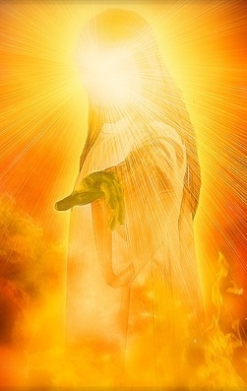
Conclusion
Jesus, the Son of God, the Messiah, the King of the Nations, now reigns at the right hand of God! (Acts 2:32-33, 36; Revelation 15:3)
Do you take the time God gives you to listen to the words of God and obey? To repent?
How will you be remembered?
For your righteousness?
For your wickedness?

Slide 24
Conclusion
Use the time you are given wisely: Repent and turn to God!

Slide 25
“What Must I Do To Be Saved?”
Hear The Gospel (Jn. 5:24; Rom. 10:17)
Believe In Christ (Jn. 3:16-18; Jn. 8:24)
Repent Of Sins (Lk. 13:3-5; Acts 2:38)
Confess Christ (Mt. 10:32; Rom. 10:10)
Be Baptized (Mk. 16:16; Acts 22:16)
Remain Faithful (Jn. 8:31; Rev. 2:10)
For The Erring Saint:
Repent (Acts 8:22), Confess (I Jn. 1:9),
Pray (Acts 8:22)

