Slide 1
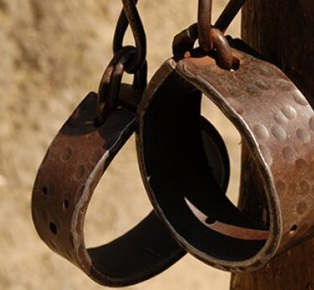
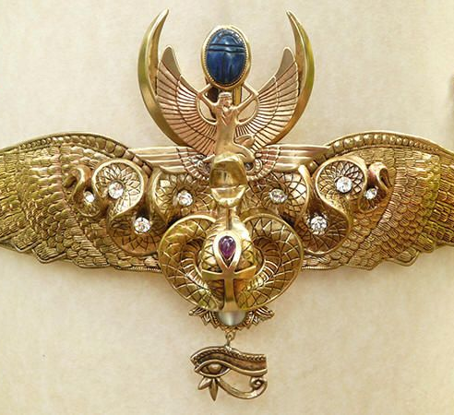
A Slave & A Princess
Text:
Exodus 2:1-10; Hebrews 11:23
Notes:
By Nathan L Morrison for Sunday 05/01/2022
All Scripture given is from NASB unless otherwise stated
For further study, or if questions, please Call: 804-277-1983 or Visit: www.courthousechurchofchrist.com
Adapted from Women Of The Bible by Ann Spangler & Jean E. Syswerda, pages 86-92

Slide 2
INTRO
The Month of May!
A time when we reflect on and honor our mothers
Mother’s Day is a special one-time event each year, but we should all honor our mothers on a daily basis – especially those who are faithful to God!

Slide 3
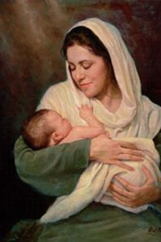
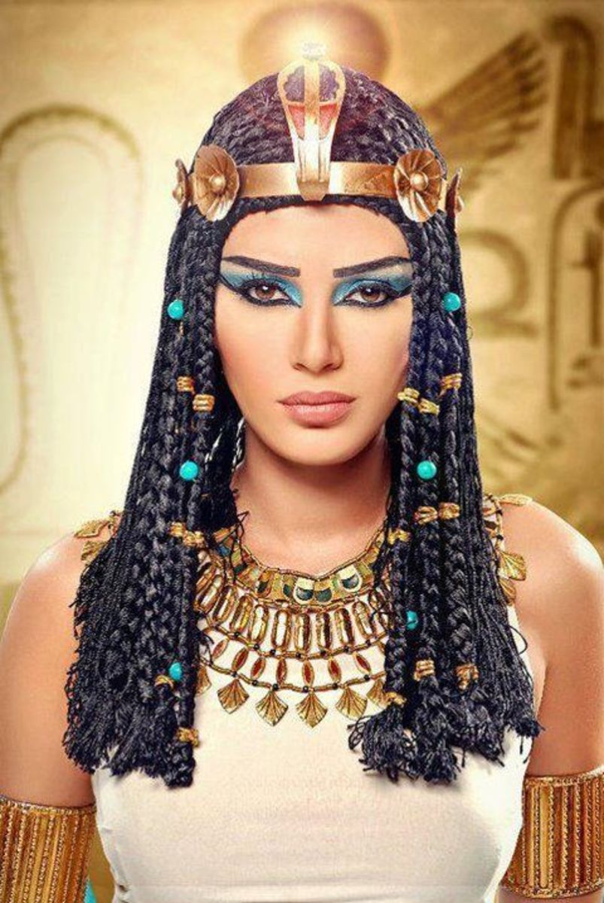
Intro
We will reflect on two mothers, one a slave, and the other a princess, but both preserved and raised a child who would become Israel’s deliverer and lawgiver!
Both women, one acting on faith, played a part in God’s grand plan to fulfill His promise to Abraham (Genesis 15:5-7, 13-16)
Mothers will do extraordinary things
for their children!

Slide 4
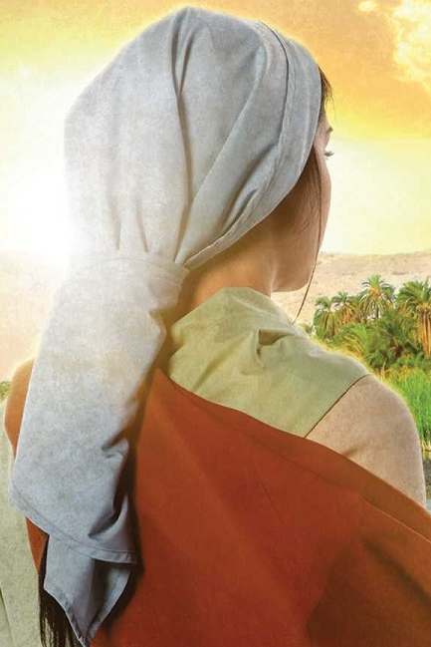
Jochebed
A Levite mother
Exodus 6:20; 2:1
The mother of Aaron, Miriam and Moses
Jochebed means: “The Lord Honors”
Her character: Her fierce love for her son and her faith in God enabled her to act heroically in the midst of great oppression!

Slide 5
Jochebed
Her Sorrow: To live in bondage as a slave
Her joy: God not only preserved the son she gave up to Him, but that He restored her child back to her.

Slide 6
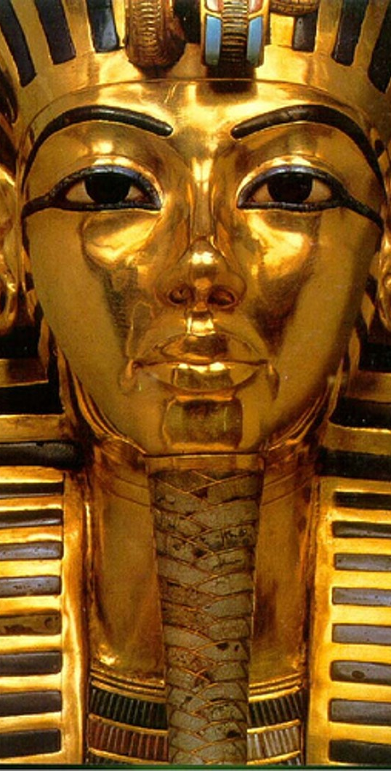
Jochebed
Background: Exodus 1:8-22
A new Pharaoh in Egypt didn’t know Joseph
He enslaved Israel but Israel grew stronger!
God had told Abraham this would happen (Genesis 15:13-14).
Pharaoh ordered the midwives to kill all the newborn males.
The midwives feared God and let the boys live, defying the king’s edict!
Pharaoh asked them why & they said Israelite women usually give birth before they arrive.
God blessed the midwives and their families and multiplied the Israelites in captivity!
Pharaoh, in anger, ordered that all newborn boys be drowned in the Nile River!

Slide 7
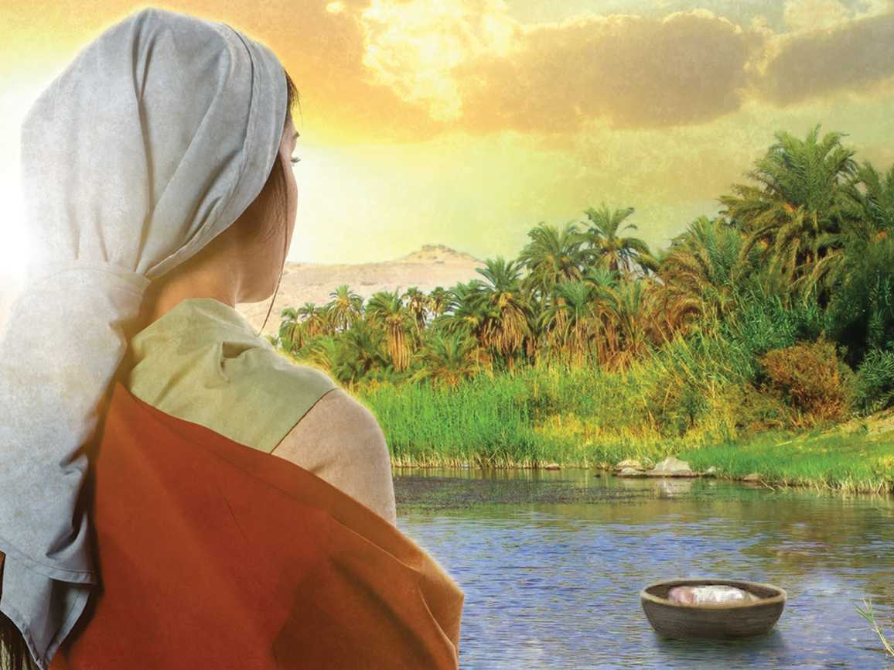
Jochebed
Her Faith: Exodus 2:1-4
1. Now a man from the house of Levi went and married a daughter of Levi.
2. The woman conceived and bore a son; and when she saw that he was beautiful, she hid him for three months.
3. But when she could hide him no longer, she got him a wicker basket and covered it over with tar and pitch. Then she put the child into it and set it among the reeds by the bank of the Nile.
4. His sister stood at a distance to find out what would happen to him.

Slide 8
Jochebed
Her Faith: Hebrews 11:23
23. By faith Moses, when he was born, was hidden for three months by his parents, because they saw he was a beautiful child; and they were not afraid of the king's edict.

Slide 9
Jochebed
Her Faith: Exodus 2:1-4; Hebrews 11:23
Baskets: Such an ordinary object that was used for such an extraordinary purpose!
Imagine the love that went into that basket!
God uses ordinary items, ordinary people, and ordinary events to bring about His will!
His older sister Miriam stood off at a distance to see what would happen to him!

Slide 10
Jochebed
Jochebed had no idea that her faith, in preserving her son, would ultimately lead to the deliverance and preserving of her people!

Slide 11
Pharaoh’s Daughter
Her character: She had compassion when she saw the Jewish boy floating in a basket in the Nile
Her Sorrow: Her adopted son, whom she had raised for 40 years, had to flee for his life to avoid Pharaoh’s wrath

Slide 12
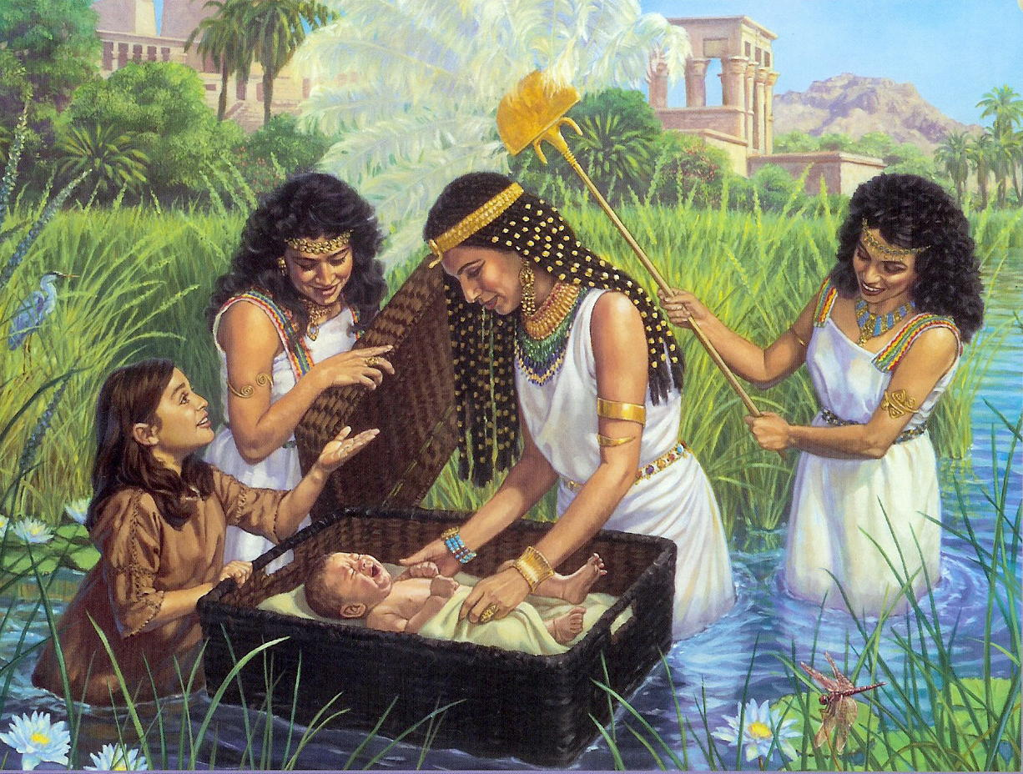
Pharaoh’s Daughter
Her Compassion: Exodus 2:5-10
5. The daughter of Pharaoh came down to bathe at the Nile, with her maidens walking alongside the Nile; and she saw the basket among the reeds and sent her maid, and she brought it to her.
6. When she opened it, she saw the child, and behold, the boy was crying. And she had pity on him and said, "This is one of the Hebrews' children."
7. Then his sister said to Pharaoh's daughter, "Shall I go and call a nurse for you from the Hebrew women that she may nurse the child for you?"
8. Pharaoh's daughter said to her, "Go ahead." So the girl went and called the child's mother.
9. Then Pharaoh's daughter said to her, "Take this child away and nurse him for me and I will give you your wages." So the woman took the child and nursed him.
10. The child grew, and she brought him to Pharaoh's daughter and he became her son. And she named him Moses, and said, "Because I drew him out of the water."

Slide 13
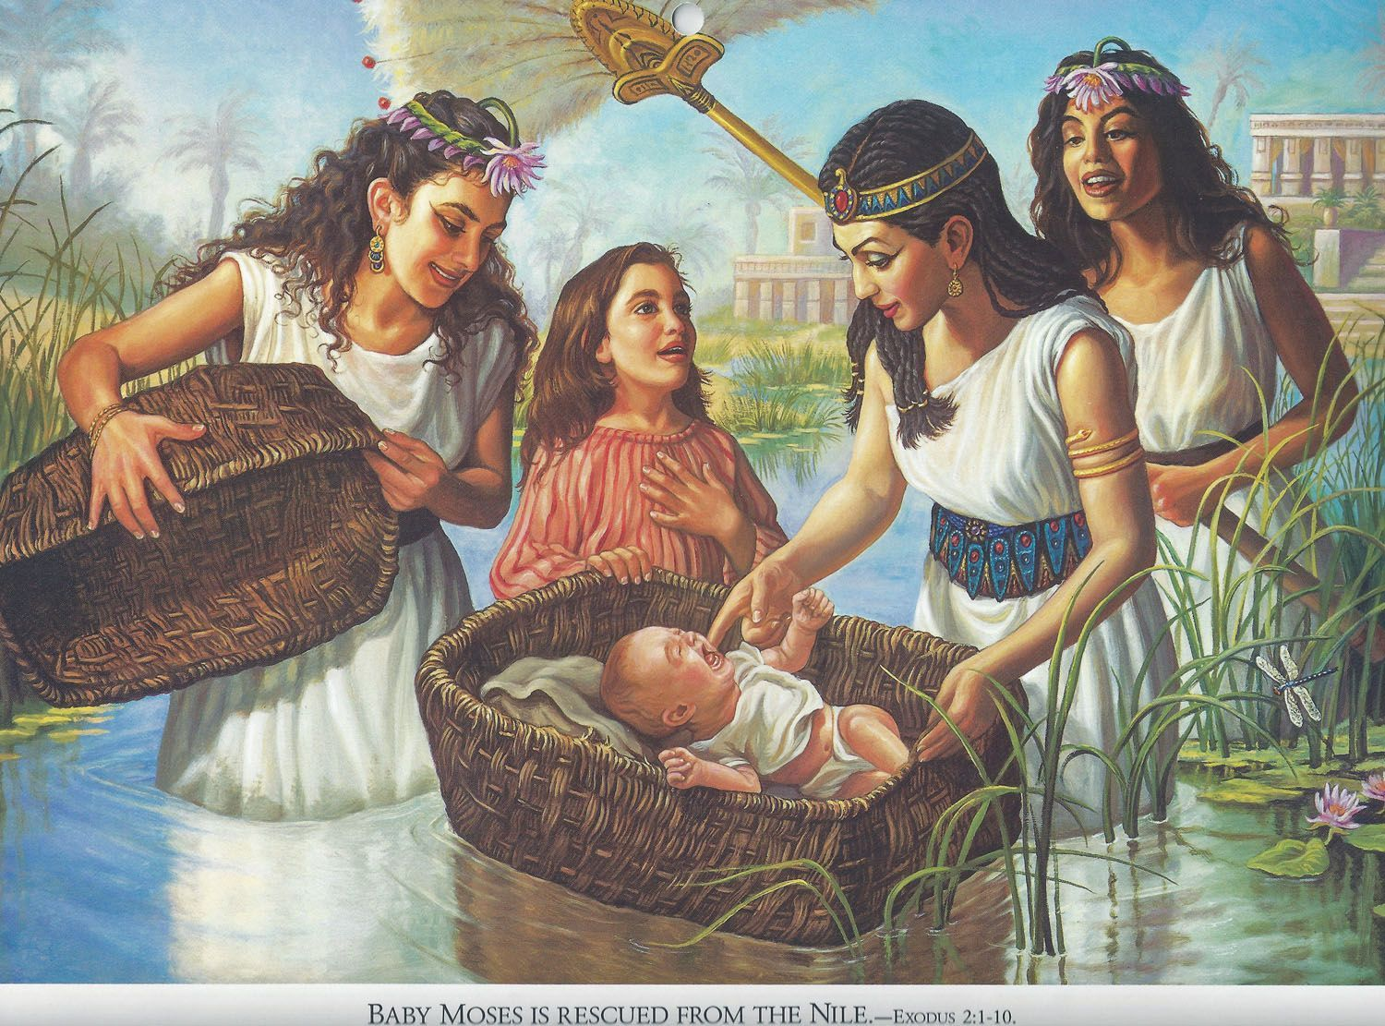
Pharaoh’s Daughter
For the next 40 years she educated him, a prince in the courts of Pharaoh himself
(Acts 7:21-22)

Slide 14
Pharaoh’s Daughter
Pharaoh’s daughter’s courage and compassion speaks volumes of her character, and in so doing, she helped fulfill God’s promise to Abraham)

Slide 15
Two Mothers Who Did the Extraordinary
God kept Moses safe during evil and dangerous times!
He used the Egyptians to protect and educate Moses in ways that made him an effective leader!
Jochebed was a mother who trusted in God, saved her baby, Moses (who she did not get to name!), and trained him to have faith in God.
She was a mother who was not only concerned about physical well-being but spiritual well-being!

Slide 16
Two Mothers Who Did the Extraordinary
Pharaoh’s daughter adopted a Hebrew boy, loved him and saw to his education, and protected him!
Pharaoh continually tried to destroy the Israelite strength, by enslaving them, ordering the boys to be executed by midwives in secret, and finally, he commanded the open extermination of all the Hebrew newborn males!

Slide 17
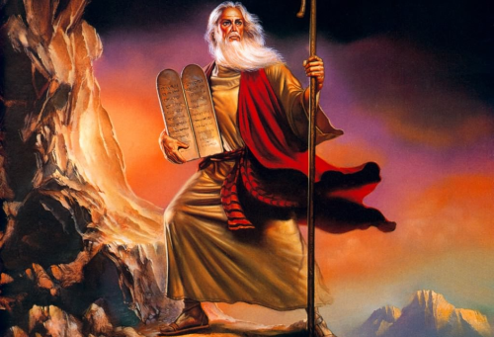
Two Mothers Who Did the Extraordinary
Moses is saved by Pharaoh’s own daughter.
The king’s efforts to destroy the strength of Israel is met with failure again and again.
That failure involved the efforts of women, whom Pharaoh did not consider a threat (he let the girls live), first by the midwives who feared God over the king, and then by Jochebed, a slave, and Pharaoh’s own daughter, a princess!

Slide 18
Two Mothers Who Did the Extraordinary
Two women, two mothers, a slave and a princess, preserved the life of Israel’s future deliverer and so preserved the entire Jewish people!

Slide 19
Conclusion
Mother’s Day
This Mother’s Day, reflect on your mothers, grandmothers, mothers-in-law, and mothers in the faith; those who have helped shape you into who you are today

Slide 20
Conclusion
Reflect on these two mothers of our study throughout the month of May as you consider the work of God in your own life!
Praise God that even the worst enemies and dangerous encounters in life are weak compared to the Mighty God we serve! (Romans 8:18)
Give thanks for God’s power to save (Romans 1:16)
Confess your own weaknesses, especially a failure to trust God for the lives of your children (James 5:16)
Ask God to give you opportunity to be an encouragement to another mother who is concerned about her children’s well-being, both physically & spiritually (Philippians 2:3-4)
Notes:
After 4th Point, Read The Reason Why
The Reason Why by Lisa Stevens, The Woodlands, Texas (Submitted to Reader’s Digest)
https://www.rd.com/article/mothers-day-short-stories/
I was rushed to the emergency room with complications from my high-risk pregnancy. After weeks of mandated bed rest in the hospital, I found myself suffering from an unfamiliar sadness. One day, my nurse brought a surprise to my room—a newborn named James.
James’ mom (who also experienced a high-risk pregnancy) sent her precious, healthy son for me to hold, along with an encouraging message: “This is the reason you are here in the hospital.” Three decades later, my heart is still full of gratitude for Baby James and his mom. And, I am thankful for my own healthy son, Hunter.

Slide 21
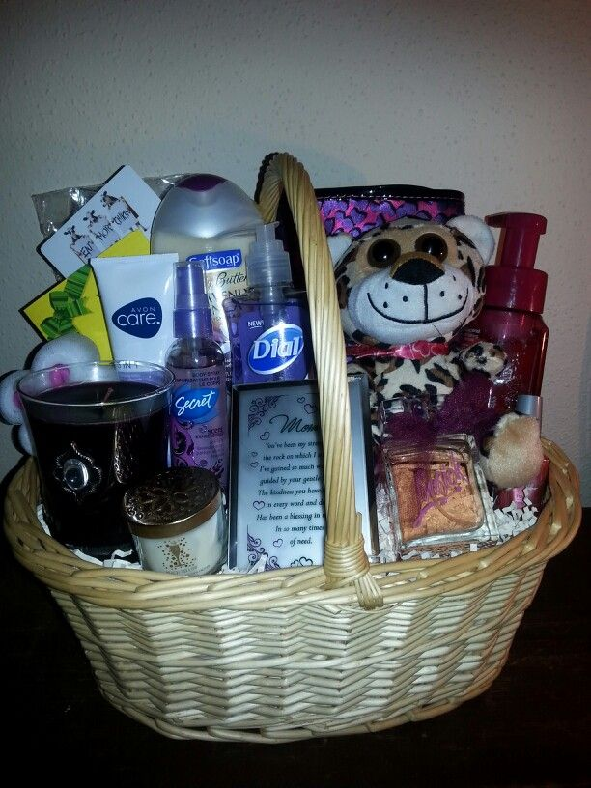
Conclusion
May Mother’s Day Challenge
As you keep these things from Exodus 2:1-10 in your mind as you pray and honor the mothers in your life, throughout the month of May make Mother’s Day last for a mother and her children of the “household of the faith” (Galatians 6:10).
God used a basket, an ordinary item, to do something extraordinary!
Look around the congregation for a mother who you want to encourage and let them know you love them and are thinking of them.
Use a Basket: Fill it with small gifts of your choice to brighten her day. Fill out a card with encouraging words from the Scriptures, and also let her know you will pray for her and each one of her family members by name for the next few weeks. You can sign it or keep it anonymous, your choice.

Slide 22
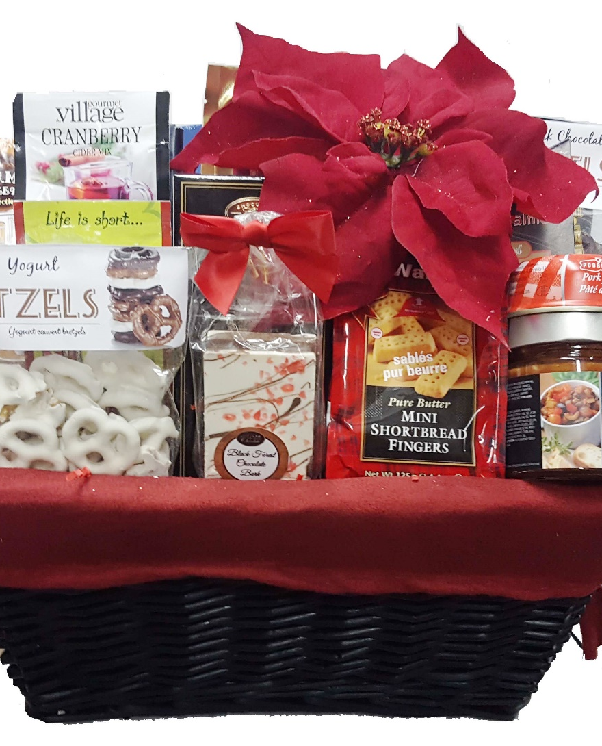
Conclusion
May Mother’s Day Challenge
Imagine the joy and encouragement you could bring to a sister in Christ and how you might use an ordinary object filled with ordinary items to brighten the day of a mother and her children!

Slide 23
Conclusion
God made a promise to Abraham to bring his descendants out of slavery from a foreign nation to Canaan (Genesis 15:13-14).
God used a basket, a slave and a princess to accomplish and fulfill that promise!
When you have faith in God and put it into action, God can turn the ordinary into the extraordinary!
Do you live your life “by faith?”
Put your faith into Action!
(Hebrews 11:23)

Slide 24
“What Must I Do To Be Saved?”
Hear The Gospel (Jn. 5:24; Rom. 10:17)
Believe In Christ (Jn. 3:16-18; Jn. 8:24)
Repent Of Sins (Lk. 13:3-5; Acts 2:38)
Confess Christ (Mt. 10:32; Rom. 10:10)
Be Baptized (Mk. 16:16; Acts 22:16)
Remain Faithful (Jn. 8:31; Rev. 2:10)
For The Erring Saint:
Repent (Acts 8:22), Confess (I Jn. 1:9),
Pray (Acts 8:22)

