Slide 1
Do Circumstances Cause Sin?
Do the Wrong Thing!
Do the Right Thing!
Text:
Philippians 4:11-13
Notes:
By Nathan L Morrison
All Scripture given is from NASB unless otherwise stated
For further study, or if questions, please Call: 804-277-1983 or Visit www.courthousechurchofchrist.com

Slide 2
Intro
Do our circumstances in life control us & cause us to sin, or do we choose to do right no matter our circumstances?
There have always been speculations on whether a good or bad environment makes us who we are
Are good circumstances the cause of faithfulness?
Are bad circumstances the cause of sin?
Notes:
Society today blames a lot on the home, the city, the school, and the friends people grow up with, even the color of one’s skin, to defend the crimes & sin people commit, or explain their blessings.
Movies have been made and stories have been told on role-reversals of good and bad people to see if the bad person in a good environment would turn good, and the good person in a bad environment would turn to crime.
Image: Trading Places (1983) Movie Poster, starring Dan Aykroyd & Eddie Murphy

Slide 3
Philippians 4:11-13
Intro
Not that I speak from want, for I have learned to be content in whatever circumstances I am.
I know how to get along with humble means, and I also know how to live in prosperity; in any and every circumstance I have learned the secret of being filled and going hungry, both of having abundance and suffering need.
I can do all things through Him who strengthens me.

Slide 4
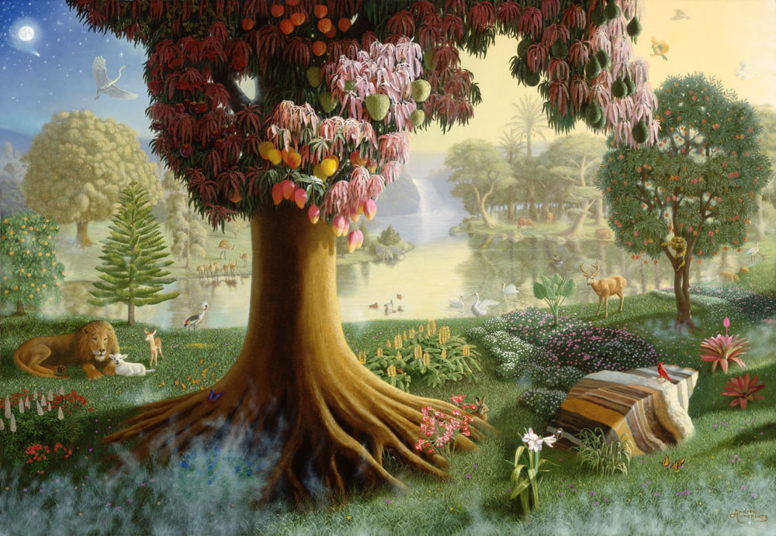
Is A Good Environment The Cause Of Faithfulness?
Adam & Eve
Sin or Faithful?
Genesis 2:8
Genesis 3:1-19
Genesis 3:6-7
SINNED!
Eden?

Slide 5
Is A Good Environment The Cause Of Faithfulness?
King Solomon
Sin or Faithful?
I Kings 10:23
I Kings 11:4
I Kings 11:4-10
SINNED!
Riches?

Slide 6
Is A Good Environment The Cause Of Faithfulness?
Young Son
Sin or Faithful?
Luke 15:22
Luke 15:11-13
SINNED!
Good Home?

Slide 7
Is A Good Environment The Cause Of Faithfulness?
Angels
Sin or Faithful?
II Peter 2:4
Jude 6
SINNED!
Heaven?

Slide 8
A good environment is not the solution to sin
Temptation and sin arises when one is not content and covets more! (James 1:14-15; 4:1-3)
Proverbs 30:15-16
Even under the best conditions man and angels have sinned
If one is foolish & rebellious, the best surroundings can still lead to sin (I Timothy 1:8-11)

Slide 9
Is A Bad Environment The Cause of Sin?
Joseph
Sin or Faithful?
Genesis 37:2-5, 8-11
Genesis 37:18-28
Genesis 39:11-20
Genesis 45:5-8
Faithful!
Slavery?

Slide 10
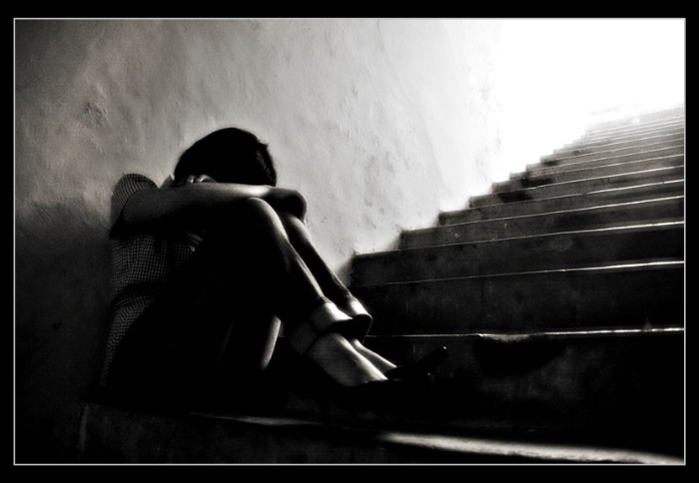
Is A Bad Environment The Cause of Sin?
Job
Sin or Faithful?
Job 1:8-11
Job 1:22
Job 2:9-10
Faithful!
Losing All?

Slide 11
Is A Bad Environment The Cause of Sin?
Jonathan
Sin or Faithful?
I Samuel 15:20-21
I Samuel 20:30-33
I Samuel 23:16-18
Faithful!
Bad Home?

Slide 12
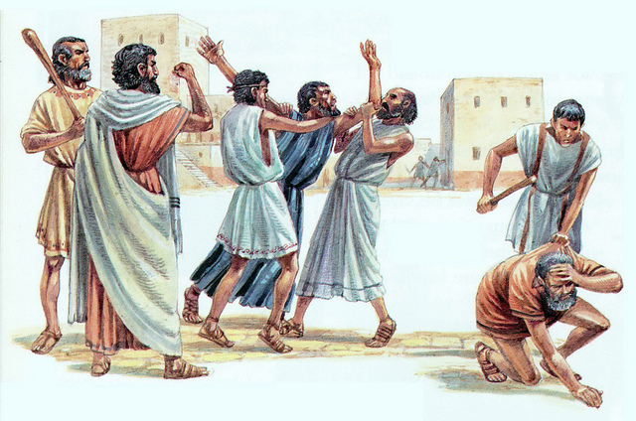
Is A Bad Environment The Cause of Sin?
Apostle Paul
Sin or Faithful?
Acts 14:19
II Corinthians 11:23-33
II Timothy 4:7-8
Faithful!
Stoned and Beaten?

Slide 13
Bad circumstances do not cause one to sin
Even under the worst conditions, we can keep ourselves from sin and remain faithful!
Revelation 2:13
Children of God still need the right attitudes:
Obedient – Rom. 6:17-18
Steadfast – Col. 1:21-23
Trusting – Prov. 3:5

Slide 14
Conclusion
Outward circumstances don’t determine if we sin or not but the inward state of mind!
Society may make excuses for the deeds of man, but there will be no excuses on the Day of Judgment – We will give an account for our own actions!

Slide 15
II Corinthians 5:10
Conclusion
For we must all appear before the judgment seat of Christ, so that each one may be recompensed for his deeds in the body, according to what he has done, whether good or bad.

Slide 16
Conclusion
We may not always be able to choose the environments we live in, but we do choose how we will live in them!
What about you?
In your current trials and storms of life, will you sin or stay faithful?

Slide 17
“What Must I Do To Be Saved?”
Hear The Gospel (Jn. 5:24; Rom. 10:17)
Believe In Christ (Jn. 3:16-18; Jn. 8:24)
Repent Of Sins (Lk. 13:3-5; Acts 2:38)
Confess Christ (Mt. 10:32; Rom. 10:10)
Be Baptized (Mk. 16:16; Acts 22:16)
Remain Faithful (Jn. 8:31; Rev. 2:10)
For The Erring Saint:
Repent (Acts 8:22), Confess (I Jn. 1:9),
Pray (Acts 8:22)

