Slide 1
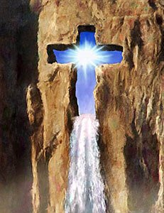
Jesus: Water From The Rock
Text:
I Corinthians 10:1-4
Notes:
By Nathan L Morrison
All Scripture given is from NASU unless otherwise stated
For further study, or if questions, please Call: 804-277-1983 or Visit: www.courthousechurchofchrist.com

Slide 2
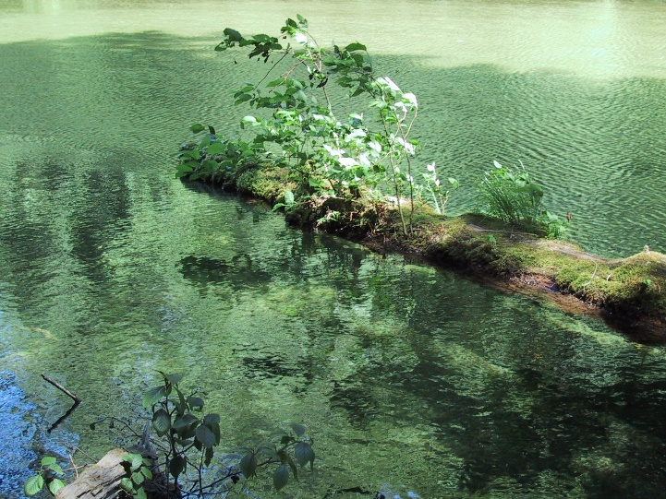
Intro
The O.T. is full of physical events that parallel spiritual things in the N.T.
The Israelites shortly after leaving Egypt and crossing the Red Sea:
Ex. 15:1-21: Song of deliverance for saving them from Egyptians.
Ex. 15:23-24: They couldn’t drink the waters at Marah because the water was bitter (thus, the name!)
Ex. 15:25: Following instructions from God, Moses threw a tree in the water and it became sweet to drink!

Slide 3
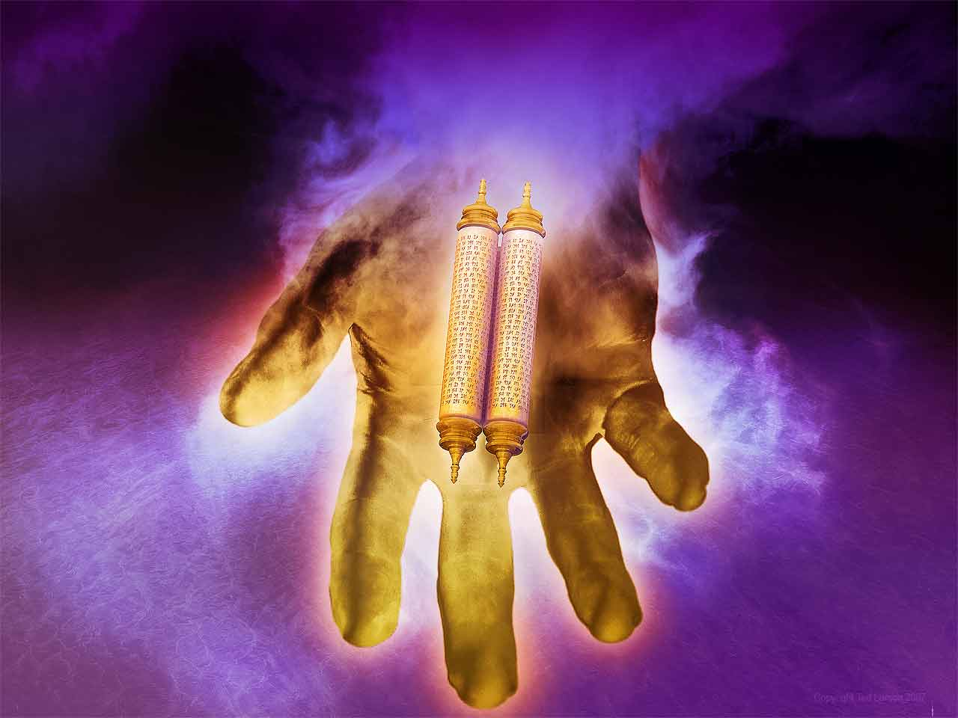
intro
God said He would be their “Healer” and keep them from the diseases on Egypt if they would:
Give heed to His voice
Do what is right in His sight
Give ear to His commands
Keep all His statutes
Exodus 15:26
And He said, "If you will give earnest heed to the voice of the LORD your God, and do what is right in His sight, and give ear to His commandments, and keep all His statutes, I will put none of the diseases on you which I have put on the Egyptians; for I, the LORD, am your healer."

Slide 4
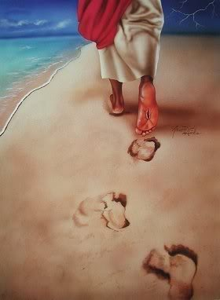
intro
Give heed to His voice
Do what is right in His sight
Give ear to His commands
Keep all His statutes
We can see the same blessings regarding healing mankind of sin if men and women follow Jesus!

Slide 5
Jesus the Great Physician (Healer)
Jesus is the “Healer” of the world & saves from sin!
(Luke 5:29-32; Romans 5:8-9; Ephesians 1:7)
Give heed to His voice
John 5:24
Truly, truly, I say to you, he who hears My word, and believes Him who sent Me, has eternal life, and does not come into judgment, but has passed out of death into life.

Slide 6
Jesus the Great Physician (Healer)
Jesus is the “Healer” of the world & saves from sin!
(Luke 5:29-32; Romans 5:8-9; Ephesians 1:7)
Give heed to His voice
Do what is right in His sight
Acts 10:34-35
Opening his mouth, Peter said: "I most certainly understand now that God is not one to show partiality,
but in every nation the man who fears Him and does what is right is welcome to Him.

Slide 7
Jesus the Great Physician (Healer)
Jesus is the “Healer” of the world & saves from sin!
(Luke 5:29-32; Romans 5:8-9; Ephesians 1:7)
Give heed to His voice
Do what is right in His sight
Give ear to His commands
Luke 8:20-21
And it was reported to Him, "Your mother and Your brothers are standing outside, wishing to see You."
But He answered and said to them, "My mother and My brothers are these who hear the word of God and do it."

Slide 8
Jesus the Great Physician (Healer)
Jesus is the “Healer” of the world & saves from sin!
(Luke 5:29-32; Romans 5:8-9; Ephesians 1:7)
Give heed to His voice
Do what is right in His sight
Give ear to His commands
Keep all His statutes
I John 2:17
The world is passing away, and also its lusts; but the one who does the will of God lives forever.

Slide 9
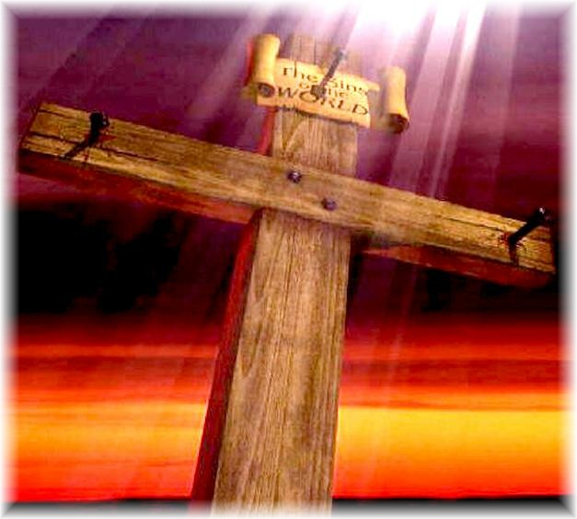
Jesus the Great Physician (Healer)
Jesus is the “Healer” of the world & saves from sin! (Luke 5:29-32; Romans 5:8-9; Ephesians 1:7)
Give heed to His voice – John 5:24
Do what is right in His sight – Acts 10:34-35
Give ear to His commands – Luke 8:20-21
Keep all His statutes – I John 2:17
Jesus is our hope of eternal life in Heaven if we but Hear and Obey Him!

Slide 10
Water From A Rock
Exodus 17:1-7: Waters of Rephidim (Massah & Meribah)
The Israelites came to Rephidim and found no water to drink and grumbled against Moses and God
The place was called “Massah” (a testing, of men or of God) and “Meribah” (a quarrel, fight or strife) because the people tested God!
God had Moses strike the rock at Horeb and provided water for them.

Slide 11
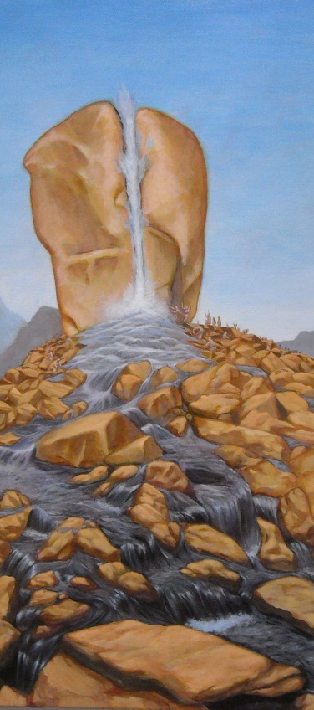
Water From A Rock
Numbers 20:1-13: Waters of Kadesh (Meribah)
Also became known as “Meribah” because the people contended with God!
Moses told to speak to a rock and God would provide water (20:8)
Moses, with Aaron, struck the rock twice and took the credit – 20:10
For their disobedience in not treating God as holy (for striking rock and taking glory that belonged to God alone) they would not enter the Promised Land & would lose their lives
(Aaron immediately – Num. 20:24; Moses later at the border of Canaan on Mt. Pisgah – Deut. 3:23-26; 32:49-50; 34:4)

Slide 12
Water From A Rock
Despite their disobedience,
God provided water
“abundantly” like the very
“ocean depths” and “like rivers”
(Ps. 78:15-16)
Psalm 78:15-16
He split the rocks in the wilderness And gave them abundant drink like the ocean depths.
He brought forth streams also from the rock And caused waters to run down like rivers.

Slide 13
Water From A Rock
The wonderful patience & love of God can be seen in His willingness to provide water for His people even when they acted disobediently!

Slide 14
Jesus: Water From The Rock
The people were rebels (Num. 20:10) and even Moses and Aaron rebelled (Num. 20:24) against God and yet…
God provided the water anyway!
Have you ever wondered why?

Slide 15
Jesus: Water From The Rock
I Corinthians 10:1-4
1. For I do not want you to be unaware, brethren, that our fathers were all under the cloud and all passed through the sea;
2. and all were baptized into Moses in the cloud and in the sea;
3. and all ate the same spiritual food;
4. and all drank the same spiritual drink, for they were drinking from a spiritual rock which followed them; and the rock was Christ.

Slide 16
Jesus: Water From The Rock
I Cor. 10:1-4: Jesus is the Spiritual Rock that nourished the Israelites, and He is the source of salvation to saints as well
John 4:13-14: Source of eternal water
Hebrews 5:9: Source of salvation to those who obey Him
Hebrews 12:2: Source (“Author”) of our faith
I Corinthians 10:4
and all drank the same spiritual drink, for they were drinking from a spiritual rock which followed them; and the rock was Christ.

Slide 17
Jesus: Water From The Rock
A beautiful parallel to the eternal water of Jesus
(John 4:13-14)
Rock at Meribah (Num. 20) | Jesus, The Rock (I Cor. 10:4) | Scriptures
Struck | Struck (Down) | Is. 53:3-8; Acts 2:36; I Pet. 3:18 (Jn. 19:34; I Jn. 5:6)
From Disobedience (Rebels) | From Disobedience (Rebels) | Acts 2:22-23, 36; 3:13-21; 4:10-11; 5:30; 7:51-53
Blessings from God Flowed (Water) | Blessings from God Flowed (Salvation to all men) | Acts 3:22-26; 4:8-12; 5:30-31; Rom. 5:8-9; Gal. 3:13-14, 26-29; Eph. 1:7; 2:4-9

Slide 18
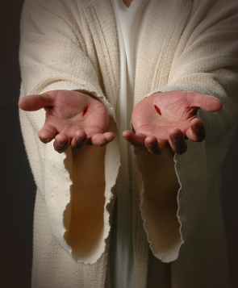
Jesus: Water From The Rock
Neither the Israelites nor we deserved God’s blessings because of disobedience and rebellion, but God was rich in mercy towards mankind!
(Ephesians 2:4-9)
Titus 2:11-14: “For the grace of God has appeared, bringing salvation to all men!” (2:11) – It is by the grace of God we are redeemed and saved!
Jesus is the Rock that nourished and saved the Israelites and is the Rock from Whom all blessings flow, granting salvation to all those who obey Him! (Heb. 5:9)

Slide 19
Conclusion
As God provided life-giving blessings from the rock at Meribah from disobedience, so has God provided soul-cleansing blessings from Jesus out of the disobedience of those who put Him to death!
We show our gratitude, our thanksgiving, to God for the sacrifice of His Son when we obey the gospel & live faithful lives!
(Colossians 3:17)

Slide 20
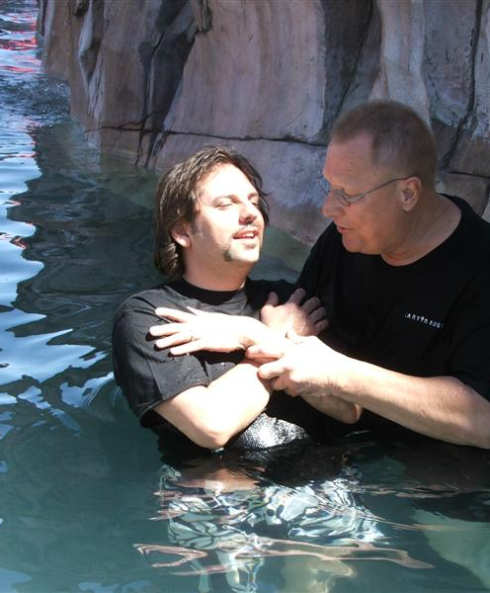
Conclusion
By obeying the gospel in baptism (no longer being rebels) we have our sins washed away in the blood of the Lamb of God (John 1:29) – Acts 2:38; 22:16

Slide 21
Conclusion
Revelation 7:16-17
"They will hunger no longer, nor thirst anymore; nor will the sun beat down on them, nor any heat;
for the Lamb in the center of the throne will be their shepherd, and will guide them to springs of the water of life; and God will wipe every tear from their eyes."
If you obey the gospel, you have the hope of eternal life (Jn. 5:24; I Jn. 2:25) and can take of “the water of life without cost”
Rev. 7:16-17

Slide 22
Conclusion
If you obey the gospel you have the hope of eternal life (Jn. 5:24; I Jn. 2:25) and can take of “the water of life without cost”
Rev. 7:16-17
Rev. 21:6
Revelation 21:6
Then He said to me, "It is done. I am the Alpha and the Omega, the beginning and the end. I will give to the one who thirsts from the spring of the water of life without cost."

Slide 23
Conclusion
Revelation 22:1-2
Then he showed me a river of the water of life, clear as crystal, coming from the throne of God and of the Lamb,
in the middle of its street. On either side of the river was the tree of life, bearing twelve kinds of fruit, yielding its fruit every month; and the leaves of the tree were for the healing of the nations.
If you obey the gospel you have the hope of eternal life (Jn. 5:24; I Jn. 2:25) and can take of “the water of life without cost”
Rev. 7:16-17
Rev. 21:6
Rev. 22:1-2

Slide 24
Conclusion
If you obey the gospel you have the hope of eternal life (Jn. 5:24; I Jn. 2:25) and can take of “the water of life without cost”
Rev. 7:16-17
Rev. 21:6
Rev. 22:1-2
Rev. 22:17
Revelation 22:17
The Spirit and the bride say, "Come." And let the one who hears say, "Come." And let the one who is thirsty come; let the one who wishes take the water of life without cost.

Slide 25
Conclusion
Are you thirsty for the waters of eternal life?
(John 4:13-14; Revelation 21:6; 22:17)
Turn to the only source for eternal life: Jesus, our Rock!
Give heed to His voice, Do what is right in His sight, Give ear to His commands, and Keep all His statutes!

Slide 26
“What Must I Do To Be Saved?”
Hear The Gospel (Jn. 5:24; Rom. 10:17)
Believe In Christ (Jn. 3:16-18; Jn. 8:24)
Repent Of Sins (Lk. 13:3-5; Acts 2:38)
Confess Christ (Mt. 10:32; Rom. 10:10)
Be Baptized (Mk. 16:16; Acts 22:16)
Remain Faithful (Jn. 8:31; Rev. 2:10)
For The Erring Saint
Repent (Acts 8:22), Confess (I Jn. 1:9),
Pray (Acts 8:22)

