Slide 1
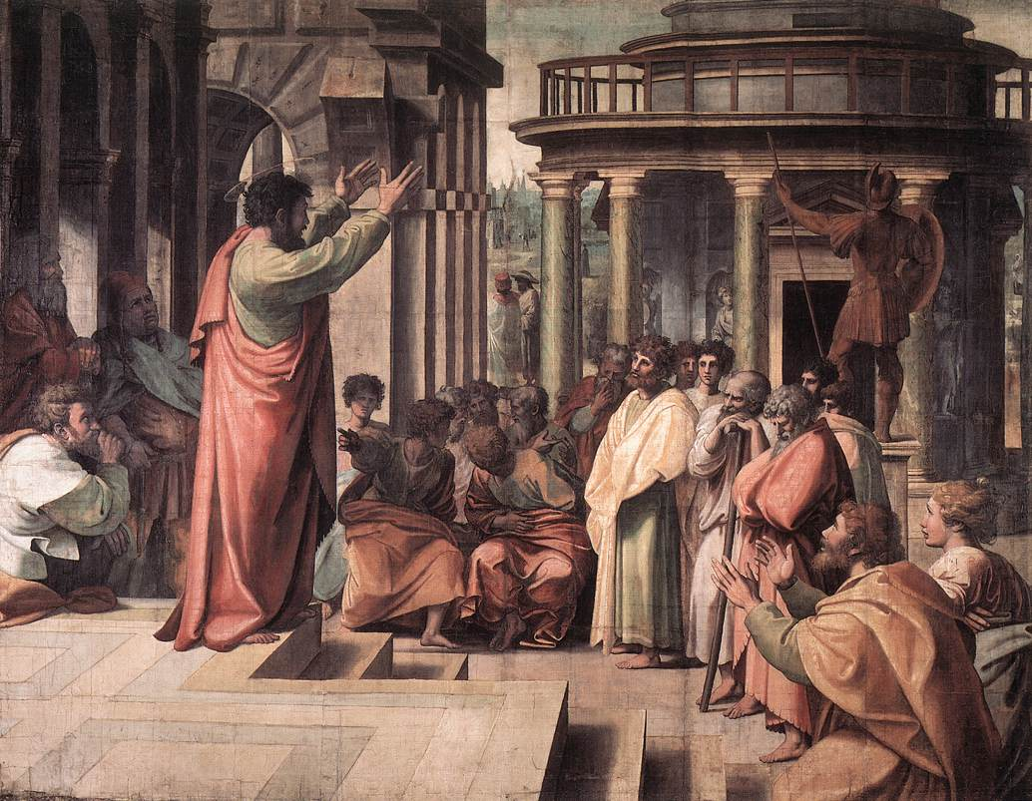
What Timothy Knew About Paul
Text:
II Timothy 3:10-11
Notes:
Prepared by Nathan L Morrison
All Scripture given is from NASB unless otherwise stated
For further study, or if questions, please Call: 804-277-1983 or Visit: www.courthousechurchofchrist.com
Adapted from a lesson by Curtis Flatt

Slide 2
INTRO
What do others know about you?
Your favorite color, food, sports team, hobby, movie or book?

Slide 3
Intro
II Timothy 3:10-11
10. Now you followed my teaching, conduct, purpose, faith, patience, love, perseverance,
11. persecutions, and sufferings, such as happened to me at Antioch, at Iconium and at Lystra; what persecutions I endured, and out of them all the Lord rescued me!
What did Timothy know and follow about Paul?
Notes:
II. II Timothy 3:10-11: In one verse (3:10) Paul reminds Timothy of seven things he knew about the Apostle Paul, and two more in verse 11.
A. The Greek word for “follow” (NASB) is translated as “fully known” in KJV.
B. It means to “conform to, attain, follow, fully known, have understanding” (Strong’s G3877).
C. The things Timothy knew of Paul was passed down to faithful men who would teach others (II Tim. 2:2).
D. The things Timothy knew of Paul was of eternal importance (Not recorded if he knew Paul’s favorite color, food, or what Gladiator he rooted for!)

Slide 4
Timothy Knew…
II Timothy 3:10: Doctrine (NKJV) is teaching
This was the teaching (doctrine):
That was given to Paul by the Lord (Galatians 1:11-12)
That is inspired by God and equips saints for every good work (II Timothy 3:16-17)
That is to be taught to others (II Timothy 2:2, 24-26)
That brings about salvation (I Timothy 4:16)
That by obeying it one can be freed of their sins (Romans 6:17-18)
Paul’s Teaching

Slide 5
Do others hear from you the teaching that can save their souls?

Slide 6
Timothy Knew…
II Timothy 3:10: Manner of life (NKJV)
Paul’s conduct (manner of life) was known by:
The Jews, before Paul’s conversion (Acts 26:4-5)
King Agrippa, after Paul’s conversion (Acts 26:19-27)
The Thessalonian saints after his conversion (I Thess. 1:5-7; II Thess. 2:14-15)
Paul’s Teaching
Paul’s Conduct
Paul’s conduct was to be taught and imitated:
By other Christians (I Thess. 1:6)
The Philippians, and thus saints today (Philippians 1:27)

Slide 7
What do others know of you by your conduct?

Slide 8
Timothy Knew…
Paul’s purpose was clearly known!
To preach the gospel, of which he was not ashamed (Romans 1:15-17)
To preach Jesus crucified (I Cor. 2:2)
To preach was all that he could do! (I Cor. 9:16)
To forget the past and press on to the prize in Christ Jesus (Philippians 3:13-14)
Paul’s Teaching
Paul’s Conduct
Paul’s Purpose
So many people live their lives with other things as their purpose!
Mark 12:30

Slide 9
Do others know your purpose and if so, do they see you living it?

Slide 10
Timothy Knew…
Faith can be seen in how we face the storms of life and our attitude towards life & death!
Paul’s faith was seen by:
The churches in Judea who had not met him after his conversion (Galatians 1:22-24)
His desire to be pleasing to God (II Corinthians 5:6-10)
In the face of his impending execution (II Timothy 4:6-8)
Paul’s Teaching
Paul’s Conduct
Paul’s Purpose
Paul’s Faith

Slide 11
Do others have to be told you’re a Christian or do they see it by your faith?

Slide 12
Timothy Knew…
II Timothy 3:10: Longsuffering (NKJV)
Paul had much to say of patience and spoke of the rewards for enduring:
The glory to come can’t even be compared (Romans 8:18, 28, 35-39)
Patience is a “Fruit of the Spirit” against which there is no law (Galatians 5:22-23)
Part of walking “in a manner worthy of the calling with which you have been called” is to show patience (Ephesians 4:1-3)
Saints are to “put on” a heart of patience (Colossians 3:12-14)
Paul’s Teaching
Paul’s Conduct
Paul’s Purpose
Paul’s Faith
Paul’s Patience

Slide 13
Would others describe you as a patient or longsuffering person?

Slide 14
Timothy Knew…
Paul preached out of love and concern for others’ souls
For Israel to be saved! (Romans 9:1-3; 10:1)
For the Corinthian saints (I Cor. 16:24; II Cor. 12:15)
I Corinthians 13 (Oft called the “Chapter of Love”)
Paul’s Teaching
Paul’s Conduct
Paul’s Purpose
Paul’s Faith
Paul’s Patience
Paul’s Love
It is our love for one another that the world is to know that we belong to Jesus (John 13:34-35)!

Slide 15
Do others see your love and concern for your brethren and people in the world?

Slide 16
Timothy Knew…
II Timothy 3:10: Endurance (NET)
Paul had to have endurance:
Romans 5:1-5
II Corinthians 6:4
Paul’s Teaching
Paul’s Conduct
Paul’s Purpose
Paul’s Faith
Paul’s Patience
Paul’s Love
Paul’s Perseverance
Endurance is needed to weather the storms of life and overcome the trials set before us!
Hebrews 10:36
Hebrews 10:39
James 1:2-4, 12

Slide 17
Do others see in you a faith not shaken, a faith that perseveres under trial?

Slide 18
Timothy Knew…
II Timothy 3:11: Persecutions & Afflictions (NKJV)
Paul knew what it meant to suffer and said, “all who desire to live godly will be persecuted” (II Timothy 3:12)
Acts 9:15-16
II Corinthians 4:7-11
II Corinthians 6:1-10
II Corinthians 11
II Timothy 1:8-12
Paul’s Teaching
Paul’s Conduct
Paul’s Purpose
Paul’s Faith
Paul’s Patience
Paul’s Love
Paul’s Perseverance
Paul’s Persecutions & Sufferings
Endurance is needed (Hebrews 10:32-39)!
The reality of persecutions & sufferings is why saints need a strong faith and endurance

Slide 19
When others see you in the midst of trials, what do they know of your faith and endurance?

Slide 20
Conclusion
What do others know about you?
Your favorite color, food, sports team, hobby, movie or book?

Slide 21
Conclusion
Your Teaching
Your Conduct
Your Purpose
Your Faith
Your Patience
Your Love
Your Perseverance
Your Persecutions & Sufferings
Or…
Do others know about you what Timothy knew about the Apostle Paul?

Slide 22
Conclusion
In being a faithful servant of God, there is great reward! (Even when suffering is a part of it!)
Revelation 22:12
“Behold, I am coming quickly, and My reward is with Me, to render to every man according to what he has done.”
Whether you care if others see in you what Timothy saw in Paul or not, Jesus sees and knows and says He will reward according to what you have done!

Slide 23
Conclusion
Your Teaching
Your Conduct
Your Purpose
Your Faith
Your Patience
Your Love
Your Perseverance
Your Persecutions & Sufferings
Do other people see in you what Timothy knew about Paul?

Slide 24
“What Must I Do To Be Saved?”
Hear The Gospel (Jn. 5:24; Rom. 10:17)
Believe In Christ (Jn. 3:16-18; Jn. 8:24)
Repent Of Sins (Lk. 13:3-5; Acts 2:38)
Confess Christ (Mt. 10:32; Rom. 10:10)
Be Baptized (Mk. 16:16; Acts 22:16)
Remain Faithful (Jn. 8:31; Rev. 2:10)
For The Erring Saint:
Repent (Acts 8:22), Confess (I Jn. 1:9),
Pray (Acts 8:22)

