Slide 1
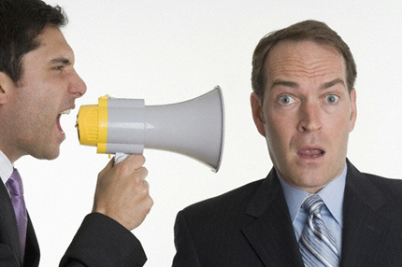
Beware Conflicting Voices Of The World
Text:
I Kings 13
Notes:
By Nathan L Morrison
All Scripture given is from NKJV unless otherwise stated
For further study, or if questions, please Call: 804-277-1983 or Visit: www.courthousechurchofchrist.com

Slide 2
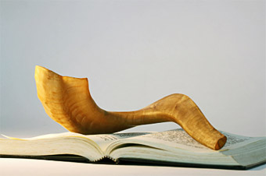
Intro
We live in a time of conflicting voices – voices of
the world conflict with the voice of God!
The matter of conflicting voices has always been around (Gen. 3)
The solution to conflicting voices where God’s word is concerned has always been to consult the source to determine truth from lie (I Kings 22:5-7: Jehoshaphat; Jer. 23)

Slide 3
Intro
I Kings 13 contains examples and warnings against
listening to conflicting voices!
Background – I Kings 12:25-33
Following King Solomon’s death the 12 Tribes of Israel split.
10 Tribes in the north follow King Jeroboam, while the 2 in the south follow King Rehoboam.
Jeroboam changed a few things:
Object of worship (12:28): Two Golden Calves
Place of worship (12:29): Bethel & Dan
Leaders of worship (12:31): From ALL the people (not just Levis)
Time of worship (12:32-33): Eighth month on the fifteenth day
The people of Israel were listening to conflicting
voices, and God sent them the answer!

Slide 4
Man of God from Judah
I Kings 13:1-3 (NKJV)
1. And behold, a man of God went from Judah to Bethel by the word of the LORD, and Jeroboam stood by the altar to burn incense.
2. Then he cried out against the altar by the word of the LORD, and said, "O altar, altar! Thus says the LORD: 'Behold, a child, Josiah by name, shall be born to the house of David; and on you he shall sacrifice the priests of the high places who burn incense on you, and men's bones shall be burned on you.' "
3. And he gave a sign the same day, saying, "This is the sign which the LORD has spoken: Surely the altar shall split apart, and the ashes on it shall be poured out."

Slide 5
Man of God from Judah
I Kings 13:4-6 (NKJV)
4. So it came to pass when King Jeroboam heard the saying of the man of God, who cried out against the altar in Bethel, that he stretched out his hand from the altar, saying, "Arrest him!" Then his hand, which he stretched out toward him, withered, so that he could not pull it back to himself.
5. The altar also was split apart, and the ashes poured out from the altar, according to the sign which the man of God had given by the word of the LORD.
6. Then the king answered and said to the man of God, "Please entreat the favor of the LORD your God, and pray for me, that my hand may be restored to me." So the man of God entreated the LORD, and the king's hand was restored to him, and became as before.

Slide 6
Man of God from Judah
I Kings 13:7-10 (NKJV)
7. Then the king said to the man of God, "Come home with me and refresh yourself, and I will give you a reward."
8. But the man of God said to the king, "If you were to give me half your house, I would not go in with you; nor would I eat bread nor drink water in this place.
9. For so it was commanded me by the word of the LORD, saying, 'You shall not eat bread, nor drink water, nor return by the same way you came.' "
10. So he went another way and did not return by the way he came to Bethel.

Slide 7
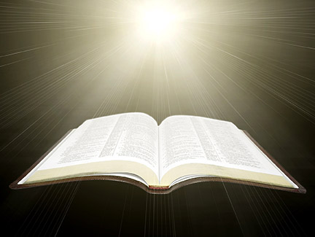
Man of God from Judah
I Kings 13:1-10
In the conflict of voices here the word of God prevailed over the altar and the king!

Slide 8
Old Prophet from Bethel
I Kings 13:11-14 (NKJV)
11. Now an old prophet dwelt in Bethel, and his sons came and told him all the works that the man of God had done that day in Bethel; they also told their father the words which he had spoken to the king.
12. And their father said to them, "Which way did he go?" For his sons had seen which way the man of God went who came from Judah.
13. Then he said to his sons, "Saddle the donkey for me." So they saddled the donkey for him; and he rode on it,
14. and went after the man of God, and found him sitting under an oak. Then he said to him, "Are you the man of God who came from Judah?" And he said, "I am."

Slide 9
Old Prophet from Bethel
I Kings 13:15-17 (NKJV)
15. Then he said to him, "Come home with me and eat bread."
16. And he said, "I cannot return with you nor go in with you; neither can I eat bread nor drink water with you in this place.
17. For I have been told by the word of the LORD, 'You shall not eat bread nor drink water there, nor return by going the way you came.'"

Slide 10
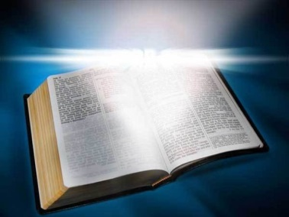
Old Prophet from Bethel
I Kings 13:11-17
No conflict here for the man of God
knew God’s answer!

Slide 11
Conflicting Voices
I Kings 13:18-19 (NKJV)
18. He said to him, "I too am a prophet as you are, and an angel spoke to me by the word of the LORD, saying, 'Bring him back with you to your house, that he may eat bread and drink water.' " (He was lying to him.)
19. So he went back with him, and ate bread in his house, and drank water.

Slide 12
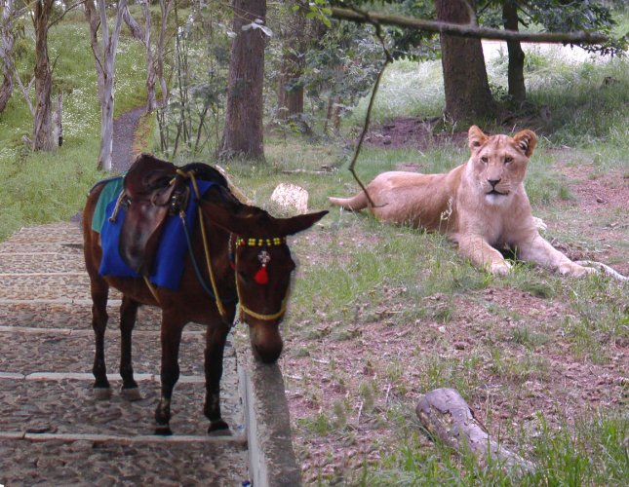
Conflicting Voices
I Kings 13:18-19
I Kings 13:20-32
God used the old prophet to pronounce judgment against the man of God for his disobedience.
God caused him to be eaten by a lion and the lion sat beside his donkey for all to see, and it was known that it was a sign from God.
The old prophet gathered him up and buried him, and wanted to be buried with him since he knew his message from God would come to pass!

Slide 13
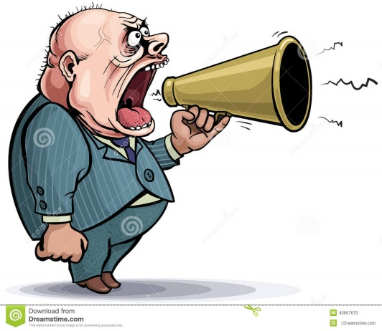
Conflicting Voices
Jer. 23:15-17, 20-22, 30-32, 40
The false prophets in Jeremiah’s day said the right words, “Thus says the Lord,” but they lied in His name rather than prophesy truth.
They would be punished, even the people that bought their lie (Mt. 15:13-14)
Gal. 1:6-9
If the message is different than God’s it doesn’t matter if someone claims it’s from an angel in the name of the Lord, it is a lie and is to be accursed! (I Kings 13:21-22)

Slide 14
Conflicting Voices
NKJV: II Pet. 3:3-6 (I Thess. 5:1-6)
3. knowing this first: that scoffers will come in the last days, walking according to their own lusts,
4. and saying, "Where is the promise of His coming? For since the fathers fell asleep, all things continue as they were from the beginning of creation."
5. For this they willfully forget: that by the word of God the heavens were of old, and the earth standing out of water and in the water,
6. by which the world that then existed perished, being flooded with water.

Slide 15
Conflicting Voices
NKJV: II Pet. 3:7-9 (I Thess. 5:1-6)
7. But the heavens and the earth which are now preserved by the same word, are reserved for fire until the day of judgment and perdition of ungodly men.
8. But, beloved, do not forget this one thing, that with the Lord one day is as a thousand years, and a thousand years as one day.
9. The Lord is not slack concerning His promise, as some count slackness, but is longsuffering toward us, not willing that any should perish but that all should come to repentance.

Slide 16
Conflicting Voices
II Pet. 3:3-9 (I Thess. 5:1-6)
God’s word will prevail over the conflicting voices – we need to know truth from lie!

Slide 17
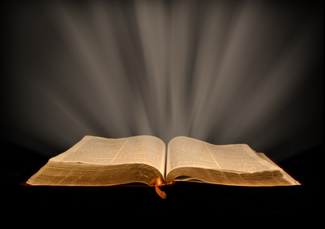
Conclusion
Voices in the world conflict with the voice of God:
Baptism isn’t necessary to be saved (Faith only!) – Mk. 16:16; Heb. 5:9
Attend the church of your choice; they’re all the same – Eph. 1:22-23; 4:4
You can serve God as you please as long as it makes you happy – Mt. 7:21-23
Be cautious of conflicting voices!
The man of God listened to the wrong voice & was punished for it!
The people of Judah listened to the false prophets over Jeremiah & were destroyed (Jer. 52: 586 B.C.)

Slide 18
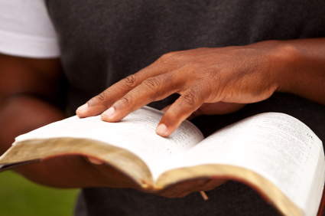
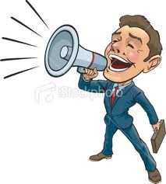
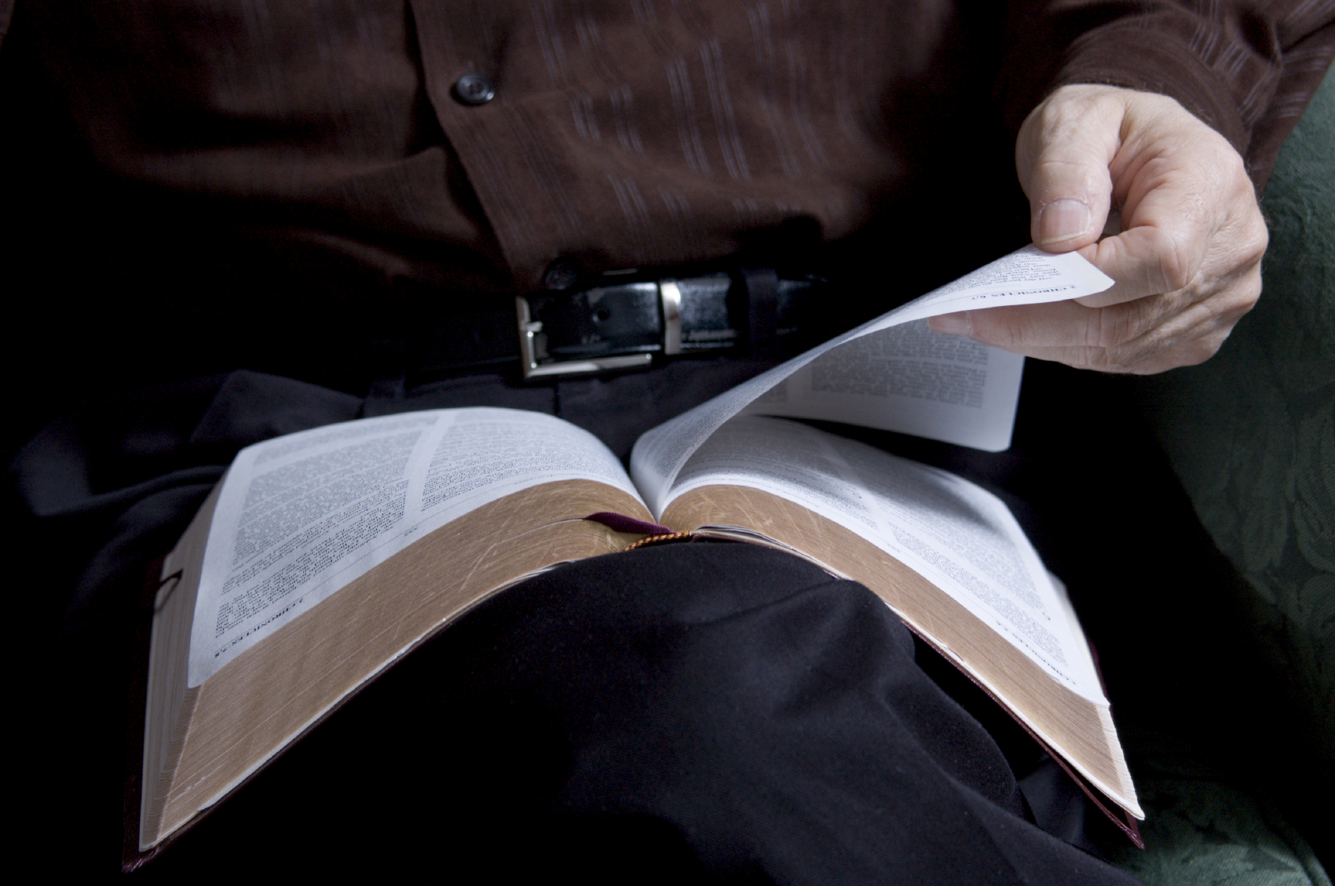
Conclusion
There’s a great day coming in which all men will be judged according to the gospel and regardless of the conflicting voices in the world, will be held accountable for their actions!
II Cor. 5:10: All people will be judged, both for the good or bad.
II Thess. 1:7-9: God’s word will prevail over those who deny Him and do not obey Him.
Beware of conflicting voices & “hold fast” to “the word of truth!” (I Cor. 15:1-2; Col.1:5)

Slide 19
“What Must I Do To Be Saved?”
Hear The Gospel (Jn. 5:24; Rom. 10:17)
Believe In Christ (Jn. 3:16-18; Jn. 8:24)
Repent Of Sins (Lk. 13:3-5; Acts 2:38)
Confess Christ (Mt. 10:32; Rom. 10:10)
Be Baptized (Mk. 16:16; Acts 22:16)
Remain Faithful (Jn. 8:31; Rev. 2:10)
For The Erring Saint:
Repent (Acts 8:22), Confess (I Jn. 1:9),
Pray (Acts 8:22)

