Slide 1
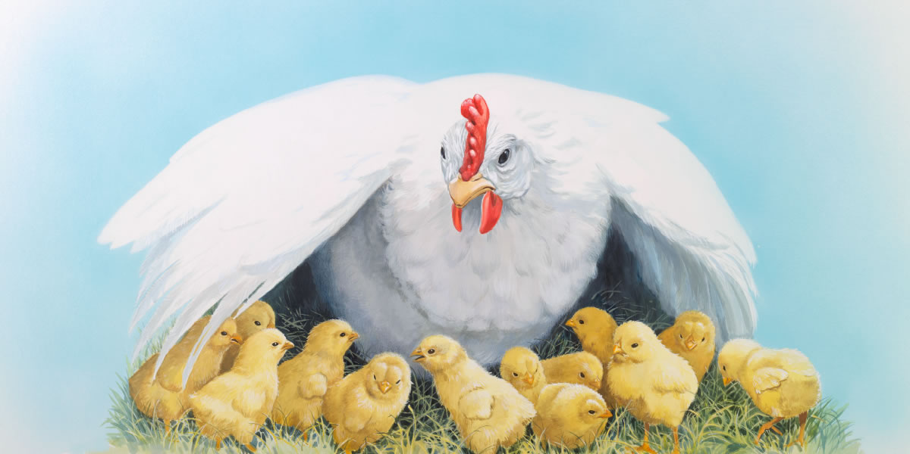
As A Hen Gathers Her Chicks Text: Matthew 23:37-39; Luke 13:31-35
Notes:
By Nathan L Morrison for Sunday 05/09/2021
All Scripture given is from NASB unless otherwise stated
For further study, or if questions, please Call: 804-277-1983 or Visit www.courthousechurchofchrist.com
A Mother's Day Lesson, from many different sources

Slide 2
Intro
Genesis 1:26-27: God says He would create man and woman in His image and then we’re told that’s what He did!
He created men and women and gave them roles and characteristics, from His image, and made them into husbands and wives, and fathers and mothers to their children.
Genesis 2:24
“For this reason a man shall leave his father and his mother, and be joined to his wife; and they shall become one flesh.”
Genesis 3:20
Now the man called his wife's name Eve, because she was the mother of all the living.

Slide 3
Intro
God is referred to in Scripture as Father and King, and Jesus is the King and Savior, but both also refer to themselves with feminine characteristics
It makes sense that the Creator that made them male and female in His image would display the characteristics both are to pattern after
Let’s see how God demonstrates His love as a mother!

Slide 4
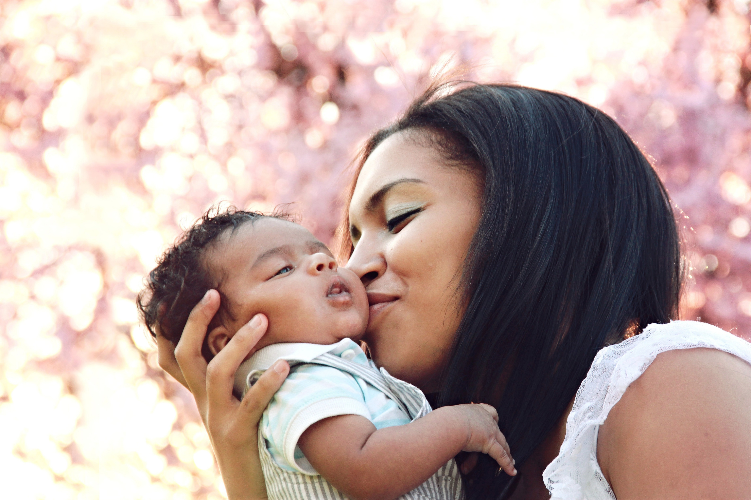
God is Compassionate
Psalm 86:15 (NKJV)
“But You, O Lord, are a God full of compassion, and gracious, Longsuffering and abundant in mercy and truth.”
God compares Himself to a mother
Isaiah 49:15
“Can a woman forget her nursing child And have no compassion on the son of her womb? Even these may forget, but I will not forget you.”

Slide 5
Jesus is Compassionate
Many times we read in the NT that the Lord had compassion on the multitudes or those that were sick (Mt. 14:14; Mk. 1:41; Lk. 7:13)
Mark 5:19 (NKJV)
However, Jesus did not permit him, but said to him, "Go home to your friends, and tell them what great things the Lord has done for you, and how He has had compassion on you.”

Slide 6
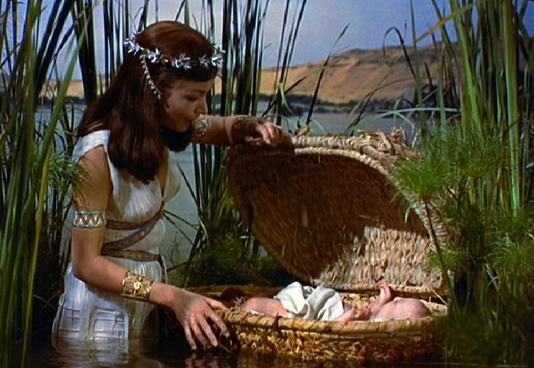
Mothers Are Compassionate
Exodus 2:5-6 (NKJV)
Then the daughter of Pharaoh came down to bathe at the river. And her maidens walked along the riverside; and when she saw the ark among the reeds, she sent her maid to get it. And when she opened it, she saw the child, and behold, the baby wept. So she had compassion on him, and said, “This is one of the Hebrews' children.”
We know that it was compassion that saved Moses

Slide 7
God is Compassionate
Compassionate mothers are a blessing from God and the Creator who is compassionate and full of mercy!
God is compassionate
Jesus is compassionate
Mothers are compassionate

Slide 8
God is Caring
I Peter 5:6-7
Therefore humble yourselves under the mighty hand of God, that He may exalt you at the proper time, casting all your anxiety on Him, because He cares for you.
God compares Himself to a mother
Isaiah 66:13
“As one whom his mother comforts, so I will comfort you; And you will be comforted in Jerusalem.”

Slide 9
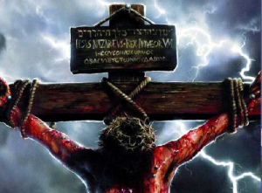
Jesus is Caring
Romans 5:6-8
For while we were still helpless, at the right time Christ died for the ungodly. For one will hardly die for a righteous man; though perhaps for the good man someone would dare even to die. But God demonstrates His own love toward us, in that while we were yet sinners, Christ died for us.
We know that Jesus cared for us

Slide 10
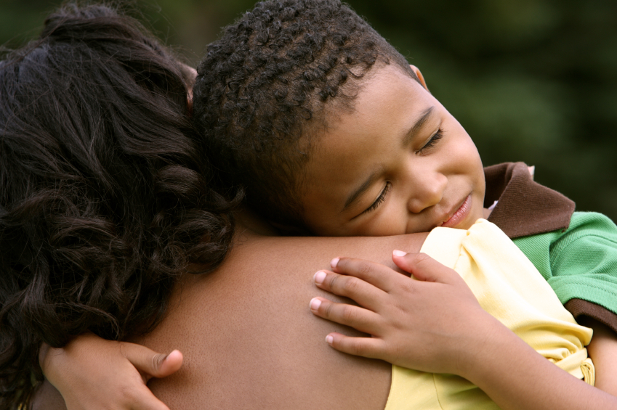
Mothers are Caring
II Kings 4:8-11
Now there came a day when Elisha passed over to Shunem, where there was a prominent woman, and she persuaded him to eat food. And so it was, as often as he passed by, he turned in there to eat food. She said to her husband, “Behold now, I perceive that this is a holy man of God passing by us continually. Please, let us make a little walled upper chamber and let us set a bed for him there, and a table and a chair and a lampstand; and it shall be, when he comes to us, that he can turn in there.” One day he came there and turned in to the upper chamber and rested.
The Shunamite woman in II Kings 4:8-17 cared for God’s prophet, Elisha, and in turn was able to care for a child

Slide 11
God is Caring
Caring mothers are a blessing from God and the Creator who cares for us!
God is caring
Jesus is caring
Mothers are caring

Slide 12
God is Loving
Deut. 10:15
“Yet on your fathers did the LORD set His affection to love them, and He chose their descendants after them, even you above all peoples, as it is this day.”
Deut. 7:7-8, 13; 10:15; Zeph. 3:17; John 3:16; Rom. 5:8
John 3:16
“For God so loved the world, that He gave His only begotten Son, that whoever believes in Him shall not perish, but have eternal life.”

Slide 13
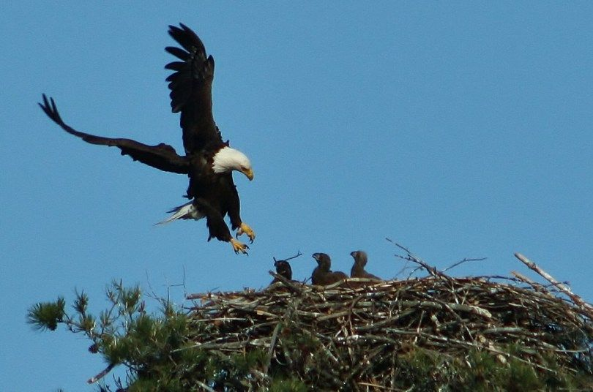
God is Loving
Part of God’s loving nature is the desire to protect His people, and He is described as a mama eagle
Deut. 32:11
“Like an eagle that stirs up its nest, That hovers over its young, He spread His wings and caught them, He carried them on His pinions.”

Slide 14
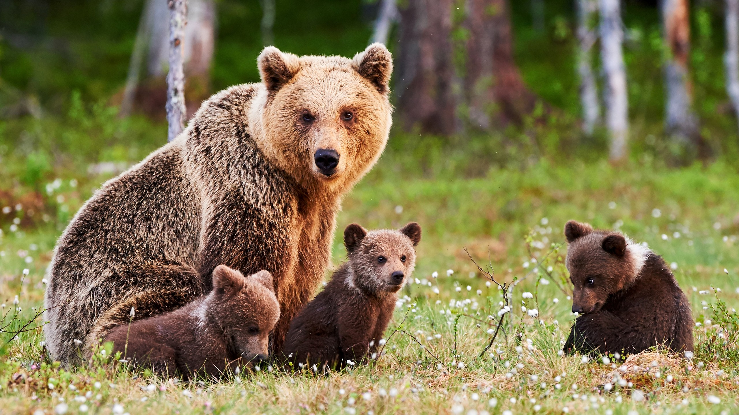
God is Loving
In pronouncing judgment on Israel, He is described as a mama Bear
Hosea 13:8
“I will encounter them like a bear robbed of her cubs, And I will tear open their chests; There I will also devour them like a lioness, As a wild beast would tear them.”

Slide 15
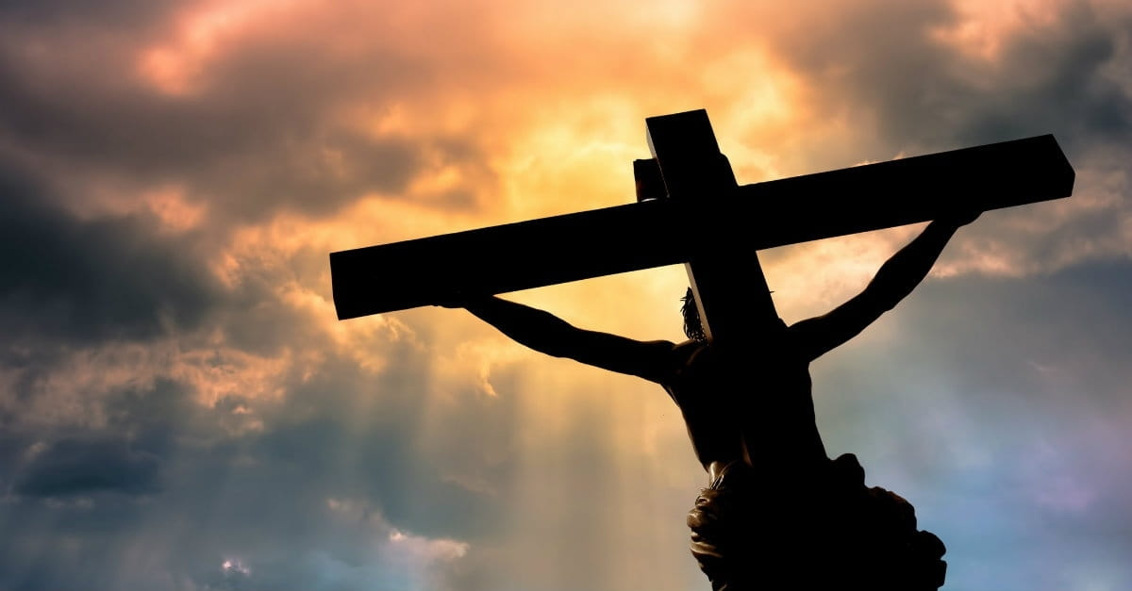
Jesus is Loving
Jesus is loving and protective
Rom. 5:8; 8:35-39: He loved us enough to die for us and to keep us in His love!
Romans 5:8
But God demonstrates His own love toward us, in that while we were yet sinners, Christ died for us.

Slide 16
Jesus is Loving
Jesus described Himself as a mother hen that gathers her chicks in relation to how He wanted to protect the Jews from the coming disaster of AD 70.
Matthew 23:37-38
“Jerusalem, Jerusalem, who kills the prophets and stones those who are sent to her! How often I wanted to gather your children together, the way a hen gathers her chicks under her wings, and you were unwilling. Behold, your house is being left to you desolate!”

Slide 17
Jesus is Loving
Just as a mother hen wants to bring her brood close when trouble comes, so God wants to bring His people close in times of difficulty
Luke 13:34
“O Jerusalem, Jerusalem, the city that kills the prophets and stones those sent to her! How often I wanted to gather your children together, just as a hen gathers her brood under her wings, and you would not have it!”
Notes:
Jesus has one point to make: Through His prophets, God has expressed His desire to deliver a penitent Israel from its enemies, and He is doing so again in the ministry of Jesus. Nevertheless, God’s children will reject Him once more as they nail His chosen one to a cross (Messiah/Christ means “anointed One of God”).

Slide 18
Jesus is Loving
A beautiful picture about God’s nature
Comfort
Safety
Matthew 11:28-30
“Come to Me, all who are weary and heavy-laden, and I will give you rest.
Take My yoke upon you and learn from Me, for I am gentle and humble in heart, and YOU WILL FIND REST FOR YOUR SOULS. For My yoke is easy and My burden is light.”
Notes:
What a beautiful image this reveals about God’s nature and what God longs to give us.
The first is comfort.
The outstretched wings of a mother hen nurture and comfort her chicks. Under her wings is where her chicks are safe and warm, right next to her heart; where they experience her gentleness and tender compassion. It is where those who feel vulnerable and afraid are cared for.
How beautiful that God has a soft, motherly side! There is something so appealing about a God who longs to comfort us like that.
The second is safety.
Ever snuggled into someone’s arms and felt the peace and rest that comes with knowing someone stronger than you has got your back?
The heart of the mother hen is always to protect her chicks from anything that might snatch away their life. She is so committed to the lives of her chicks that she would even give up her own life to keep them safe under her wings. No questions asked. It’s who she is. It’s her nature.
It’s God’s nature, too.
It is no coincidence Jesus uses this image towards the end of His life. He would rather give up His own life than have us lose ours. Herod is the fox (Luke 13:32), an enemy of chicks. Jesus would go to him to die for His people (chicks, brood).
The arms of Jesus Christ stretched out as He died on the cross are the wings of a mother hen, the arms God outstretched for us to come and find comfort and safety in them (Matthew 11:28-30: He offers eternal rest).

Slide 19
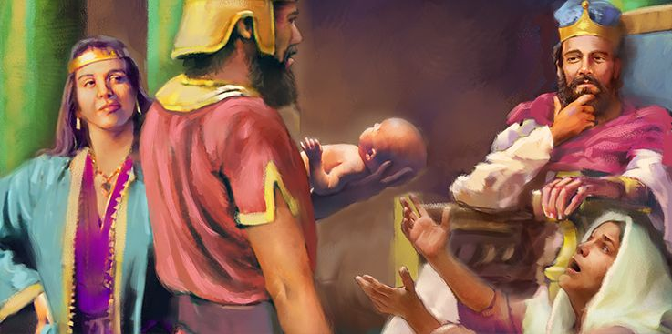
Mothers are Loving
I Kings 3:26-27
Then the woman whose child was the living one spoke to the king, for she was deeply stirred over her son and said, “Oh, my lord, give her the living child, and by no means kill him.” But the other said, “He shall be neither mine nor yours; divide him!” Then the king said, “Give the first woman the living child, and by no means kill him. She is his mother.”
two women came to King Solomon each claiming to be the mother of a living child (for one child died in the night). He commanded the child cut into two and each would get half!
Notes:
He saw the loving, protective nature of the child’s real mother come out in wanting to see no harm done to him. She would prefer to see her son raised by the other woman than to see him dead!
Mothers are loving and protective and want the best for their children!

Slide 20
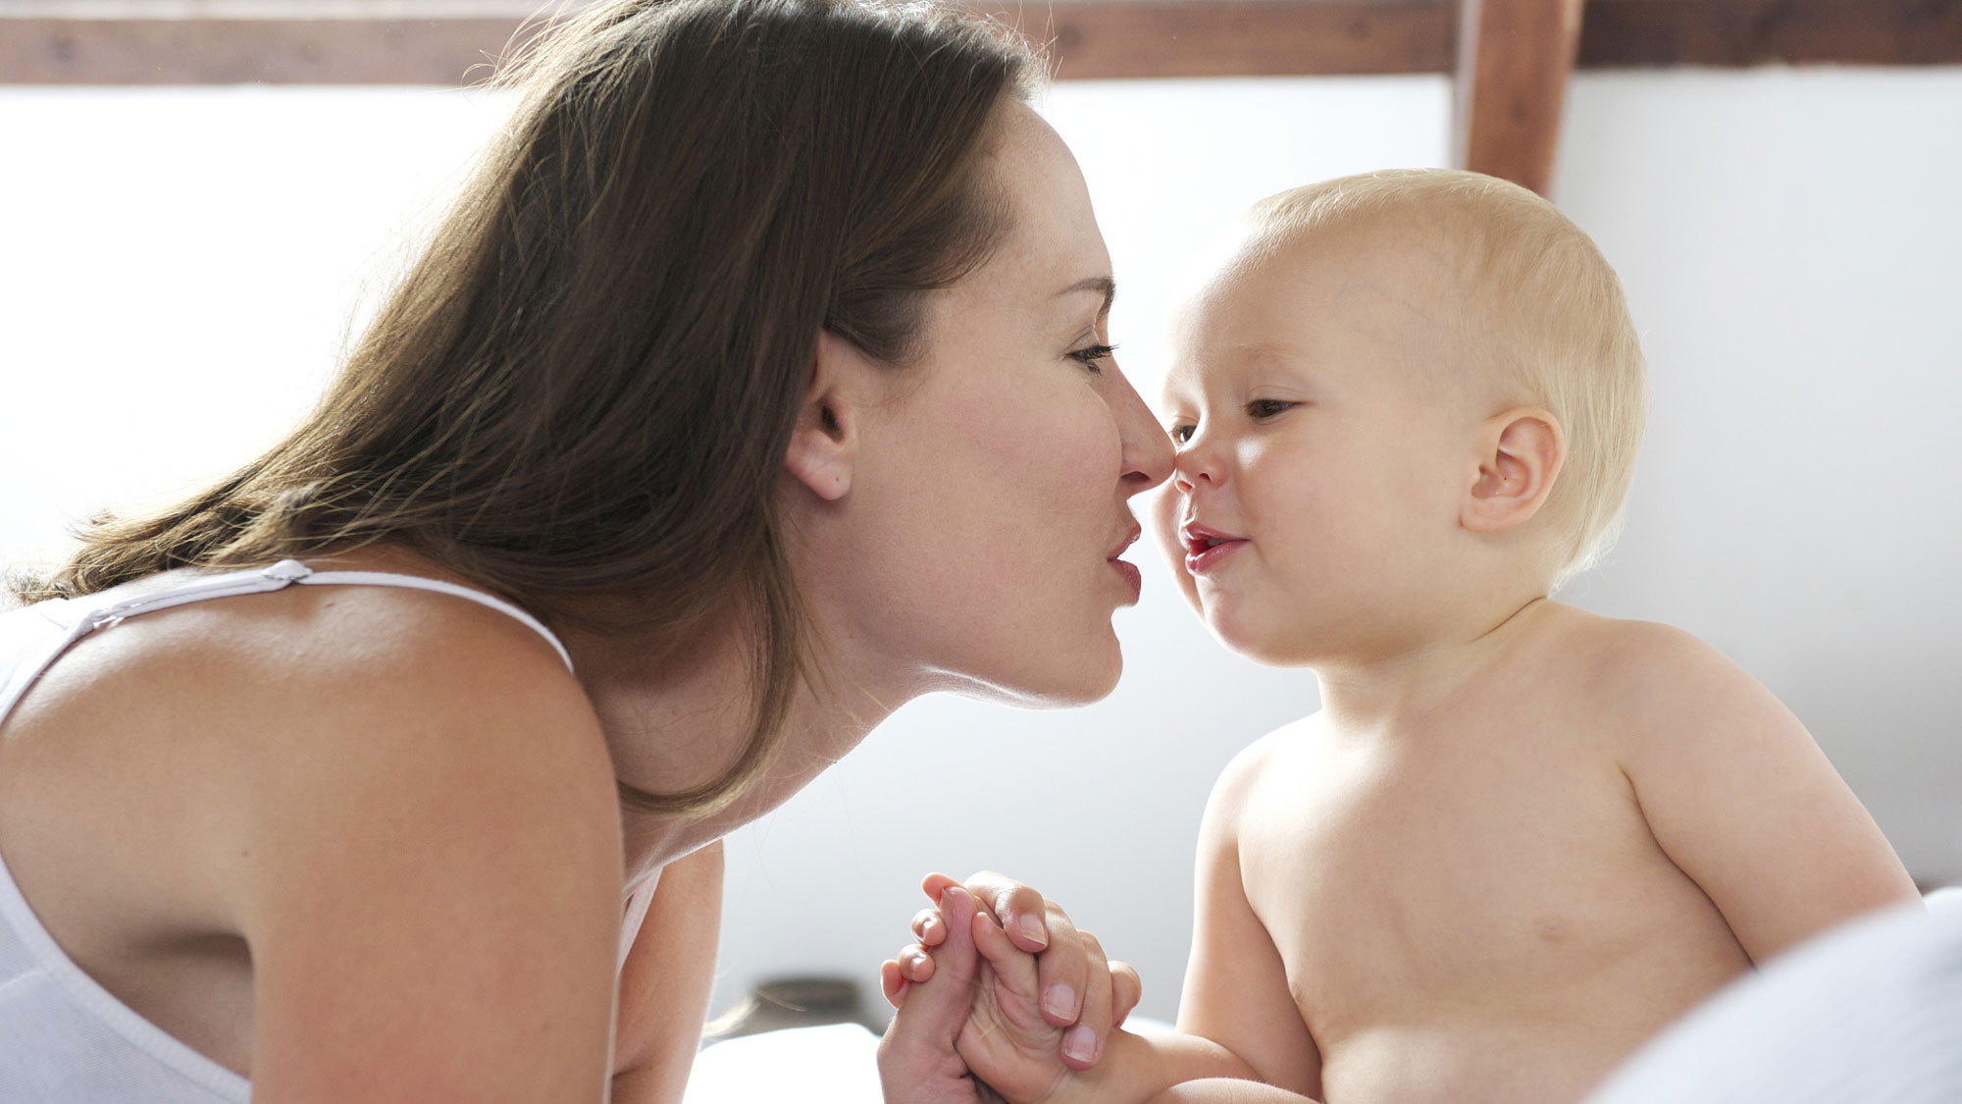
God is Loving
Loving mothers are a blessing from God and the Creator who loves us and gave us the best of Heaven: Jesus Christ!
God is loving
Jesus is loving
Mothers are loving

Slide 21
Conclusion
God is described in mostly masculine language but also in feminine with characteristics of a mother
Deut. 32:6
“Do you thus repay the LORD, O foolish and unwise people? Is not He your Father who has bought you? He has made you and established you.”
‘The Song of Moses,’ that closes Deuteronomy begins picturing God as Father!
Deut. 32:18
“You neglected the Rock who begot you, And forgot the God who gave you birth.”
But soon adds mother to the thought
Notes:
God is described in masculine language but on rare occasions He chooses to describe Himself with feminine language that conveys the characteristics of a mother.
The poem, ‘The Song of Moses,’ that closes Deuteronomy begins picturing God as Father:
Deut. 32:6: “Do you thus repay the LORD, O foolish and unwise people? Is not He your Father who has bought you? He has made you and established you.”
But soon adds mother to the thought:
Deut. 32:18: “You neglected the Rock who begot you, And forgot the God who gave you birth.”
Here God is depicted as a mother who gave birth to the nation!

Slide 22
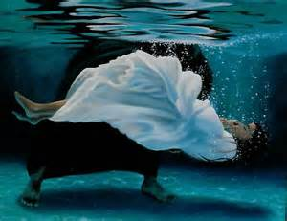
Conclusion
I Peter 1:3
“Blessed be the God and Father of our Lord Jesus Christ, who according to His great mercy has caused us to be born again to a living hope through the resurrection of Jesus Christ from the dead.”
Christianity is referred to as a “new birth,” which provokes the imagery of God as a Father & a Mother of His people. First Israel (Deut. 32:6, 18) and then Christians (John 3:3-10; James 1:18)
I John 4:7
“Beloved, let us love one another, for love is from God; and everyone who loves is born of God and knows God.”
As A Hen Gathers Her Chicks

Slide 23
Conclusion
This Mother’s Day as you appreciate your mother, praise God, the Creator of mothers, because He made them to be…
Compassionate
Caring
Loving
As A Hen Gathers Her Chicks

Slide 24
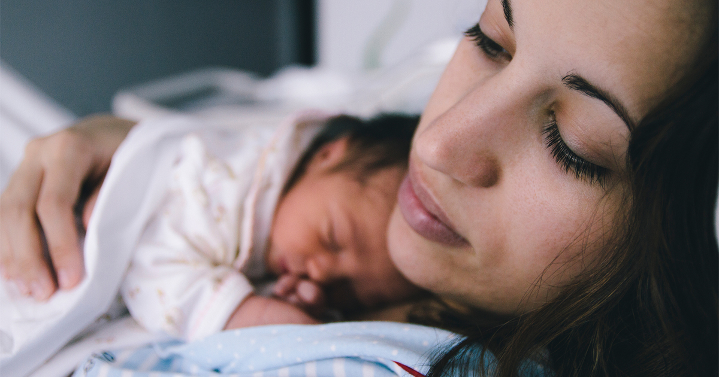
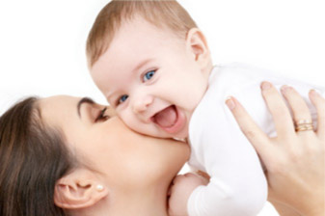
Conclusion
Mothers reflect the highest attributes of God! Perhaps this is at least part of what God meant when he said, “Let us make man in our image…Male and female He created them!”
As A Hen Gathers Her Chicks

Slide 25
“What Must I Do To Be Saved?”
Hear The Gospel (Jn. 5:24; Rom. 10:17)
Believe In Christ (Jn. 3:16-18; Jn. 8:24)
Repent Of Sins (Lk. 13:3-5; Acts 2:38)
Confess Christ (Mt. 10:32; Rom. 10:10)
Be Baptized (Mk. 16:16; Acts 22:16)
Remain Faithful (Jn. 8:31; Rev. 2:10)
For The Erring Saint:
Repent (Acts 8:22), Confess (I Jn. 1:9),
Pray (Acts 8:22)

