Slide 1
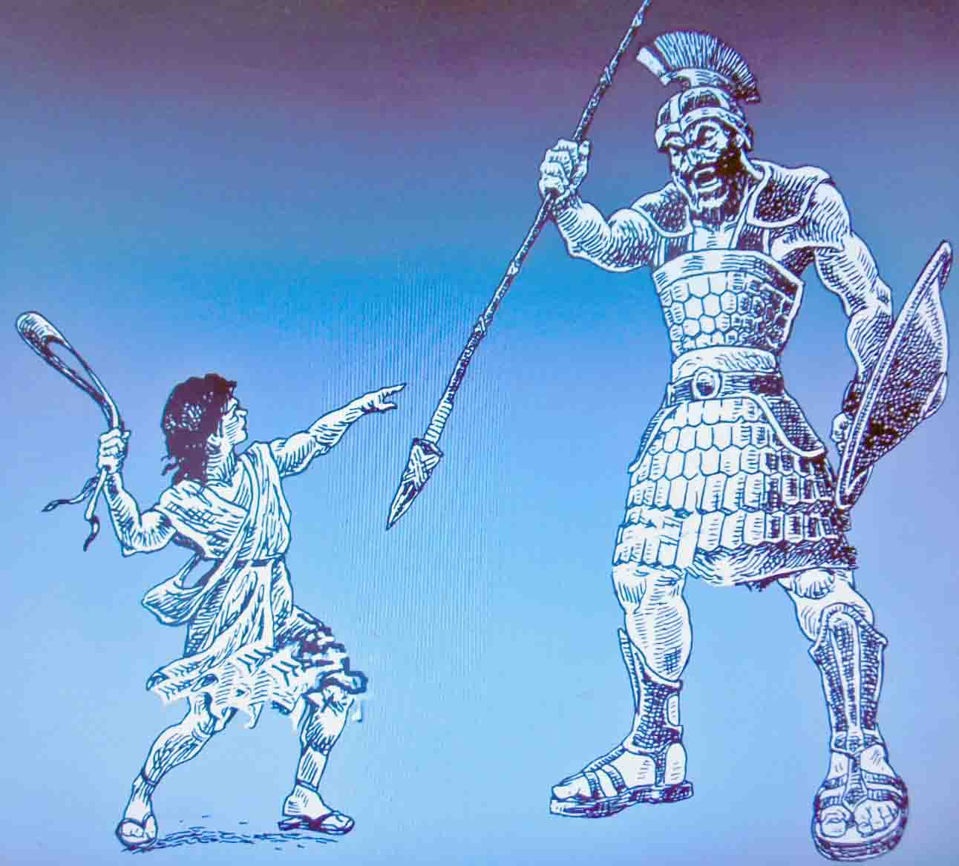
DAVID vs.
GOLIATH
I Samuel 17
Notes:
By Nathan L Morrison for Sunday 03/21/2021
All Scripture given is from NASB unless otherwise stated
For further study, or if questions, please Call: 804-277-1983 or Visit: www.courthousechurchofchrist.com
Additional helps at the end of the presentation
Some points and slides from a lesson by Steve Wallace

Slide 2
Intro
I Corinthians 16:13
13. Be on the alert, stand firm in the faith, act like men, be strong.
Courage is needed for every soldier in battle, and essential for the soldiers of Christ!
II Timothy 1:7
7. For God has not given us a spirit of timidity, but of power and love and discipline.

Slide 3
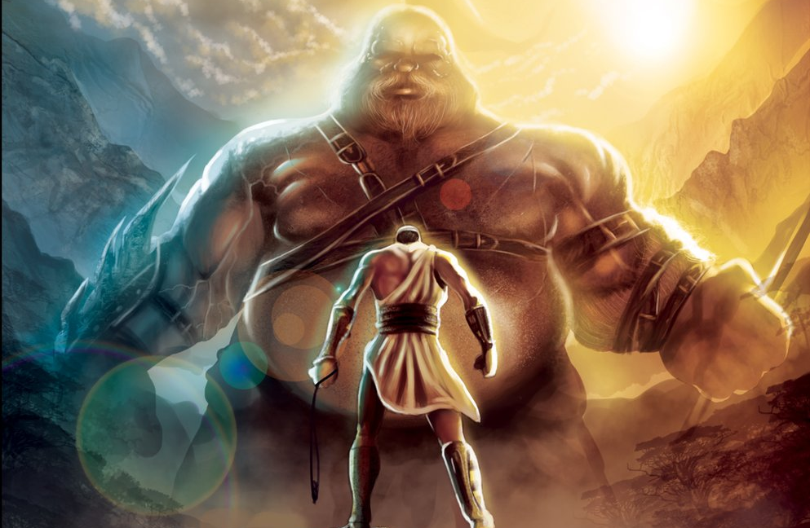
Intro
We will face the “giants” of the world and when we do, we need the courage & faith of David to overcome!
Notes:
Image: Artist is Nick Huddleston

Slide 4
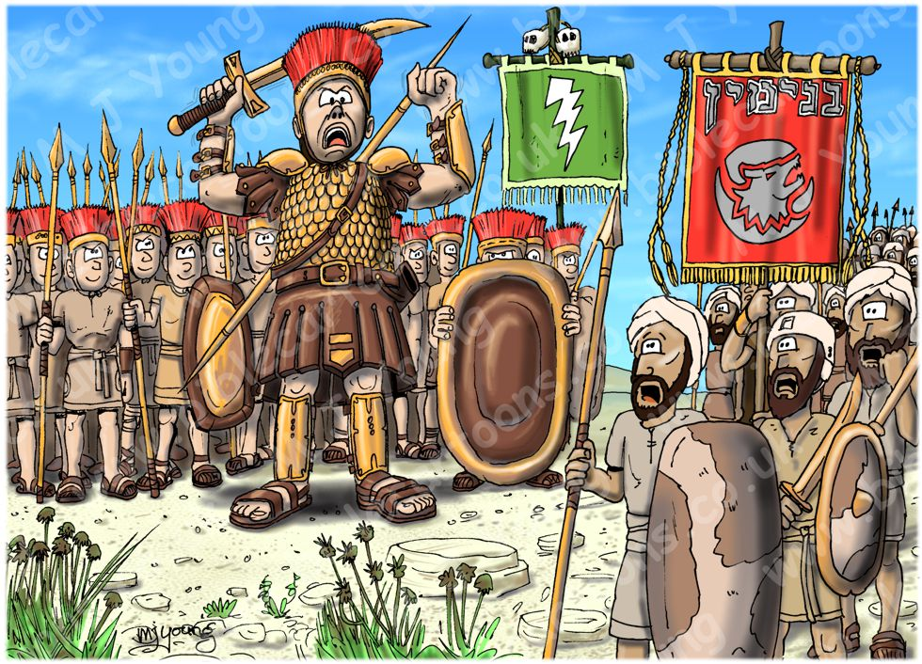
The Challenge
I Samuel 17:1-11, 16, 32
Philistines and Israel on each side of the Valley of Elah
Goliath challenged Israel for 40 days
Winner-take-all
Loser would serve winner
The freedom of each army was at stake
Israelite Army afraid!
David, a shepherd, accepted the challenge
For forty days the Israelites heard the challenge and were terrified!

Slide 5
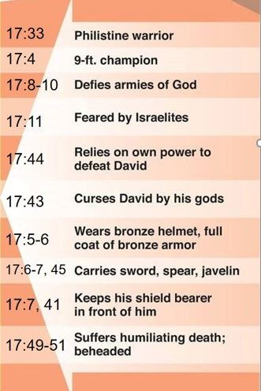
The Challengers
Goliath

Slide 6
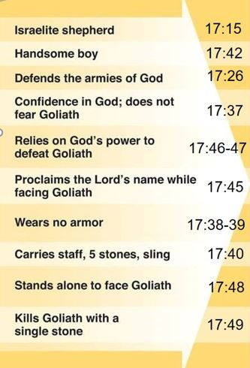
David
The Challengers

Slide 7
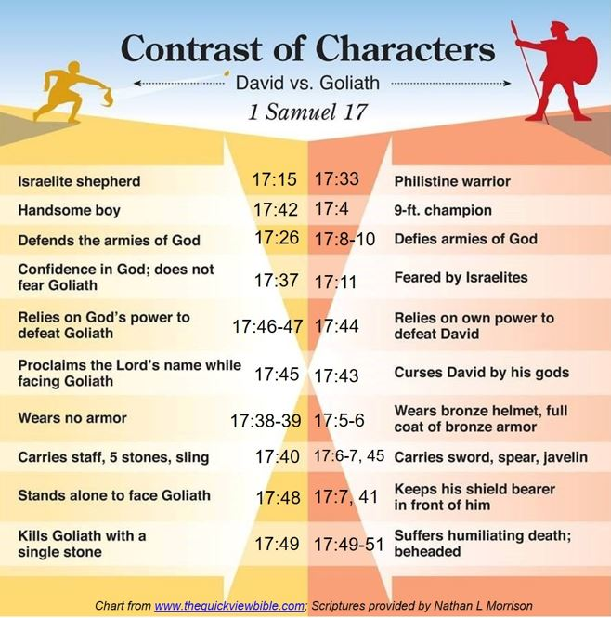
David’s courage was not in his personal stature or military training, but from his faith in God, knowing God is bigger than any giants and the battle belongs to the Lord!

Slide 8
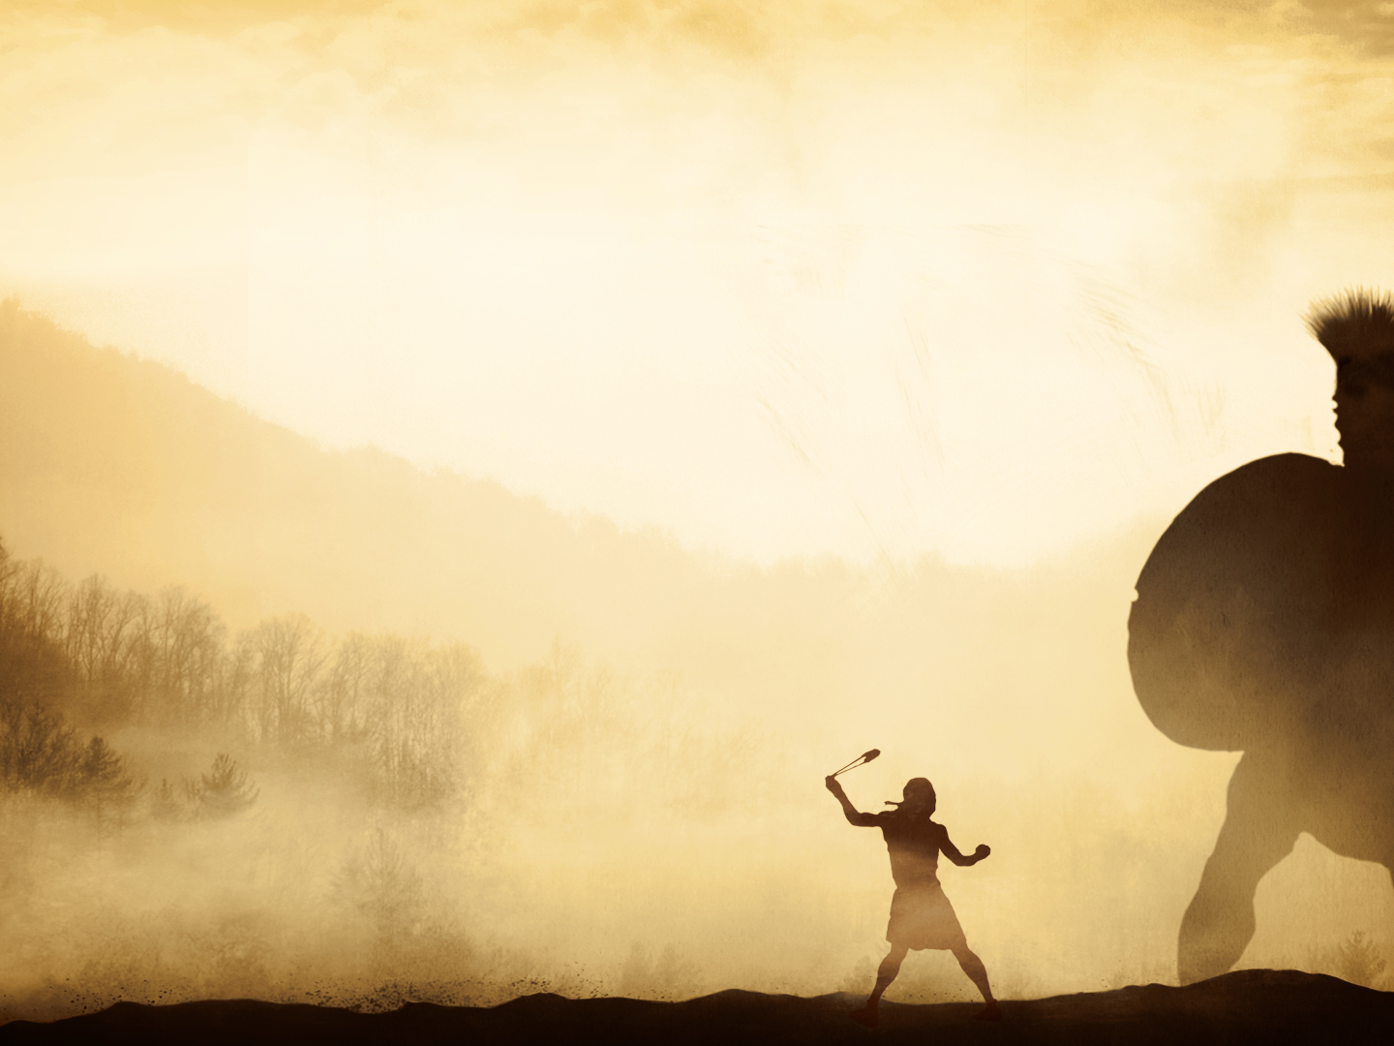
The Fight
David’s Faith – I Samuel 17
He fought a lion & a bear and God would deliver Goliath (17:33-37)
David wore no armor and no sword but took what he was used to into battle (17:38-40)
Goliath mocked David and cursed him by his gods (17:42-44)
David carried no sword but promised to cut off Goliath’s head because he knew God “does not deliver by sword or by spear; for the battle is the LORD'S!” (17:45-47, 50)

Slide 9
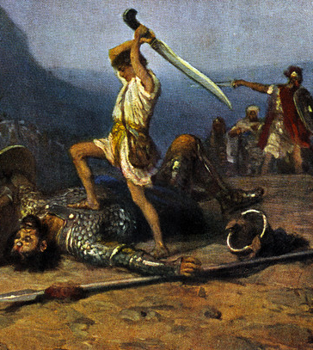
The Fight
David ran to the battle line, slung a stone and felled the giant, then stood over him, removed Goliath’s sword and beheaded him with it! (17:48-51)
The Philistines fled and the Israelite army chased them and plundered them! (17:51-54)
David’s courage and faith in God let him stand fearless in fearful times among fearful people and won the day!

Slide 10
The God of David is Your God!
He is the “living God” – I Samuel 17:26, 36
He is the Leader of the armies of Israel – I Samuel 17:46
He delivers His people – I Samuel 17:37, 47
He can deliver by many or by few – I Samuel 17:46; 14:6
Ephesians 3:20-21
20. Now to Him who is able to do far more abundantly beyond all that we ask or think, according to the power that works within us,
21. to Him be the glory in the church and in Christ Jesus to all generations forever and ever. Amen.
Notes:
"Years back the 'Daily Bread' devotional booklet passed on a fascinating story. During World War II a farmer in Sussex, England, sent some money to the Scripture Gift Mission, semi-apologizing that it was not more, but he said the harvest on his farm had been disappointing due to a lack of water. He also mentioned that he was very fearful because the Germans were dropping so many bombs and asked for the mission staff's prayers that he and his family might be spared. One staff member replied that although they couldn't ask the Lord that no bombs would fall on his land (perhaps that was too specific?), they would pray that 'God's will in the matter would prevail'. Not long after the farmer had received their reply, a huge German missile crashed down on his place. No family members or livestock were injured. However, the bomb went so deep into the ground that it liberated a submerged stream. The spring kept flowing and provided irrigation not only for our farmer's farm but for those of his neighbors. The next year was a larger donation!"
Dale Ralph Davis
"In the Presence of My Enemies" Christian Focus Publications, Ross-shire, Scotland, 2020, pp 114-115

Slide 11
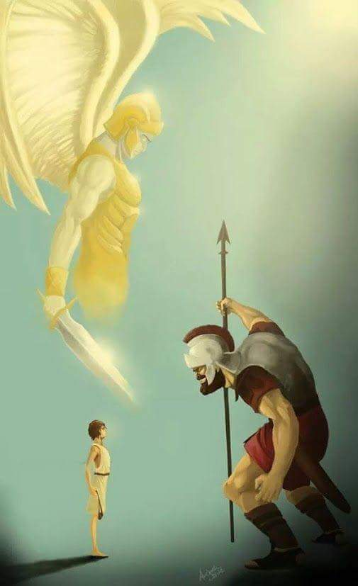
The God of David is Your God!
He is the “living God” –
I Samuel 17:26, 36
He is the Leader of the armies of Israel – I Samuel 17:46
He delivers His people –
I Samuel 17:37, 47
He can deliver by many or by few – I Samuel 17:46; 14:6
Ephesians 3:20-21
God is bigger than any giants in your life and you must face them with courage and faith!

Slide 12
Conclusion
“The battle is the Lord’s” today:
You will face giants in your life – II Corinthians 10:3-5
Faith must lead to courage – I Samuel 17:26, 33-37, 45-47; I Cor. 16:13
We must not let others discourage us – I Samuel 17:11, 23, 24, 26, 28, 32, 45-47; II Tim. 1:7
I Corinthians 16:13
13. Be on the alert, stand firm in the faith, act like men, be strong.
II Timothy 1:7
7. For God has not given us a spirit of timidity, but of power and love and discipline.

Slide 13
Conclusion
The “giants” of today include:
Worldliness
Compromise
Peer Pressure
Indifference
False doctrine
Lack of growth
Lack of Faith
Notes:
Image: Artist is Nick Huddleston

Slide 14
Conclusion
As in the days of Israel, the “giants” of today are not bigger than God!
We need to have the courage and faith in God like David to recognize “there is a God,” and that “the Lord does not save with sword and spear,” but that “the battle belongs to the Lord!”

Slide 15
“What Must I Do To Be Saved?”
Hear The Gospel (Jn. 5:24; Rom. 10:17)
Believe In Christ (Jn. 3:16-18; Jn. 8:24)
Repent Of Sins (Lk. 13:3-5; Acts 2:38)
Confess Christ (Mt. 10:32; Rom. 10:10)
Be Baptized (Mk. 16:16; Acts 22:16)
Remain Faithful (Jn. 8:31; Rev. 2:10)
For The Erring Saint:
Repent (Acts 8:22), Confess (I Jn. 1:9),
Pray (Acts 8:22)

Slide 17
Editable Table of David vs. Goliath

Slide 18
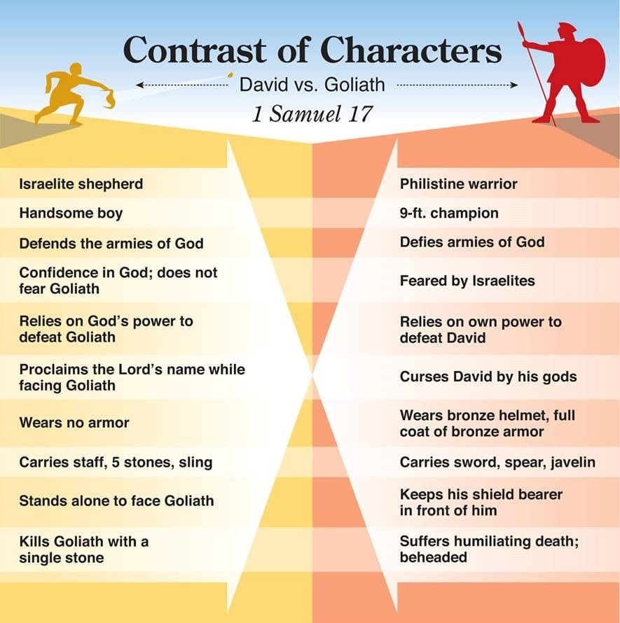
17:15
17:33
17:42
17:4
17:26
17:8-10
17:32, 37
17:11
17:46-47
17:44
17:45
17:43
17:38-39
17:5-6
17:40
17:6-7, 45
17:48
17:7, 41
17:49
17:49-51
Notes:
Contrast of Characters image from www.thequickviewbible.com
Editable Table

Slide 19
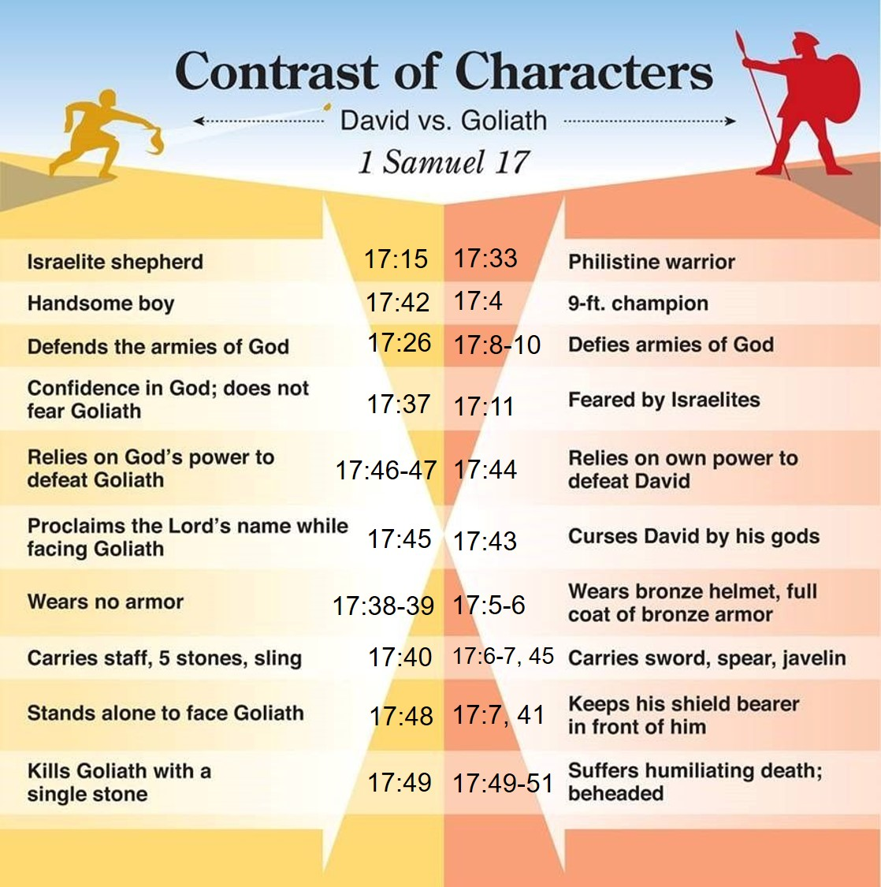
Chart from www.thequickviewbible.com; Scriptures provided by Nathan L Morrison
Notes:
Picture with editable bottom line

Slide 20
Picture of David vs. Goliath

