Slide 1
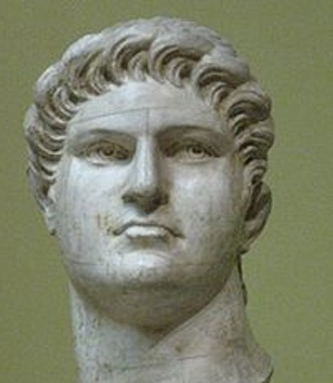
Saints In Caesar’s Household
Text:
Philippians 4:21-23
Notes:
By Nathan L Morrison
All Scripture given is from NASB unless otherwise stated
For further study, or if questions, please Call: 804-277-1983 or Visit www.courthousechurchofchrist.com
Image: Bust of Emperor Nero, Pushkin Museum in Moscow, Russia

Slide 2
Intro
“Paul and Timothy, bond-servants of Christ Jesus, To all the saints in Christ Jesus who are in Philippi, including the overseers and deacons: Grace to you and peace from God our Father and the Lord Jesus Christ” (Philippians 1:1-2)
“Saints” (Hagios, G40: Holy ones, sacred, morally blameless, pure, consecrated)
Equivalent to “holy” in OT: Heb. Qadowsh (H6918: sacred, set apart).
“Saints” identifies people “set apart” from the world and consecrated to God.
“Saint” doesn’t mean sinless beings! (I Cor. 1:2; ch. 5; ch. 11)
Notes:
Image: Ruins of Philippi, city center

Slide 3
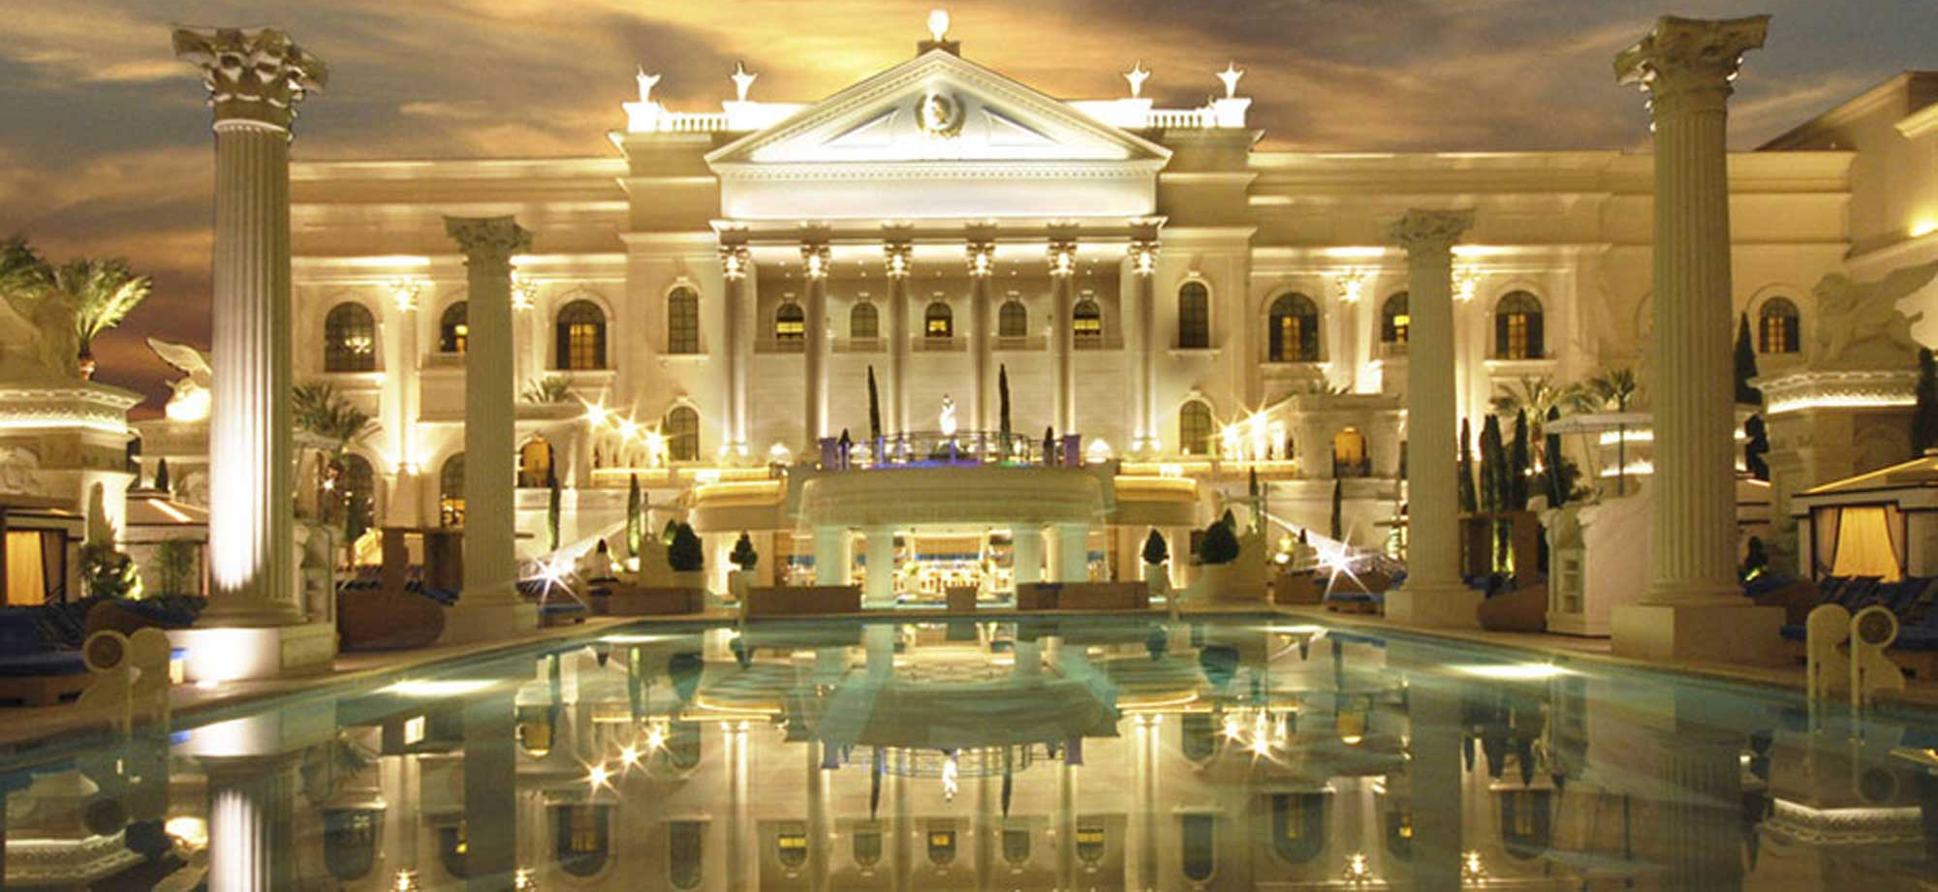
Intro
One can be “set apart” and live godly in an evil world!
Could refer to slaves or actual members of Caesar’s family.
The Caesars were not known for their spirituality, their morality, their self-control, nor for their appreciation for Christianity.
Many of them were avowed enemies of Christianity and persecuted the church.
“All the saints greet you, especially those of Caesar's household” (Philippians 4:22)
Notes:
Image: Caesar’s Palace in Las Vegas, NV, the Pool

Slide 4
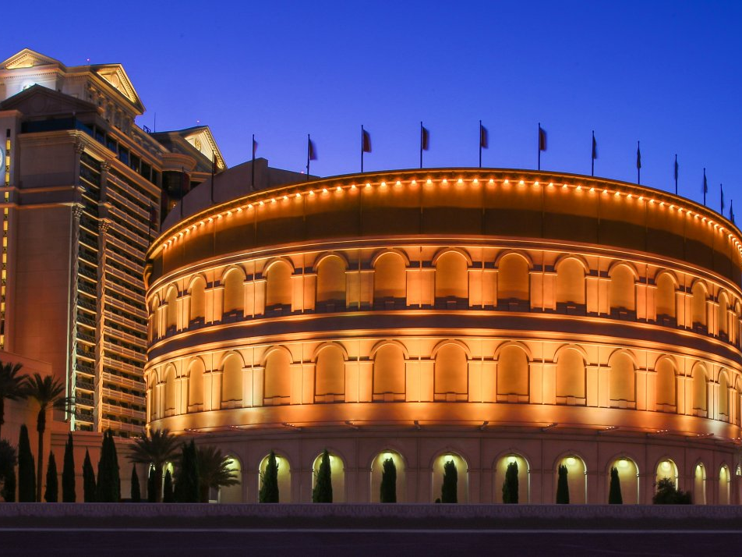
Joseph (Genesis 39)
“Saints in Caesar’s Household” in the Past
Notes:
Image: Caesar’s Palace in Las Vegas, NV, the Coliseum

Slide 5
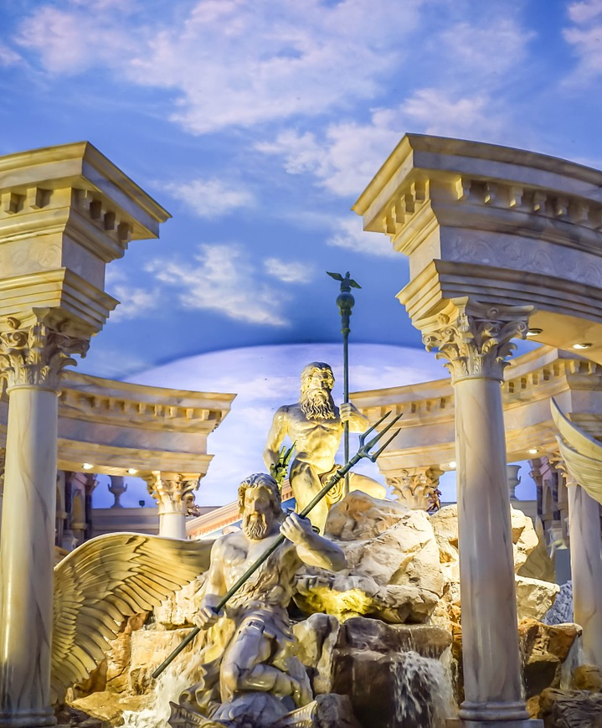
Joseph (Genesis 39)
“Saints in Caesar’s Household” in the Past
He served in the house of a pagan (polytheist) (Gen. 39:1-2).
He was often tempted to commit adultery (Gen. 39:10).
He suffered for doing what was right & was thrown in prison! (Gen. 39:11-20)
He prospered even in jail because he never lost faith in God (Gen. 39:21-23).
His faith was not circumstantial – Gen. 50:20 (God used his circumstances for good)
He didn’t vote for the Pharaoh of Egypt but served God faithfully under him!
Notes:
Image: Caesar’s Palace in Las Vegas, NV, the Fountain

Slide 6
Joseph (Genesis 39)
“Saints in Caesar’s Household” in the Past
Shadrach, Meshach, and Abed-nego (Daniel 3)
Notes:
Image: Caesar’s Palace in Las Vegas, NV, the Coliseum

Slide 7
Shadrach, Meshach, and Abed-nego (Dan. 3)
“Saints in Caesar’s Household” in the Past
They didn’t vote for King Nebuchadnezzar but served God faithfully under him!
Hananiah, Mishael and Azariah (Dan. 1:6-7)
Did not fall for “Everyone else was doing it!”
Stood out because they would not bow (Dan. 3:12).
Did not say, “When in Babylon…”
Their faith in God was not circumstantial – Dan. 3:16-18 (If God saved them or not, they would not bow!)
Their faith caused the pagan king to make a declaration of faith (Dan. 3:28-30)
Notes:
Image: Caesar’s Palace in Las Vegas, NV, the Fountain

Slide 8
Joseph (Genesis 39)
“Saints in Caesar’s Household” in the Past
Shadrach, Meshach, and Abed-nego (Daniel 3)
Daniel (Daniel 6)
Notes:
Image: Caesar’s Palace in Las Vegas, NV, the Coliseum

Slide 9
Daniel (Dan. 6)
“Saints in Caesar’s Household” in the Past
Daniel’s faith wasn’t left in Judah (Dan. 1:8)
His faith was not circumstantial – Dan. 6:10 (Whether it was the Babylonians in 605 B.C. or the Medo-Persians in 539 B.C., and even after he knew the foolish decree was signed by the Persian king, which cannot be retracted, he still prayed 3 times a day, as was his habit)
He unwaveringly faced the danger of death by lion’s den (Dan. 6:16-17).
His faith caused the pagan king to make a declaration of faith (Dan. 6:26-27).
He didn’t vote for any of the Babylonian kings or for any of the Persian kings but continually faithfully served God under them!
Notes:
Image: Caesar’s Palace in Las Vegas, NV, the Fountain

Slide 10
Joseph (Genesis 39)
“Saints in Caesar’s Household” in the Past
Shadrach, Meshach, and Abed-nego (Daniel 3)
Daniel (Daniel 6)
Saints in Caesar’s Household (Phil. 4:22)
Notes:
Image: Caesar’s Palace in Las Vegas, NV, the Coliseum

Slide 11
Saints in Caesar’s Household (Phil. 4:22)
“Saints in Caesar’s Household” in the Past
They didn’t vote for Caesar but were remaining faithful to God under him, even living in his house!
These were saints in Caesar’s household (slaves, soldiers or family members).
Phil. 1:12-14; Prov. 30:28
A tough household to remain faithful in and be a godly influence.
When you think you have it tough, ask yourself, “Could I have been a saint in Caesar’s household?”
Notes:
Image: Caesar’s Palace in Las Vegas, NV, the Fountain

Slide 12
Joseph (Genesis 39)
“Saints in Caesar’s Household” in the Past
Shadrach, Meshach, and Abed-nego (Daniel 3)
Daniel (Daniel 6)
Saints in Caesar’s Household (Phil. 4:22)
Despite the circumstances of life, these saints lived godly lives and influenced the idolaters they lived amongst!
Notes:
Image: Caesar’s Palace in Las Vegas, NV, the Coliseum

Slide 13
In Some Homes
“Saints in Caesar’s Household” Today
I Cor. 7:12-16
I Pet. 3:1-2
Think of the saints living in the household of Caesar! (Phil. 4:22)
Notes:
Image: Caesar’s Palace in Las Vegas, NV, the Pool

Slide 14
In Some Homes
“Saints in Caesar’s Household” Today
I Pet. 4:3-5
Col. 3:23-24
Think of Daniel, whose work ethic was beyond reproach! (Dan. 1:8; 6:4)
On Certain Jobs
Notes:
Image: Caesar’s Palace in Las Vegas, NV, the Pool

Slide 15
In Some Homes
“Saints in Caesar’s Household” Today
I Tim. 4:12; Titus 2:6-8
Think of Daniel (a youth) and the impact he had on a kingdom! (Dan. 1:3-4, 8, 18-21)
On Certain Jobs
In Some Schools
Notes:
Image: Caesar’s Palace in Las Vegas, NV, the Pool

Slide 16
In Some Homes
“Saints in Caesar’s Household” Today
James 1:13-15
Rom. 14:12; Phil. 2:10
Think of Cornelius, a military man, whose character was impeccable (Acts 10:1-2)
On Certain Jobs
In Some Schools
In The Military
Notes:
Image: Caesar’s Palace in Las Vegas, NV, the Pool

Slide 17
In Some Homes
“Saints in Caesar’s Household” Today
Christians can live godly lives regardless of their circumstances in life!
On Certain Jobs
In Some Schools
In The Military
Notes:
Image: Caesar’s Palace in Las Vegas, NV, the Pool

Slide 18
Conclusion
One can do what is right if the determination is strong enough!
(Philippians 4:13)
Philippians 2:14-16
The world today closely resembles that of Rome, and we are under the same charge to be faithful in a dark world!

Slide 19
Philippians 2:14-16
Conclusion
14. Do all things without grumbling or disputing;
15. so that you will prove yourselves to be blameless and innocent, children of God above reproach in the midst of a crooked and perverse generation, among whom you appear as lights in the world,
16. holding fast the word of life, so that in the day of Christ I will have reason to glory because I did not run in vain nor toil in vain.

Slide 20
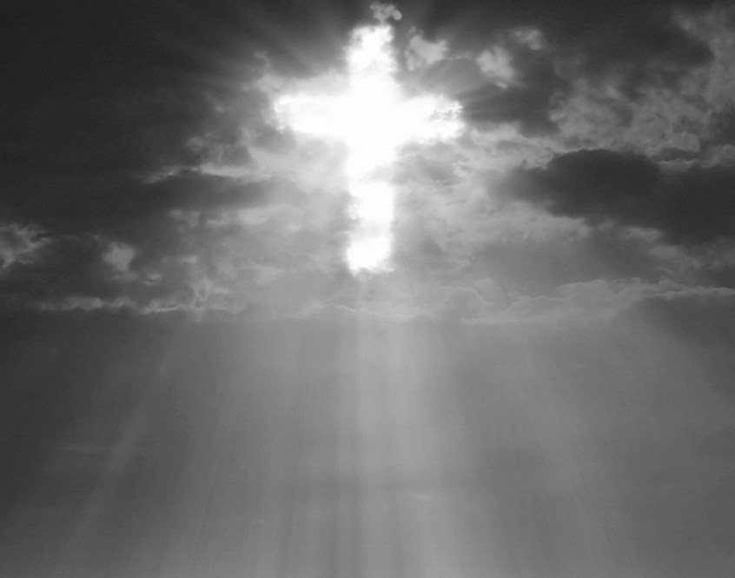
Conclusion
A great lesson found in
Phil. 4:22…
One can do what is right in spite of unfavorable circumstances!

Slide 21
“What Must I Do To Be Saved?”
Hear The Gospel (Jn. 5:24; Rom. 10:17)
Believe In Christ (Jn. 3:16-18; Jn. 8:24)
Repent Of Sins (Lk. 13:3-5; Acts 2:38)
Confess Christ (Mt. 10:32; Rom. 10:10)
Be Baptized (Mk. 16:16; Acts 22:16)
Remain Faithful (Jn. 8:31; Rev. 2:10)
For The Erring Saint:
Repent (Acts 8:22), Confess (I Jn. 1:9),
Pray (Acts 8:22)

