Slide 1
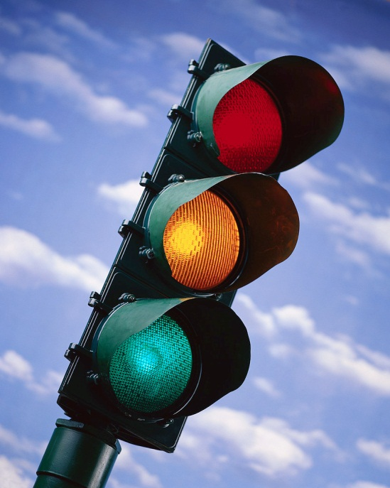
Traffic Lights Of God
Text:
II John 9-11
Notes:
By Nathan L Morrison
All Scripture given is from NASB unless otherwise stated
For further study, or if questions, please Call: 804-277-1983 or Visit: www.courthousechurchofchrist.com
Based on a lesson by Richard Thetford

Slide 2
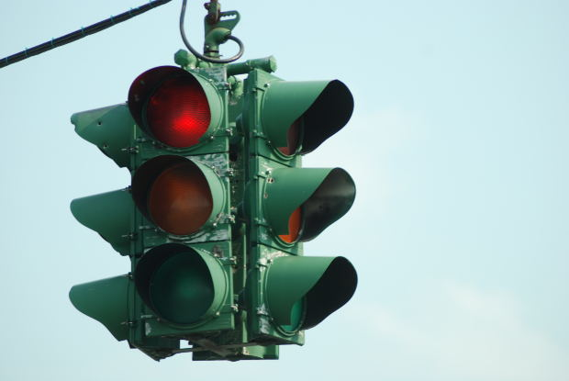
Intro
Traffic lights are a common sight at intersections today
and are there to direct traffic
The colors red (Stop), yellow (Caution), and green (Go) are meant for our protection while driving.
More important than the flow of
traffic are God’s traffic lights!
II John 9-11
9. Anyone who goes too far and does not abide in the teaching of Christ, does not have God; the one who abides in the teaching, he has both the Father and the Son.
10. If anyone comes to you and does not bring this teaching, do not receive him into your house, and do not give him a greeting;
11. for the one who gives him a greeting participates in his evil deeds.
We must watch for and obey the traffic lights of God!
Notes:
Emphasis in Scriptures mine!

Slide 3
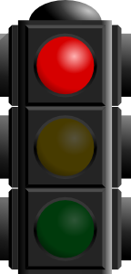
God’s Red Lights
STOP
Committing sin/practicing lawlessness (I John 3:4; Mt. 7:21-23; Col. 3:5; Js. 4:1-4)
Causing stumbling blocks (I Cor. 8:12; Mt. 18:7; Rom. 14:21) & division (I Cor. 1:10; 12:22-25)
Perverting the gospel (Gal. 1:6-8; II Pet. 2:1-3)
Going beyond God’s Word (II Tim. 4:3-4; II John 9)
There are serious consequences for transgressing God’s
RED LIGHTS! (Eternal Punishment)

Slide 4
God’s Yellow Lights
Caution
To not follow after just any way (Prov. 14:12; Mt. 7:13-14)
To do God’s will (Mt. 7:21; Heb. 5:9)
To test the spirits (I Jn. 4:1; Eph. 4:14-16)
To take heed lest we fall (I Cor. 10:12; Rom. 11:22; II Jn. 10-11)
To be prepared for Christ’s 2nd Coming (Mt. 25:13; II Pet. 3:10-12)
God’s YELLOW LIGHTS direct us away from eternal
punishment and to eternal life! (Reward)
Traffic Lights Of God

Slide 5
God’s Green Lights
Go
Obey the Gospel (Rom. 10:17; Jn. 3:16; Lk. 13:3; Rom. 10:9; Acts 22:16; Jn. 8:31)
Teach the Gospel (Acts 8:4; I Pet. 3:15)
Abide in the doctrine of Christ (II Jn. 9; Jn. 8:31)
Grow in Christ (Heb. 6:1; II Tim. 2:15; II Pet. 3:18)
Be with the Lord (Phil. 1:23; I Thess. 4:17)
Following God’s GREEN LIGHTS leads to an eternal home
with God! (Eternal Life)
Traffic Lights Of God

Slide 6
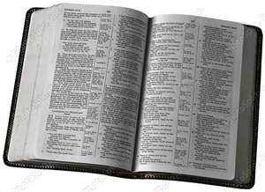
Conclusion
There are many other red, yellow, and green lights found
in God’s word; these are just a few!
Saints need to know what things to stop, when to use
caution, and to do the things God has instructed us to do!
II Tim. 2:15
15. Be diligent to present yourself approved to God as a workman who does not need to be ashamed, accurately handling the word of truth.
Obedience to the traffic lights of
God will result in our eternal
salvation with Him!
Notes:
Emphasis in Scripture mine!

Slide 7
“What Must I Do To Be Saved?”
Hear The Gospel (Jn. 5:24; Rom. 10:17)
Believe In Christ (Jn. 3:16-18; Jn. 8:24)
Repent Of Sins (Lk. 13:3-5; Acts 2:38)
Confess Christ (Mt. 10:32; Rom. 10:10)
Be Baptized (Mk. 16:16; Acts 22:16)
Remain Faithful (Jn. 8:31; Rev. 2:10)
For The Erring Saint:
Repent (Acts 8:22), Confess (I Jn. 1:9),
Pray (Acts 8:22)

