Slide 1
IN CHRIST
Text: II Corinthians 5:14-17
Happiness
In Life
Hope
In Death
Salvation
In Eternity
Notes:
By Nathan L Morrison
All Scripture given is from NASB unless otherwise stated
For further study, or if questions, please Call: 804-277-1983 or Visit: www.courthousechurchofchrist.com

Slide 2
Intro
We all want to feel special!

Slide 3
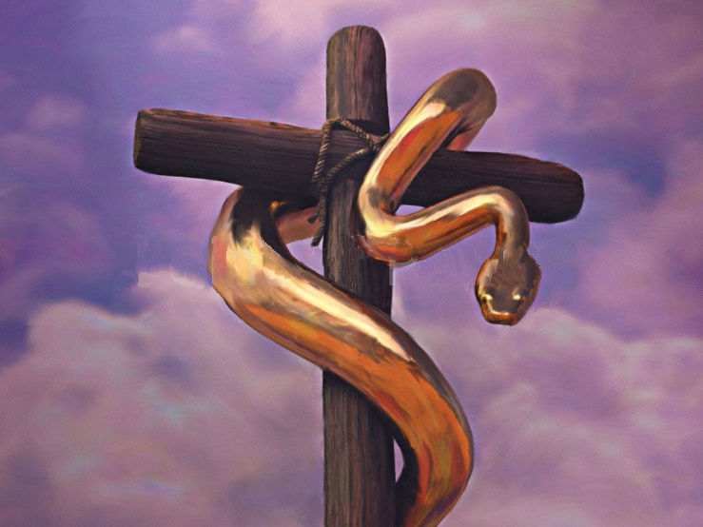
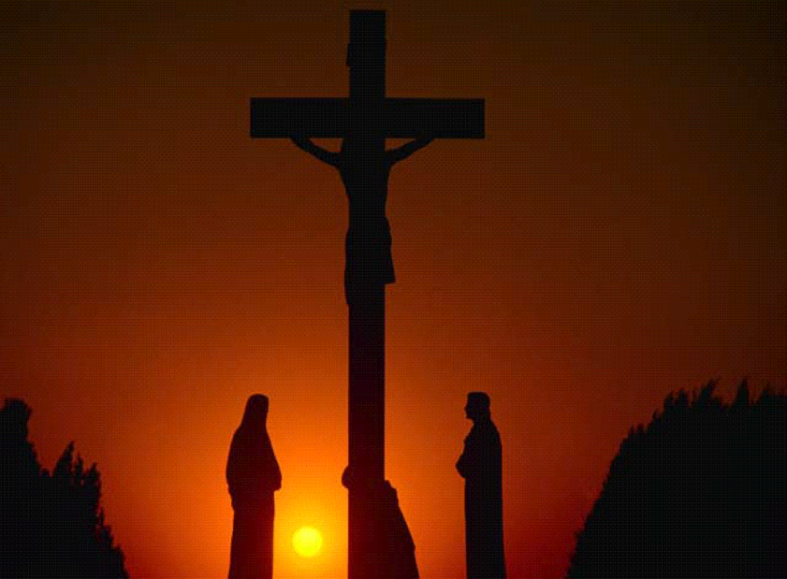
Intro
John 3:14-15
14. "As Moses lifted up the serpent in the wilderness, even so must the Son of Man be lifted up;
15. so that whoever believes will in Him have eternal life.
John 12:32
32. "And I, if I am lifted up from the earth, will draw all men to Myself."
All men have been bitten by the
viper of sin, and the only
cure is to look in obedient faith
to the cross of Calvary where
the Son of God died and shed
His blood for our sins!

Slide 4
Intro
II Cor. 5:14-17
14. For the love of Christ controls us, having concluded this, that one died for all, therefore all died;
15. and He died for all, so that they who live might no longer live for themselves, but for Him who died and rose again on their behalf.
16. Therefore from now on we recognize no one according to the flesh; even though we have known Christ according to the flesh, yet now we know Him in this way no longer.
17. Therefore if anyone is in Christ, he is a new creature; the old things passed away; behold, new things have come.
Notes:
Emphasis in Scripture mine!

Slide 5
Intro
In Christ:
Happiness
In Life
Hope
In Death
Salvation
In Eternity
In Christ are found the blessings of God!

Slide 6
In Christ:
II Cor. 5:17
How does one get “into Christ” to become a “new creature?”
Gal. 3:27: Baptized into Christ
Rom. 6:3-7
Col. 3:15
In Christ there is peace (Phil. 4:6-9) and salvation (Eph. 5:23) of the body (church – Col. 1:18) – One Can love life (I Pet. 3:10-12)
II Cor. 12:10; Phil. 4:11
Paul learned to be content in all circumstances
In Christ, one can be happy in this life, even with its ups and downs!
Happiness
In Life
In Christ one can truly enjoy and have happiness in life!
(both here and eternity)
Notes:
Image: Hebron today

Slide 7
In Christ:
II Cor. 5:17
In Christ, one is a “new creature”
John 15:1-6
Some do not “abide” in Christ
Some fall from grace – Gal. 5:4
Some depart the faith – I Tim. 4:1
Some deny the faith – I Tim. 5:8
Some overthrow the faith – II Tim. 2:18
We must “abide” in Christ
To abide the teaching of Christ – II Jn. 9
To abide in holiness and purity – Rom. 12:1-2; I Jn. 3:3
To abide in faithful obedience to Christ’s commands – Jn. 15:14; I Jn. 3:24
II Timothy 4:6-8 (I Jn. 2:25)
Hope
In Death
If one is “in Christ” they have hope even in death!
Notes:
Image: Hebron today

Slide 8
In Christ:
II Cor. 5:17
In Christ, the old things passed away” and “new things have come”
Rev. 14:13 (Rev. 2:10)
Phil. 1:21
“For to me, to live is Christ and to die is gain”
How could he say that?
He had been baptized into Christ – Acts 22:16; Rom. 6:3
He served a life abiding in Christ – II Tim. 4:6-8
I Pet. 1:3-4 (Rev. 21:7)
Heaven is reserved for the faithful and if they overcome the trials and storms of life they will inherit the home of God!
Salvation
In Eternity
If one is “in Christ” and remains faithful until death they will inherit Heaven, the home of God Almighty!
Notes:
Image: Hebron today

Slide 9
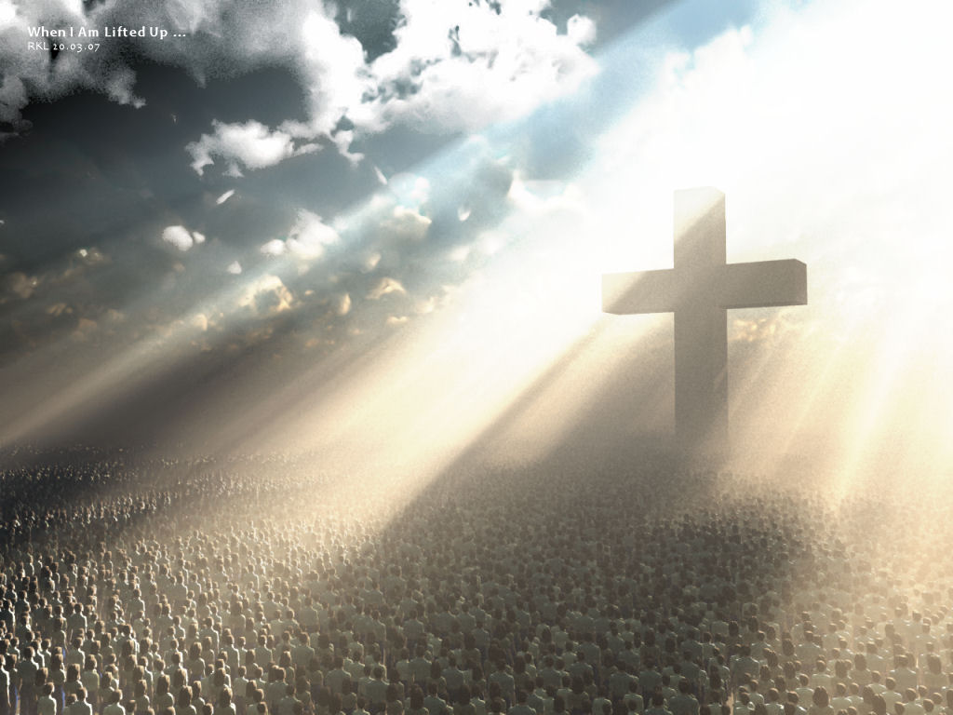
Conclusion
Jesus said He would draw all men to Himself in His
sacrifice on the cross! (Jn. 12:32)

Slide 10
Conclusion
The apostle Paul said we get “into Christ” through faith in
baptism! (Gal. 3:26-27)
Paul also says, “If anyone is in Christ, he is a new
creature; the old things passed away; behold, new things
have come” (II Cor. 5:17; Rev. 21:5-6)

Slide 11
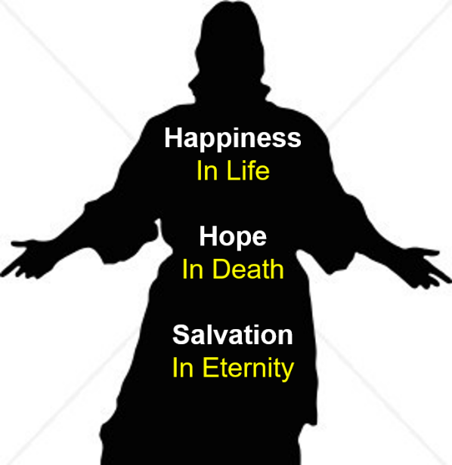
Conclusion
Only in Christ are found the blessings of God…
Blessed is the one who gets into Christ, abides in Christ, and dies in Christ!

Slide 12
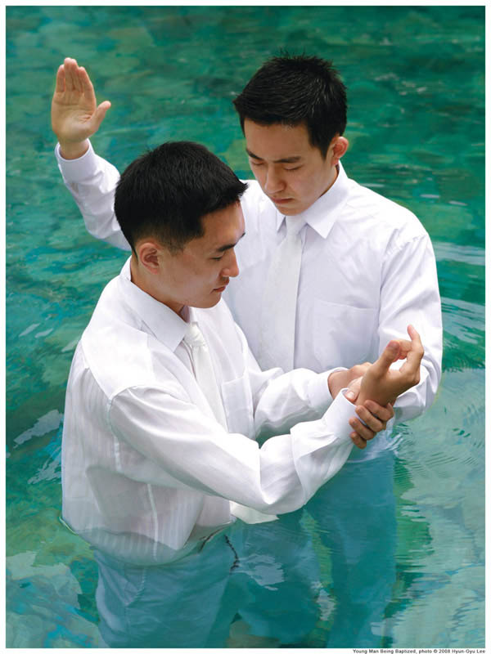
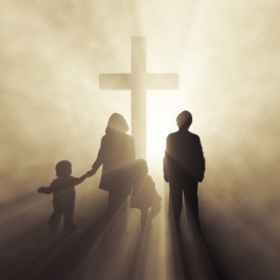
Conclusion
Are you “in Christ?”

Slide 13
“What Must I Do To Be Saved?”
Hear The Gospel (Jn. 5:24; Rom. 10:17)
Believe In Christ (Jn. 3:16-18; Jn. 8:24)
Repent Of Sins (Lk. 13:3-5; Acts 2:38)
Confess Christ (Mt. 10:32; Rom. 10:10)
Be Baptized (Mk. 16:16; Acts 22:16)
Remain Faithful (Jn. 8:31; Rev. 2:10)
For The Erring Saint:
Repent (Acts 8:22), Confess (I Jn. 1:9),
Pray (Acts 8:22)

