Slide 1
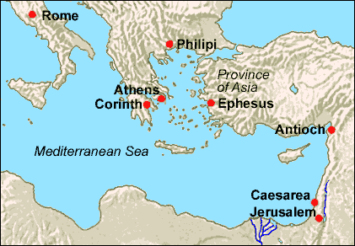
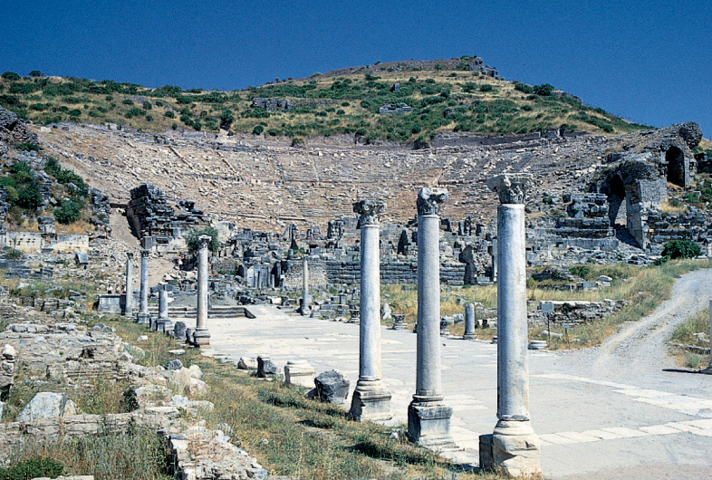
Lessons From Ephesus Text: Ephesians 1:13-14
Notes:
Prepared By Nathan L Morrison
All Scripture given is from NASB unless otherwise stated
For further study, or if questions, please Call: 804-277-1983 or Visit: www.courthousechurchofchrist.com
Adapted from a lesson by Richie Thetford
Images:
L: Map of Ephesus
R: Garden Walkway in Ephesus

Slide 2
Intro
“What do I need to do to become a Christian?”
Many “theories” and false doctrines attempt to answer this question
The answer is in the word of God! (Not found in creeds of man)
The conversion of the Ephesians is an example of what
they were before Christ, and how they became Christians!
How did the church grow in the center of Artemis(Diana) worship?
The example of the Ephesians’ conversion answers the
question of life: “What must I do to be saved?”

Slide 3
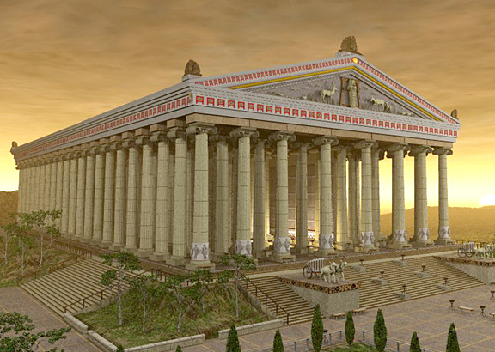
What The Ephesians Were Before Conversion
Study from books of Ephesians and Acts illuminates the
kind of people they were before they heard the gospel
Disciples of John, not of Jesus (Acts 19:1-7); “Exorcists &
Magicians” (19:13, 19); Idolaters (19:24-41)
After being taught John the Baptist pointed to Christ, they were baptized in Christ’s name.
There were those who tried to exorcize demons in the name of Christ, but had no authority to do so and were overpowered (19:13-17).
Many who practiced “magic” converted and burned their books (19:18-19).
Idolaters: Ephesus was the center for Artemis (Greeks)/Diana (Romans) worship – Temple to Artemis was considered one of the 7 Wonders of the World (Acts 19:34: “Great is Artemis of the Ephesians!”)
“The Great Mother Goddess”
Notes:
Image:
Artist’s rendering of Artemis’ (Diana’s) Temple in Ephesus
The temple no longer stands and the site had to be excavated to find the remains.
Artists can render what they imagine it looked like based off detailed accounts of its structure.

Slide 4
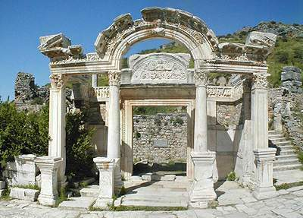
What The Ephesians Were Before Conversion
In book of Ephesians we learn more of who they were
before conversion:
Eph. 5:8 – Once were in darkness
Notes:
Emphasis in Scripture mine
Image:
Hadrian’s Temple in Ephesus

Slide 5
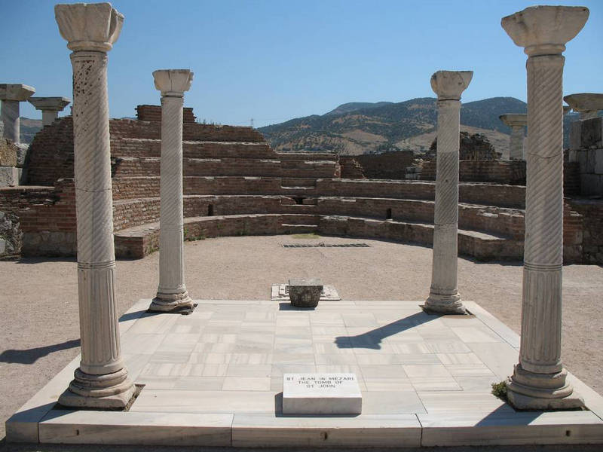
What The Ephesians Were Before Conversion
In book of Ephesians we learn more of who they were before conversion:
Eph. 5:8 – Once were in darkness
Eph. 2:1-3 – Were “dead” in sins
Were “dead” in trespasses and sins – 2:1
“Walked according to the course of this world, according to the prince of the power of the air;” “disobedient” – 2:2
“Formerly lived in the lusts” of flesh (sexual immorality) – 2:3
“Indulging the desires of the flesh and of the mind” – 2:3
“Children of wrath” – 2:3
Notes:
Image:
Ruins in Ephesus

Slide 6
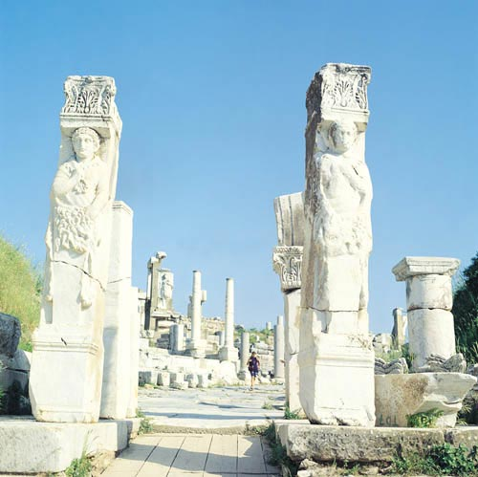
What The Ephesians Were Before Conversion
In book of Ephesians we learn more of who they were before conversion:
Eph. 5:8 – Once in darkness
Eph. 2:1-3 – Dead in sin
Eph. 2:11-13 – Separate from Christ & God, No Hope
“Separate from Christ” – Eph. 2:12
“Excluded from the commonwealth of Israel” (Considered dogs by Jews) – 2:12
“Strangers to the covenants of promise” (No spiritual home) – 2:12
“Having no hope and without God in the world” – 2:12
“Formerly were far off” – 2:13
Notes:
Image:
Ruins at Ephesus

Slide 7
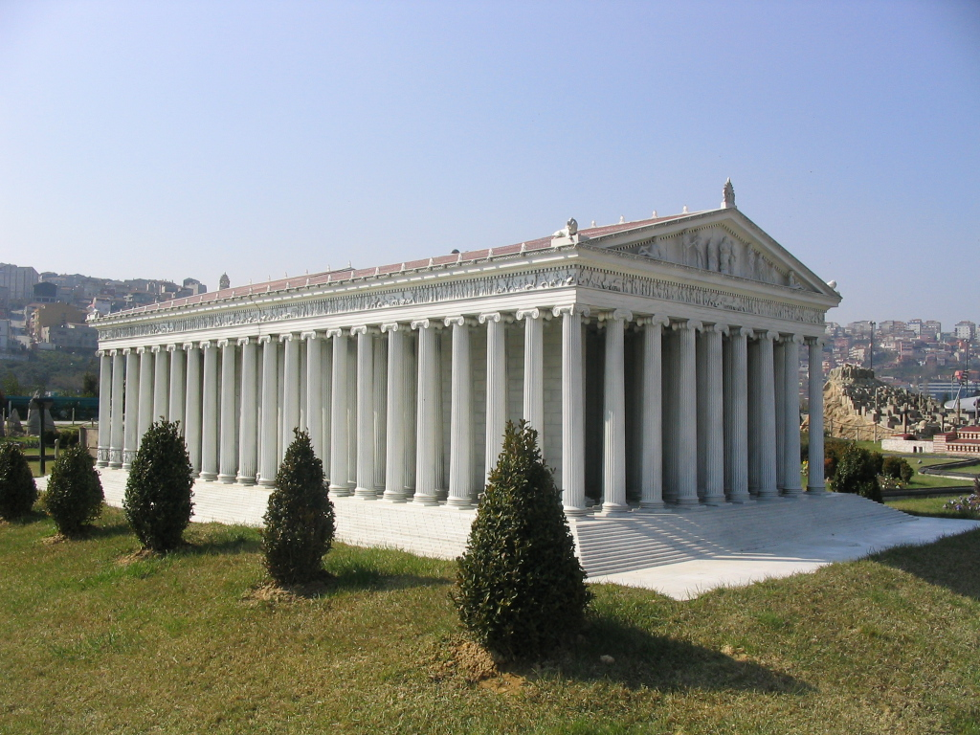
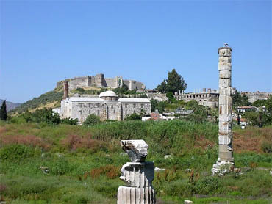
What The Ephesians Were Before Conversion
In book of Ephesians we learn more of who they were before conversion:
Eph. 5:8 – Once in darkness
Eph. 2:1-3 – Dead in sin
Eph. 2:11-13 – Separate from Christ, No Hope
Eph. 4:14 – Carried about by every wind of doctrine
Notes:
Image:
To-scale Model of Diana’s Temple in Miniaturk Park, Istanbul, Turkey
http://en.wikipedia.org/wiki/Temple_of_Artemis
Image:
Diana’s Temple site
A pillar has been erected to remind people where the temple once stood. Excavated in 1869-1874 and again in 1904-1906

Slide 8
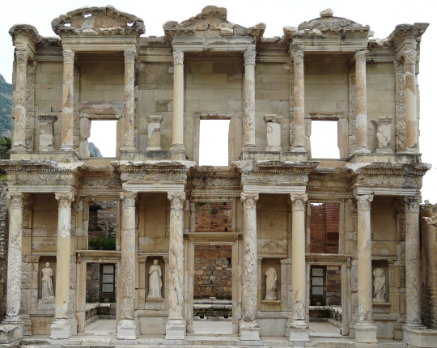
What The Ephesians Were Before Conversion
In book of Ephesians we learn more of who they were before conversion:
Eph. 5:8 – Once in darkness
Eph. 2:1-3 – Dead in sin
Eph. 2:11-13 – Separate from Christ, No Hope
Eph. 4:14 - “Carried about by every wind of doctrine”
Eph. 4:17-20 – Futility of mind
“Futility of mind”
“darkened in their understanding”
“ignorance”
“callous”
“practice of every kind of impurity”
Notes:
Image:
Celsus Library Ruins
The library was built to house over 12,000 scrolls!

Slide 9
What The Ephesians Were Before Conversion
In book of Ephesians we learn more of who they were before conversion:
Eph. 5:8 – Once in darkness
Eph. 2:1-3 – Dead in sin
Eph. 2:11-13 – Separate from Christ, No Hope
Eph. 4:14 – Carried about by every wind of doctrine
Eph. 4:17-20 – Futility of mind
The Nature of Sin: Twisted and Ugly!

Slide 10
What The Ephesians Did To Become Christians
They “HEARD” the word of Truth – the Gospel
Acts 19:5
5. When they heard this, they were baptized in the name of the Lord Jesus.
Acts 19:10
10. This took place for two years, so that all who lived in Asia heard the word of the Lord, both Jews and Greeks.
Acts 20:26-27
26. "Therefore, I testify to you this day that I am innocent of the blood of all men.
27. "For I did not shrink from declaring to you the whole purpose of God.

Slide 11
What The Ephesians Did To Become Christians
They “HEARD” the word of Truth – the Gospel
Eph. 1:13-14
13. In Him, you also, after listening to the message of truth, the gospel of your salvation--having also believed, you were sealed in Him with the Holy Spirit of promise,
14. who is given as a pledge of our inheritance, with a view to the redemption of God's own possession, to the praise of His glory.

Slide 12
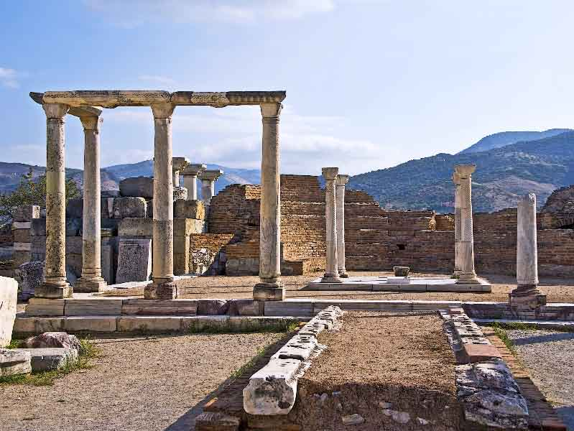
What The Ephesians Did To Become Christians
They “BELIEVED” the word of God
Acts 20:21
21. solemnly testifying to both Jews and Greeks of repentance toward God and faith in our Lord Jesus Christ.
Eph. 1:13
13. In Him, you also, after listening to the message of truth, the gospel of your salvation--having also believed, you were sealed in Him with the Holy Spirit of promise,
Notes:
Image:
Ruins at Ephesus

Slide 13
What The Ephesians Did To Become Christians
They “REPENTED” of their sins
Acts 19:18-19
18. Many also of those who had believed kept coming, confessing and disclosing their practices.
19. And many of those who practiced magic brought their books together and began burning them in the sight of everyone; and they counted up the price of them and found it fifty thousand pieces of silver.
Acts 20:21
21. solemnly testifying to both Jews and Greeks of repentance toward God and faith in our Lord Jesus Christ.
Notes:
Image:
Hadrian’s Temple

Slide 14
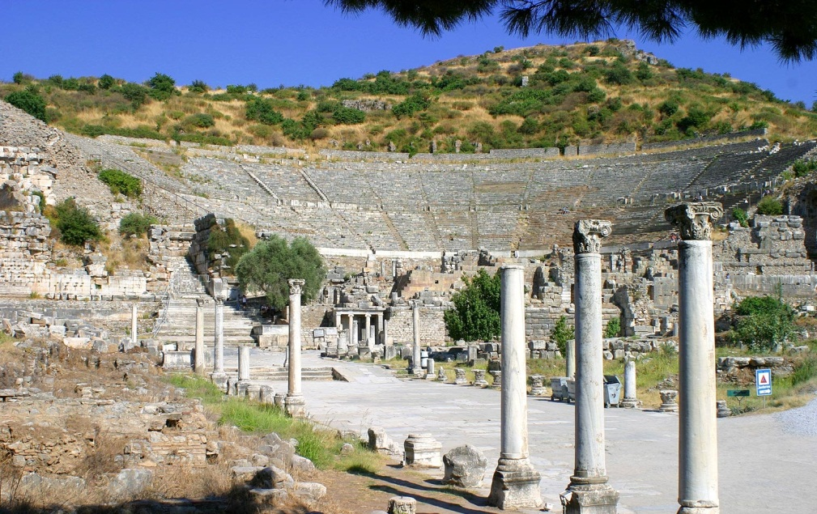
What The Ephesians Did To Become Christians
They “Confessed” Christ as Lord
Acts 19:17
17. This became known to all, both Jews and Greeks, who lived in Ephesus; and fear fell upon them all and the name of the Lord Jesus was being magnified.
The book of Ephesians is a confession of Christ’s Lordship!
(5:20-21, 23; 6:24)
Eph. 6:24
24. Grace be with all those who love our Lord Jesus Christ with incorruptible love.
Notes:
Image:
Garden Walkway in Ephesus

Slide 15
What The Ephesians Did To Become Christians
They were “BAPTIZED” in the name of Christ
Acts 19:5
5. When they heard this, they were baptized in the name of the Lord Jesus.
Eph. 4:4-6
4. There is one body and one Spirit, just as also you were called in one hope of your calling;
5. one Lord, one faith, one baptism,
6. one God and Father of all who is over all and through all and in all.
Eph. 5:25-26
25. Husbands, love your wives, just as Christ also loved the church and gave Himself up for her,
26. so that He might sanctify her, having cleansed her by the washing of water with the word,

Slide 16
What The Ephesians Did To Become Christians
They were exhorted to remain “OBEDIENT”
Eph. 5:1
1. Therefore be imitators of God, as beloved children;
Eph. 5:6-8
6. Let no one deceive you with empty words, for because of these things the wrath of God comes upon the sons of disobedience.
7. Therefore do not be partakers with them;
8. for you were formerly darkness, but now you are Light in the Lord; walk as children of Light
Eph. 5:11
11. Do not participate in the unfruitful deeds of darkness, but instead even expose them;
Eph. 5:15
15. Therefore be careful how you walk, not as unwise men but as wise,

Slide 17
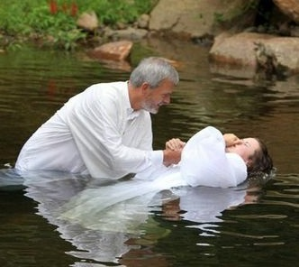
What The Ephesians Did To Become Christians
They “HEARD” the Gospel – Eph. 1:13-14
They “BELIEVED” the word of God – Eph. 1:13
They “REPENTED” of their sins – Acts 19:18
They “CONFESSED” Christ as Lord – Acts 19:17; Eph. 6:24
They were “BAPTIZED” in the name of Christ – Acts 19:5
They were exhorted to remain “OBEDIENT” – Eph. 5:6-8
The Ephesians are an example of obedience to
God’s word!

Slide 18
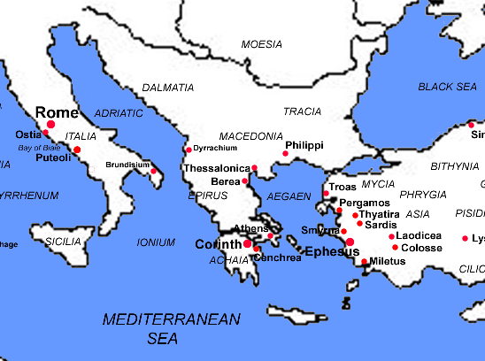
Conclusion
The things done in the 1st century are in obedience to
God’s commands – not man’s
They are just as binding today as they were then
Eph. 1:1:22-23; 5:23-24: The church today can do no different than it did then, for Christ is still it’s “Head” and so the church must be “subject to Christ.”

Slide 19
Conclusion
People today must take the same steps as the Ephesians
did to be saved or they are still left in the same
“darkness” the Ephesians “formerly” were in!
People searching for the answer to “What must I do to be
saved?” need to go to same source the Ephesians did:
the word of God!
Believe and obey God’s word, God’s way, TODAY!

Slide 20
“What Must I Do To Be Saved?”
Hear The Gospel (Eph. 1:13-14)
Believe In Christ (Eph. 1:13)
Repent Of Sins (Acts 19:18)
Confess Christ (Acts 19:17; Eph. 6:24)
Be Baptized (Acts 19:5)
Remain Faithful (Eph. 5:6-8)
For The Erring Saint:
Repent (Acts 8:22), Confess (I Jn. 1:9),
Pray (Acts 8:22)

