Slide 1
The Noble Bereans
Text:
Acts 17:10-12
Notes:
By Nathan L Morrison
All Scripture given is from NASB unless otherwise stated
For further study, or if questions, please Call: 804-277-1983 or Visit www.courthousechurchofchrist.com
Adapted from an article by the Olive Tree Bible App

Slide 2
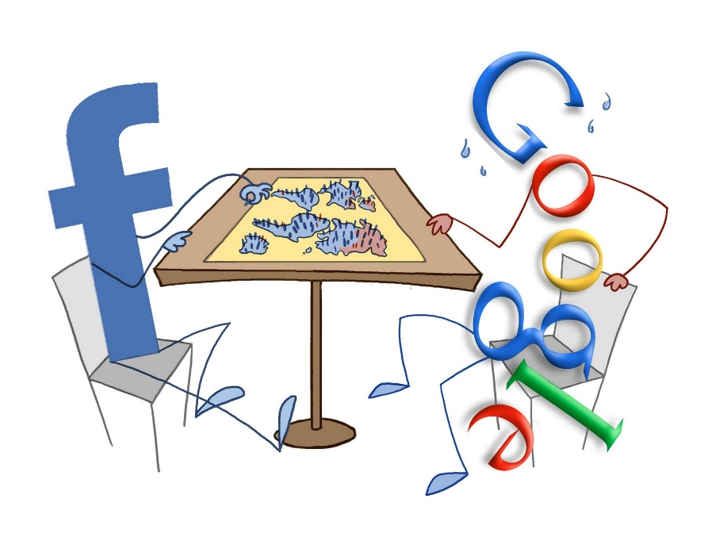
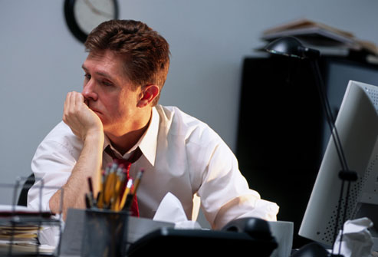
Intro
It can be very difficult to know what is true and what isn’t!
Do you often feel overwhelmed and exhausted by all the fact checking that is required of us?
We are CONSTANTLY receiving new information: News broadcasts, articles shared on Facebook, opinions on Twitter, advertisements on Instagram, books, movies, app notifications…the list goes on and on!
Let's look at Acts 17:10-12 and see how the Bereans handled all the information they were receiving!

Slide 3
Nobility of the Bereans
“The brethren immediately sent Paul and Silas away by night to Berea, and when they arrived, they went into the synagogue of the Jews. Now these were more noble-minded than those in Thessalonica, for they received the word with great eagerness, examining the Scriptures daily to see whether these things were so. Therefore many of them believed, along with a number of prominent Greek women and men.” (Acts 17:10-12)

Slide 4
Nobility of the Bereans
The Bereans were aware of the pressure to have correct information
With the news Paul and Silas were spreading about Jesus, everyone was on edge
Back in Thessalonica the Jews accused Paul & Silas of being the “men who have upset the world” (Acts 17:5-6)
The NKJV says, “These who have turned the world upside down…”

Slide 5
Nobility of the Bereans
The Gospel challenged the current trends on...
Religion (Mark 12:30-31; Romans 1:16)
Politics (Romans 13:1-7; I Peter 2:13-17)
Socioeconomics (Galatians 3:26-28; Colossians 3:11; James 2:1-9)
Racial Barriers (Acts 17:26; Ephesians 2:11-22; James 2:9)
…and more!

Slide 6
Nobility of the Bereans
choosing sides was a lot more threatening than picking Democrat or Republican!
This decision was religious rulers versus Jesus, Rome versus Jesus, cultural values versus Jesus…and behind the scenes, Satan versus Jesus
Believing Jews could still be put out of the Synagogue (John 9:18-22; 12:42-43) so the decision to believe in Jesus was a life-changing one, as it has always been!

Slide 7
Nobility of the Bereans
Acts 17:10-12: Luke wrote something attention-grabbing!
He lifts the Berean Jews up as an example
This is rare!
Why did he choose to say this, out of all the people they met on their journey?
A characteristic stood out to him—a very important one!

Slide 8
Nobility of the Bereans
“Noble”: Greek word eugenes (G2104, Strong’s)
It means: “well born, i.e. (literally) high in rank, or (figuratively) generous"
In 2020: “The Berean Jews knew how to stay classy”
When they were met with a difficult message, they kept their character in check and remained honorable
When everything they were taught was challenged by the Gospel, they didn’t run away plugging their ears or start shouting over Paul and Silas
With eagerness and a willing mind they began the process of fact checking, seeing if the Old Testament really did prophecy Jesus to be the Messiah!
In the end, they discovered the Gospel to be true and became followers of Jesus!

Slide 9
Nobility Today
Maybe this Sunday you will find yourself questioning if what is being preached is true
Perhaps you’ve had a Bible class and the teacher has made some interesting claims
maybe you’re simply scrolling online and a headline makes your stomach churn with anger, fear, and questions!
How can we be like the Bereans in these moments?

Slide 10
Nobility Today
Be like the Bereans…
Don’t lose your temper (James 1:19-20; Galatians 5:20)
Have a willing mind (Hebrews 3:15; Romans 12:2)
Listen to what others say (James 1:19; Acts 18:19)
Evaluate the claims others make (Acts 17:2-4, 10-12)
Compare what you hear with Scripture (I John 4:1-6; Acts 17:2-3)
Consider if some of your long-held interpretations of Scripture needs to be re-examined (Acts 18:24-28; I Thessalonians 1:9-10)
Ask friends to join you in your research (Colossians 1:3-8; I Thessalonians 1:2-8; Philippians 4:3)
Rinse & Repeat!

Slide 11
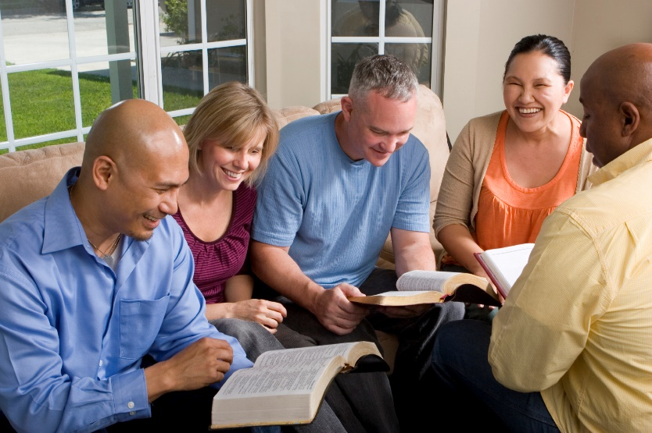
Nobility Today
The world isn’t the only battleground for misinformation
The religious world is filled with error and contradictions
Today we must, like the Bereans of old, be noble-minded to fact check and make sure what we hear is truly from the word of God!

Slide 12
Conclusion
One of the trickiest situations we encounter is when someone claims the Bible to mean something we aren’t sure to be true
The problem is that our English Bibles are translations and not all of us are Greek and Hebrew scholars.
How do we evaluate these claims then?
You can use a Bible study tool that has Strong’s, Vine’s or Thayer, or other reputable Hebrew-Greek Lexicons.
With tools like this, you can look up nearly any word with a tap or two and read its original definition!

Slide 13
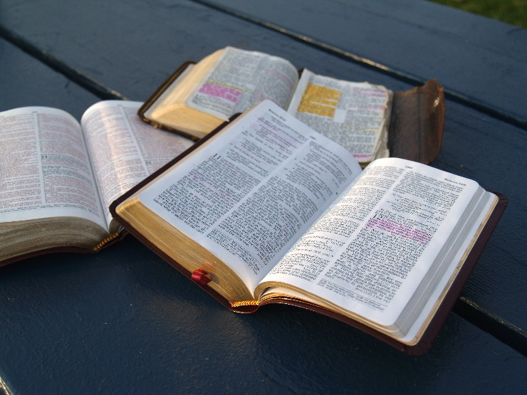
Conclusion
“Be diligent to present yourself approved to God as a workman who does not need to be ashamed, accurately handling the word of truth.” (II Timothy 2:15)

Slide 14
Conclusion
It is necessary to not only read the Scriptures but, like the noble Bereans, be noble-minded to study them to make sure we are obeying God the way He wants us to!

Slide 15
“What Must I Do To Be Saved?”
Hear The Gospel (Jn. 5:24; Rom. 10:17)
Believe In Christ (Jn. 3:16-18; Jn. 8:24)
Repent Of Sins (Lk. 13:3-5; Acts 2:38)
Confess Christ (Mt. 10:32; Rom. 10:10)
Be Baptized (Mk. 16:16; Acts 22:16)
Remain Faithful (Jn. 8:31; Rev. 2:10)
For The Erring Saint:
Repent (Acts 8:22), Confess (I Jn. 1:9),
Pray (Acts 8:22)

