Slide 1
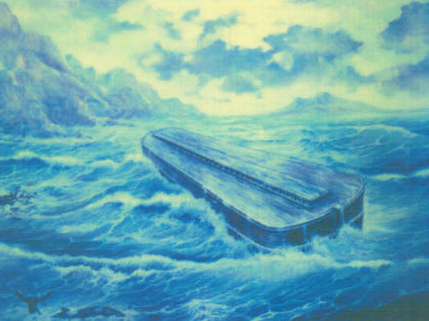
The Days Of Noah Part 2 Grace Of God Text: Genesis 6:8-9; Hebrews 11:7
Notes:
By Nathan L Morrison
All Scripture given is from NASB unless otherwise stated
For further study, or if questions, please Call: 804-277-1983 or Visit www.courthousechurchofchrist.com
Image: Painting based on drawing by Alfred Lee based on “eye witness” report of George Hagopian
George Hagopian claimed to have visited and even climbed up on top of the ark many times in the years of 1906-1907 as a boy, and later gave his “eye witness” descriptions of the ark in the 1970’s.

Slide 2
Intro
Matthew 24:36-39
36. "But of that day and hour no one knows, not even the angels of heaven, nor the Son, but the Father alone.
37. "For the coming of the Son of Man will be just like the days of Noah.
38. "For as in those days before the flood they were eating and drinking, marrying and giving in marriage, until the day that Noah entered the ark,
39. and they did not understand until the flood came and took them all away; so will the coming of the Son of Man be.
Jesus compared the days of Noah to the last days & His return:
Marriage abused (Gen. 6:2) – Is abused today as well!
The word of God was rejected (Gen. 6:3) – Is rejected today!
The wicked ruled (Gen. 6:4) –Those in authority act wickedly today!
Sin conquered (Gen. 6:5) – Wickedness is rampant today!
Violence prevailed (Gen. 6:11, 13) – The world today: violence as a means to an end!
Men were corrupt (Gen. 6:12) – Mankind today no different!
Few were righteous (Gen. 7:1, 7) – No different today! (Matthew 7:13-14)

Slide 3
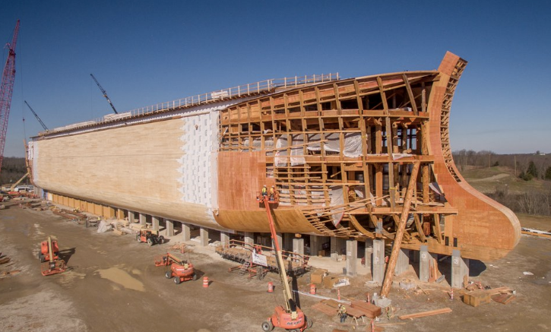
Intro
Genesis 6:8-9
8. But Noah found favor in the eyes of the LORD.
9. These are the records of the generations of Noah. Noah was a righteous man, blameless in his time; Noah walked with God.
Noah was righteous among the wicked –
Found favor in the eyes of God!
Noah is a reminder that one can be a light in the
darkness and walk with God!
Saints are to be lights in the midst of a crooked and perverse generation – Phil. 2:14-16
Notes:
Image: The ark under construction in Kentucky at the Creation Museum

Slide 4
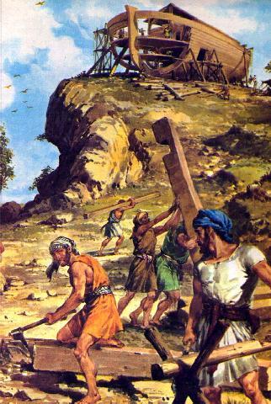
The Days Of Noah
Noah Obeyed God – Hebrews 11:7
Hebrews 11:7
7. By faith Noah, being warned by God about things not yet seen, in reverence prepared an ark for the salvation of his household, by which he condemned the world, and became an heir of the righteousness which is according to faith.

Slide 5
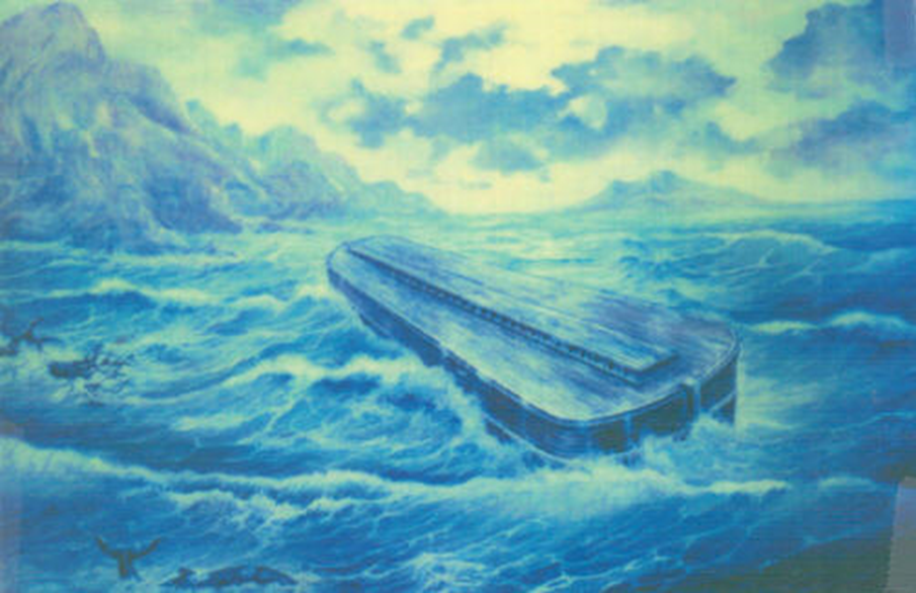
Noah Obeyed God
Noah’s expression of faith – Obedience!
Hebrews 11:7; Genesis 6:14-17, 22; 7:5
Noah was given a difficult task and overcame!
Genesis 6:14-17, 22
Notes:
Image: Painting based on drawing by Alfred Lee based on “eye witness” report of George Hagopian

Slide 6
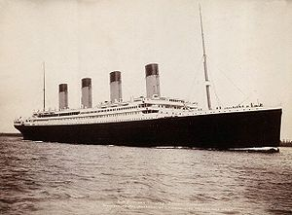
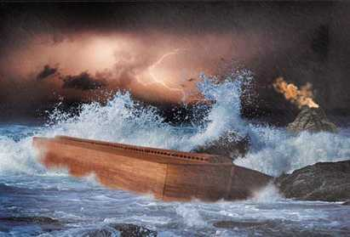
Noah Obeyed God
Noah was given a difficult task and overcame –
Consider:
RMS Titanic
L: 882’ 9”
W: 92’
H: 59’ (175’ overall)
Time: 3 years
(03/31/1909-03/31/1912)
Noah’s Ark
L: 450’
W: 75’
H: 45’
Time: 120 years
(Gen. 6:3)
Notes:
Picture on Left:
RMS Titanic
Picture on Right:
Painting based on drawing by Alfred Lee based on “eye witness” report of George Hagopian

Slide 7
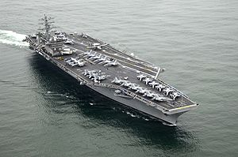
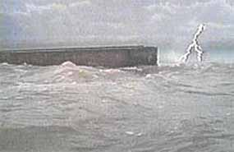
Noah Obeyed God
Noah was given a difficult task and overcame –
Consider:
USS Nimitz
L: 1092’
W: 252’ (flight deck)
H: 134’ (above water line)
Time: 5 years
(06/22/1968-05/13/1972)
Noah’s Ark
L: 450’
W: 75’
H: 45’
Time: 120 years
(Gen. 6:3)
Notes:
Picture on Left:
USS Nimitz
Picture on Right:
Painting based on drawing by Alfred Lee based on “eye witness” report of George Hagopian

Slide 8
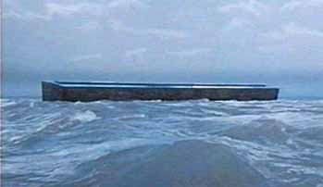
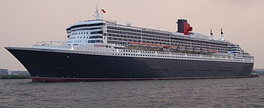
Noah Obeyed God
Noah was given a difficult task and overcame –
Consider:
RMS Queen Mary 2
L: 1132’
W: 147’
H: 236’
Time: 1.5 years
(07/04/2002-12/23/2003)
Noah’s Ark
L: 450’
W: 75’
H: 45’
Time: 120 years
(Gen. 6:3)
Notes:
Picture on Left:
RMS Queen Mary 2
Picture on Right:
Painting based on drawing by Alfred Lee based on “eye witness” report of George Hagopian

Slide 9
Noah Obeyed God
Noah’s expression of faith – Obedience!
Hebrews 11:7; Genesis 6:14-17, 22; 7:5
Noah was given a difficult task and overcame!
Genesis 6:14-17, 22
His good example condemned those who were wicked in the world
Hebrews 11:7 (Phil. 2:14-16)
His faith was an obedient faith –
caused him to do the will of the Lord!
Notes:
Image: Painting based on drawing by Alfred Lee based on “eye witness” report of George Hagopian

Slide 10
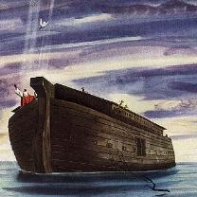
The Days Of Noah
Noah Obeyed God – Hebrews 11:7
God Cared For Noah – Genesis 6:8
Genesis 6:8
But Noah found favor in the eyes of the LORD.

Slide 11
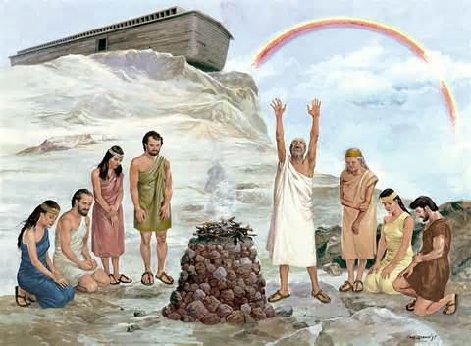
God Cared For Noah
Noah was favored by God – Gen. 6:8 – In the midst of darkness there was a light!
Genesis 6:5-17; I Pet. 3:20-21 (II Pet. 3:10-12)
God kept His promises to Noah and gave even more
Genesis 6:18; 9:8-13
God cares for those who obey Him and has prepared an eternal home
Revelation 21:3-7
God notices the lights in the world and promises to reward them for all eternity!

Slide 12
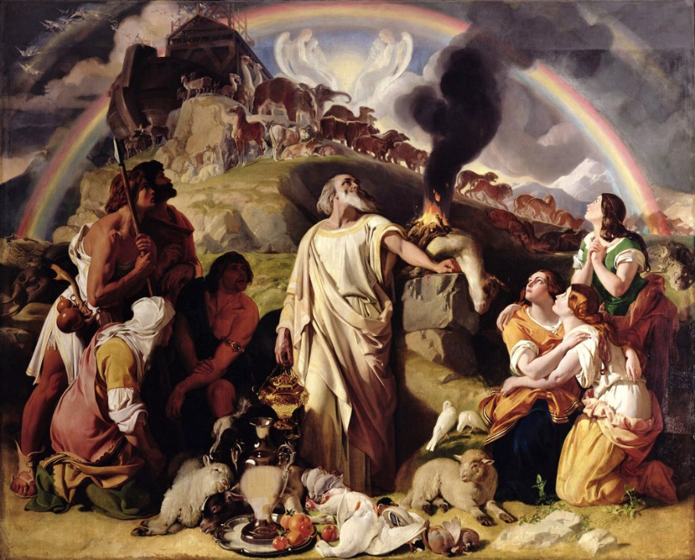
The Days Of Noah
Noah Obeyed God – Hebrews 11:7
God Cared For Noah – Genesis 6:8
Noah Thanked God – Genesis 8:18-20
Genesis 8:18-20
18. So Noah went out, and his sons and his wife and his sons' wives with him.
19. Every animal, every creeping thing, every bird, and whatever creeps on the earth, according to their families, went out of the ark.
20. Then Noah built an altar to the LORD, and took of every clean animal and of every clean bird, and offered burnt offerings on the altar.

Slide 13
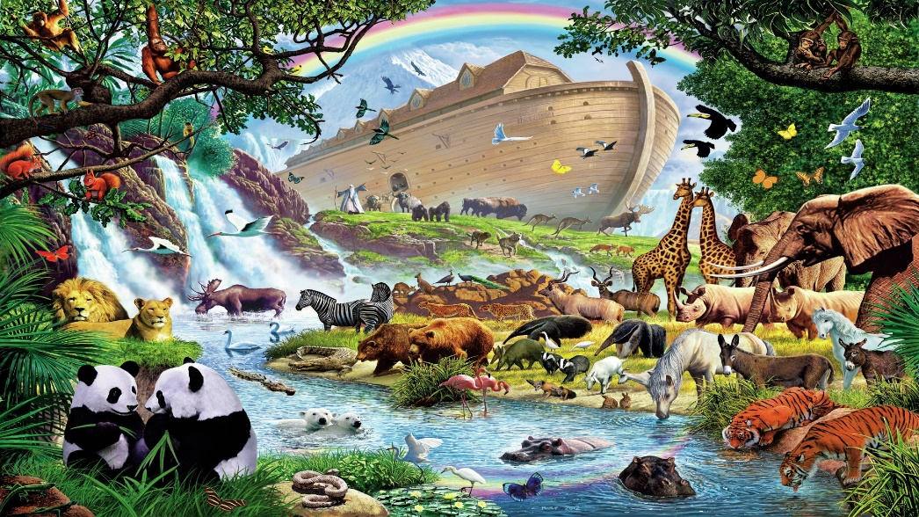
Noah Thanked God
God was pleased with Noah’s offerings
Genesis 8:21-22
How often do we give thanks?
I John 5:14; Colossians 3:17
God was pleased with Noah’s sacrifices and blessed him beyond what He said He would
Ephesians 2:4-8; 3:20-21 (Hebrews 5:9)
We should have the attitude of thankfulness for all that God has done for us!

Slide 14
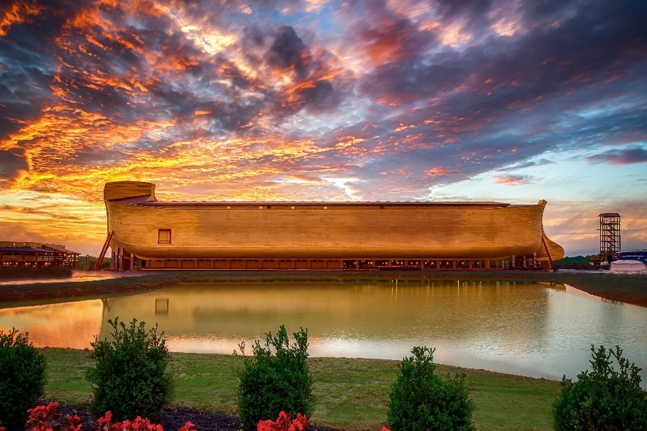
Conclusion
Hebrews 11:7
7. By faith Noah, being warned by God about things not yet seen, in reverence prepared an ark for the salvation of his household, by which he condemned the world, and became an heir of the righteousness which is according to faith.
(NKJV: “Moved with godly fear…”)
It was Noah’s genuine faith in God that caused him to obey (found grace with God)
I Pet. 3:20
Noah had to exhibit great patience to build the ark for 120 years (Gen. 6:3) while preaching to a wicked, unrepentant audience!
Notes:
Image: Ark in Kentucky at Creation Museum

Slide 15
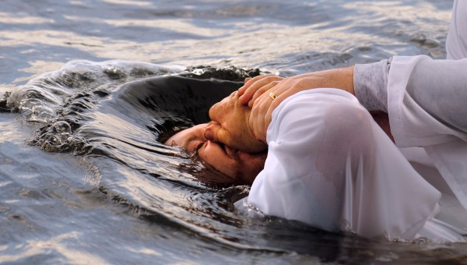
Conclusion
God told Noah judgment was coming and to prepare, so we are warned to be prepared:
He gave the people of Noah’s day 120 years to repent – the ark saved!
He has given us an undetermined time and said, “Be ready” (Mt. 24:36-37, 42)
Jesus saves! In His name alone is found salvation! (John 14:6; Acts 4:10-12)
II Pet. 3:7, 10-12: God revealed the fiery judgment and said, “Be ready”
Baptism saves! (I Pet. 3:21: Baptism is an act of obedient faith – Js. 2:14-26)
Notes:
Image: Ark in Kentucky at Creation Museum

Slide 16
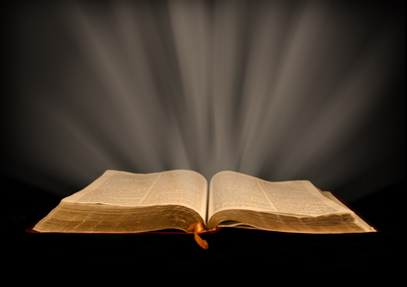
Conclusion
Are you prepared? We are to be found in contrast to the people in the days of Noah! – Matthew 24:37
Noah found grace with God by his obedience in a wicked world – Let your light shine the grace of God on the dark world around you!

Slide 17
“What Must I Do To Be Saved?”
Hear The Gospel (Jn. 5:24; Rom. 10:17)
Believe In Christ (Jn. 3:16-18; Jn. 8:24)
Repent Of Sins (Lk. 13:3-5; Acts 2:38)
Confess Christ (Mt. 10:32; Rom. 10:10)
Be Baptized (Mk. 16:16; Acts 22:16)
Remain Faithful (Jn. 8:31; Rev. 2:10)
For The Erring Saint:
Repent (Acts 8:22), Confess (I Jn. 1:9),
Pray (Acts 8:22)

