Slide 1
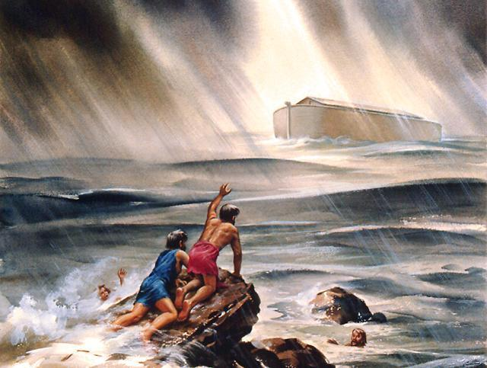
The Days Of Noah Part 1 Wickedness Of Men Text: Matthew 24:36-39; I Peter 3:20
Notes:
By Nathan L Morrison
All Scripture given is from NASB unless otherwise stated
For further study, or if questions, please Call: 804-277-1983 or Visit www.courthousechurchofchrist.com

Slide 2
Intro
Matthew 24:36-39
36. "But of that day and hour no one knows, not even the angels of heaven, nor the Son, but the Father alone.
37. "For the coming of the Son of Man will be just like the days of Noah.
38. "For as in those days before the flood they were eating and drinking, marrying and giving in marriage, until the day that Noah entered the ark,
39. and they did not understand until the flood came and took them all away; so will the coming of the Son of Man be.
Wait…Was THAT today?!!

Slide 3
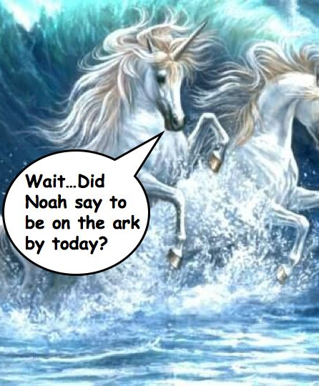
Intro
I Peter 3:20
20. who once were disobedient, when the patience of God kept waiting in the days of Noah, during the construction of the ark, in which a few, that is, eight persons, were brought safely through the water.
The “days of Noah” were filled with
the wickedness of man!

Slide 4
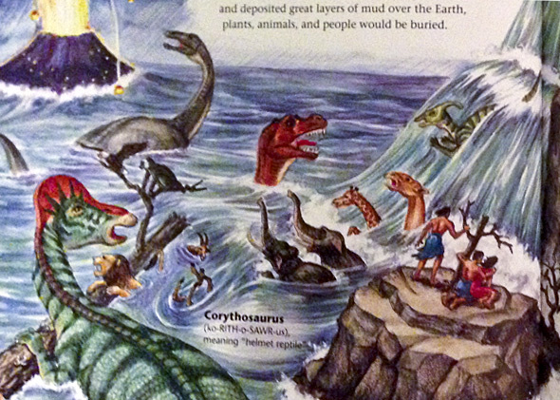
The Days Of Noah
They Were Evil Days – Ephesians 5:15-16
Ephesians 5:15-16
15. Therefore be careful how you walk, not as unwise men but as wise,
16. making the most of your time, because the days are evil.

Slide 5
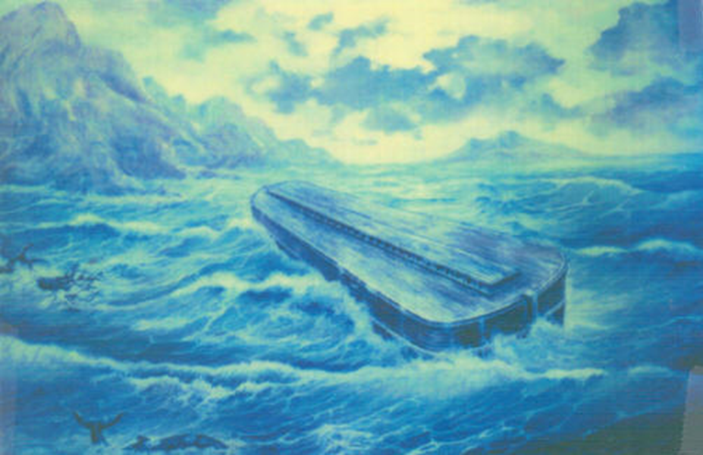
They Were Evil Days
Marriage was abused (Gen. 6:2)
Mt. 22:30; II Cor. 6:14; Gen. 4:23
The wicked ruled (Gen. 6:4-5)
Gen. 6:5
Violence prevailed (Gen. 6:11, 13)
Gen. 4:10, 24; Gen. 9:6
Men were corrupt (Gen. 6:12)
II Pet. 2:5; II Tim. 3:13
God was grieved (Gen. 6:6)
Mankind was so evil God was grieved!
Notes:
Image: Painting based on drawing by Alfred Lee based on “eye witness” report of George Hagopian

Slide 6
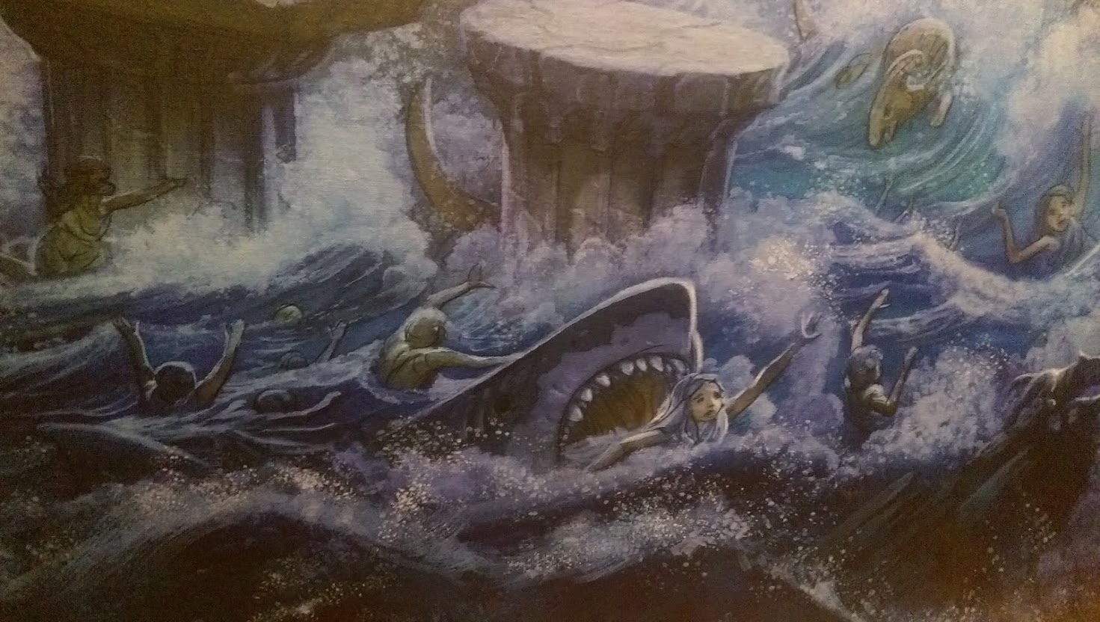
The Days Of Noah
They Were Evil Days – Ephesians 5:15-16
They Were Dark Days – II Timothy 3:1, 13
II Timothy 3:1, 13
1. But realize this, that in the last days difficult times will come.
13. But evil men and impostors will proceed from bad to worse, deceiving and being deceived.

Slide 7
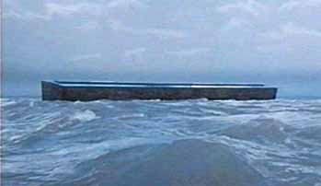
They Were Dark Days
It was a time of apostasy (Gen. 6:2)
The “sons of God” married “daughters of men” (II Pet. 2:4;Jude 6)
The word of God was rejected (Gen. 6:3)
Gen. 6:3; II Pet. 2:5; I Pet. 3:20
Sin conquered (Gen. 6:5)
Few were righteous (Gen. 7:1, 7)
I Pet. 3:20; Mt. 7:13-14
Appointed for destruction (Gen. 6:17)
Gen. 6:7, 17; 7:4; II Pet. 2:5
The days were dark for mankind was evil and God had set the world for destruction!

Slide 8
The Days Of Noah
They Were Evil Days – Ephesians 5:15-16
They Were Dark Days – II Timothy 3:1, 13
They Were Trying Times – II Peter 2:5, 9
II Peter 2:5, 9
5. and did not spare the ancient world, but preserved Noah, a preacher of righteousness, with seven others, when He brought a flood upon the world of the ungodly;
9. then the Lord knows how to rescue the godly from temptation, and to keep the unrighteous under punishment for the day of judgment,

Slide 9
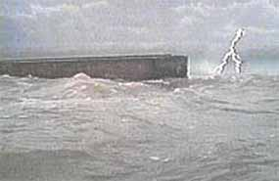
They Were Trying Times
People were indifferent (Mt. 24:39)
They didn’t know because they were concerned in other things – Mt. 24:38
The results were discouraging (I Pet. 3:20)
When the day came to enter the ark, Noah & his family entered
(8 souls – He at least saved his family!) – Ezek. 14:14, 20
The outcome was horrifying (Heb. 11:7)
“He condemned the world”
Though trying, Noah and his family overcame and
condemned the world with their faith!

Slide 10
Conclusion
Our days (before Christ comes again) are “as the days of Noah” were – Mt. 24:36-39
These days are evil – Eph. 5:16
These days are dark – II Tim. 3:13
These days are trying – II Pet. 2:9
Jesus said His return would be like in those days – Are you prepared?
Judgment is coming just as it did in the flood
(II Peter 3:3-7)

Slide 11
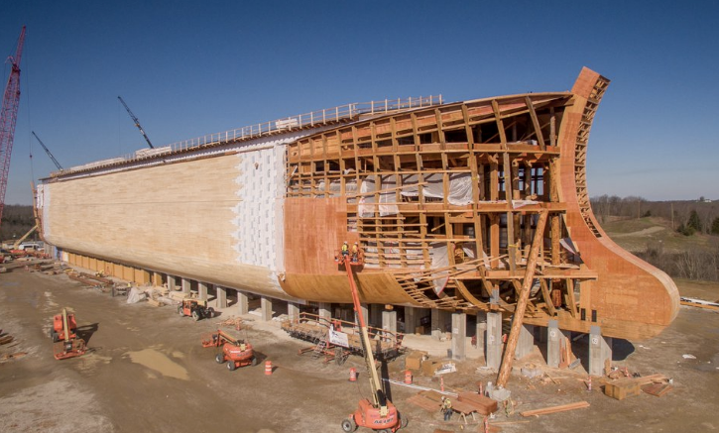
Conclusion
We must face “our” days as Noah faced “his” days:
Noah sought after God & found favor (grace) – Gen. 6:8; Heb. 11:6
Noah was obedient to God’s word – Gen. 6:22; 7:5; Heb. 11:7
Noah preached, showing concern for the lost (I Pet. 3:20)
Noah was prepared for the day of the Lord – the rest of the world wasn’t! – Heb. 11:7
Notes:
Image: Ark in Kentucky under construction!

Slide 12
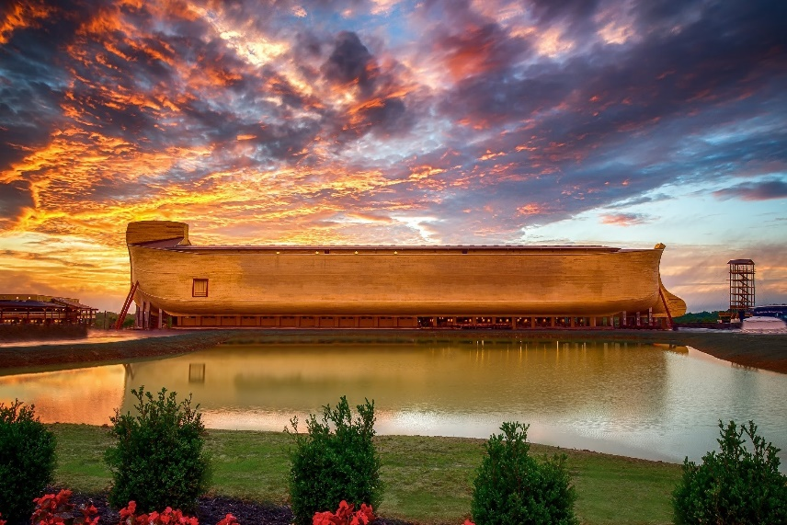
Conclusion
“What sort of people ought you to be?” (II Pet. 3:10-11)
The answer to this question will decide where we will spend eternity!
Are you striving to live holy and godly lives to stand before Him spotless & blameless? (II Pet. 3:11, 14)
Are you looking for and hastening the day of Christ’s return? (II Pet. 3:12)
Are you counting the patience (mercy) of God as salvation? (II Pet. 3:15)
Notes:
Image: Ark in Kentucky

Slide 13
Conclusion
Let us not be so distracted with the cares of this world that we be like those “in the days of Noah” who were caught by destruction unaware!
Let us look for & hasten His return, being diligent to live godly & righteously!

Slide 14
“What Must I Do To Be Saved?”
Hear The Gospel (Jn. 5:24; Rom. 10:17)
Believe In Christ (Jn. 3:16-18; Jn. 8:24)
Repent Of Sins (Lk. 13:3-5; Acts 2:38)
Confess Christ (Mt. 10:32; Rom. 10:10)
Be Baptized (Mk. 16:16; Acts 22:16)
Remain Faithful (Jn. 8:31; Rev. 2:10)
For The Erring Saint:
Repent (Acts 8:22), Confess (I Jn. 1:9),
Pray (Acts 8:22)

