Slide 1
“The True Grace Of God” Text: I Peter 5:12
Notes:
By Nathan L Morrison
All Scripture given is from NASB unless otherwise stated
For further study, or if questions, please Call: 804-277-1983 or Visit www.courthousechurchofchrist.com
Adapted from an article by Joe R. Price

Slide 2
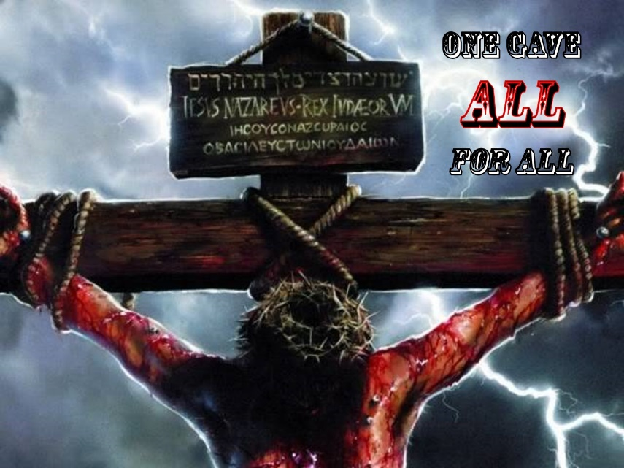
Intro
Grace is favor granted to someone who does not deserve it (or has not earned it)
Titus 2:11-12
11 For the grace of God has appeared, bringing salvation to all men,
12 instructing us to deny ungodliness and worldly desires and to live sensibly, righteously and godly in the present age,
Heb. 2:9: Christ, by God’s grace, died for all
Acts 20:32: The word of God is the “word of His grace”

Slide 3
Intro
To obtain the grace of God is conditional
Like a wrapped gift, one must accept it and then open it to receive the gift.
Like contents in a glass you must use a straw or drink from it to gain the contents.
Heb. 5:9: Jesus is the “source of eternal salvation” to those who obey Him!
Titus 2:12: Deny ungodliness and worldliness …live sensibly, righteously, and godly!
OBEDIENCE
GRACE

Slide 4
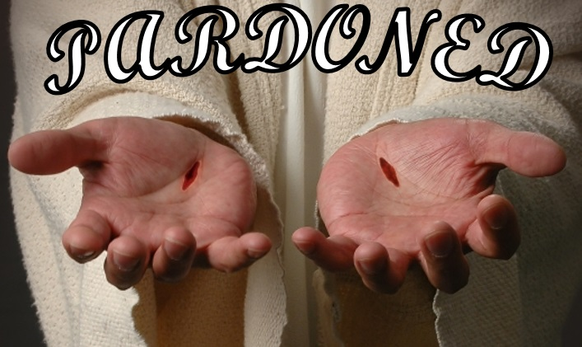
Intro
I Peter 5:12
12. Through Silvanus, our faithful brother (for so I regard him), I have written to you briefly, exhorting and testifying that this is the true grace of God. Stand firm in it!
Let us keep the commands of God to stand firm in the true grace of God!

Slide 5
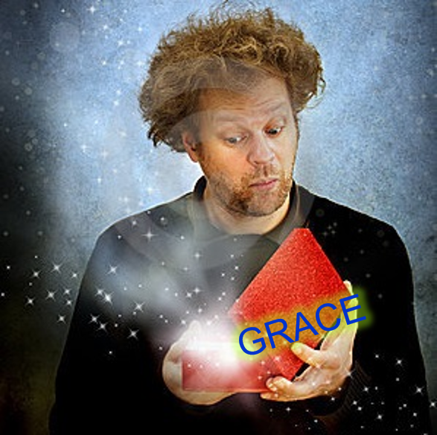
Understanding The True Grace Of God
The Scriptures teach “the true grace of God” includes the commands of God (Acts 20:32)
I Peter 5:12
I John 5:2-4
Faith and obedience to the commands of God go together! (I John 5:3)
By observing what the apostle wrote, we too can understand “the true grace of God!”
Peter confirmed his brief letter to the saints (I Peter) gave exhortation and testimony of “the true grace of God”

Slide 6
Living In The Grace Of God
In his first letter, Peter indicates living in the grace of God includes the following:
Obedience in holy living – I Pet. 1:13-16
Abstaining from fleshly lusts – I Pet. 2:11-12
Submitting to civil government – I Pet. 2:13-17
Marital responsibilities – I Pet. 3:1-7
Putting away worldliness (including sexual immorality, drinking alcoholic beverages socially and to excess, along with associated riotous behavior) – I Pet. 4:1-3

Slide 7
Living In The Grace Of God
In his first letter, Peter indicates living in the grace of God includes the following:
Putting away idolatry – I Pet. 4:3
Hospitality – I Pet. 4:9
The work of elders – I Pet. 5:1-3
Submitting to one another – I Pet. 5:5-7
Sober, watchful living (being alert) – I Pet. 5:8-9
These are only some of the instructions the grace of God gives us so that we may stand firm in “the true grace of God” (Titus 2:11-12; I Pet. 5:12)

Slide 8
Living In The Grace Of God
We don’t earn Grace!
Noah obeyed God by building the ark (Heb. 11:7)
Grace to Abraham in offering Isaac (Gen. 22)
Grace to Noah to build an ark (Gen. 6:13-14)
Grace to Naaman in curing leprosy
(II Kings 5:10; Luke 4:27)
Abraham obeyed God (Heb. 11:17; James 2:22-24)
Naaman obeyed God
(II Kings 5:14)
We don’t establish our own righteousness when we obey Jesus in faith (Rom. 10:3; I John 5:2-4)
These men obtained (not earned) God's grace when they faithfully obeyed God's word – Same today!

Slide 9
Living In The Grace Of God
I Peter shows living in the grace of God includes:
Obedience in holy living – I Pet. 1:13-16
Abstaining from fleshly lusts – I Pet. 2:11-12
Submitting to civil government – I Pet. 2:13-17
Marital responsibilities – I Pet. 3:1-7
Putting away worldliness – I Pet. 4:1-3
Putting away idolatry – I Pet. 4:3
Hospitality – I Pet. 4:9
The work of elders – I Pet. 5:1-3
Submitting to one another – I Pet. 5:5-7
Sober, watchful living (being alert) – I Pet. 5:8-9
By living in the grace of God’s word, we can stand firm in “the true grace of God!”

Slide 10
Growing In The Grace Of God
Peter said to grow in the grace and knowledge of the Lord (II Pet. 3:18):
Saints stand in “the true grace of God” when we trust and obey God (Acts 20:32; Rom. 5:1-2).
To trust and obey does not mean God saves us because we have earned salvation!
Doing that would demand sinlessness (Rom. 3:10, 19, 23) – Only Jesus was sinless! (Heb. 4:15)
We are unprofitable servants, only doing our duty to our Master (Lk. 17:10).
Like Abraham, we are sinners saved by grace through faith, not merit (Rom. 4:1-5).

Slide 11
Growing In The Grace Of God
In grace, Some live in fear
II Tim. 1:7: “For God has not given us a spirit of timidity, but of power and love and discipline”
(discipline = NET: “self-control;” NKJ: “sound mind”)
Having self-control or a sound mind helps us avoid temptation and sin, but we will still “mess up” from time to time (Rom. 3:23) – We are not perfect!
God’s grace is greater than our sin! (Heb. 4:15-16)
God’s grace grants forgiveness when we mess up and then repent! (I John 1:9)!

Slide 12
Growing In The Grace Of God
In grace, Some live in sin
Romans 6:1-2: “What shall we say then? Are we to continue in sin so that grace may increase? May it never be! How shall we who died to sin still live in it?”
God's grace does not mean He accepts us and saves us despite continuing to sin!
Romans 6:4-18
Rom. 6:1-2; Titus 2:11-12
II Cor. 6:1-2
Grace doesn’t overlook sin if we continue in it (Heb. 10:26-31)
The people in Matthew 7:21-23 pleaded for salvation despite their “lawlessness” – Didn’t receive it! Neither will we!

Slide 13
Growing In The Grace Of God
Since God commands us to “grow in the grace and knowledge of our Lord and Savior Jesus Christ,” we must not deceive ourselves into thinking God's grace saves us regardless of what we know, believe, and do (I Pet. 5:12; II Pet. 3:18; Rom. 6:1-2, 14-16; Titus 2:11-12)
Faith and obedience go together!
Growing in the grace of God helps us to not live in fear, and not to live in sin!
By growing in the grace and knowledge of Jesus our Lord, we can stand firm in “the true grace of God!”

Slide 14
Conclusion
The grace of God is the free gift of God found in Jesus and the result is eternal life for those who obey Him! (Rom. 6:23; Heb. 5:9)
By reading & studying the “word of His grace” (Acts 20:32; I Peter 5:12) we can understand “the true grace of God!”
By keeping the commands of God (I John 5:2-4) we can live in “the true grace of God!”
By growing in the grace and knowledge of Lord Jesus we no longer live in fear or sin, but stand firm in “the true grace of God!”

Slide 15
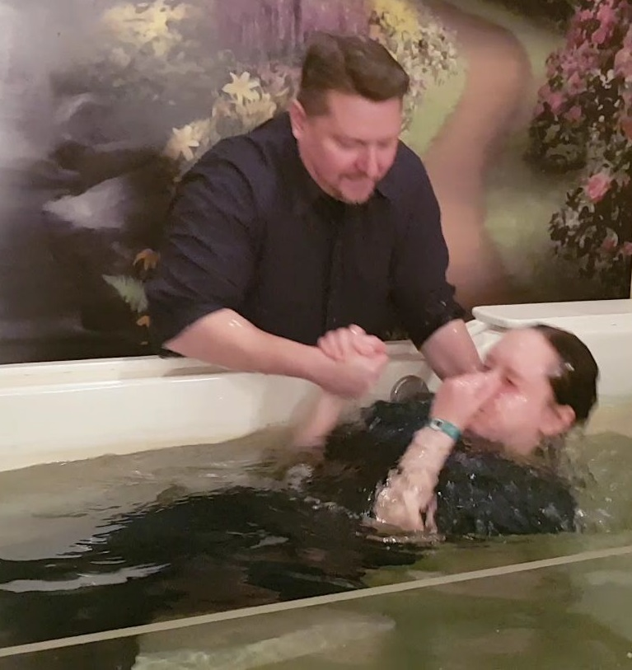
Conclusion
Come to Jesus, the source of eternal life, and obey His word!
Mark 16:16: "He who has believed and has been baptized shall be saved; but he who has disbelieved shall be condemned.!
Must obey the words of Jesus to be saved!
“Believe and be baptized!”
Acts 20:32: “Word of His grace”
Gal. 1:6: “Called you by the grace of Christ”
God is rich in mercy, grace and love, and He has more than enough to give to you!
You can accept the grace of God, the free gift of eternal life, in obedience to His word today!

Slide 16
“What Must I Do To Be Saved?”
Hear The Gospel (Jn. 5:24; Rom. 10:17)
Believe In Christ (Jn. 3:16-18; Jn. 8:24)
Repent Of Sins (Lk. 13:3-5; Acts 2:38)
Confess Christ (Mt. 10:32; Rom. 10:10)
Be Baptized (Mk. 16:16; Acts 22:16)
Remain Faithful (Jn. 8:31; Rev. 2:10)
For The Erring Saint:
Repent (Acts 8:22), Confess (I Jn. 1:9),
Pray (Acts 8:22)

