Slide 1
Calvary Part 2: The Thief On The Cross
Text: Luke 23:39-43
Notes:
Prepared by Nathan L Morrison
All Scripture given is from NASB unless otherwise stated
For further study, or if questions, please Call: 804-277-1983 or Visit www.courthousechurchofchrist.com
Based on a tract by Robert Schales

Slide 2
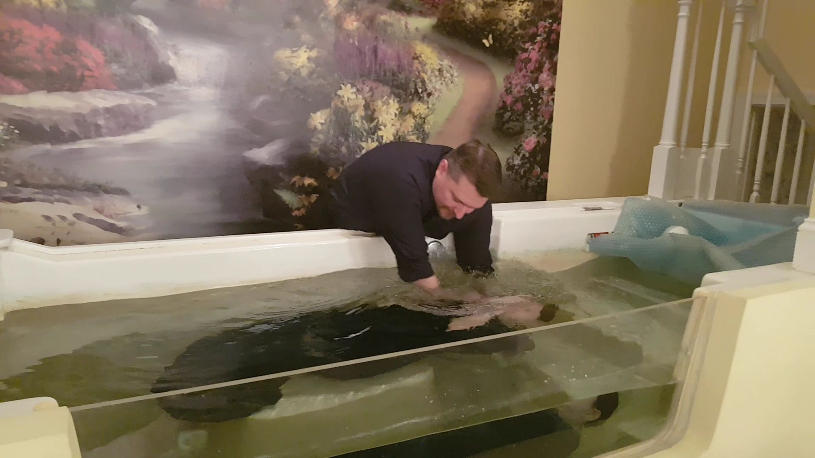
Intro
The Scriptures make clear the conditions for salvation:
Baptism for the forgiveness of sins!
Mk. 16:16; Acts 2:38; 22:16; I Pet. 3:21
Is there an exception to this rule?
“But what about the thief on the cross?”

Slide 3
Intro
The thief on the cross is thought by some to be the
exception that would justify salvation at the point of
confession of Christ as Lord alone today
There is no doubt that the remorseful thief on the cross was saved, but the question is, “Can people today be saved in the same manner?”

Slide 4
At Calvary
Christ was crucified with two thieves on either side of Him
(Mt. 27:38; Mk. 15:27; Lk. 23:33; Jn. 19:18)
Both insulted Jesus at one point (Mt. 27:44) like the people (Mt. 27:39-43)
One of them hurled insults like the masses below (Lk. 23:39).
One of them rebuked the other, admitted guilt, confessed Christ as innocent, and asked to be remembered in Christ’s kingdom (Lk. 23:39-43).
Luke 23:39-43
39. One of the criminals who were hanged there was hurling abuse at Him, saying, "Are You not the Christ? Save Yourself and us!"
40. But the other answered, and rebuking him said, "Do you not even fear God, since you are under the same sentence of condemnation?
41. "And we indeed are suffering justly, for we are receiving what we deserve for our deeds; but this man has done nothing wrong."
42. And he was saying, "Jesus, remember me when You come in Your kingdom!"
43. And He said to him, "Truly I say to you, today you shall be with Me in Paradise."

Slide 5
At Calvary
“But what about the thief on the cross?”
Quick answer is it was under the Old Law so doesn’t apply today.
Some argue the point: Jesus died before the thief thus fulfilling the Old Covenant (Jn. 19:31-34).
Heb. 9:15-17: A testament (will) is made while one is alive. Christ died to fulfill the Old Testament.
Heb. 7:22; 8:6, 13: Christ died and raised from the dead and became the “mediator” of a new covenant, making the old one obsolete.
Thus the New Testament began after His death and resurrection.
His words in Mk. 16:16 on baptism were fully carried out on the day of Pentecost in Acts 2, under the New Covenant.
The events at Calvary were under the
Old Law and do not apply today!

Slide 6
Was the Thief Saved?
The thief asked to be remembered when Jesus came into
His kingdom:
Could have been mistakenly thinking of a physical kingdom:
Jesus spoke of the church as His earthly kingdom – Mk. 9:1
The Jews believed the Messiah would establish an earthly kingdom.
Acts 1:6: The disciples and apostles were still under that misconception all the way up to Christ’s ascension! (Jn. 18:36: Jesus said not earthly)
Could have been thinking of Christ’s eternal kingdom:
Mt. 7:21: Jesus spoke of Heaven as His kingdom.
Lk. 23:43: Jesus’ response was that they both would be in “Paradise,” answering the thief’s question, perhaps showing he meant eternal.

Slide 7
Was the Thief Saved?
“Paradise” (paradeisos = G3857: A park, an Eden, place of
future happiness; paradise)
Evidences for “realm of departed spirits” (Hades G86: place of the dead):
Jesus did not go to Heaven the day He died. On the day of resurrection He said to Mary, “I have not yet ascended to the Father” (Jn. 20:17).
Lk. 16:19-31: Jesus told an account of a rich man and poor man named Lazarus who died and were sent to the Hadean world.
(II Pet. 2:4: Tartarus, G5020: deepest abyss of Hades)
The rich man went to “Torments” – Lk. 16:23
Lazarus went to “Abraham’s bosom” – Lk. 16:22
Many believe those 3 days was when “He Led Captive a Host of Captives” (Eph. 4:8) from Hades (righteous dead) to Heaven.

Slide 8
Was the Thief Saved?
“Paradise” (paradeisos = G3857: A park, an Eden, place of
future happiness; paradise)
Evidences for “Heaven”:
II Cor. 5:6-8: Paul says to be absent from body is “home with the Lord.”
II Cor. 12:2, 4: “Paradise” is the 3rd Heaven (beyond space?)
Heb. 4:14: Jesus, when He ascended, “passed through the heavens.”
Rev. 2:7: A metaphor for an eternal Garden of Eden.
Whether it was Heaven or “Abraham’s bosom”
it was with the Lord!
Whether it was Heaven or “Abraham’s bosom”
it has no bearing on our salvation today!
The thief was saved because only Jesus has the power to
forgive and save and He did promise the thief would
be with Him in Paradise! (With Jesus)

Slide 9
Can We Be Saved the Same Way?
Even though we agree the thief was saved, we cannot be
saved in the same way today!
The thief lived in a time when Christ on earth personally
forgave sins:
Lk. 5:17-20: The paralyzed man.
Lk. 7:36-50: The sinful woman.
What does the word of God teach about salvation this side of the cross?
Heb. 8:6: We live under a “better covenant with better promises.”
Heb. 9:15-17: Became effective at the death of Christ, the Testator.
Mk. 16:16; Acts 22:16: Those who believe in Christ as the Son of God are to confess Him as Lord and be baptized into His name (Acts 8:37-38; 10:47-48) for forgiveness of sins!
Baptism is now required as an act of obedient faith
for salvation! (I Pet. 3:21)

Slide 10
Conclusion
Instead of, “But what about the thief on the cross?” it should be asked, “But how am I saved today?”
We are baptized into the body of Christ – I Cor. 12:13
Christ is the Savior of the body – Eph. 5:23
Christ saves those who are obedient to Him – Heb. 5:9
There is no promise of salvation to those outside
the body of Christ!
Baptism was required in all cases of conversion under the New Covenant:
Acts 2:38; 8:12-18; 10:47-48; 16:15; 16:33; 18:8; 19:3-5; 22:16

Slide 11
Conclusion
Those who attempt to find an exception to baptism in the
experience of the thief on the cross do so to try to justify
that baptism isn’t required of men today!
Teaching such a doctrine allows the thief on the cross to
remain a thief by stealing the truth from the hearts of
individuals who are seeking Salvation!
Those with a heart for truth will see the context of
Luke 23:43 as belonging to the O.T.

Slide 12
Conclusion
Heaven is too wonderful and Hell too terrible for us to risk being misled by false beliefs concerning the thief on the cross!
Obey the gospel today Christ’s way! (Mark 16:16)

Slide 13
“What Must I Do To Be Saved?”
Hear The Gospel (Jn. 5:24; Rom. 10:17)
Believe In Christ (Jn. 3:16-18; Jn. 8:24)
Repent Of Sins (Lk. 13:3-5; Acts 2:38)
Confess Christ (Mt. 10:32; Rom. 10:10)
Be Baptized (Mk. 16:16; Acts 22:16)
Remain Faithful (Jn. 8:31; Rev. 2:10)
For The Erring Saint:
Repent (Acts 8:22), Confess (I Jn. 1:9),
Pray (Acts 8:22)

