Slide 1
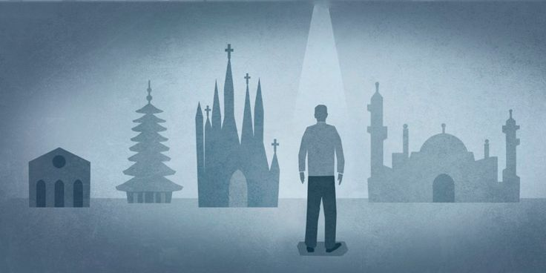
Mixed Seed (Why Are There So Many Churches?)
Text: II Tim. 4:3-4
Notes:
By Nathan L Morrison
All Scripture given is from NASB unless otherwise stated
For further study, or if questions, please Call: 804-277-1983 or Visit www.courthousechurchofchrist.com

Slide 2
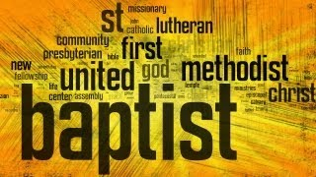
Intro
There are many misconceptions about the church which Jesus established
The misconceptions are from confusion over the religious
world’s many churches all claiming to have been
the one Jesus founded!

Slide 3
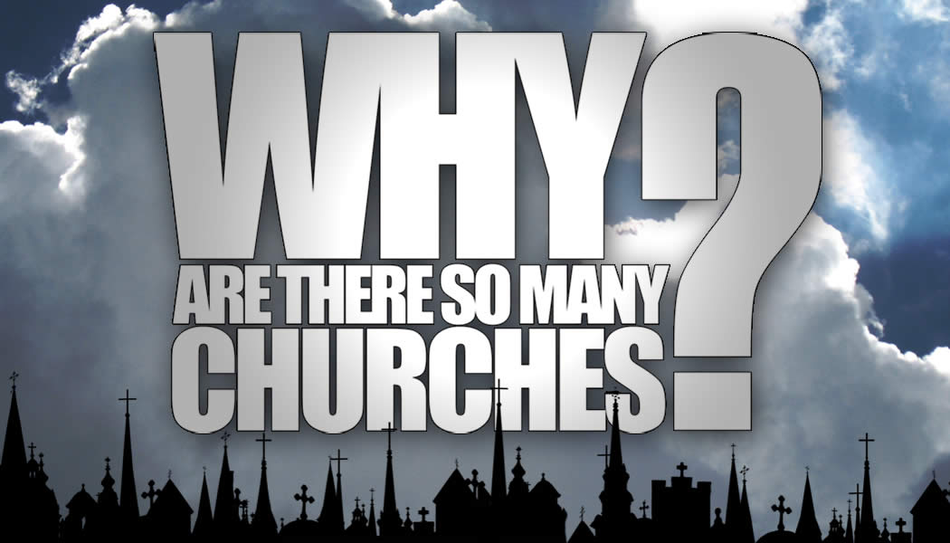
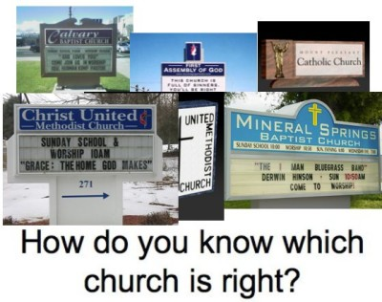
Intro
Notes:
Image: http://www.wvbs.org/

Slide 4
Intro
The question people should be asking is,
“Is it the church Jesus built?”
If one church is as good another, then Christ’s blood was
spilled in vain, for He said He would build His church
(singular, not plural) – Mt. 16:18; Acts 20:28
If Christ built only one church, then
why are there so many churches?

Slide 5
There Is Only One Church Jesus Died to Save
The word "church" is used in two senses in the N.T.
Universal Sense: This refers to the saved of all the earth, and is the church in the whole (Mt. 16:18; Acts 2:47) – “catholic” means “universal”
Local Sense: This refers to the saved gathered together according to geographical terms of limitation (I Cor. 1:2; Phil. 1:1) – Local churches

Slide 6
There Is Only One Church Jesus Died to Save
Right Founder: Jesus Christ
Foretold: Jer. 23:5-6: Branch of David foretold
Fulfilled: Jesus – Mt. 1:21; 16:18; John 1:29; Acts 20:28
Mt. 16:18: Jesus said, “…upon this rock I will build My church.”
Ekklesia (G1577): “called out, calling out.” (II Thess. 2:14: By the gospel)
If not built by Jesus Christ, then that church is from man, and not God!

Slide 7
There Is Only One Church Jesus Died to Save
Right Place: Jerusalem
Foretold: Is. 2:1-3: God made the choice to build His church (house) in Jerusalem.
Fulfilled: The church began in Jerusalem! – Mark 9:1; Acts 1:9-12; 2:1-5, 47: (Acts 11:15: “…at the beginning”)
Any church that had its beginning in any place other than Jerusalem is not the church Isaiah prophesied about being built in Jerusalem, nor the church Jesus built!

Slide 8
There Is Only One Church Jesus Died to Save
Right Time: 1st century, in the days of Rome
Foretold: Dan. 2:44: The eternal kingdom Daniel saw would be built in the days of the Romans (“…in the days of those kings...”).
Fulfilled: Day of Pentecost, 1st c. - Acts 2; 11:15: Notice the wording, “…as upon us at the beginning
Points back to the day of Pentecost (Pente = 50; cost = day) in Acts 2
Any church not built in Jerusalem on the day of Pentecost in 1st c. is not the church Jesus built!
(The days of the Romans are long gone – Gal. 4:4: When the “fullness of time came”)

Slide 9
There Is Only One Church Jesus Died to Save
Right Foundation: Teachings of the apostles & Jesus as revealed by the Holy Spirit
Foretold: Is. 28:16: God said He would lay in Zion (Jerusalem) a foundation stone.
Fulfilled: Jesus, the Son of God is the Rock or Foundation (Acts 8:37) – I Cor. 3:10-11: The foundation is Christ, & no other foundation can be laid!
Foretold: John 14:26; 16:13: The Holy Spirit would guide the apostles into all truth and remind them of all that Jesus taught.
Fulfilled: Teachings of the apostles & Jesus as revealed by the Holy Spirit, who inspired the word of God! (II Tim. 3:16-17; II Pet. 1:19-21)
Any church not founded on the teachings of the apostles & Jesus as revealed by the Holy Spirit is not the church Jesus built!

Slide 10
There Is Only One Church Jesus Died to Save
Right Name: The church that belongs to Jesus Christ; Christians
Foretold: Mt. 16:18: Jesus said He would “My church.”
“MY” is a personal pronoun that denotes possession – the church belongs to Christ! (Rom. 16:16: The churches of Christ greet you”)
Fulfilled: Names given for the church that belongs to Jesus:
Church(es) of Christ (Rom. 16:16); church of God (Acts 20:28); church of the Living God (I Tim. 3:15); church of the firstborn (Heb. 12:23)
Those who make up the Lord’s church are not members of any denomination – they are simply His disciples who wear His name.
Acts 11:26 (“Called”: divinely called – G5537 chrēmatizō)
Acts 26:28 (NKJ): Agrippa said to Paul, “You almost persuade me to become a Christian.”
I Pet. 4:16: “If anyone suffers as a Christian, he is not to be ashamed, but is to glorify God in this name.”
Any church or disciples of Jesus called by a different name is not the church that belongs to Jesus!

Slide 11
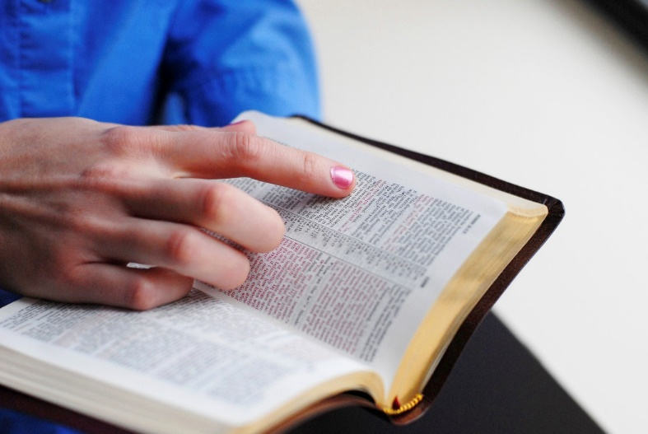
There Is Only One Church Jesus Died to Save
Built by the Right Founder
Built in the Right Place
Built at the Right Time
Built on the Right Foundation & Doctrine
Wears the Right Name
The church that belongs to Christ was established on the Day of Pentecost with Jesus Christ as its founder!

Slide 12
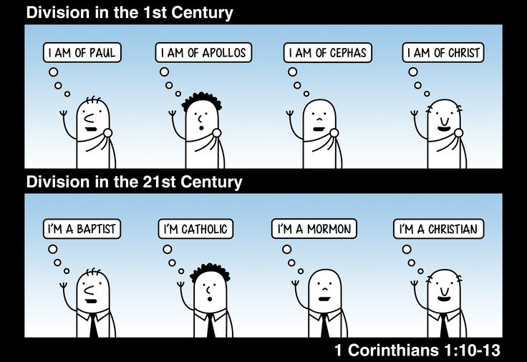
Why Are There So Many Churches?
Short answer: Men would depart from the truth of God’s word!
Apostasy was warned – From unity would come factions
I Cor. 1:10-13: Denomination mind-set condemned!
Divisions are not from God!

Slide 13
Why Are There So Many Churches?
Apostasy was warned – From unity would come factions
I Tim. 4:1-3; II Tim. 4:3-4: Men would leave the church (unity) to hear and teach things that they desired to hear! (Selfishness would lead to factions)
I Tim. 4:1-3
1. But the Spirit explicitly says that in later times some will fall away from the faith, paying attention to deceitful spirits and doctrines of demons,
2. by means of the hypocrisy of liars seared in their own conscience as with a branding iron,
3. men who forbid marriage and advocate abstaining from foods which God has created to be gratefully shared in by those who believe and know the truth.

Slide 14
Why Are There So Many Churches?
Apostasy was warned – From unity would come factions
I Tim. 4:1-3; II Tim. 4:3-4: Men would leave the church (unity) to hear and teach things that they desired to hear! (Selfishness would lead to factions)
II Tim. 4:3-4
3. For the time will come when they will not endure sound doctrine; but wanting to have their ears tickled, they will accumulate for themselves teachers in accordance to their own desires,
4. and will turn away their ears from the truth and will turn aside to myths.

Slide 15
Why Are There So Many Churches?
A denomination defined
A denomination is part of a whole (IE: A quarter is part of a dollar)
A religious organization smaller than the whole church, but larger than the local church.
A denomination is too small to be the church in the whole sense, and too large to be the church in the local sense!

Slide 16
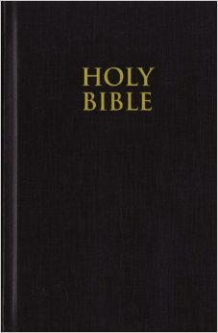
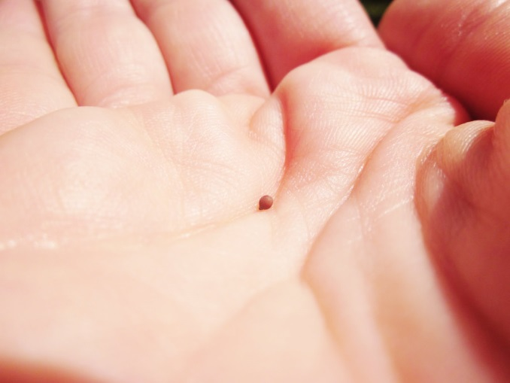
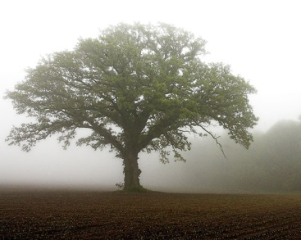
Mixed Seed
The Word of God is like “seed”
Luke 8:11: “Now the parable is this: The seed is the word of God.”
One characteristic of seed is that it ALWAYS produces after its kind!
Notes:
Image of Seed: Mustard Seed
Image of Tree: Mustard Tree

Slide 17
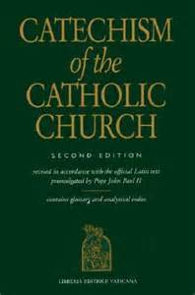
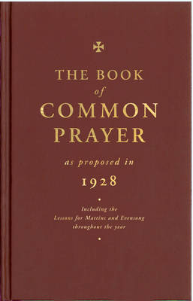
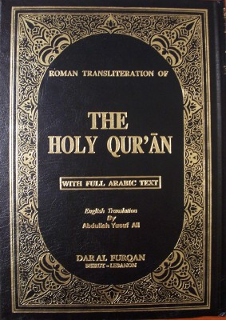
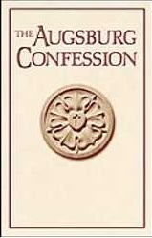
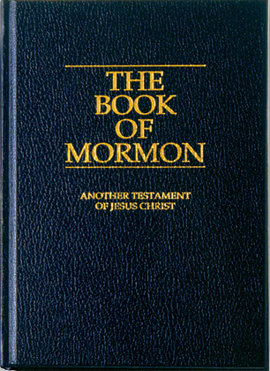
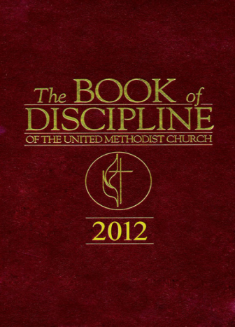
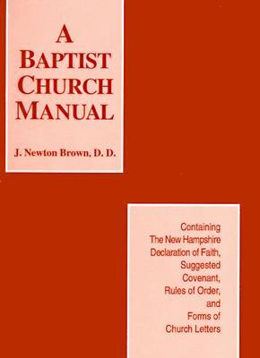
Mixed Seed
From Catholics to Islam, from denominations to other cults, they all have added something extra to the inspired word of God! They have mixed seed!
Peter warned “there will be false teachers among you, who will secretly bring in destructive heresies” (II Pet. 2:1-3).
Peter reminded and warned us to beware of such false religious teachers “lest you also fall from your own steadfastness, being led away with the error of the wicked” (II Pet. 3:17).
John warned that because “many false prophets have gone out into the world” saints are to “test the spirits to see whether they are from God” (I Jn. 4:1).
Paul warned that men would leave the church to hear and teach things that they desired to hear! (I Tim. 4:1-3; II Tim. 4:3-4)

Slide 18
Mixed Seed
From Catholic to Muslim, from denominations to other cults, they all had their beginnings hundreds of years too late to be Christ’s church!
Notes:
Timeline: From World Vision Bible School @ www.wvbs.org
Sources:
http://www.truthforsaints.com/Christian_Denominations/Christian_Denominations.html
http://www.topicalbiblestudies.com/resources/Articles/The_Church/Church%20Timeline.pdf
http://klcc.faithsite.com/content.asp?SID=655&CID=43145
http://www.wvbs.org/
http://www.wvbs.org/video/

Slide 19
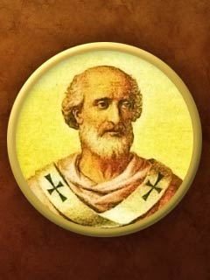
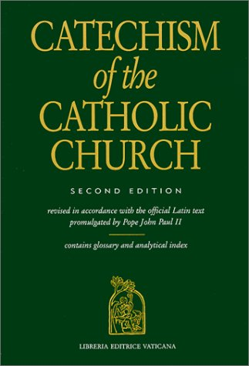
Mixed Seed
The Catholic Church
Founded
Pope Boniface III
Rome, Italy
AD 607
Emperor Phocas [Byzantine, A.D. 602-610] crowned him as “Universal Bishop, successor of Saint Peter” – “God on earth”
Founded on: Catholic Catechism & Apostle’s, Nicene & Athanasian Creeds (Added to the Bible!)
The Roman Catholic Catechism will always produce a Catholic!
Notes:
http://klcc.faithsite.com/content.asp?SID=655&CID=43145

Slide 20
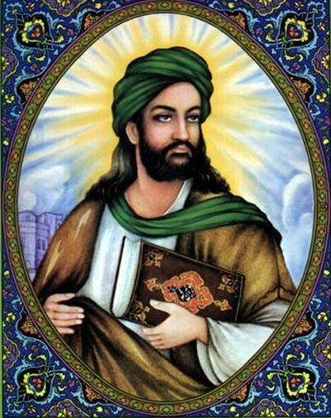
Mixed Seed
Islam
Founded
Muhammad
Mecca, Saudi Arabia
AD 610
Meanings
Islam: “Submission”
Muslim: “One who submits”
Founded on: He wrote the Koran (assembled 70-200 years after his death) and there are other writings
The Koran (Qur’An) will always produce a Muslim!

Slide 21
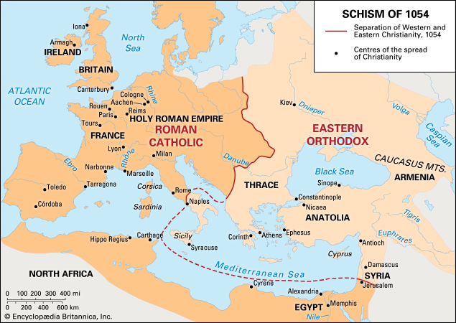
Mixed Seed
Eastern & Western Orthodoxy
Founded
Great Schism of A.D. 1054
Eastern Orthodoxy (Constantinople, Turkey)
Roman Catholic Church (Rome, Italy)
Founded on: Catholic Catechism & Apostle’s, Nicene & Athanasian Creeds
Their mixed seed will always produce Eastern Orthodoxy or Catholics!

Slide 22
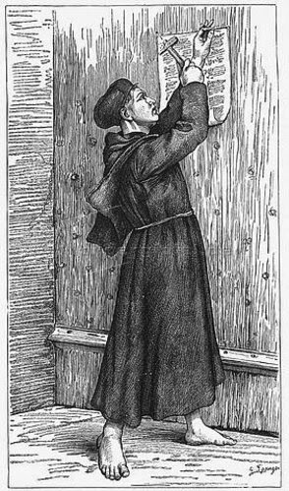
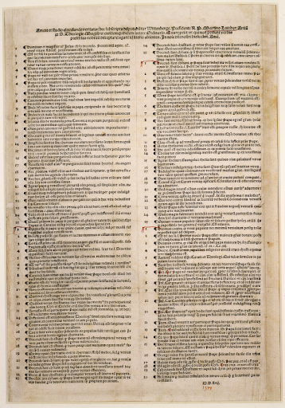
Mixed Seed
Lutherans
Founded
Martin Luther’s Teachings
Wittenberg, Germany
1517/1526/1546
Known for
Faith only
Luther added “alone” to Rom. 3:28 (not in Greek) so it says, “faith alone”
Luther posted his 95 thesis on the Castle Door at Wittenberg, Germany in 1517
Founded on: Augsburg Confessions (1530) & Book of Concord (1580)
The Augsburg Confession & Book of Concord will always produce a Lutheran!

Slide 23
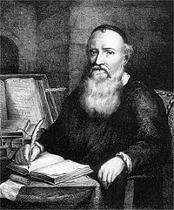
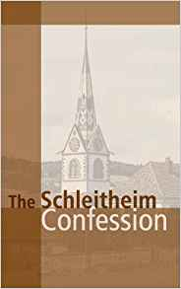
Mixed Seed
Menno Simons
Anabaptists
Founded
Hutterites: Jacob Hutter in Switzerland, 1527/1528
Mennonites: Menno Simons in Holland, 1536
Amish: Jacob Amman in Switzerland, 1690
Anapabist = “one who baptizes again”
Founded on: Schleitheim Confession (1527 Swiss Anabaptists), and the Dordrecht Confession (1632 by Dutch Mennonite leaders)
Their mixed seed will always produce Anabaptists! (Various offshoots)!

Slide 24
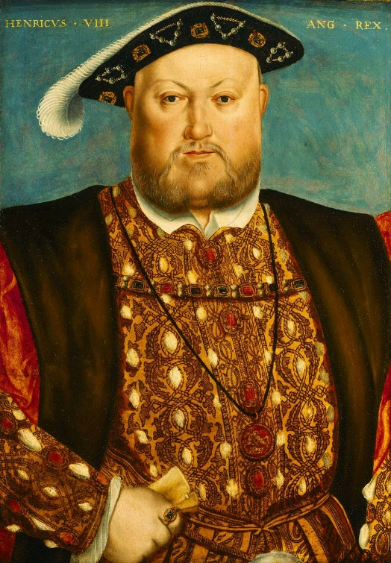
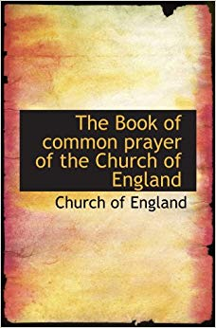
Mixed Seed
Church of England
Founded
King Henry VIII
England
1534
Reason for Split
Broke from The Roman Catholic Church to divorce his 1st wife!
Exchanged one pope for another: The Monarch over England! (even Queens!)
Founded on: Book of Common Prayer, Catholic Creeds & Thirty-Nine Articles of Religion
Their mixed seed will always produce Church of England believers!
Notes:
King Henry VIII’s first wife was Catherine of Aragon

Slide 25
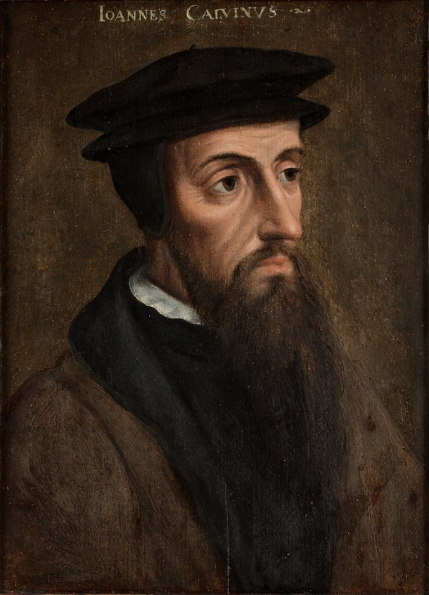
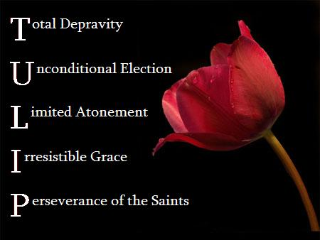
Mixed Seed
Calvinism
Founded
John Calvin
Geneva, Switzerland
1536
Known for
Predestination
Once saved always saved
Faith only
Founded on: The teachings of John Calvin
Nearly all denominations have adopted whole or parts of this doctrine!

Slide 26
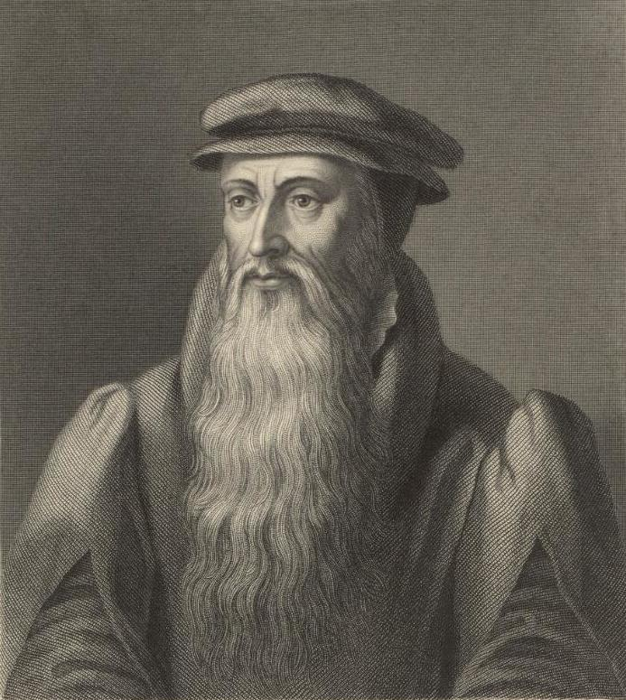
Mixed Seed
Presbyterians
Founded
John Knox
Geneva & Scotland
1560
Known for
Predestination
Once saved always saved
Faith only
Founded on: Book of Common Prayer (Tailored to their beliefs) & teachings of John Calvin, the Geneva Bible
The Presbyterian Book of Common Prayer will always produce a Presbyterian!

Slide 27
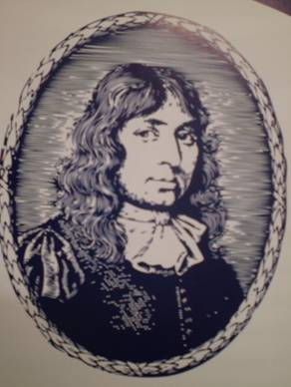
Mixed Seed
The Baptist Church
Founded
John Smyth
Holland
1607/1609
Of Note
Opposed doctrine of Calvin & instrumental music
Within 30 years of Smyth’s death, they adopted parts of Calvinism
Late 1800’s used instrumental music
Founded on: The Baptist Church Manual
The Baptist Church Manual will always produce a Baptist!

Slide 28
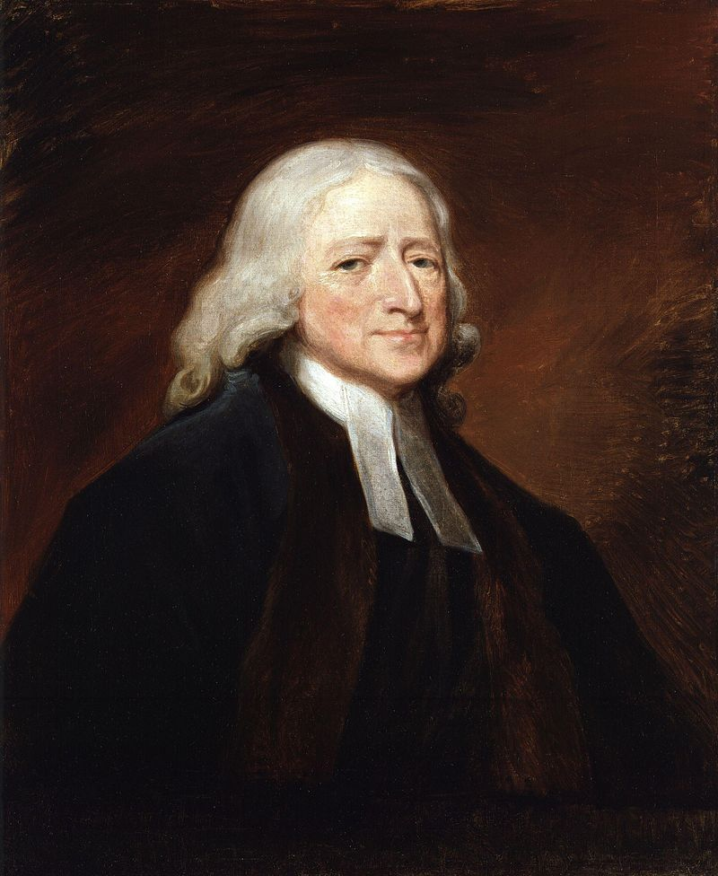
Mixed Seed
The Methodist Church
Founded
John Wesley
England
1738/1739
Founded on: The Book of Discipline, The Book of Common Prayer by John Wesley
The Book of Discipline will always produce a Methodist!
Notes:
Image: John Wesley painting by George Romney (Wikipedia)

Slide 29
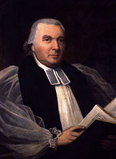
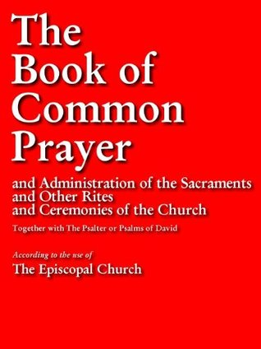
Mixed Seed
The Episcopal Church
Founded
Samuel Seabury
U.S.A.
1783
Of Note
Was Church of England (Colonials)
After U.S. Revolutionary War, changed name (1783)
Founded on: Book of Common Prayer, Catholic Creeds & Thirty-Nine Articles of Religion (Revised for USA), Communion Offices (by Seabury)
Their mixed seed will always produce Episcopalians!
Notes:
https://en.wikipedia.org/wiki/Samuel_Seabury

Slide 30
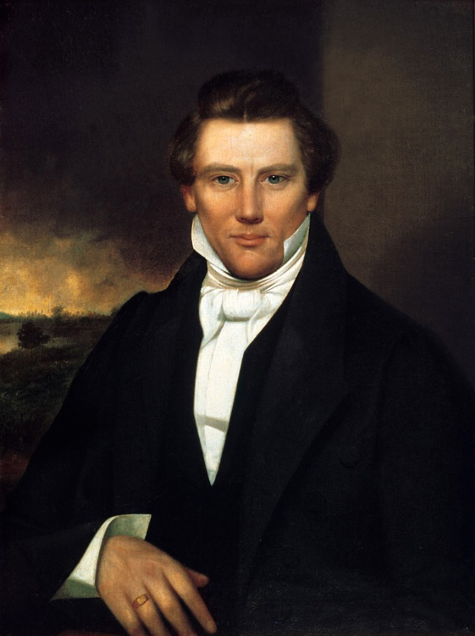
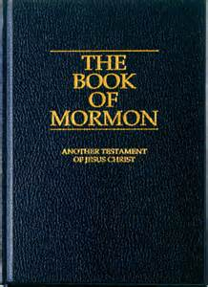
Mixed Seed
The Church of Jesus Christ of Latter-day Saints
Founded
Joseph Smith, Jr.
U.S.A.
1830
Members
Mormons
Founded on: Book of Mormon (Other writings)
The Book of Mormon will always produce a Mormon!
Notes:
Image: Joseph Smith, Jr., Portrait owned by Joseph Smith III (Wikipedia)

Slide 31
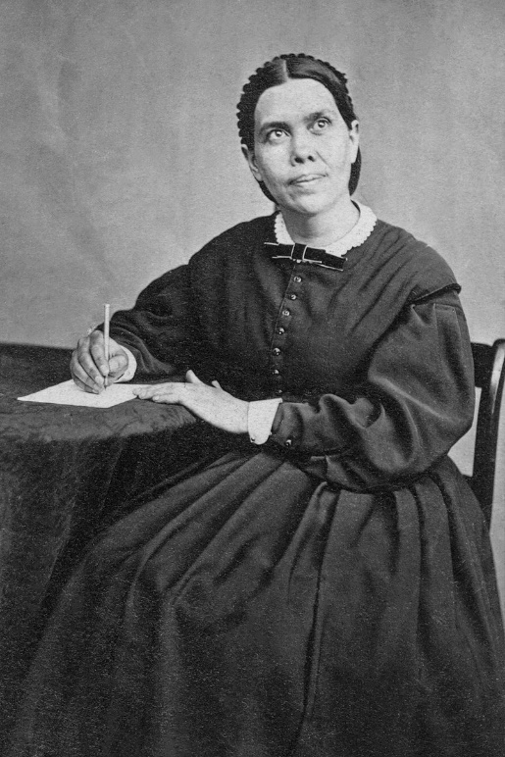
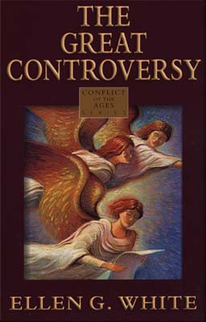
Mixed Seed
Seventh Day Adventists
Founded
William Miller and Ellen G. White
U.S.A.
1844-1863
Known for
Teach Christians are to observe the Sabbath
Founded on: The Great Controversy (Other prophecies and books by Ellen G. White)
The Great Controversy will always produce a 7th Day Adventist!

Slide 32
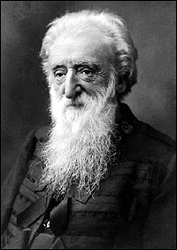
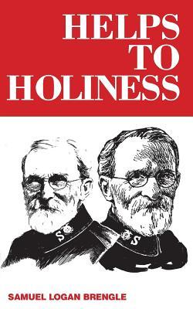
Mixed Seed
The Salvation Army
Founded
William Booth
U.S.A.
1865
Of Note
The use of military ranks for their clergy
Helps to Holiness and the Salvation Army’s Eleven Doctrines will always produce a Salvation Army Officer/Member!
Founded on: Helps to Holiness by Samuel Logan Brengle (1896) and the Salvation Army’s Eleven Doctrines

Slide 33
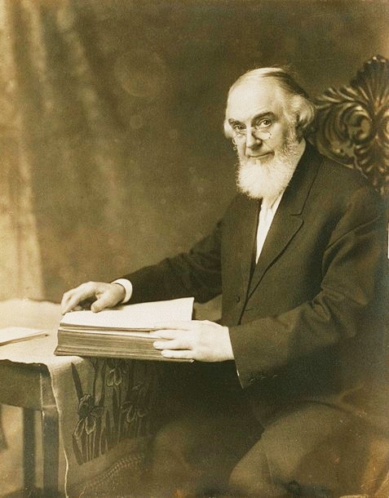
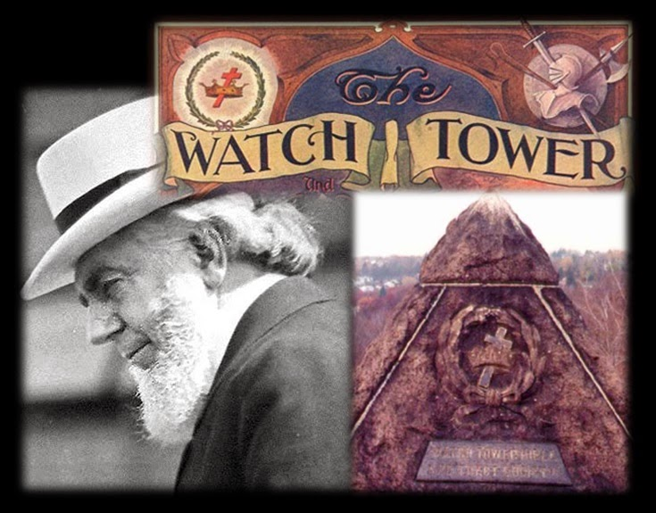
Mixed Seed
Jehovah’s Witnesses
Founded
Charles Taze Russell
U.S.A.
1870
Founded on: The Watchtower Society
The Watchtower Society will always produce a Jehovah’s Witness!

Slide 34
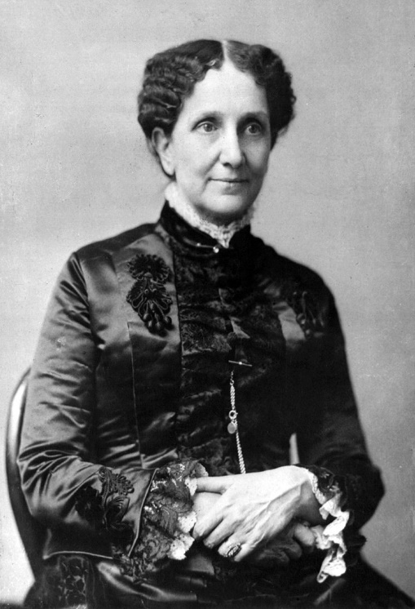
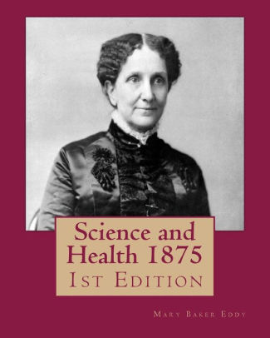
Mixed Seed
Christian Scientists
Founded
Mary Baker Eddy
U.S.A.
1875
Known for
Teaches that sickness is in the mind!
Founded on: Science and Health (1875) – Other writings
Science and Health and other Eddy writings will always produce a Christian Scientist!

Slide 35
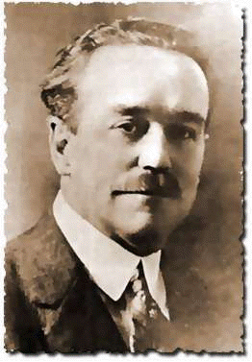
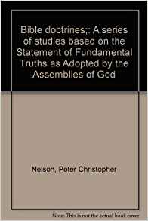
Mixed Seed
The Pentecostal Church
Founded
Charles Parham, U.S.A., 1901
Assemblies of God – 1906
Church of the Nazarene – 1907-1908
Church of God (various forms) – 1901-1906
“Holiness churches” & Charismatic Movement
Founded on: Assemblies of God Statement of Fundamental Truths (Direct operation of Holy Spirit)
Assemblies of God Statement of Fundamental Truths will always produce a Pentecostal!

Slide 36
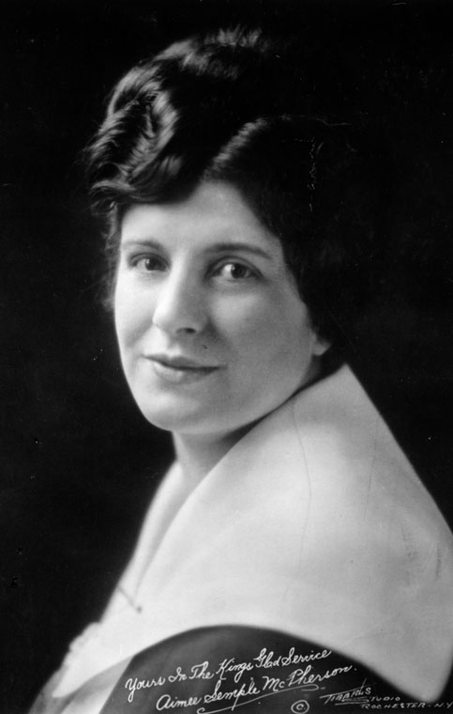
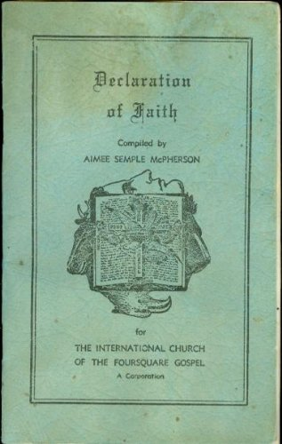
Mixed Seed
Foursquare Church
Founded
Aimee Semple McPherson
L.A., U.S.A.
1923
Their Declaration of Faith and Pentecostal literature will always produce a Foursquare Church member or Pentecostal!
Founded on: Declaration of Faith by Aimee Semple McPherson
Notes:
Image: Original Description: "Portrait of Aimee Semple McPherson, signed by her and inscribed, "Yours In the King's Glad Service." Orig Subject: Faith healing ministry of Aimee Semple McPherson (Wikipedia)

Slide 37
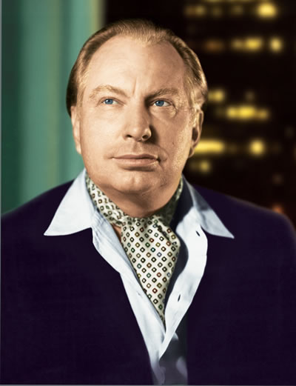
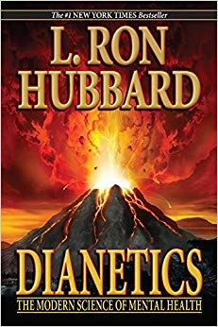
Mixed Seed
Church of Scientology
Founded
L. Ron Hubbard
U.S.A.
1953
Founded on: Dianetics (other writings)
Dianetics will always produce a Scientologist!

Slide 38
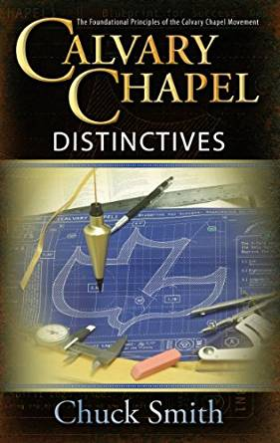
Mixed Seed
Calvary Chapel Church
Founded
Chuck Smith
U.S.A.
1965
Known for
Ministered to hippies, outcasts, surfers, and drug addicts!
Founded on: Calvary Chapel Distinctives by Chuck Smith
Calvary Chapel Distinctives will always produce a Calvary Chapel member!

Slide 39
Mixed Seed
These churches were built by men 600-1900 years after Christ built His church!
Different founders, different founding locations & dates, & differing founding documents!
The Scriptures foretold the one church would be founded by Jesus Christ in Jerusalem on the day of Pentecost, which happened in the 1st c. and on the word of Jesus as revealed by the Holy Spirit
These all have a place in secular history that records their founders and dates, and all are too late to be the “one body” (church) that Jesus died to save!
Notes:
Timeline: From World Vision Bible School @ www.wvbs.org
Sources:
http://www.truthforsaints.com/Christian_Denominations/Christian_Denominations.html
http://www.topicalbiblestudies.com/resources/Articles/The_Church/Church%20Timeline.pdf
http://klcc.faithsite.com/content.asp?SID=655&CID=43145
http://www.wvbs.org/
http://www.wvbs.org/video/

Slide 40
Conclusion
II Tim. 4:3-4: Men departed the truth of God and devised doctrines in accordance with their likings and began teaching as doctrine their traditions!
(Mt. 15:8-9)
What they all have in common is they are human in origin! (Man-made)
MIXED SEED!
II Cor. 11:3 (Too many people allow themselves to be deceived!)
3. But I am afraid that, as the serpent deceived Eve by his craftiness, your minds will be led astray from the simplicity and purity of devotion to Christ.

Slide 41
Conclusion
Mixed Seed will only produce confusion and a perverted
message of the gospel!
The only way to get the unity Jesus prayed for is to use the same seed! (Luke 8:11)
If the only “seed” sown was the
N.T. gospel as taught by the
apostles, what would result?
Because seed always
produces after its kind,
the only thing that could
possibly be produced by
the N.T. is a Christian —
No other names
necessary!

Slide 42
Conclusion
It is important to know the differences between the church Jesus died to build and denominations!
Notes:
Timeline: From World Vision Bible School @ www.wvbs.org

Slide 43
Conclusion
Are you of the seed that is the word of God,
or from “mixed seed?”
Salvation is found only in the one church Jesus
built for He is the Savior of “the body!”
(Eph. 5:23)

Slide 44
“What Must I Do To Be Saved?”
Hear The Gospel (Jn. 5:24; Rom. 10:17)
Believe In Christ (Jn. 3:16-18; Jn. 8:24)
Repent Of Sins (Lk. 13:3-5; Acts 2:38)
Confess Christ (Mt. 10:32; Rom. 10:10)
Be Baptized (Mk. 16:16; Acts 22:16)
Remain Faithful (Jn. 8:31; Rev. 2:10)
For The Erring Saint:
Repent (Acts 8:22), Confess (I Jn. 1:9),
Pray (Acts 8:22)

Slide 45
Mixed Seed (Why Are There So Many Churches?)
by Nathan L Morrison, Sunday 03/08/2020
For further study, or if questions, please Call: 804-277-1983
or Visit: www.courthousechurchofchrist.com
The Church Jesus Died To Save
The Right Founder – Jesus (Jer. 23:5-6; Mal. 3:1-3; Mt. 16:18)
The Right Place – Jerusalem (Is. 2:1-2; Mk. 9:1; Acts 1:9-12; 2:1-5, 47)
The Right Time – Day of Pentecost in 1st century (Dan. 2:44; Acts 2; 11:15; Gal. 4:4)
The Right Foundation & Doctrine – Jesus Christ and His Word (Is. 28:16; I Cor. 3:10-11; John 14:26; 16:13; II Tim. 3:16-17; II Pet. 1:19-21)
The Right Name – Church(es) of Christ (Rom. 16:16); church of God (Acts 20:28); church of the Living God (I Tim. 3:15); church of the firstborn (Heb. 12:23)
– Christians (Acts 11:26; Acts 26:28; I Pet. 4:16)

Slide 46
Founder | Place | Time | Foundation | Name
Jesus Christ | Jerusalem | Pentecost (1st c. AD) | Teachings of Jesus Christ | church of Christ
Pope Boniface III | Rome, Italy | AD 607 | Catholic Catechism & Apostle’s, Nicene & Athanasian Creeds | Catholic Church
Muhammad | Medina | AD 610 | Koran (Others) | Islam
Great Schism | Constantinople, Turkey Rome, Italy | 1054 | Catholic Catechism & Apostle’s, Nicene & Athanasian Creeds | Eastern Orthodox & Roman Catholic
Martin Luther | Germany | 1517/1526/1546 | Augsburg Confessions (1530), Book of Concord (1580) | Lutherans
Jacob Hutter Menno Simons Jacob Amman | Switzerland Holland Switzerland | 1527/1528 1536 1690 | Schleitheim Confession (1527), and the Dordrecht Confession (1632) | Hutterites Mennonites Amish (Anabaptists)
King Henry VIII | England | 1534 | Book of Common Prayer, Catholic Creeds & Thirty-Nine Articles of Religion | Church of England

Slide 47
It Wears the Right Name
Founder | Place | Time | Foundation | Name
Jesus Christ | Jerusalem | Pentecost (1st c. AD) | Christ | church of Christ
John Calvin | Geneva, Switzerland | 1536 | His own teachings | Calvinism (Calvinists)
John Knox | Geneva & Scotland | 1560 | Book of Common Prayer & Calvinism | Presbyterians
John Smyth | Holland | 1609 | Baptist’s Manual | Baptists
John Wesley | England | 1739 | The Book of Discipline | Methodists
King Henry VIII/Samuel Seabury | U.S.A. | 1783 | Book of Common Prayer, Catholic Creeds & Thirty-Nine Articles of Religion (Tailored to USA) | Episcopal
Joseph Smith | U.S.A. | 1830 | Book of Mormon (Others) | Mormons
Ellen G. White | U.S.A. | 1844-1863 | The Great Controversy (Others) | Seventh Day Adventists
William Booth | U.S.A. | 1865 | Helps to Holiness by Samuel Logan Brengle (1896) and the Salvation Army’s Eleven Doctrines | Salvation Army

Slide 48
It Wears the Right Name
Founder | Place | Time | Foundation | Name
Jesus Christ | Jerusalem | Pentecost (1st c. AD) | Christ | church of Christ
Charles Taze Russell | U.S.A. | 1870 | The Watchtower Society | Jehovah’s Witnesses
Mary Baker Eddy | U.S.A. | 1875 | Science and Health (1875) | Christian Scientists
Charles Parham | U.S.A. | 1901 | Assemblies of God Statement of Fundamental Truths (Direct operation of Holy Spirit) | Pentecostals (Many Variations: Assemblies of God (Church of God) Church of the Nazarene
Aimee Semple McPherson | L.A., U.S.A. | 1923 | Declaration of Faith by Aimee Semple McPherson | Foursquare Church
L. Ron Hubbard | U.S.A. | 1953 | Dianetics | Church of Scientology (Scientology)
Chuck Smith | U.S.A. | 1965 | Calvary Chapel Distinctives by Chuck Smith | Calvary Chapel

