Slide 1
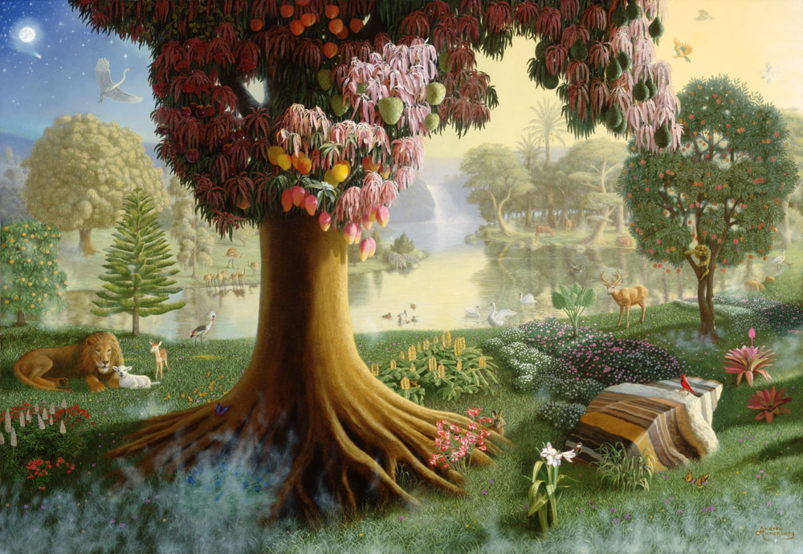
East OF Eden
Text: Gen. 3:22-24
Notes:
By Nathan L Morrison
All Scripture is from NASB unless otherwise stated
For further study, or if questions, please Call: 804-277-1983 or Visit www.courthousechurchofchrist.com
Adapted from lessons by Joe Price & Mark Posey

Slide 2
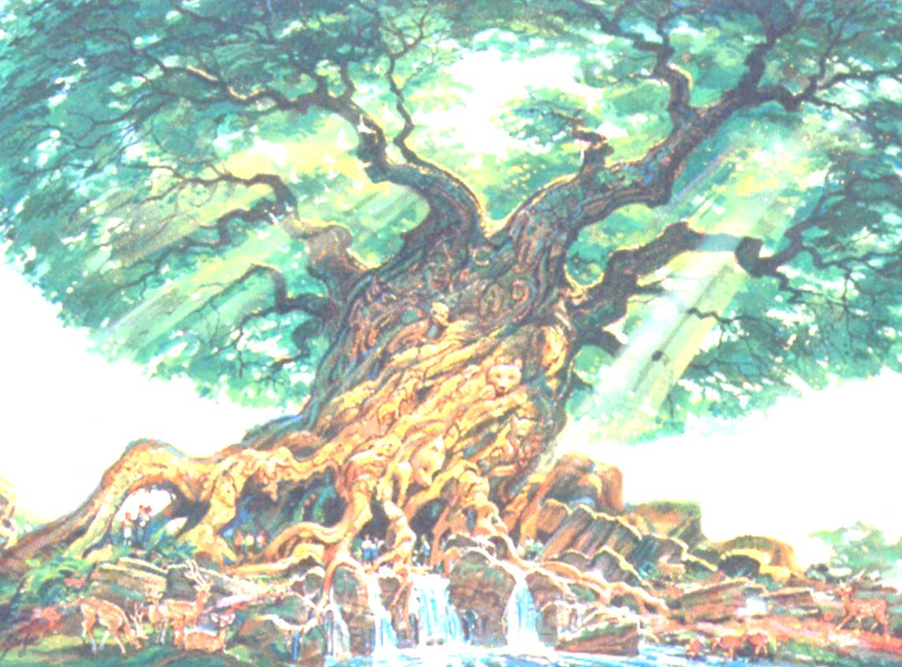
Intro
Gen. 2:8-15 (vss. 8-12)
8. The LORD God planted a garden toward the east, in Eden; and there He placed the man whom He had formed.
9. Out of the ground the LORD God caused to grow every tree that is pleasing to the sight and good for food; the tree of life also in the midst of the garden, and the tree of the knowledge of good and evil.
10. Now a river flowed out of Eden to water the garden; and from there it divided and became four rivers.
11. The name of the first is Pishon; it flows around the whole land of Havilah, where there is gold.
12. The gold of that land is good; the bdellium and the onyx stone are there.

Slide 3
Intro
Gen. 2:8-15 (vss. 13-15)
13. The name of the second river is Gihon; it flows around the whole land of Cush.
14. The name of the third river is Tigris; it flows east of Assyria. And the fourth river is the Euphrates.
15. Then the LORD God took the man and put him into the garden of Eden to cultivate it and keep it.

Slide 4
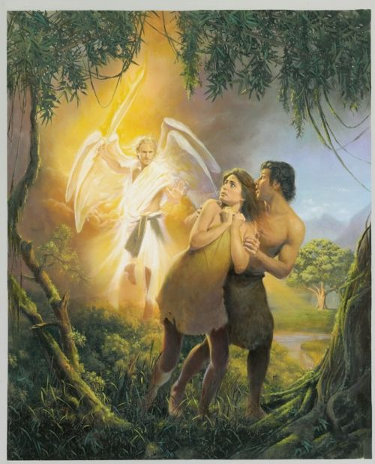
Intro
In Genesis and elsewhere, when people go “east,” they
leave the land of blessing (Eden and the Promised Land)
for a land where their greatest hopes turn to ruin
(IE: Sodom & Babylon – Is. 2:6; 39:6)
Living East of Eden is Paradise Lost
and efforts to regain it
Adam and Eve were cast out of the Garden to the east – Gen. 3:22-24
Cain was expelled from the presence of the Lord and went east – Gen. 4:16
People moved east and built the tower of Babel – Gen. 11:2
Lot separated from Abram and took the best lands toward the east – Gen. 13:10-11
Sodom and Gomorrah were in the east, where Lot pitched his tent – Gen. 13:11-13

Slide 5
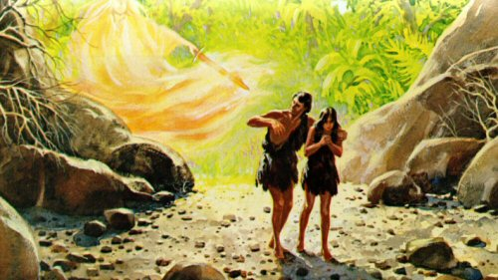
Intro
Living East of Eden is a metaphor for life, for damage caused by sinful choices, and for seeking redemption!

Slide 6
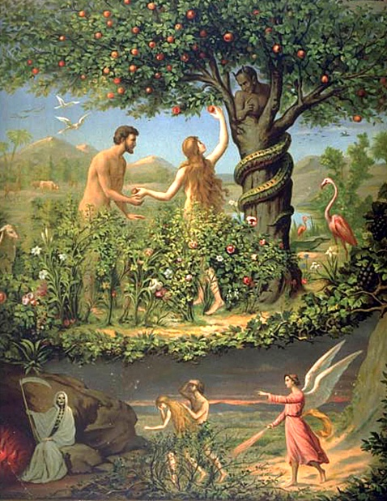
East of Eden = Sin & Death
It Was East of Eden…
Where the consequence for sin was
death brought into the world –
Gen. 3:19, 22
Physical death became possible – Gen. 5:5
Spiritual death (separation from God) is the 2nd Death – Rom. 5:12-14; I Cor. 15:21-22; Rev. 20:11-15
Where men began to trust their own
wisdom and will instead of God's –
Gen. 4:16, 19-24
Away from the presence of the Lord – Gen. 4:16 (Jn. 14:23)
Marriage and the home corrupted and defiled – 4:19 (2:21-22, 24; Mt. 19:4-6)
Oppression and injustice increased – 4:23-24

Slide 7
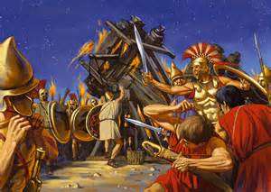
East of Eden = Sin & Death
It Was East of Eden…
Where men “began to call on the name of the Lord” –
Gen. 4:25-26
God did not forget His promise (seed of woman) – Gen. 3:15
God gives us children to comfort us – Ps. 127:3
The blessing of free will is confirmed there (Ezek. 18:10-18)
Our culture does not define our faith! We must live above the culture – Rom. 13:11-14; Phil. 2:15
Where people thoroughly corrupted
themselves – Gen. 6:1-5
Spiritual indifference (no love for God) – 6:5, 12 (Mt. 22:37)
Violence (no love for others) – 6:11, 13 (Mt. 22:39)

Slide 8
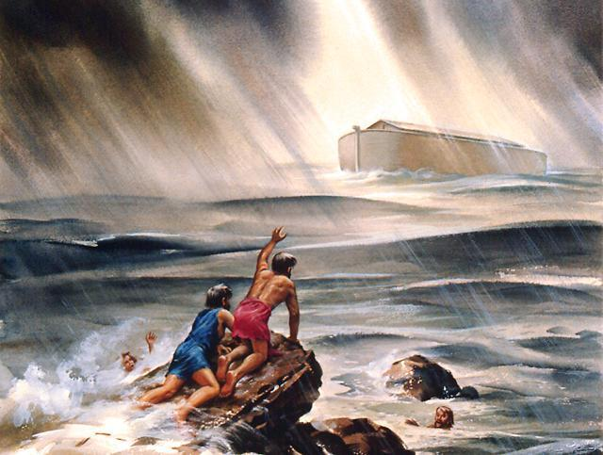
East of Eden = Sin & Death
It Was East of Eden…
Where God's judgment against sin was announced and
applied – Gen. 6:6-7; 7:11-12, 19
Water judgment foreshadows fire judgment – II Pet. 3:5-7, 10
How we live now determines our judgment – Jn. 5:28-29
Where Noah found grace in the eyes
of the Lord (Despite the world
around him – Phil. 2:15) – Gen. 6:8
Grace is found East of Eden: Announced by God's command and received by Noah's obedient faith – Gen. 6:13-14, 22-7:1 (Heb. 11:7)
Living East of Eden is to dwell away from the presence of God!

Slide 9
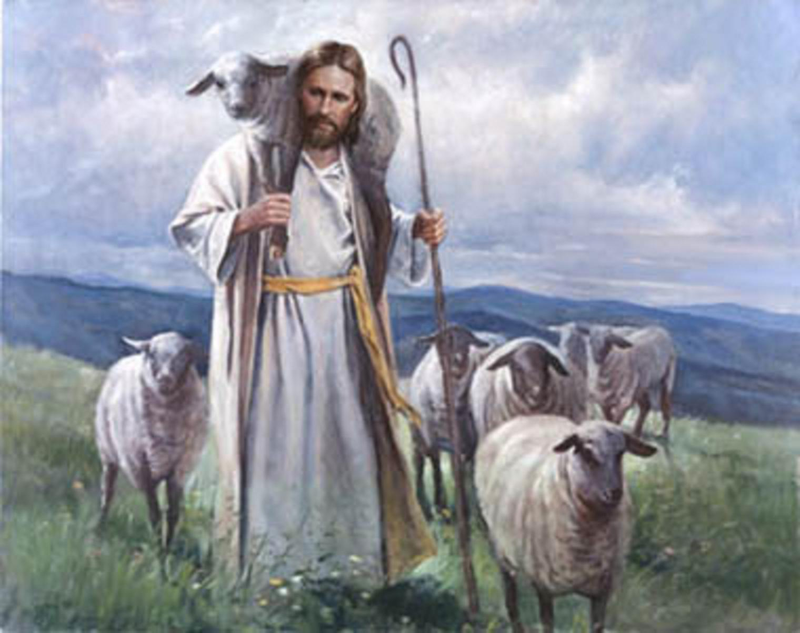
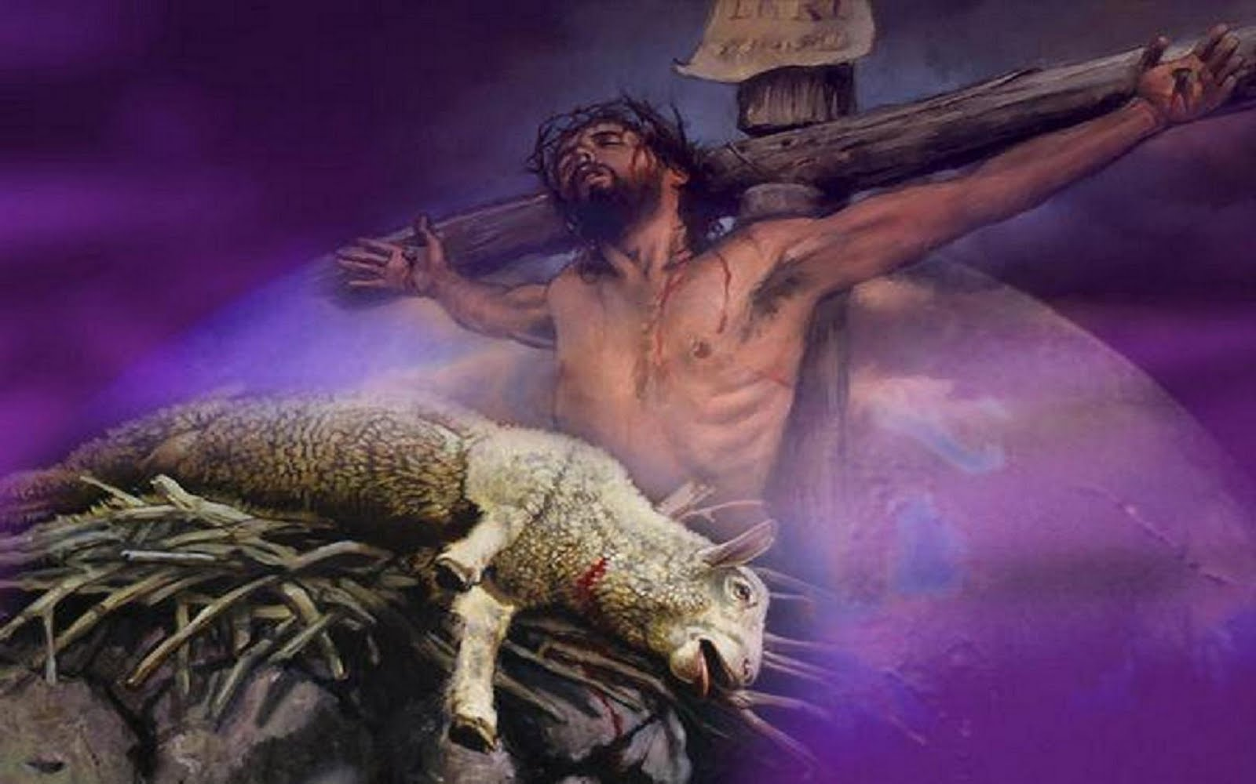
We Have All Lived East of Eden, But Christ Can Take Us to the “Paradise of God”
Christ, the Good Shepherd (Jn. 10:11, 14), left the 99
righteous sheep to go “East of Eden” to bring back the one
who had gone astray (Mt. 18:12-13; Lk. 15:1-7)
Christ offers the cure to the death sin brought into the world – Rom. 5:17-21; 6:23; I Cor. 15:21-22; Eph. 2:13-16 (Eternal life is found in Christ!)

Slide 10
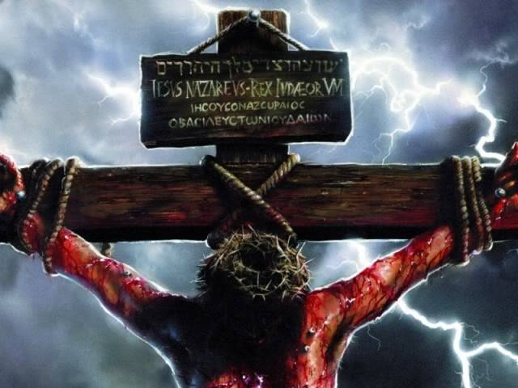
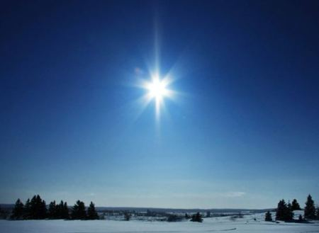
We Have All Lived East of Eden, But Christ Can Take Us to the “Paradise of God”
Hope and salvation are found East of Eden: Messiah –
Mt. 2:1-2; Gal. 4:4; Rev. 22:16: The Bright Morning Star
(in the east); Lk. 1:76-79
It was the star in the east that led the wise men from the east to the place where the baby Jesus was, and they worshiped Him! (Mt. 2:1-2, 9-11)
John the Baptist prepared the way for the Messiah (Lk. 1:76-79)
It was Jesus Who would bring people back to the Lord because of His sacrifice for sins – Mt. 1:21; Jn. 1:29; 12:32; Eph. 2:13-16 (Reconciled man to man and man to God!)

Slide 11
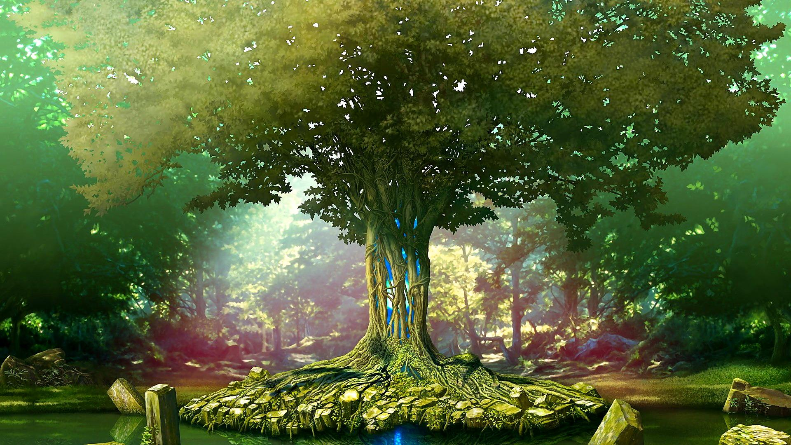
We Have All Lived East of Eden, But Christ Can Take Us to the “Paradise of God”
It is Christ Who can bring us from “East of Eden” back to
the Garden of God (Paradise)
Rev. 2:7: To Ephesus: “To him who overcomes, I will grant to eat of the tree of life which is in the Paradise of God.”
Rev. 22:1-4, 14, 17: The water of life & the tree of life – Saints have the right to both!

Slide 12
We Have All Lived East of Eden, But Christ Can Take Us to the “Paradise of God”!
Revelation 22:1-4
1. Then he showed me a river of the water of life, clear as crystal, coming from the throne of God and of the Lamb,
2. in the middle of its street. On either side of the river was the tree of life, bearing twelve kinds of fruit, yielding its fruit every month; and the leaves of the tree were for the healing of the nations.
3. There will no longer be any curse; and the throne of God and of the Lamb will be in it, and His bond-servants will serve Him;
4. they will see His face, and His name will be on their foreheads.

Slide 13
We Have All Lived East of Eden, But Christ Can Take Us to the “Paradise of God”
Rev. 22:14, 17
14. Blessed are those who wash their robes, so that they may have the right to the tree of life, and may enter by the gates into the city.
17. The Spirit and the bride say, "Come." And let the one who hears say, "Come." And let the one who is thirsty come; let the one who wishes take the water of life without cost.

Slide 14
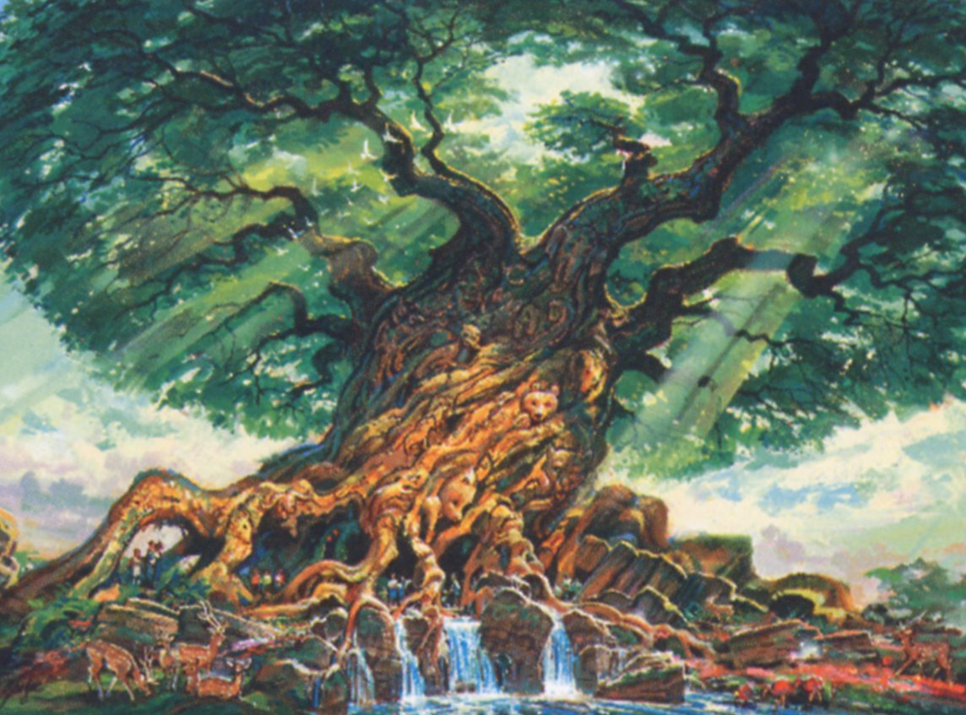
We Have All Lived East of Eden, But Christ Can Take Us to the “Paradise of God”
It is Christ Who can bring us from “East of Eden” back to
the Garden of God (Paradise)
Rev. 2:7: To Ephesus: “To him who overcomes, I will grant to eat of the tree of life which is in the Paradise of God.”
Rev. 22:1-4, 14, 17: The water of life & the tree of life – Saints have the right to both!
Those who obey Him (saints) will be given the right to the Tree of Life and enjoy the Garden of Paradise (new Eden) God has waiting for the faithful!

Slide 15
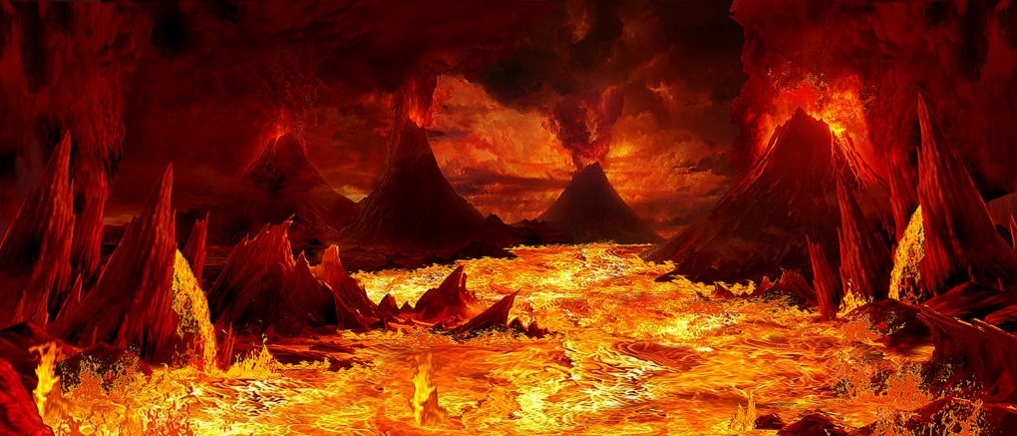
Conclusion
Living “East of Eden” is a metaphor for life after sin came
into the world and into our lives; of life lived away from
God and away from His blessings!
God's judgment of sin and eternal death lie “East of Eden!” (Rev. 20:11-15: Anyone whose names are not recorded in the Book of Life will suffer the 2nd Death in eternal torment!)
Those disobedient to the
gospel and remain “East of Eden” will suffer eternal punishment
(II Thess. 1:7-9; Rev. 22:18-19)

Slide 16
Conclusion
God's grace, salvation and living hope are also found
“East of Eden,” compelling us to live by faith and obey Jesus Christ, to be given entrance into the eternal
“Paradise of God” (Rev. 2:7; 22:1-5)!
Are you living “East of Eden,” awaiting
punishment, or have you obeyed the gospel to
gain entrance to the eternal “Paradise of God?”

Slide 17
“What Must I Do To Be Saved?”
Hear The Gospel (Jn. 5:24; Rom. 10:17)
Believe In Christ (Jn. 3:16-18; Jn. 8:24)
Repent Of Sins (Lk. 13:3-5; Acts 2:38)
Confess Christ (Mt. 10:32; Rom. 10:10)
Be Baptized (Mk. 16:16; Acts 22:16)
Remain Faithful (Jn. 8:31; Rev. 2:10)
For The Erring Saint:
Repent (Acts 8:22), Confess (I Jn. 1:9),
Pray (Acts 8:22)

