Slide 1
Dare To Be Like Ananias
Text: Acts 9:10-22
Notes:
By Nathan L Morrison
All Scripture given is from NKJV unless otherwise stated
For further study, or if questions, please Call: 804-277-1983 or Visit www.courthousechurchofchrist.com

Slide 2
intro
Courage needed by God’s people
“Mental or moral strength to persevere” (Webster)
Deut. 31:6: “Be strong and of good courage…”
Josh. 1:6-7: “Be strong and very courageous”
Dare to be like Ananias!
Acts 9:10-22: Ananias sent to Saul of Tarsus
Ananias displayed courage needed to serve God!

Slide 3
Courage Caused Him to be Ready
Acts 9:10
10. Now there was a certain disciple at Damascus named Ananias; and to him the Lord said in a vision, "Ananias." And he said, "Here I am, Lord."
“Here I am, Lord”
Abraham – Heb. 11:8 (Gen. 12:1-5)
Samuel – I Sam. 3:10
Isaiah – Is. 6:8

Slide 4
Courage Caused Him to be Ready
Acts 9:10
10. Now there was a certain disciple at Damascus named Ananias; and to him the Lord said in a vision, "Ananias." And he said, "Here I am, Lord."
Be Ready!
To give an answer of the hope within us – I Pet. 3:15
To preach the gospel as Paul was – Rom. 1:15
To do good to all men – Gal. 6:10
To pray for all saints – Eph. 6:18; Col. 4:2
To avoid temptation – I Pet. 5:8-9
To stand firm in the faith – I Cor. 16:13
For the coming day of the Lord – Mt. 24:42; 25:13
Dare to be like Ananias in being ready to serve God, whatever the call may be!

Slide 5
Courage Caused Him to be Ready
Acts 9:11-12
11. So the Lord said to him, "Arise and go to the street called Straight, and inquire at the house of Judas for one called Saul of Tarsus, for behold, he is praying.
12. And in a vision he has seen a man named Ananias coming in and putting his hand on him, so that he might receive his sight."
Courage Caused Him to Go Where He Wouldn’t Normally Go
Knowing where Saul of Tarsus was would usually be the place one wouldn’t want to go
II Tim. 1:7: We need to strive to develop courage
Dare to be like Ananias in courage to go where you wouldn’t normally go!

Slide 6
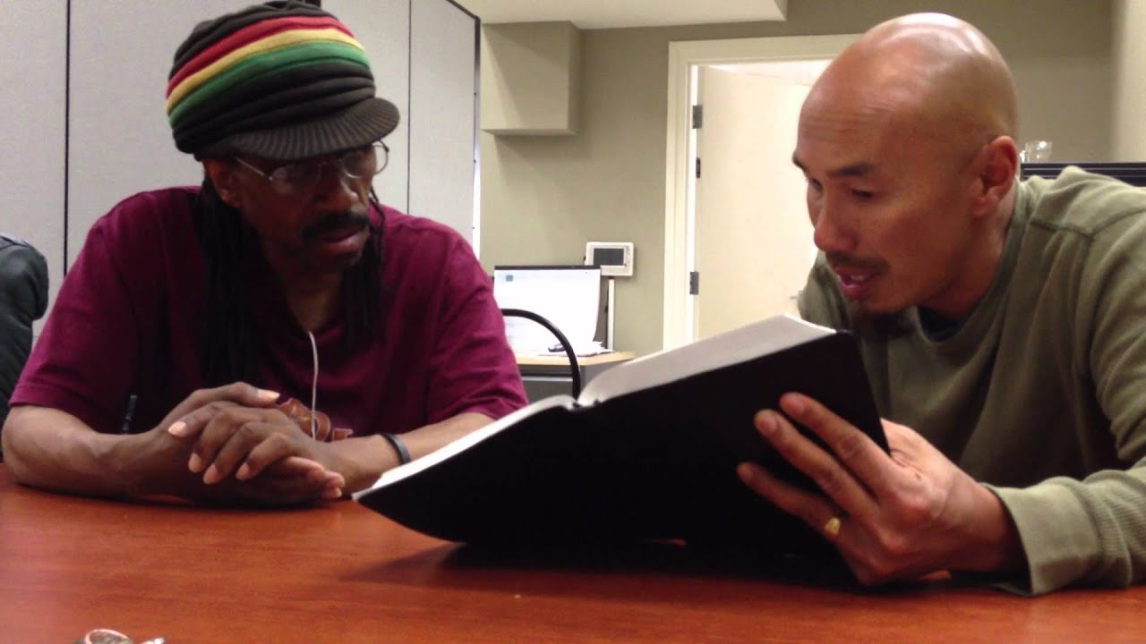
Courage Caused Him to be Ready
Acts 9:13-14
13. Then Ananias answered, "Lord, I have heard from many about this man, how much harm he has done to Your saints in Jerusalem.
14. And here he has authority from the chief priests to bind all who call on Your name."
Courage Caused Him to Go Where He Wouldn’t Normally Go
Matthew 10:16: Sheep amidst the wolves – Need Courage!
Ananias feared for his life
There were times men of God walked away – Saints need to be realistic with their courage
Elijah (I Kings 19)
Jesus (John 8:59)
Courage Caused Him to be Realistic
Dare to be like Ananias in doing whatever is needed,
following the right course!

Slide 7
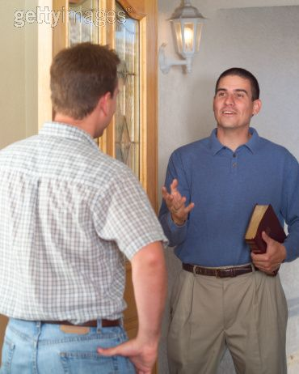
Courage Caused Him to be Ready
Acts 9:15-17
15. But the Lord said to him, "Go, for he is a chosen vessel of Mine to bear My name before Gentiles, kings, and the children of Israel.
16. For I will show him how many things he must suffer for My name's sake."
17. And Ananias went his way and entered the house; and laying his hands on him he said, "Brother Saul, the Lord Jesus, who appeared to you on the road as you came, has sent me that you may receive your sight and be filled with the Holy Spirit."
Courage Caused Him to Go Where He Wouldn’t Normally Go
Courage Caused Him to be Realistic
Courage Caused Him to Receive God’s Word
Ananias was ready to go and do what God said – didn’t run the opposite direction like Jonah!

Slide 8
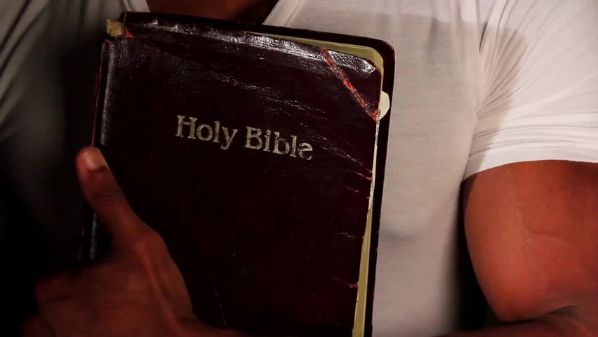
Courage Caused Him to be Ready
Acts 9:17
17. And Ananias went his way and entered the house; and laying his hands on him he said, "Brother Saul, the Lord Jesus, who appeared to you on the road as you came, has sent me that you may receive your sight and be filled with the Holy Spirit."
Courage Caused Him to Go Where He Wouldn’t Normally Go
Think of the courage it took to go to the house he knew Saul of Tarsus was in! (I Thess. 2:4)
Courage Caused Him to be Realistic
Courage Caused Him to Receive God’s Word
Dare to be like Ananias in being
ready to obey the word of God!

Slide 9
Courage Caused Him to be Ready
Acts 9:18-22 (22:12-16)
18. Immediately there fell from his eyes something like scales, and he received his sight at once; and he arose and was baptized.
19. So when he had received food, he was strengthened. Then Saul spent some days with the disciples at Damascus.
20. Immediately he preached the Christ in the synagogues, that He is the Son of God.
21. Then all who heard were amazed, and said, "Is this not he who destroyed those who called on this name in Jerusalem, and has come here for that purpose, so that he might bring them bound to the chief priests?"
22. But Saul increased all the more in strength, and confounded the Jews who dwelt in Damascus, proving that this Jesus is the Christ.
Courage Caused Him to Go Where He Wouldn’t Normally Go
Courage Caused Him to be Realistic
Courage Caused Him to Receive God’s Word
Courage Helped Cause Great Results

Slide 10
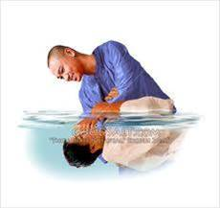
Courage Caused Him to be Ready
Acts 22:16
16. 'Now why do you delay? Get up and be baptized, and wash away your sins, calling on His name.'
Courage Caused Him to Go Where He Wouldn’t Normally Go
What if Ananias had been afraid to say what Saul needed to hear?
We never know who the person we convert will convert! (Phil. 4:22)
Courage Caused Him to be Realistic
Courage Caused Him to Receive God’s Word
Courage Helped Cause Great Results
Dare to be like Ananias and sow the seed of the Kingdom!
(Mark 4:1-20)

Slide 11
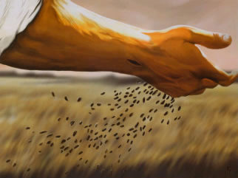
Conclusion
We need to have courage to preach the gospel: we never
know what that convert will accomplish!
Think of all those who heard the gospel through Paul’s
preaching & suffering!
Dare to have the courage of Ananias!
(Sow the seed of the Kingdom)

Slide 12
“What Must I Do To Be Saved?”
Hear The Gospel (Jn. 5:24; Rom. 10:17)
Believe In Christ (Jn. 3:16-18; Jn. 8:24)
Repent Of Sins (Lk. 13:3-5; Acts 2:38)
Confess Christ (Mt. 10:32; Rom. 10:10)
Be Baptized (Mk. 16:16; Acts 22:16)
Remain Faithful (Jn. 8:31; Rev. 2:10)
For The Erring Saint:
Repent (Acts 8:22), Confess (I Jn. 1:9),
Pray (Acts 8:22)

