Slide 1
What Is Your Life?
Text: James 4:13-16
Notes:
By Nathan L Morrison
All Scripture given is from the NASB, unless otherwise stated
For further study, or if questions, please Call: 804-277-1983 or Visit www.courthousechurchofchrist.com

Slide 2
Intro
For the Christian, a funeral or memorial service is a reminder of the frailty of life
(Heb. 9:27; Rev. 14:12-13)
We don’t know if we will be given another hour or tomorrow, so we live daily for Jesus
Mt. 24:36: “But of that day and hour no one knows, no, not even the angels of heaven, but My Father only.”
Mt. 25:13: “Watch therefore, for you know neither the day nor the hour in which the Son of Man is coming” (NKJV).
Christians are urged to “examine” ourselves – II Cor. 13:5

Slide 3
Intro
James 4:13-16 (NKJV)
13. Come now, you who say, "Today or tomorrow we will go to such and such a city, spend a year there, buy and sell, and make a profit";
14. whereas you do not know what will happen tomorrow. For what is your life? It is even a vapor that appears for a little time and then vanishes away.
15. Instead you ought to say, "If the Lord wills, we shall live and do this or that."
16. But now you boast in your arrogance. All such boasting is evil.
It’s important to “take inventory,” especially in
view of the answer to “What Is Your Life?”

Slide 4
“What Is Your Life” In Relation to Duration?
Need to recognize because:
Man lives but one time on earth – Heb. 9:27
Man’s eternal destiny is dependent on the choices made in life – II Cor. 5:10
What man plans to do in life must be done immediately – Jn. 9:4
Life is brief:
James 4:14: Like a vapor!
Job 14:1: Short & full of trouble
This brief life is full of change (and trouble)!

Slide 5
“What Is Your Life” In Relation to Duration?
Self-Inventory is necessary because there’s a danger of “drifting” as long as life lasts:
Heb. 2:1: We must be diligent in the things we know to be right!
Gal. 1:6: The Galatians had “drifted away” to another gospel!
Rom. 11:22: The goodness of God is bestowed on those who “continue in His goodness.”
Rev. 3:1-2: The church at Sardis was charged to take inventory and strengthen the things that remained!
The duration of man’s life is
brief (Job 14:2) so we must
examine ourselves!

Slide 6
“What Is Your Life” In Relation to Purpose?
The true value of life is not measured by quantity but by quality!
The biography of the oldest man on record (Methuselah lived 969 years) is given in three verses (Gen. 5:25-27)!
Christ lived on earth approx. 33 years, but there are 4 books of biography (the gospels) about His life and even they could not contain all that He did (Jn. 21:25)!
It’s not how long one lives, but what one does with the time given! (Alexander the Great had conquered the known world by the time he died at age 32!)

Slide 7
“What Is Your Life” In Relation to Purpose?
The purpose in life for some seems to be “Eat, drink, and be merry”
The rich farmer had this philosophy of life: was called a “fool” (Lk. 12:15-21)
If life on earth is the totality of man’s existence then this view of life makes sense, according to Paul (I Cor. 15:32).
The purpose in life for some is to get as many material things as they can get
Lk. 12:15; Mt. 6:19-20; I Tim. 6:9-10: The pursuit of riches can be a snare!
“He who dies with the most toys wins”
“He who dies with the most toys still dies!”
(Luke 12:20)

Slide 8
“What Is Your Life” In Relation to Purpose?
What should be man’s purpose in life?
Mt. 6:33: Jesus said the necessities of life will be added to the one who puts God first!
To “keep his commandments” we must know them! (Ps. 119:105: God’s word is lamp to our path!; II Tim. 2:15: We must study to rightly divide God’s word)
Eccl. 12:13-14 (NKJ)
13. Let us hear the conclusion of the whole matter: Fear God and keep His commandments, For this is man's all.
14. For God will bring every work into judgment, Including every secret thing, Whether good or evil.
Since life is brief, self-inventory is
necessary to see if we continue in the
same purpose!

Slide 9
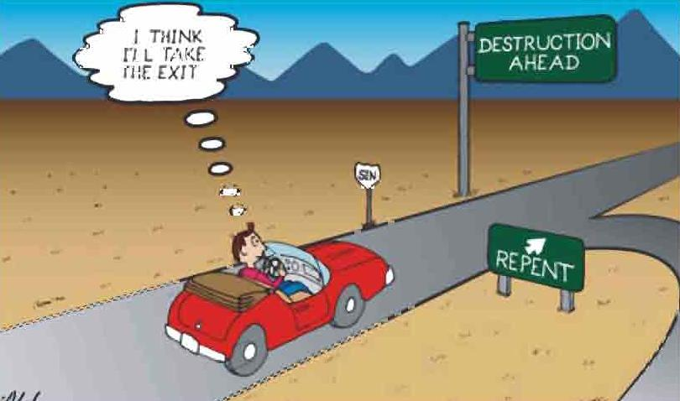
“What Is Your Life” In Relation to Destiny?
The issue of destiny is directly connected to the issue of purpose!

Slide 10
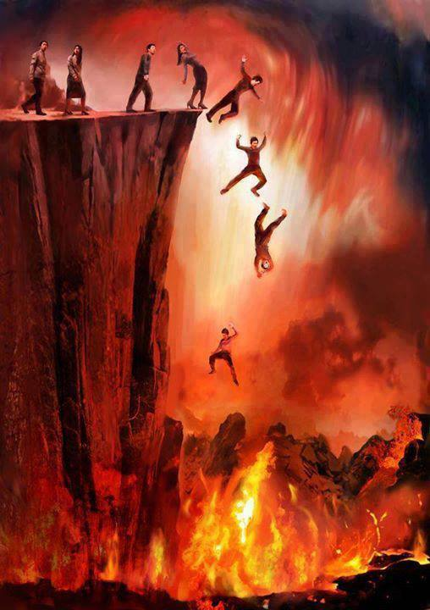
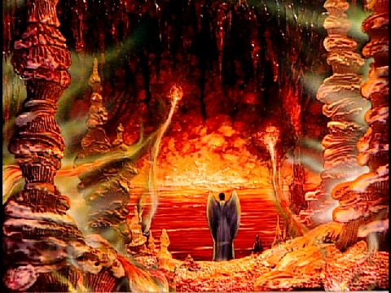
“What Is Your Life” In Relation to Destiny?
God’s word clearly reveals the destiny of some people is:
“Destruction” – Mt. 7:13-14
“Eternal punishment” – Mt. 25:46
“Eternal separation from God” – II Thess. 1:9
“A lake of fire and brimstone” (“2nd death”) – Rev. 21:8

Slide 11
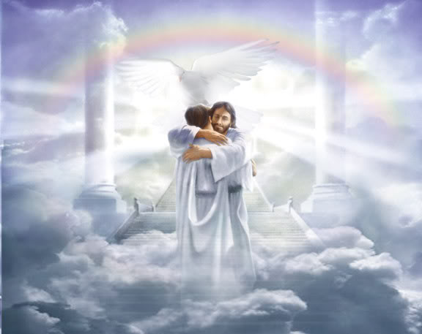
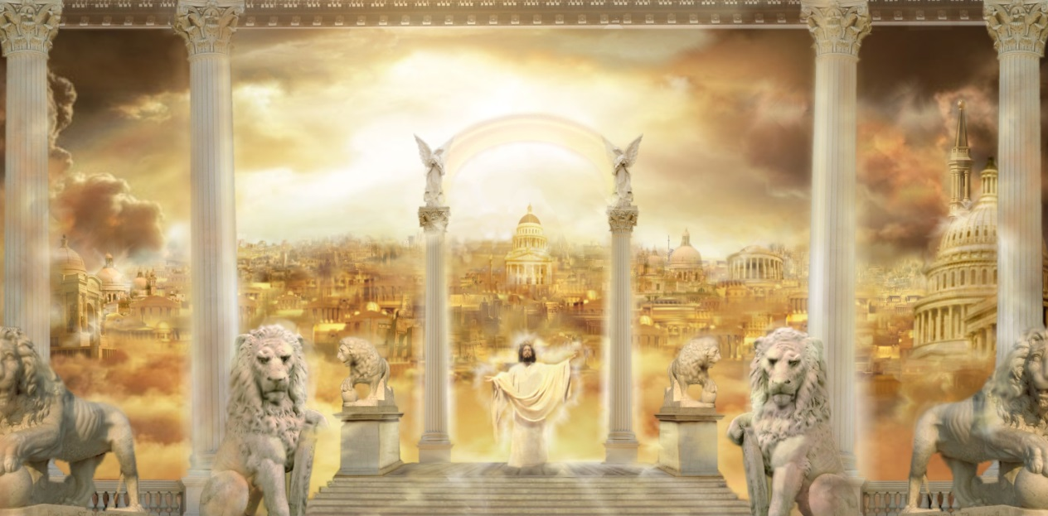
“What Is Your Life” In Relation to Destiny?
God’s word clearly reveals the destiny of some people is:
“Life” – Mt. 7:13-14
“Eternal life” & “rest” – Rom. 6:23; Rev. 14:13
“Immortality with glory and honor” – Rom. 2:7
“New Jerusalem” (“Heaven” – I Pet. 1:4) – Rev. 21:1-7

Slide 12
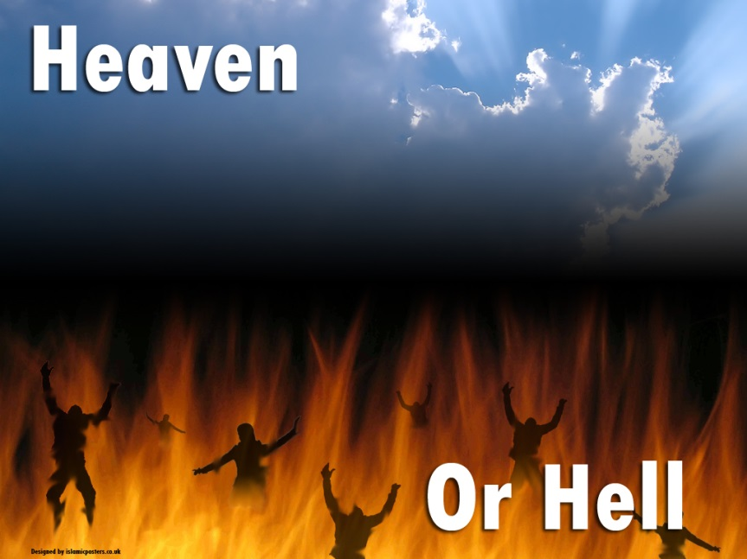
“What Is Your Life” In Relation to Destiny?
The purpose of life determines the destiny
(Mt. 7:13-14: Two roads of life)!
While life on earth is brief, man’s destiny is
eternal, so self-inventory is important to make
sure we are on the right road!

Slide 13
Conclusion
An “Inventory” of a business is only beneficial if the picture is accurate of where they stand
“Inventory” often reveals weaknesses, and if the company is honest they will use their findings to fix the problem areas, not just cover them up.
Christians need not only “take inventory” but be honest to see what God sees (Heb. 4:12-13):
Need to be honest enough with ourselves and God to repent! (I Jn. 1:9-10; II Sam. 12:13)
If not honest with ourselves, the Scriptures will not be profitable for reproof and correction to us – Prov. 22:3; II Tim. 3:16-17

Slide 14
Conclusion
All people are confronted with the question,
“What is your life?”
We need to answer with our duration, purpose, and
destiny in mind – BE PREPARED!
The purpose and the
destiny of life are decided
in a few vapor years!
(James 4:14; Eph. 5:16; Col. 4:5)
Despite all that we may accomplish in life, what truly matters is we are remembered as a faithful servant of God and follower of Jesus! (John 12:26)

Slide 15
Conclusion
We should use our brief duration to ensure we
are living up to our purpose so we may
confidently face the future of an eternal destiny!

Slide 16
“What Must I Do To Be Saved?”
Hear The Gospel (Jn. 5:24; Rom. 10:17)
Believe In Christ (Jn. 3:16-18; Jn. 8:24)
Repent Of Sins (Lk. 13:3-5; Acts 2:38)
Confess Christ (Mt. 10:32; Rom. 10:10)
Be Baptized (Mk. 16:16; Acts 22:16)
Remain Faithful (Jn. 8:31; Rev. 2:10)
For The Erring Child:
Repent (Acts 8:22), Confess (I Jn. 1:9),
Pray (Acts 8:22)

Slide 17
James 4:13-16 (NKJV)
13. Come now, you who say, "Today or tomorrow we will go to such and such a city, spend a year there, buy and sell, and make a profit";
14. whereas you do not know what will happen tomorrow. For what is your life? It is even a vapor that appears for a little time and then vanishes away.
15. Instead you ought to say, "If the Lord wills, we shall live and do this or that."
16. But now you boast in your arrogance. All such boasting is evil.

