Slide 1
Ephesians 1

Slide 2
4 Blessed be - praise God
6 Adopted… to the praise of the glory of His grace…
12 hope… would be to the praise of His glory…
14 redemption… to the praise of His glory
Notes:
Intro lesson – A Church to the PRAISE of God’s Glory
A church (as well as each individual) is to exist to bring praise of the glory of GOD.
Hence some 4 verses in this 1st chapter
4 Blessed be - praise God
6 Adopted… to the praise of the glory of His grace…
12 hope… would be to the praise of His glory…
redemption… to the praise of His glory
BUT such doesn’t always happen! THINGS get in the way..

Slide 3
Blessed Be God
20 Now to Him who is able to do far more abundantly beyond all that we ask or think, according to the power that works within us,
21 to Him be the glory in the church and in Christ Jesus to all generations forever and ever. Amen.
Eph. 3:20-21
Notes:
Blessed Be God
20 Now to Him who is able to do far more abundantly beyond all that we ask or think, according to the power that works within us,
21 to Him be the glory in the church and in Christ Jesus to all generations forever and ever. Amen.

Slide 4
MANKIND Created
Abraham
Isaac
Jacob
12 Tribes of Israel
Moses and the Law
Circumcision
Notes:
MANKIND Created
Abraham
Isaac
Jacob
12 Tribes of Israel
Moses and the Law
Circumcision
→ LEAVING A DIVISION

Slide 5
Jews
Gentiles
Notes:
Thus TWO ‘groups’ of people – (seen from the Jewish standpoint)
Paul – brings gospel to Ephesus –
a Jewish synagogue and home of Pagan Gentile religion
→ Gospel to BOTH

Slide 6
Paul in Ephesus – Acts 19
5 - Heard this – were baptized in the name of the Lord Jesus
8 Entered the Synagogue –
9 Withdrew – school of Tyrannus
10 – both Jews and Greeks
Notes:
8 And he entered the synagogue and continued speaking out boldly for three months, reasoning and persuading them about the kingdom of God.
9 But when some were becoming hardened and disobedient, speaking evil of the Way before the people, he withdrew from them and took away the disciples, reasoning daily in the school of Tyrannus.
10 This took place for two years, so that all who lived in Asia heard the word of the Lord, both Jews and Greeks.
→ Result – a church of Jews AND Greeks

Slide 7
Jews
Gentiles
Notes:
Thus TWO ‘groups’ of people – (seen from the Jewish standpoint)
How is that working?
TWO groups – but no fellowship, love, acceptance ??
This seen as the Jews demanded that the Gentiles become proselytes
→ Acts 15 -

Slide 8
Continuing Problem
Some men came down from Judea and began teaching the brethren, “Unless you are circumcised according to the custom of Moses, you cannot be saved.” Acts 15:1
But some of the sect of the Pharisees who had believed stood up, saying, “It is necessary to circumcise them and to direct them to observe the Law of Moses.” Acts 15:5
NO!
Notes:
The DEMAND that Gentiles be circumcised / keep the law - become JEWS (at least proselytes )
NO –
HOW to change this? HOW to change the thinking?
HOW to bring ‘one body’?
HOW to bring praise out of a divided church?
→ Ephesian letter written for this purpose

Slide 9
Ephesians 1
GOD
GOD
To UNITE a divided church
Bringing Praise to the Glory
Of God
Notes:
Church in Ephesus – Jews and Gentiles –
Meet in same building
Worship same God
Take SAME Lord’s Supper
…. But NOT accept one another?
→ All Spiritual Blessings IN CHRIST

Slide 10
All Spiritual Blessings IN CHRIST
GOD
GOD
Eph. 1:3
Notes:
Eph 1:3 – ALL spiritual blessings IN Christ
While many physical / material ‘blessings’ come upon all
ALL Spiritual Blessings are in CHRIST

Slide 11
All Spiritual Blessings In Christ
4 us
we
5 us
6 us
7 WE
4 in Him
in Him
in Him
5 Through Jesus
In the Beloved
In Him
11 In Him (10)
Chosen
Holy
Blameless
Adopted as sons
Grace bestowed
Redemption and
Forgiveness of sins
Obtain an
Inheritance
13…
You Also ?
Notes:
IN CHIRST – the specifics
THEN – note the US WE….
THEN – YOU ALSO
→ YOU? 2:11

Slide 12
You Also – 2:11
Therefore remember that formerly you, the Gentiles in the flesh,
Separate from Christ
Excluded from commonwealth
Strangers to Covenants
Notes:
Therefore remember that formerly you, the Gentiles in the flesh,
Separate from Christ
Excluded from commonwealth
Strangers to Covenants
→ WHAT happens to GENTILE BELIEVERS?

Slide 13
YOU (gentiles) ALSO (1:14-15)
IN HIM
You ALSO
after listening
Believed
Sealed IN HIM
To the praise of His Glory!
Notes:
You GENTILES Also – (1:14-15)
IN HIM
You ALSO
after listening
Believed
Sealed IN HIM
To the praise of His Glory!
→ Return to chart but NOW – BOTH in CHRIST

Slide 14
All Spiritual Blessings In Christ
4 in Him
in Him
in Him
5 Through Jesus
In the Beloved
In Him
11 In Him (10)
Chosen
Holy
Blameless
Adopted as sons
Grace bestowed
Redemption and
Forgiveness of sins
Obtain an
Inheritance
BOTH
Jew
And
Gentile
Notes:
Both Jew and Gentile
SAME BLESSINGS
SAME Christ
→ SO WHAT?

Slide 15
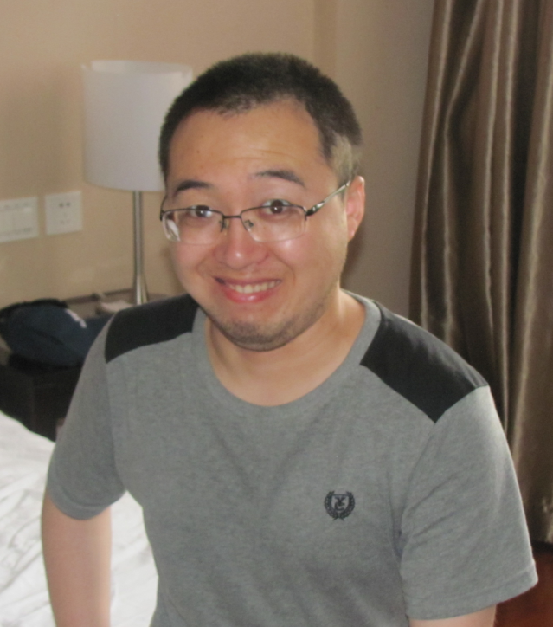
So WHAT?
China and Japan
Notes:
THE SO WHAT of this
Chinese man – love / accept the Japanese?
Division is WRONG –
Almost every country, era, civilization had such division over ‘things’
BUT NOW – IT IS DIFFERENT
BUT ALL OF THIS IS “IN CHRIST”
Hence – the need to love one another, to accept one another, to support one another…
→ HOW get INTO CHRIST

Slide 16
Jesus said:
“A new commandment I give to you, that you love one another, even as I have loved you, that you also love one another.
“By this all men will know that you are My disciples, if you have love for one another.” John 13:34-35

Slide 17
All Spiritual Blessing In Christ
3 in Him | Chosen
In Him | Holy
In Him | Blameless
5 Through Jesus | Adopted as sons
6 In The Beloved | Grace bestowed
7 In Him | Redemption and Forgiveness of sins
11 In Him (10) | Obtain an inheritance

Slide 18
All Spiritual Blessing In Christ
Believe
3 in Him | Chosen
In Him | Holy
In Him | Blameless
5 Through Jesus | Adopted as sons
6 In The Beloved | Grace bestowed
7 In Him | Redemption and Forgiveness of sins
11 In Him (10) | Obtain an inheritance

Slide 19
All Spiritual Blessing In Christ
Believe
3 in Him | Chosen
In Him | Holy
In Him | Blameless
Repent
5 Through Jesus | Adopted as sons
6 In The Beloved | Grace bestowed
7 In Him | Redemption and Forgiveness of sins
11 In Him (10) | Obtain an inheritance

Slide 20
All Spiritual Blessing In Christ
Believe
3 in Him | Chosen
In Him | Holy
In Him | Blameless
Repent
5 Through Jesus | Adopted as sons
6 In The Beloved | Grace bestowed
Confess
7 In Him | Redemption and Forgiveness of sins
11 In Him (10) | Obtain an inheritance

Slide 21
All Spiritual Blessing In Christ
Believe
3 in Him | Chosen
In Him | Holy
In Him | Blameless
Repent
5 Through Jesus | Adopted as sons
6 In The Beloved | Grace bestowed
Confess
7 In Him | Redemption and Forgiveness of sins
Baptized
11 In Him (10) | Obtain an inheritance

