Slide 1
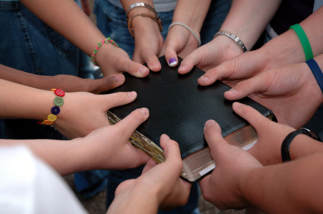
Joy In Fellowship Text: Philippians 1:3-11
Notes:
By Nathan L Morrison
All Scripture given is from NASB unless otherwise stated
For further study, or if questions, please Call: 804-277-1983 or Visit www.courthousechurchofchrist.com

Slide 2
Intro
Fellowship: “Koinos” (G2839) is “sharing something with someone, a partner, companion, partaker”
Luke 5:10: James and John were “partners” with Peter (G2844 koinonos)
Heb. 2:14: Jesus, in order to destroy the power of Satan over mankind, shared with man “flesh and blood” that He might deliver man through His death – “Share” (G2841 koinoneo).
II Pet. 1:4: We become “partakers” (sharers) of the divine nature – “Partakers” (G2844)
Rom. 11:17: Gentiles became “partakers” of the “rich root” – (G4791 sugkoinōnos)
I Jn. 1:3: We are enabled to enjoy “fellowship” (G2842 koinōnia) with the Apostles, God and Christ through the Gospel (I Cor. 10:16)
I Jn. 1:6-7: Through the blood of Christ and walking in His light, we have fellowship with God and with one another (G2842)

Slide 3
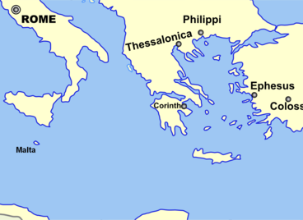
Intro
Fellowship:
Paul is in Rome, miles away from the brethren at Philippi (over 4600 miles away!)
Epaphroditus brought Paul a gift from the Philippian brethren – 4:18
He got sick and nearly died, but when he was better he takes Paul’s letter to the Philippians (along with Timothy) – 2:19-30
Paul’s imprisonment for the cause of Christ is well known by the Praetorian Guard and everyone else – 1:12-14
Paul sends greetings from saints in Caesar’s household – 4:22
Though miles away, Paul says his fellowship through the gospel with the saints at Philippi brought him joy! – Phil. 1:3-11
True joy comes from fellowship in the gospel!
Notes:
Distance from Rome to Philippi: (http://m.distancebetween2.com/rome/philippi)

Slide 4
I Have You On My Mind
Philippians 1:3-5
3. I thank my God in all my remembrance of you,
4. always offering prayer with joy in my every prayer for you all,
5. in view of your participation in the gospel from the first day until now.
Phil. 1:3-5

Slide 5
I Have You On My Mind
He tells them every recollection of them brings him joy!
Their “participation in the gospel from the first day till now” points to Acts 16 when he 1st came to Philippi.
It is fun to imagine that Lydia (Acts 16:12-15, 40) and the Jailer (Acts 16:23-40) might be in the assembly when this letter is read to all!
Paul had told the Thessalonian brethren how he “suffered” and was “mistreated” in Philippi
(I Thess. 2:2)
Yet, here he says when he thinks of them, he has joyful thoughts!
As Paul awaited trial in Rome he wasn’t thinking of himself but of the saints in Philippi!

Slide 6
Application!
Joy In Fellowship
I Have You On mY Mind
Am I the kind of Christian that brings joy to other Christians when they think of me?

Slide 7
I Have You In My Heart
Philippians 1:6-7
6. For I am confident of this very thing, that He who began a good work in you will perfect it until the day of Christ Jesus.
7. For it is only right for me to feel this way about you all, because I have you in my heart, since both in my imprisonment and in the defense and confirmation of the gospel, you all are partakers of grace with me.
Phil. 1:6-7

Slide 8
I Have You In My Heart
It is possible to think of people (have them on your mind) but not have them in your heart
Their love for Paul is evidenced in their standing with him when he preached and when he was imprisoned – They supported him and continued to do so (Phil. 4:15-18).
Paul considered his imprisoned circumstances an opportunity for preaching the gospel – Phil. 1:12-14: He said others were emboldened to preach the gospel without fear!
Their fellowship with Paul in the gospel has them on his mind & in his heart!

Slide 9
Application!
Joy In Fellowship
I Have You In mY Heart
Am I the kind of Christian others hold in their hearts and thank God for?

Slide 10
I Have You In My Prayers
Philippians 1:4, 9
4. always offering prayer with joy in my every prayer for you all,
9. And this I pray, that your love may abound still more and more in real knowledge and all discernment,
Phil. 1:4, 9

Slide 11
I Have You In My Prayers
Have abounding & discerning love (Phil 1:9)
Approve excellent things (Phil 1:10)
“Be sincere and blameless” (Phil 1:10)
“Be filled with fruit” (Phil 1:11)
Paul said they were on his mind, in his heart, and in his payers –
He prayed for them to…

Slide 12
Application!
Joy In Fellowship
I Have You In mY Prayers
Am I the kind of Christian others think about and pray for?

Slide 13
Conclusion
“I have you on my mind…in my heart…in my prayers”
Do we think of others in the faith?
Do we hold others in our hearts enough to think about them?
Do we think about and love others enough to pray for them?

Slide 14
Conclusion
III John 4
4. I have no greater joy than this, to hear of my children walking in the truth.
The fellowship we have with God, Jesus, the apostles, and with each other is the kind of fellowship that produces joy!
Have you obeyed the gospel?

Slide 15
“What Must I Do To Be Saved?”
Hear The Gospel (Jn. 5:24; Rom. 10:17)
Believe In Christ (Jn. 3:16-18; Jn. 8:24)
Repent Of Sins (Lk. 13:3-5; Acts 2:38)
Confess Christ (Mt. 10:32; Rom. 10:10)
Be Baptized (Mk. 16:16; Acts 22:16)
Remain Faithful (Jn. 8:31; Rev. 2:10)
For The Erring Saint:
Repent (Acts 8:22), Confess (I Jn. 1:9),
Pray (Acts 8:22)

