Slide 1
Summertime! (A Call To Be Salt & Light In Summer) Text: Philippians 4:8
Notes:
By Nathan L Morrison
All Scripture given is from NASB unless otherwise stated
For further study, or if questions, please Call: 804-277-1983 or Visit www.courthousechurchofchrist.com
Some points from a lesson by Steve Higgenbotham

Slide 2
Intro
It’s Summertime!
The world around Christians starts to shed clothes as the days grow hotter the next few months.
Saints live where it’s hot and can enjoy summer too – but we need to remember that we are called to be salt & light to the world, even in the summer!

Slide 3
Intro
Worldliness is:
“Of or limited to this world; temporal or secular; devoted to or concerned with the affairs, pleasures, etc. of this world.” (Webster)
I Jn. 2:15-17: God says we must not love the world or things in it.

Slide 4
Intro
In contrast to worldliness a Christian is to be pure, and unstained by the world:
Matthew 5:13-16; Ephesians 5:11-12: Salt & Light! For preserving and illumination, influence and exposing darkness (evil)! Need to do what’s right despite others around us!
James 1:27; I John 3:3-4: To be in the world but live apart from it!
Matthew 5:13-16
13. "You are the salt of the earth; but if the salt has become tasteless, how can it be made salty again? It is no longer good for anything, except to be thrown out and trampled under foot by men.
14. "You are the light of the world. A city set on a hill cannot be hidden;
15. nor does anyone light a lamp and put it under a basket, but on the lampstand, and it gives light to all who are in the house.
16. "Let your light shine before men in such a way that they may see your good works, and glorify your Father who is in heaven.
One cannot engage in the immoral practices of the world and be pleasing to God!

Slide 5
A Call To modesty
The purpose of clothing is to “cover” and “hide” our nakedness (Gen. 2:25; 3:7)
Purpose of Clothing

Slide 6
A Call To modesty
The way we dress reveals much about our character, what we value, and what we are trying to portray
Mt. 11:8: wealth statement
II Sam. 3:31; 14:2; Mt. 11:21: religious statement
Prov. 7:10: moral statement
Purpose of Clothing
Our Clothing Speaks

Slide 7
A Call To modesty
Prov. 7:10: “Attire of a harlot”
II Sam. 11:2-4: David saw Bathsheba and lusted.
Mt. 5:28: Lusting after a woman makes one guilty of adultery/fornication!
Avoid the second look!
The young naïve man from Prov. 7 didn’t turn away!
David on his rooftop at night didn’t turn away! (II Sam. 11:2-4)
Purpose of Clothing
Our Clothing Speaks
Our Dress and Actions Affect Others

Slide 8
A Call To modesty
Purpose of Clothing
Our Clothing Speaks
Our Dress and Actions Affect Others
What Our Clothing Needs to Say
I timothy 2:9-10
9. Likewise, I want women to adorn themselves with proper clothing, modestly and discreetly, not with braided hair and gold or pearls or costly garments,
10. but rather by means of good works, as is proper for women making a claim to godliness.
Modest/”proper”: “Having or showing a moderate estimation of one’s own talents, abilities, and value; observing conventional proprieties in speech, behavior, and dress; quiet and humble in appearance.” (American Heritage Dictionary)
Kosmios (G2887): “Orderly, of good behavior, modest.”

Slide 9
A Call To modesty
Purpose of Clothing
Our Clothing Speaks
Our Dress and Actions Affect Others
What Our Clothing Needs to Say
I timothy 2:9-10
9. Likewise, I want women to adorn themselves with proper clothing, modestly and discreetly, not with braided hair and gold or pearls or costly garments,
10. but rather by means of good works, as is proper for women making a claim to godliness.
Modestly/Shamefacedness: aidos (G127): (From G1 & G1492 that means “downcast eyes”) “bashfulness, that is, (towards men), modesty or (towards God) awe”: - reverence, shamefacedness
Webster’s says, “Bashfulness, excess of modesty”

Slide 10
A Call To modesty
Purpose of Clothing
Our Clothing Speaks
Our Dress and Actions Affect Others
What Our Clothing Needs to Say
Our clothing can say, “Sex,” “Pride,” “Money,” or “Purity,” “Humility,” and “Moderation”
Our clothing should not leave people wondering whether we want to be “chased” or “chaste”

Slide 11
A Call To modesty
Our (men & women) clothes should:
Be modest – reserved, decent, respectable
Show shame/humility – one can still blush (Jer. 6:15; 8:12)
Show good judgment – common sense
Show godliness – devoted to God not to world
Respect others – not intentionally causing lustful thoughts
Bring glory to God – In all that we do we are to glorify God (Col. 3:17)

Slide 12
We must live pure lives even in the apparel we choose to wear! (no matter how hot it is!)
A Call to modesty

Slide 13
A Call to Guard Our Thoughts
Hebrews 13:4
4. Marriage is to be held in honor among all, and the marriage bed is to be undefiled; for fornicators and adulterers God will judge.
Marriage to be Honored

Slide 14
A Call to Guard Our Thoughts
Guard hearts, thoughts & eyes against:
“Sensuality” (NAS)/ “Lasciviousness” (KJV)/ “Lewdness” (NKJ)
Vine’s: “Lewdness is an absence of restraint, it is indecency, wantonness.”
Thayer: “Unbridled lust, excess, licentiousness, lasciviousness, wantonness, outrageousness, shamelessness, insolence.”
Webster’s: “Inciting lust; unlawful sexual desires.”
Lewdness/ Sensuality

Slide 15
A Call to Guard Our Thoughts
Guard hearts, thoughts & eyes against:
“Sensuality” (NAS)/ “Lasciviousness” (KJV)/ “Lewdness” (NKJ)
II Cor. 12:21
Gal. 5:19-21
Eph. 4:19
I Pet. 4:3
II Pet. 2:18
Lewdness/ Sensuality

Slide 16
A Call to Guard Our Thoughts
Guard hearts, thoughts & eyes against:
“Impurity” (NAS) – “Uncleanness” (KJV/NKJ)
Thayer: “Uncleanness is lustful, luxurious, profligate living.”
Lust = strong desire, usually in context of something forbidden. Warning against fleshly lusts – I Pet. 2:11; Rom. 8:13
Luxurious = acting on those lusts without restraint.
Profligate: Webster’s says, “unprincipled.”
Lewdness/ Sensuality
Uncleanness/Impurity

Slide 17
A Call to Guard Our Thoughts
Guard hearts, thoughts & eyes against:
“Impurity” (NAS) – “Uncleanness” (KJV/NKJ)
II Cor. 12:21; Gal. 5:19; Eph. 4:19
Rom. 1:24; 6:19
Eph. 5:3
Col. 3:5
Lewdness/ Sensuality
Uncleanness/Impurity

Slide 18
A Call To guard Our Thoughts
Some may say they haven’t committed sexual sin (fornication & adultery), so they are OK:
Some use that to justify immodest dress, dancing (sensual), and looking at pornography!
Job 31:1: Job said, “I have made a covenant with my eyes.”

Slide 19
A Call to Guard Our Thoughts
Proverbs 7:7-23
The young naïve man saw the adulteress dressed as a harlot (7:10) and did not turn away but went towards her house, talked to her, listened to her, let her kiss him and entice him.
Had he committed sexual sin? No!
Before he was guilty of that sin (Prov. 7:22-23) he was guilty of lewd conversation, thoughts, and acts (kissed a married woman)!
While one may not commit sexual immorality (fornication & adultery) other sins are committed…

Slide 20
A Call to Guard Our Thoughts
II Samuel 11:2-4
As David gazed at Bathsheba bathing from his rooftop, had he committed sexual sin? No!
As he waited to find out who she was and then waited for her to be brought to him, had he committed sexual sin? No!
Before he committed adultery, he was guilty of lewd/unclean thoughts that then led to sexual immorality!
While one may not commit sexual immorality (fornication & adultery) other sins are committed…

Slide 21
A Call to guard Our Thoughts
Immodesty can incite lustful and lewd behavior, and the Christian is to flee from it!

Slide 22
A Call to purity
I John 3:3
3. And everyone who has this hope fixed on Him purifies himself, just as He is pure.
Christians are called to be pure because God is pure
Romans 13:13: “Let us behave properly as in the day, not in carousing and drunkenness, not in sexual promiscuity and sensuality, not in strife and jealousy.”
I Thessalonians 4:7: “For God did not call us to uncleanness, but in holiness.”

Slide 23
A Call to purity
What did Joseph do when Potiphar’s lewd/unclean wife began talking to him?
Gen. 39:7-12: She desired him and tried to entice him. Joseph fled!
Though there was lewd and unclean conversation and intent (Potiphar’s wife tried to seduce Joseph), Joseph was not guilty of it!
Christians are called to be pure because God is pure

Slide 24
A Call to purity
Christians are called to be pure because God is pure
Flee lusts & sexual immorality
II Timothy 2:22
I Corinthians 6:18

Slide 25
To be pure as God is pure one must not engage in any practice that is lewd/unclean!
A Call to purity

Slide 26
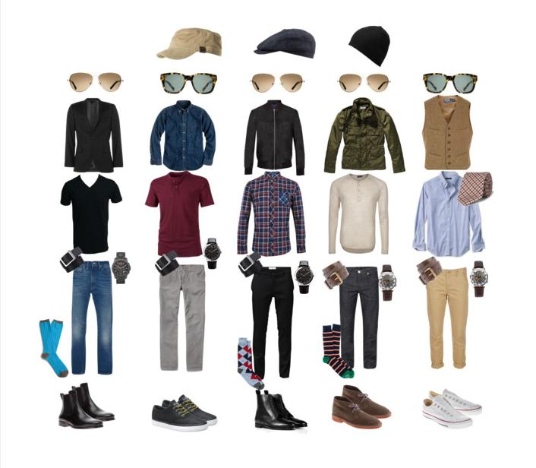
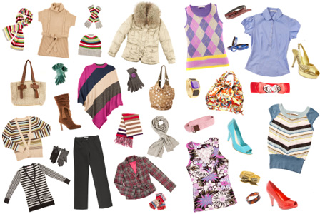
conclusion
In the summertime immodesty will be all around us:
Immodest dress is a problem because it can incite lustful intentions in men and women, despite some justifying it as “Trendy.”
To not be guilty of or cause others to be guilty of lewdness/sensuality, one must be cautious in what one wears!
Is it
too low,
too tight,
too shear,
or not even there?

Slide 27
conclusion
The way we dress and hold up God’s standard for holiness in any situation just may be what opens a door of opportunity among those who are seeking God!
Act in love toward one another and not put a stumbling block in each other’s way!
“Am I Pure?”

Slide 28
conclusion
Philippians 4:8
Finally, brethren, whatever is true, whatever is honorable, whatever is right, whatever is pure, whatever is lovely, whatever is of good repute, if there is any excellence and if anything worthy of praise, dwell on these things.
In the dark world around us saints need to be Salt & Light! (Mt. 5:13-16)

Slide 29
Let us all flee from lusts and immoral behavior so that we may be found blameless, even in the heat, and enjoy the summertime! (Phil. 2:15)
conclusion

Slide 30
“What Must I Do To Be Saved?”
Hear The Gospel (Jn. 5:24; Rom. 10:17)
Believe In Christ (Jn. 3:16-18; Jn. 8:24)
Repent Of Sins (Lk. 13:3-5; Acts 2:38)
Confess Christ (Mt. 10:32; Rom. 10:10)
Be Baptized (Mk. 16:16; Acts 22:16)
Remain Faithful (Jn. 8:31; Rev. 2:10)
For The Erring Child of God:
Repent (Acts 8:22), Confess (I Jn. 1:9),
Pray (Acts 8:22)

