Slide 1


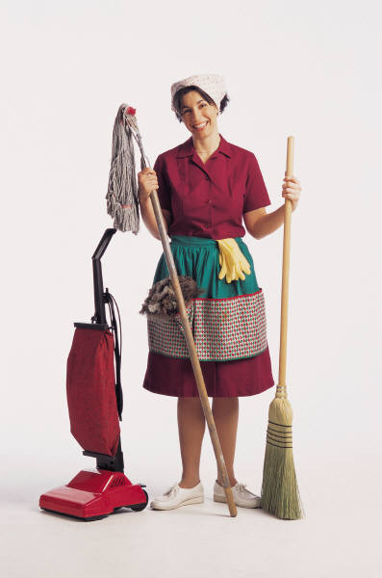
Spring Cleaning
Text: I Cor. 5:6-8
Notes:
By Nathan L Morrison
All Scripture given is from NASB unless otherwise stated
For further study, or if questions, please Call: 804-277-1983 or Visit www.courthousechurchofchrist.com

Slide 2
Intro
Many scholars believe we owe “Spring Cleaning” to the
Jews!
The Passover was to be celebrated with the eating of unleavened bread.
By the time of Jesus, the Jews had a tradition in the weeks leading up to the Passover, to clean out their houses top to bottom of any leaven they could find.
They would search out every nook and cranny to throw out any leaven they found so that when Passover came, not even their houses would have it in them.
The side effect of this practice was a clean house, and unnecessary things gotten rid of.
This became known as the phrase, “Spring Cleaning” through the years.

Slide 3
Intro
Paul uses this practice to apply it to our spiritual lives:
I Cor. 5:6-8
“Your boasting is not good. Do you not know that a little leaven
leavens the whole lump of dough?
Clean out the old leaven so that you may be a new lump, just as you
are in fact unleavened. For Christ our Passover also has been
sacrificed.
Therefore let us celebrate the feast, not with old leaven, nor with the
leaven of malice and wickedness, but with the unleavened bread of
sincerity and truth.”
“Clean out the old leaven”

Slide 4
Out With The Old
Toss out the old leaven!
Of Malice & Wickedness (I Cor. 5:6-8)
Of bitterness, wrath & anger, clamor and slander, malice (Eph. 4:30-31)
Of the old self: anger, wrath, malice, slander, abusive speech, lies (Col. 3:8-9)
Of malice, deceit & hypocrisy, envy, slander (I Pet. 2:1)
In the physical we clean our houses (or garages) and remove the trash and unnecessary things and restore order and cleanliness!

Slide 5
Out With The Old
We need to do the same in our lives!
Gal. 5:19-21: “Fruit (Deeds) of the Flesh” will not gain us entrance to Heaven
God expects us to cleanse our lives more than every
spring
Eph. 5:3-5, 7, 11-12: The leaven of life is darkness and Christians are expected to not only not participate in them, but also to expose them!
Have you cleansed out the leaven from your life?

Slide 6
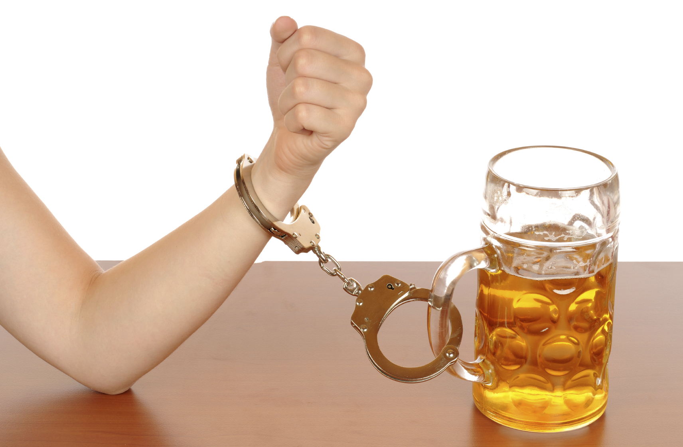
In With The New
Matthew 12:43-45
43. "Now when the unclean spirit goes out of a man, it passes through waterless places seeking rest, and does not find it.
44. "Then it says, 'I will return to my house from which I came'; and when it comes, it finds it unoccupied, swept, and put in order.
45. "Then it goes and takes along with it seven other spirits more wicked than itself, and they go in and live there; and the last state of that man becomes worse than the first. That is the way it will also be with this evil generation."
Once the cleaning is done, rearranging takes place to make sure corners and spaces are not cluttered up again
When we remove the old, we must replace it with new or the old could come back!
This happens with addictions or bad habits!

Slide 7
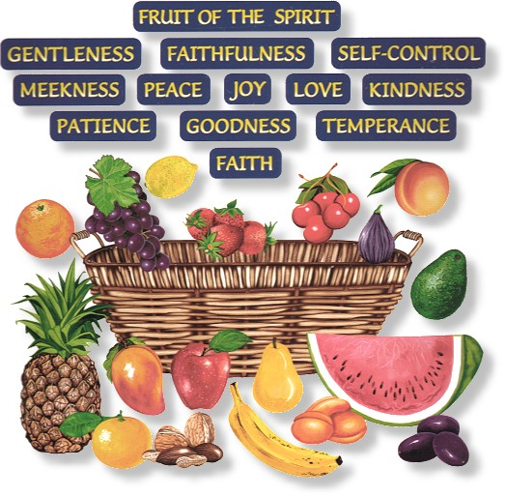
In With The New
Replace the old with the New!
Fruits of the Spirit: love, joy, peace, patience, kindness, goodness, faithfulness, gentleness, self-control (Gal. 5:23-25)
Kindness, tenderness & forgiveness (Eph. 4:32)
The new self: compassion, kindness, humility, gentleness and patience, forgiveness, love (Col. 3:10, 12-14)
Desire for God’s word (I Pet. 2:2-3)
Being rid of the old self requires replacing it with new one:
I Tim. 6:11; II Tim. 2:20-26; Eph. 5:8-10
Have you replaced the leaven with unleavened or have
you just cleared a space?

Slide 8
Maintaining Cleanliness
Be Vigilant! Be alert & Ready (I Thess. 5:1-6)
Live sensibly, righteously, godly (Titus 2:11-14)
Practice the Fruits of the Spirit: love, joy, peace, patience, kindness, goodness, faithfulness, gentleness, self-control (Gal. 5:23-25)
Look ahead to Heaven as our goal (Phil. 3:12-14; II Pet. 3:10-12)
Cleaning out the old leaven is the beginning –
Have you maintained purity?

Slide 9
Conclusion
We often stumble in the “Maintenance” part – we sin and
let our old way of life creep in
We need to get rid of our old ways and repent, asking God for forgiveness.
(I Jn. 1:9)
Spring Cleaning is a good idea in the physical, but a MUST spiritually if we are to live eternally with God!
I Cor. 9:26-27: Paul had to practice discipline daily (self-control – Gal. 5:23)

Slide 10
Conclusion
Do you practice maintenance daily?
We will fill our lives with something – make sure it is not
the old we got rid of, but the new that will result in
sanctification! (Rom. 6:19)
Have you thrown out the leaven from your life?
Replace it with Righteousness!

Slide 11
“What Must I Do To Be Saved?”
Hear The Gospel (Jn. 5:24; Rom. 10:17)
Believe In Christ (Jn. 3:16-18; Jn. 8:24)
Repent Of Sins (Lk. 13:35; Acts 2:38)
Confess Christ (Mt. 10:32; Rom. 10:10)
Be Baptized (Mk. 16:16; Acts 22:16)
Remain Faithful (Jn. 8:31; Rev. 2:10)
For The Erring Saint:
Repent (Acts 8:22), Confess (I Jn. 1:9),
Pray (Acts 8:22)

