Slide 1
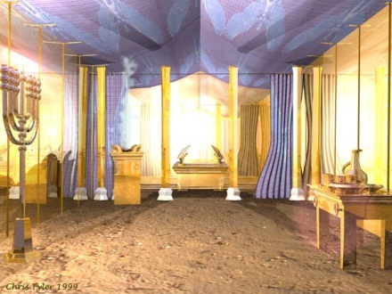
In The Presence Of God
Text: Hebrews 9:2; 10:19-25; James 4:8
Notes:
By Nathan L Morrison
All Scripture given is from NASB unless otherwise stated
For further study, or if questions, please Call: 804-277-1983 or Visit www.courthousechurchofchrist.com

Slide 2
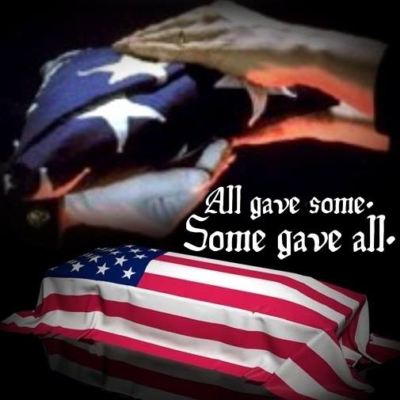
Intro
Eph. 1:7
(Freedom isn’t free)
7. In Him we have redemption through His blood, the forgiveness of our trespasses, according to the riches of His grace
When one remembers fallen soldiers, great men and women of history, or family loved ones, etc., it is a way to be in their presence – By drawing near to their memory

Slide 3
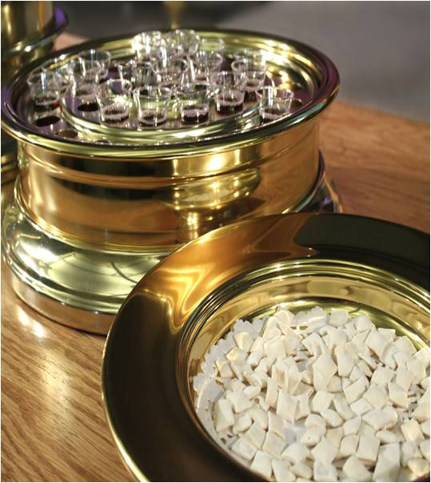
Intro
As saints we remember Jesus’ sacrifice every week!
I Cor. 11:24-25
24. and when He had given thanks, He broke it and said, "This is My body, which is for you; do this in remembrance of Me."
25. In the same way He took the cup also after supper, saying, "This cup is the new covenant in My blood; do this, as often as you drink it, in remembrance of Me."

Slide 4
Intro
Heb. 10:19-25
19. Therefore, brethren, since we have confidence to enter the holy place by the blood of Jesus,
20. by a new and living way which He inaugurated for us through the veil, that is, His flesh,
21. and since we have a great priest over the house of God,
22. let us draw near with a sincere heart in full assurance of faith, having our hearts sprinkled clean from an evil conscience and our bodies washed with pure water.
23. Let us hold fast the confession of our hope without wavering, for He who promised is faithful;
24. and let us consider how to stimulate one another to love and good deeds,
25. not forsaking our own assembling together, as is the habit of some, but encouraging one another; and all the more as you see the day drawing near.

Slide 5
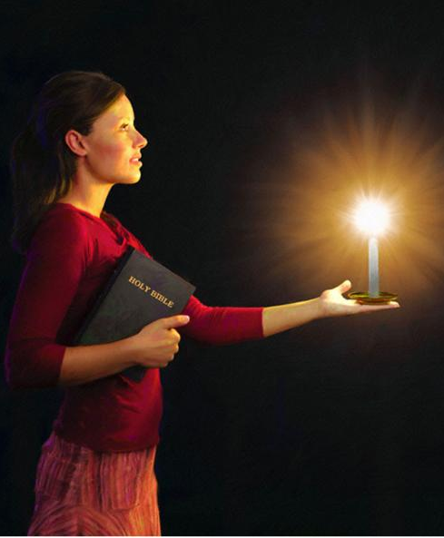
Intro
Js. 4:8
8. Draw near to God and He will draw near to you. Cleanse your hands, you sinners; and purify your hearts, you double-minded.

Slide 6
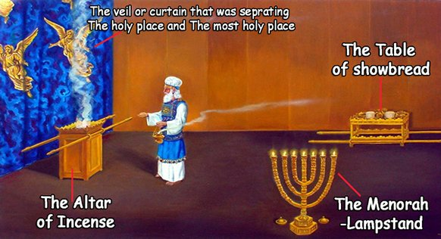
Intro
Context of drawing near to God – Contents of Tabernacle (Heb. 9:2)
The table of the bread of the Presence (KJV: “Shewbread”) – Ex. 25:23-30 (right side)
The golden lampstand – Ex. 25:31-40 (left side)
The incense altar – Ex. 30:1-10 (straight ahead)
Notes:
Image courtesy of:
http://www.bing.com/images/search?q=tabernacle+holy+place&view=detail&id=C90453CF5554D72205BAE4C6C45EC9781EBAA758&first=31&FORM=IDFRIR

Slide 7
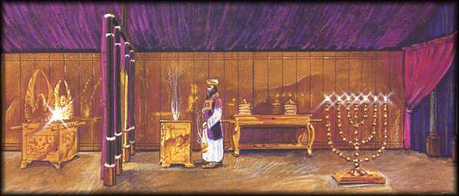
Intro
The parallel of the Tabernacle and the church shows us:
We are in the presence of God!
Notes:
Image courtesy of:
http://www.bing.com/images/search?q=tabernacle+holy+place&view=detail&id=C90453CF5554D72205BAE4C6C45EC9781EBAA758&first=31&FORM=IDFRIR

Slide 8
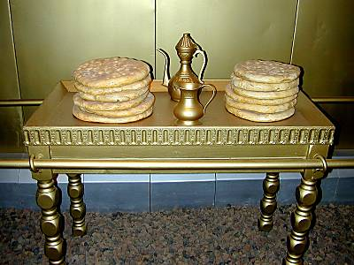
Table of the Bread of the Presence
Ex. 25:23-30; 40:22-23
The first item in the Holy Place is the Table that the KJV calls the “Table of Shewbread.”
Literally translated is “the table of the bread of the Face” (H3899 H6440).
There are 12 loaves of unleavened bread on this table and they represent the 12 tribes of Israel (Lev. 24:5-9).
What God is telling His people is: they are always before His PRESENCE (Face). He cared for them and He was constantly remembering them.
We have entered the “Holy Place” (Heb. 10:19)
Under the Law, only the priests could enter the holy place.
I Pet. 2:9: Saints are priests!

Slide 9
Table of the Bread of the Presence
I Cor. 10:16-17
16. Is not the cup of blessing which we bless a sharing in the blood of Christ? Is not the bread which we break a sharing in the body of Christ?
17. Since there is one bread, we who are many are one body; for we all partake of the one bread.
“Do this in remembrance of Me” (Lk. 22:15)

Slide 10
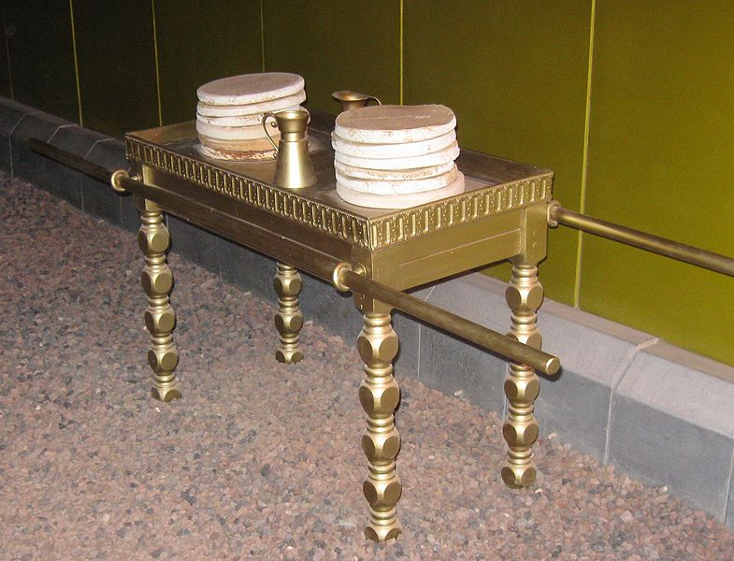
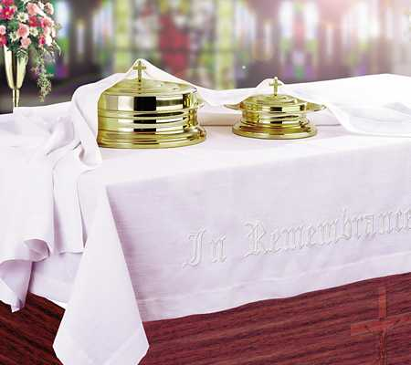
Table of the Bread of the Presence
The table of the Bread of the Presence/Lord’s Supper:
Table of Showbread: God remembered His people, through His mighty works in making them a nation!
Lord’s Supper: Jesus remembered us, in His death, burial, and resurrection!
Table of Showbread: The people were in God’s Presence
Lord’s Supper: We are in the Presence of Jesus.
Table of Showbread: The Showbread was changed every Sabbath.
Lord’s Supper: Observed every Sunday.
Table of Showbread: A memorial for Israel to all that God did for the 12 Tribes of Israel
Lord’s Supper: We remember Jesus and proclaim His death till He comes again! (I Cor. 11:23-26)

Slide 11
Table of the Bread of the Presence
At this table (its focus: death of Christ for us) we draw nearer to God in “SHARING in the body of Christ!”

Slide 12
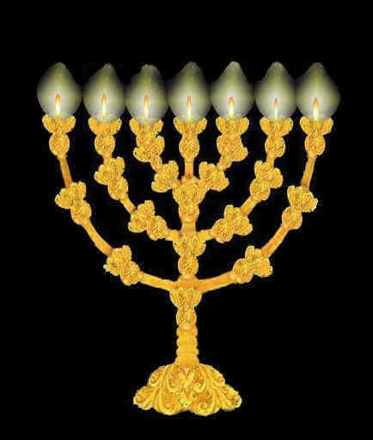
Golden Lampstand
Ex. 25:31-40; 40:24-25
Across from the table is the Golden Lampstand.
The priests’ job was to make sure its lamps are constantly filled with oil and that its wicks are replaced when they burn down.
Every morning and every evening the High Priest lights the wicks (Leviticus 24:3) so that there is always light in the Holy Place.
At first glance it appears that the lampstand’s primary purpose is to shed light in this room so that the priests could see to do their service for God.
It is positioned directly across from the “Table of the Presence,” designed to shed its light on that table.

Slide 13
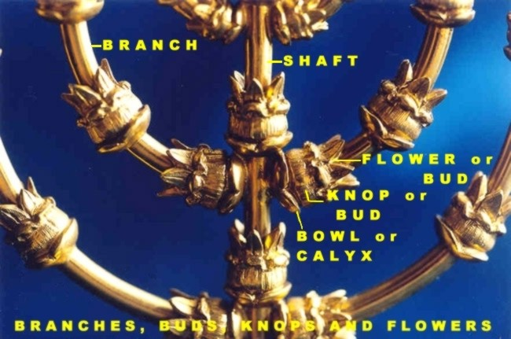
Golden Lampstand
It’s made of one piece of pure gold
Central staff ends in a lamp at its top with 6 branches – 3 on each side.
Each branch has a lamp at the top and each lamp has a unique decoration.
They are “shaped like almond blossoms, its bulbs and its flowers.”
Branches, buds, fruit, and flowers – Represents a LIVING thing!

Slide 14
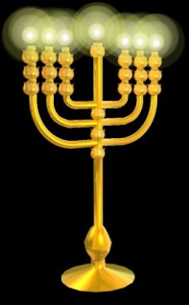
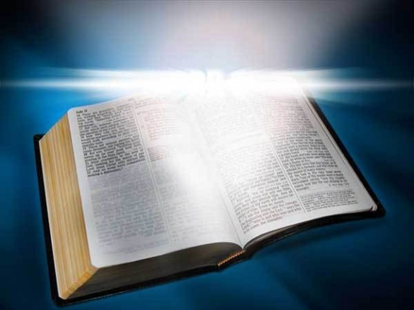
Golden Lampstand
Heb. 4:12
12. For the word of God is living and active and sharper than any two-edged sword, and piercing as far as the division of soul and spirit, of both joints and marrow, and able to judge the thoughts and intentions of the heart.
God’s word is LIVING and active – Sharper than any double-edged sword! (Heb. 4:12)
The lampstand gave light to the worship held in the Holy Place so also God’s Word sheds light on what we need to know about our worship of Jesus.
David wrote: “Your word is a lamp to my feet And a light to my path” (Psalm 119:105)

Slide 15
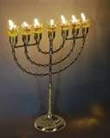
Golden Lampstand
The lampstand highlighted the table of God’s presence – God’s word highlights Jesus
This table represents the table we use for the Lord’s Supper (Christ’s sacrifice).
Thus the Lampstand’s purpose was to illuminate that table!
The lampstand could also represent Jesus, as Jesus is the Word of God! (Jn. 1:1, 4-5)
Jesus uses the “lampstand” imagery to also define the churches that belong to Him! (Rev. 1:12, 20; 2:5: The 7 Lampstands are the 7 churches)
We draw nearer to God when in the presence of His word
(study), for its light makes it possible for us to SEE and
understand what God has done for us – and to lead us to
eternal life!

Slide 16
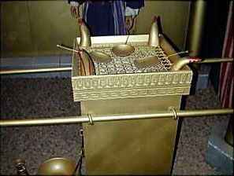
Altar of Incense
Ex. 30:1-10; 40:26-27
The last article of furniture in the tabernacle is the altar of incense
The priests’ job was to bring incense for the High Priest to burn on the altar.
Every evening and every morning – after the High Priest sees to the lamps – he brings fire from the altar of sacrifice (outside the Tabernacle) and lights the incense before God (Lev. 16:12-13; Num. 16:46).
This incense was lit both evening and morning so that it would be a continual offering of a sweet smelling odor before God.
This incense is used elsewhere in Scripture to refer to our
prayers being lifted up to God
Ps. 141:2: David prays, “May my prayer be counted as incense before You.”
Rev. 8:3-4: Correlates the incense from the golden altar with the prayers of the saints!

Slide 17
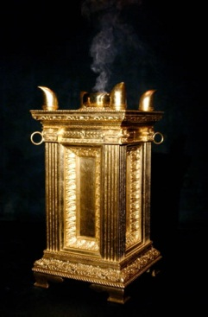
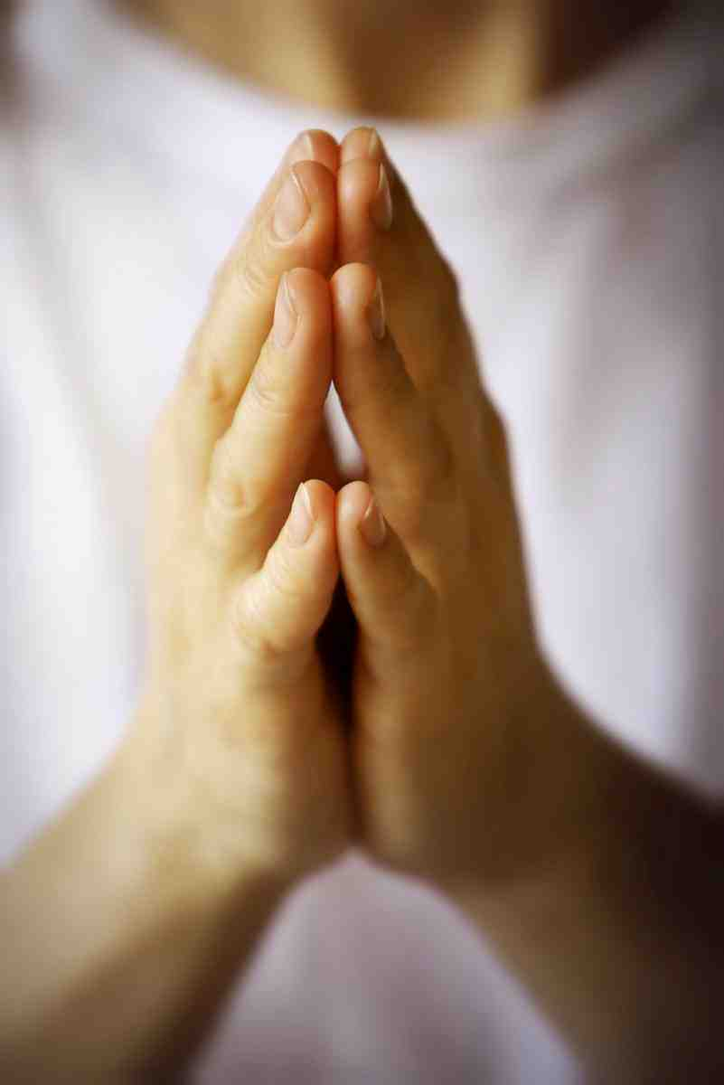
Altar of Incense
Heb. 13:15
15. Through Him then, let us continually offer up a sacrifice of praise to God, that is, the fruit of lips that give thanks to His name.
Our prayers ought to give praise to God!
This type of prayer (focuses on praise) changes the nature of our requests from being a “wish-list” to petitions of a grateful servant of God.
This kind of “incense” prayer is done THROUGH Jesus (Heb. 13:15).
Just as the altar of incense was lit by the fires
of the sacrifice, so also our prayerful incense is
made acceptable to God, because our prayers
are based upon the ultimate sacrifice of Jesus!
We draw nearer to the presence of God when we spend
time with Him in PRAYER!

Slide 18
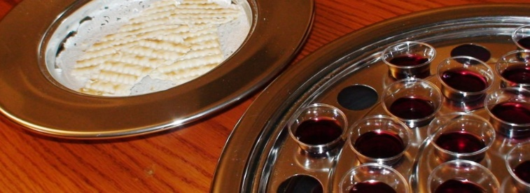
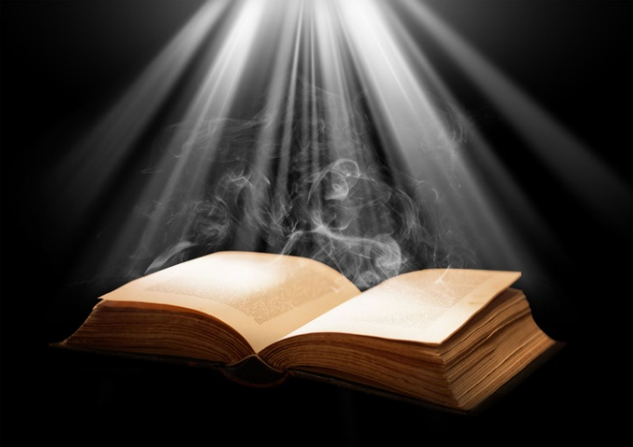
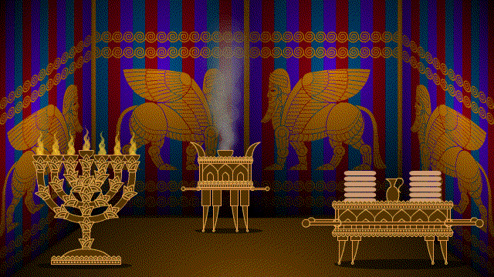
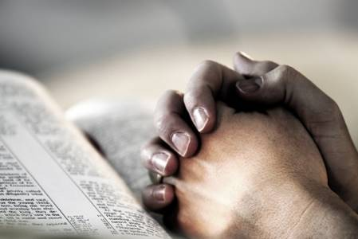
Conclusion
Drawing near to God “in the Holy Place” (the church!)

Slide 19
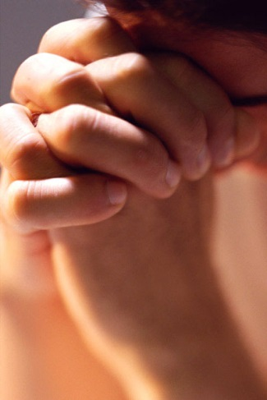
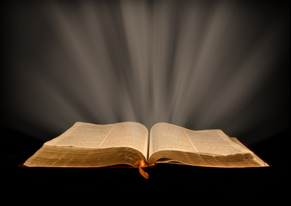
Conclusion
Acts 2:42
42. They were continually devoting themselves to the apostles' teaching and to fellowship, to the breaking of bread and to prayer.
Acts 2:42: “They devoted themselves to...”
“The apostles’ teaching (the lampstand) and to fellowship,”
“to the breaking of bread (table of showbread)”
“and to prayer (the altar of incense)”

Slide 20
Conclusion
Heb. 6:19-20
19. This hope we have as an anchor of the soul, a hope both sure and steadfast and one which enters within the veil,
20. where Jesus has entered as a forerunner for us, having become a high priest forever according to the order of Melchizedek.
There in the Holy of Holies
was the ark of the covenant, the
ultimate expression of God’s
presence! (Heb. 9:6-12)
There in Heaven (the most holy place) Jesus, our High Priest,
awaits the faithful!

Slide 21
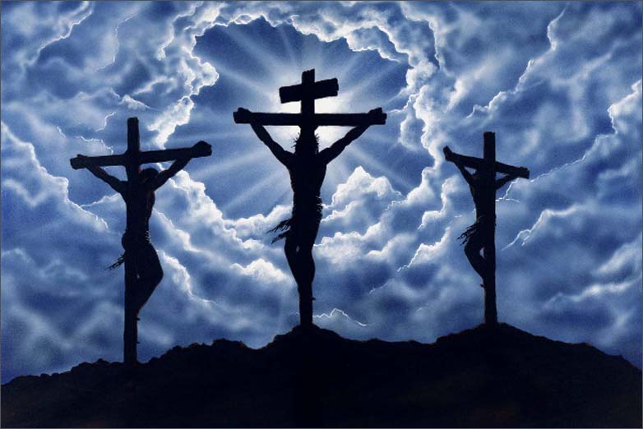
Conclusion
Let us remember Jesus and His sacrifice as we draw nearer to God each day through study, prayer, and as we partake (share) in the Lord’s Supper weekly!

Slide 22
“What Must I Do To Be Saved?”
Hear The Gospel (Jn. 5:24; Rom. 10:17)
Believe In Christ (Jn. 3:16-18; Jn. 8:24)
Repent Of Sins (Lk. 13:35; Acts 2:38)
Confess Christ (Mt. 10:32; Rom. 10:10)
Be Baptized (Mk. 16:16; Acts 22:16)
Remain Faithful (Jn. 8:31; Rev. 2:10)
For The Erring Child:
Repent (Acts 8:22), Confess (I Jn. 1:9),
Pray (Acts 8:22)

