Slide 1
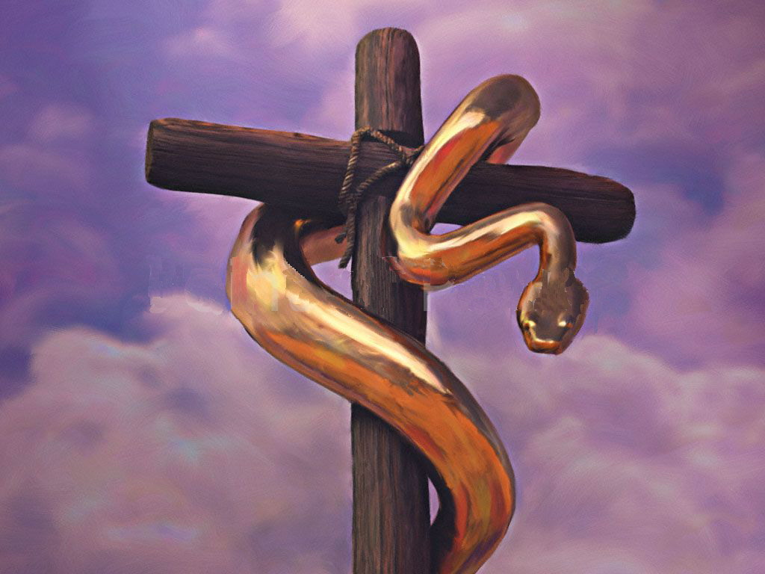
“If I Am Lifted Up…”
Text: Jn. 3:14-17; 12:32
"And I, if I am lifted up from the earth, will draw all men to Myself.“
(John 12:32)
Notes:
By Nathan L Morrison
All Scripture given is from the NASB, unless otherwise stated
For further study or if questions, Call: 804-277-1983, or Visit: www.courthousechurchofchrist.com

Slide 2
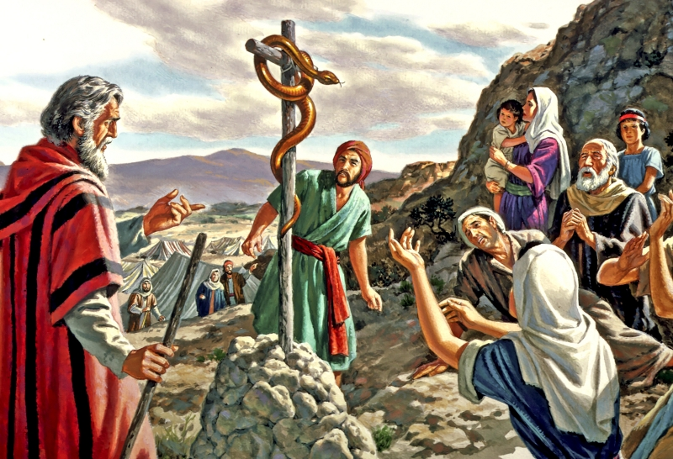
Intro: John 3:14-17
As the Bronze serpent became the focus of all those plagued, so will Christ!
John 3:14-17
14. As Moses lifted up the serpent in the wilderness, even so must the Son of Man be lifted up;
15. so that whoever believes will in Him have eternal life.
"For God so loved the world, that He gave His only begotten Son, that whoever believes in Him shall not perish, but have eternal life.
For God did not send the Son into the world to judge the world, but that the world might be saved through Him.

Slide 3
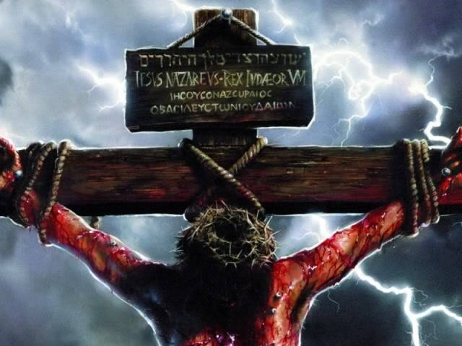
Intro: John 12:32
Believer & unbeliever alike still talk about the
Messiah that walked the earth nearly
2,000 years ago!
John 12:32
32. "And I, if I am lifted up from the earth, will draw all men to Myself."
What draws men to Christ?

Slide 4
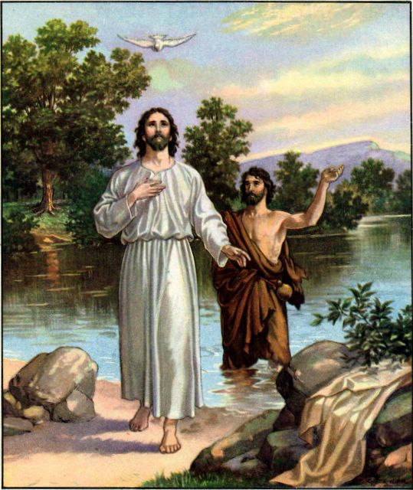
The Person of Jesus
His character was sinless
II Cor. 5:21; Heb. 4:15
He is an example
I Pet. 2:21-25; Jn. 13:34-35
His character is that of love
I Jn. 4:8; Jn. 15:9-11; Mk. 2:15-16; Mt. 9:35-38
He revealed God to man
Jn. 14:7-9; 5:17-19; 10:30
There was never a man who lived the perfect life that Jesus lived!

Slide 5
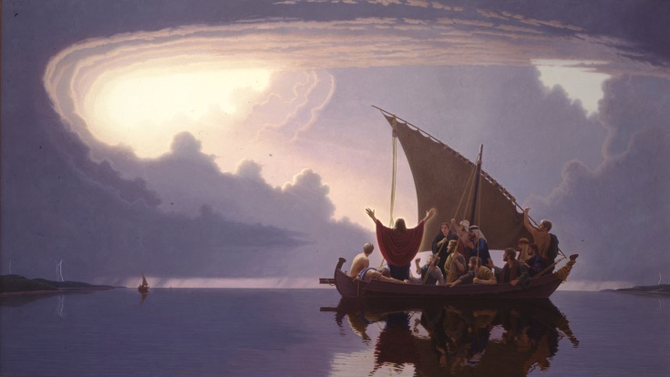
The Miracles of Jesus
Miracles recorded so men would believe and have eternal life
Jn. 20:30-31
Miracles commanded attention
Mt. 4:24-25; 8:23-27; 9:8
His miracles astonished men
Jn. 6:19: Walked on water
Mk. 4:39: Calmed the tempest
Mt. 14:21: Fed five thousand
Jn. 9: Healed man born blind

Slide 6
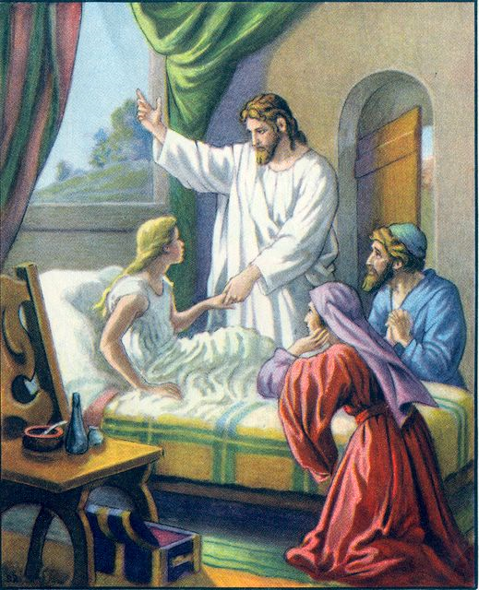
The Miracles of Jesus
His miracles astonished men
Raising the Dead
Mk. 5:22-43: Jairus’ daughter
Lk. 7:11-17: Widow’s son
Jn. 11: Lazarus
Christ’s miracles proved He was from God
and drew people to Him!

Slide 7
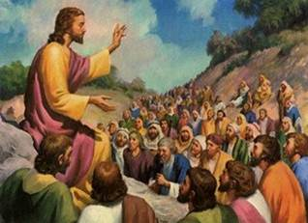
The Teachings of Jesus
His teaching was noticeably different than religious leaders
Mt 7:28-29; Jn. 7:44-46
His teaching drew multitudes
Mt. 13:1-2; Mk. 2:1-12
His parables were easy to remember
Mt. 13:10-17
His words commanded men’s attention then, now, and one day will judge all men!
(Jn. 12:48)

Slide 8
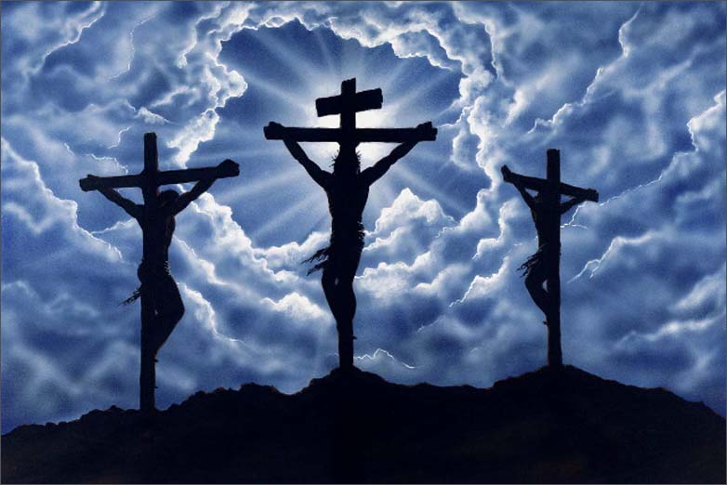
The Sacrifice of Jesus
His death was not for crimes that He had committed
II Cor. 5:21; Jn. 15:13; Rom. 5:6-8
His agony in Gethsemane
Mt. 26:36-44
He was mocked by the soldiers
Mt. 27:27-31

Slide 9
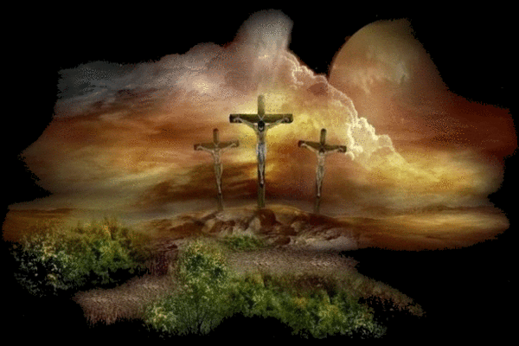
The Sacrifice of Jesus
He was declared innocent, but still sentenced to death
Lk. 23:20-22
He was scourged
Mk. 15:14-15
He was crucified for the sins of the world
Mk. 15:25-37; Heb. 9:24-28; 10:10-12
The Perfect Sacrifice; the sinless Lamb;
and out of love He died for you and for me!

Slide 10
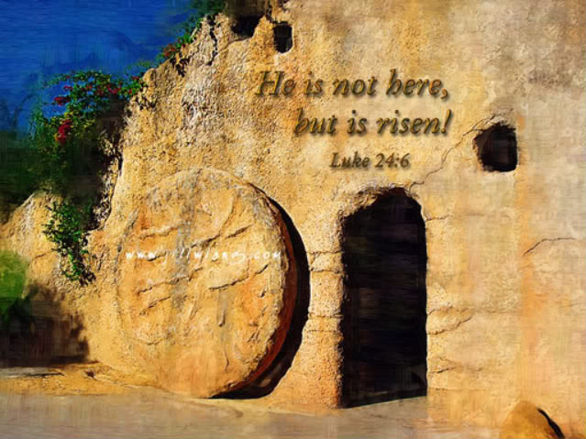
The Resurrection of Jesus
He raised Himself from the dead!
Jn. 2:19-21; 5:25-26; 10:14-18
His raised body witnessed by men
I Cor. 15:1-11
He alone has the solution to our fear of death
Heb. 2:14-15
Christ’s resurrection stands as proof of God’s
power and love to all people for all time!

Slide 11
His Words of Eternal Life
Men came to Jesus to learn how to receive eternal life
Jn. 6:68; Mt 19:16; Lk 10:25
Men are still drawn to Jesus to learn His words of eternal life:
Jn. 8:24: Faith in Christ
Lk. 13:3: Repentance
Mt. 10:32: Confession of faith
Jn. 3:3; Mk.16:16: Baptism
Mt. 24:13: Faithful living
“Lord, to whom shall we go? You have words
of eternal life!” (No other source!)

Slide 12
Conclusion
For two thousand years or so Jesus Christ has
drawn mankind to Him. His name evokes
emotions to both non-believers as well as
believers, though for different reasons!
John 12:32
32. "And I, if I am lifted up from the earth, will draw all men to Myself."

Slide 13
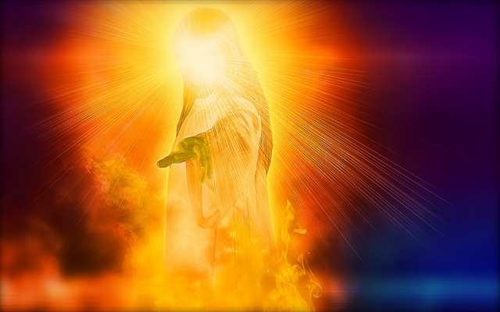
Conclusion
Those who are drawn to Him and believe in Him will be saved! (Heb. 12:1-3)
Israelites had to look to the bronze serpent (Num. 21:9)
As all eyes are on Him for being lifted up (Acts 2:33; 5:31; Phil. 2:9: “Exalted”), when He returns in judgment, “every eye” will see Him! (Rev. 1:7)
As He was lifted up for salvation, He will lift up the humble! (I Pet. 5:6: “Exalt”)

Slide 14
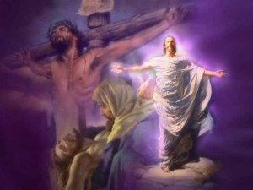
Conclusion
Those drawn to Him and wish for eternal life must
obey the gospel to be saved! (Mk. 16:16)
Has He drawn you to Him?
(Heb. 12:2)
We will be held accountable to how we are drawn to the Son of God, either out of love obey Him, or out of ridicule reject Him!
(Jn. 12:48)

Slide 15
“What Must I Do To Be Saved?”
Hear The Gospel (Jn. 5:24; Rom. 10:17)
Believe In Christ (Jn. 3:16-18; Jn. 8:24)
Repent Of Sins (Lk. 13:35; Acts 2:38)
Confess Christ (Mt. 10:32; Rom. 10:10)
Be Baptized (Mk. 16:16; Acts 22:16)
Remain Faithful (Jn. 8:31; Rev. 2:10)
For The Erring Saint:
Repent (Acts 8:22), Confess (I Jn. 1:9),
Pray (Acts 8:22)

