Slide 1
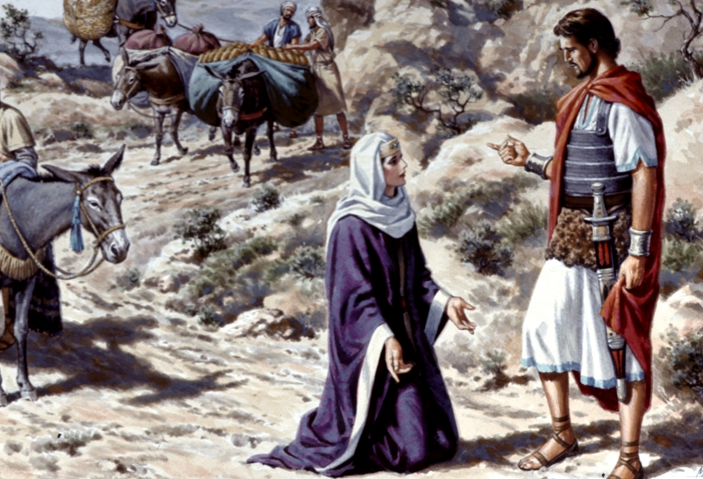
Abigail: Heart Of A Hero
Godly Women Series Part 4
Text: I Sam. 25
Notes:
By Nathan L Morrison
All Scripture given is from NASB unless otherwise stated
For further study, or if questions, please Call: 804-277-1983 or Visit www.courthousechurchofchrist.com

Slide 2
Intro
There are examples both good and bad in the Scriptures
Men and women alike can provide us with sources of
strength and inspiration
Eve: “Mother of all living” (Gen. 3:20) and an example of moving past sin!
Sarah: Mother of nations (Gen. 17:16), Mother of saints (Gal. 4:26,31), Mother of godly wives (I Pet. 3:6), and is an example of faith and overcoming one’s weaknesses!
Ruth: An example of faith and virtue (Ruth 1:16-18; 3:11)
Godly role models are greatly needed in our society!

Slide 3
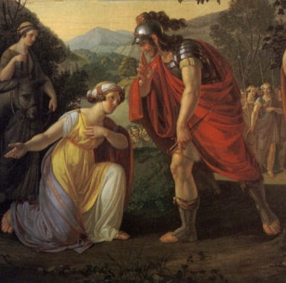
Intro
The account of Abigail, wife of Nabal, in I Sam. 25 is about a godly woman saving Israel’s future king from a foolish mistake, and thus saving the nation!
Abigail has been called “A woman of wisdom,” “The hidden hero,” & “A worthy wife.”
Account is between two accounts of David sparing Saul (I Sam. 24, 26).

Slide 4
Intro
I Sam. 25:1-13
Samuel, the Prophet, Priest, and Judge died and all the land mourned him.
David is in the wilderness of Paran and protected shepherds of a rich man (Nabal).
At the sheep shearing at Carmel, David sent messengers asking for a gift (tip) for his services in the field.
(Lesson: Don’t act out of kindness expecting to be repaid)
Nabal refused and insulted David.
David called his men to arms and declared war on Nabal’s house!

Slide 5
Intro
I Sam. 25:3 (NASB)
3. (now the man's name was Nabal, and his wife's name was Abigail. And the woman was
intelligent and beautiful in appearance, but the man was harsh and evil in his dealings, and he was a Calebite)
Abigail and Nabal – I Sam. 25:3
Abigail (Heb. Source of Joy; “My father is joy”) was wise (discerning, intelligent) and beautiful!
Nabal (Heb. Fool, Worthless) was like his name: foolish, harsh, evil, badly behaved. He was a Calebite, descendant of Caleb (Heb. “Dog”).
Nabal the Calebite = “Foolish Dog”
Abigail was wise, beautiful, and possessed
the heart of a hero!

Slide 6
A Heart of Wisdom
I Sam. 25:3 (NASB)
3. (now the man's name was Nabal, and his wife's name was Abigail. And the woman was intelligent and beautiful in appearance, but the man was harsh and evil in his dealings, and he was a Calebite)
I Sam. 25:14-19
When a servant told her what David and his men had done for them and of David’s request and Nabal’s answer, she put things in motion quick!
She had the respect of her servants as one can see she put together a lot of food fast to send to David.
The servant called her husband “a worthless man” without rebuke.
Hospitality at that time was important, and she knew as well as her servants that a mighty man and his 600 men of war had been insulted.
She didn’t ask permission, counsel with anyone, tell her husband, she just went into action to save her household, even her husband’s life!
Notes:
Emphasis in Scripture Mine!

Slide 7
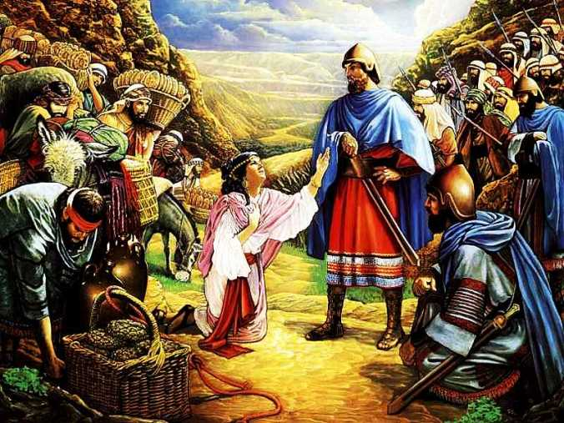
A Heart of Wisdom
I Sam. 25:32-33
32. Then David said to Abigail, "Blessed be the LORD God of Israel, who sent you this day to meet me,
33. and blessed be your discernment, and blessed be you, who have kept me this day from bloodshed and from avenging myself by my own hand.
In a time of lesser roles for women, the future king listened to a woman & thanked God for her!
I Sam. 25:36
She was wise enough to not fight with a drunk, but waited till he was sober.
Notes:
Emphasis in Scripture mine!

Slide 8
A Heart of Wisdom
Abigail’s wisdom saved the day for her
and her household!
Wisdom
Notes:
Emphasis in Scripture mine!

Slide 9
A Heart of Respect
I Sam. 25:20-25
David had intended to kill Nabal and all who belonged to him!
When she came to David, she “bowed herself to the ground” before David.
I Sam. 25:25
She admitted her husband was as his name, a fool.
I Sam. 25:23-24
23. When Abigail saw David, she hurried and dismounted from her donkey, and fell on her face before David and bowed herself to the ground.
24. She fell at his feet and said, "On me alone, my lord, be the blame. And please let your maidservant speak to you, and listen to the words of your maidservant.
Gen. 33:3-7
Bowing was a form of showing respect – Jacob and his family bowed before Esau when they met.
Not a secret – the man’s servants, and David and his men knew!

Slide 10
A Heart of Respect
Abigail’s respect caused David to listen to her, and not
just brush her off!
Respect

Slide 11
A Heart of Faith
I Sam. 25:26-29
26. "Now therefore, my lord, as the LORD lives, and as your soul lives, since the LORD has restrained you from shedding blood, and from avenging yourself by your own hand, now then let your enemies and those who seek evil against my lord, be as Nabal.
27. "Now let this gift which your maidservant has brought to my lord be given to the young men who accompany my lord.
28. "Please forgive the transgression of your maidservant; for the LORD will certainly make for my lord an enduring house, because my lord is fighting the battles of the LORD, and evil will not be found in you all your days.
29. "Should anyone rise up to pursue you and to seek your life, then the life of my lord shall be bound in the bundle of the living with the LORD your God; but the lives of your enemies He will sling out as from the hollow of a sling.

Slide 12
A Heart of Faith
It is important for God’s people to have mates that share
their faith!
II Cor. 6:14: It was true of the Israelites, and Paul says it’s important for Christians too, though not as binding as under the Old Law.
David did not have that connection with his first wife Michal, the daughter of Saul.
She loved David (I Sam. 18:20) and her love was partly the reason Saul hated David and became his enemy (18:27-29).
Later in the years to come she had become bitter and resented David and she rebuked him for dancing before the ark as it came into Jerusalem (II Sam. 6:20).
Perhaps for that reason she had no children all her days (II Sam. 6:23).
In Abigail, David saw and heard the word of God,
and found a kindred spirit!

Slide 13
A Heart of Faith
Abigail’s faith stopped David from bloodshed and
from avenging himself!
Faith

Slide 14
A Heart of Concern
I Sam. 25:30-31
30. "And when the LORD does for my lord according to all the good that He has spoken concerning you, and appoints you ruler over Israel,
31. this will not cause grief or a troubled heart to my lord, both by having shed blood without cause and by my lord having avenged himself. When the LORD deals well with my lord, then remember your maidservant."
She showed concern for her husband, her servants, her property and even her own life in coming to David quickly to stop him from his murderous rampage.
Eph. 5:22-33
The church is paralleled to the marriage relationship.
Christ loved the church and gave Himself for it.
Husbands are to love their wives, and wives are to submit to and respect their husbands.
Husbands and wives act out of concern for one another, just as Christ acted selflessly for the church.

Slide 15
A Heart of Concern
Abigail acted selflessly and out of concern for her family put herself at the mercy of David on behalf of her husband and household!
I Sam. 25:32-35
32. Then David said to Abigail, "Blessed be the LORD God of Israel, who sent you this day to meet me,
33. and blessed be your discernment, and blessed be you, who have kept me this day from bloodshed and from avenging myself by my own hand.
34. "Nevertheless, as the LORD God of Israel lives, who has restrained me from harming you, unless you had come quickly to meet me, surely there would not have been left to Nabal until the morning light as much as one male."
35. So David received from her hand what she had brought him and said to her, "Go up to your house in peace. See, I have listened to you and granted your request."
The future king listened to a woman & thanked God for her!
Notes:
Emphasis in Scripture Mine!

Slide 16
A Heart of Concern
Abigail’s concern saved her family and household from
the wrath of a mighty man of war!
Concern

Slide 17
Conclusion
I Sam. 25:36-38
She went home to find Nabal exalting himself like a king and very drunk.
She waited till morning “when the wine had gone out of Nabal” to tell him what she did.
Upon hearing how close he had come to death at the hands of the man he insulted, and what his wife had done to stop it, “his heart died within him” and God struck him that he died 10 days later.
Despite the kind of man Nabal was, he was blessed to have such a wife as Abigail!
To her credit, she stayed with him and selflessly saved him, even taking on his sin!

Slide 18
Conclusion
I Sam. 25:39-42
David heard of Nabal’s death, praised God for dealing with his enemy, and proposes marriage to Abigail to be his wife!
She went from being the petitioner to the petitioned!
She humbly accepts his proposal.
Prov. 31:10
An excellent wife, who can find?
For her worth is far above jewels.
In this account we see that whoever exalts himself will be humbled (Nabal was killed by God), and she who humbles herself will be exalted (Abigail became the wife of the king) – Luke 14:11

Slide 19
Conclusion
Abigail had the heart of a hero and was blessed by God in
what she did!

Slide 20
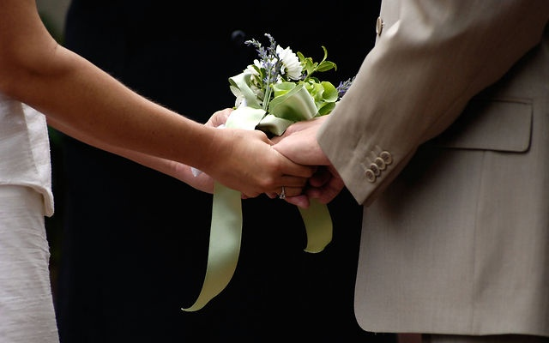
Conclusion
After her marriage to David little is known of her
She was taken captive by the Amalekites from Ziklag and was rescued by David and his men (I Sam. 30).
She gave to David a son, Chileab, his second son (II Sam. 3:3)
Abigail stands as an example of a faithful woman despite her circumstances and who she was married to!

Slide 21
Conclusion
Do you have the heart of Abigail?
Wisdom
Respect
Faith
Concern

Slide 22
“What Must I Do To Be Saved?”
Hear The Gospel (Jn. 5:24; Rom. 10:17)
Believe In Christ (Jn. 3:16-18; Jn. 8:24)
Repent Of Sins (Lk. 13:35; Acts 2:38)
Confess Christ (Mt. 10:32; Rom. 10:10)
Be Baptized (Mk. 16:16; Acts 22:16)
Remain Faithful (Jn. 8:31; Rev. 2:10)
For The Erring Child of God:
Repent (Acts 8:22), Confess (I Jn. 1:9),
Pray (Acts 8:22)

