Slide 1

Covering Sins
(Wrong & Right Ways)
Text: Rom. 4:7-8
Notes:
By Nathan L Morrison
All Scripture given is from NASB unless otherwise stated
For further study, or if questions, please Call: 804-277-1983 or Visit www.courthousechurchofchrist.com

Slide 2
Intro
People who sin usually do not want their sins exposed!
Jn. 3:19-21 (Is. 5:20)
19. "This is the judgment, that the Light has come into the world, and men loved the darkness rather than the Light, for their deeds were evil.
20. "For everyone who does evil hates the Light, and does not come to the Light for fear that his deeds will be exposed.
21. "But he who practices the truth comes to the Light, so that his deeds may be manifested as having been wrought in God."

Slide 3
Intro
Rom. 4:7-8 (Ps. 32:1-2): “How blessed is he whose
transgression is forgiven, Whose sin is covered!”
(Ps. 32:1)
Rom. 4:7-8
7. "BLESSED ARE THOSE WHOSE LAWLESS DEEDS HAVE BEEN FORGIVEN, AND WHOSE SINS HAVE BEEN COVERED.
8. "BLESSED IS THE MAN WHOSE SIN THE LORD WILL NOT TAKE INTO ACCOUNT."
There is something about sin that makes people want
it to be covered!

Slide 4

Intro
There are two ways in which men try to cover their sins:
Prov. 28:13 (NKJ) – Wrong
13. He who covers his sins will not prosper, But whoever confesses and forsakes them will have mercy.
Ps. 85:2 – Right
2. You forgave the iniquity of Your people; You covered all their sin. Selah.
In having our sins covered let us make sure it is done
the right way and not the wrong way!

Slide 5
Reasons People Want to Cover Their Sins
Jn. 3:19-20
19. "This is the judgment, that the Light has come into the world, and men loved the darkness rather than the Light, for their deeds were evil.
20. "For everyone who does evil hates the Light, and does not come to the Light for fear that his deeds will be exposed.
Jn. 3:21 (Rom. 4:7)
21. "But he who practices the truth comes to the Light, so that his deeds may be manifested as having been wrought in God."
People want their sins covered to avoid the disapproval
of God Who can punish and condemn!
Adam and Eve in the beginning of sin hid from God in order to cover their sin! (Gen. 3:1-8)
They could not hide from God and neither can people today – Heb. 4:12-13

Slide 6
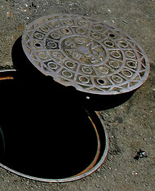
Reasons People Want to Cover Their Sins
The voice of God caused Adam & Eve to come out of
hiding (Gen. 3:8-10) and confess their sins!
Mankind today needs to stop trying to “cover” their own sins, and come to the voice of God (through His word), realize their own spiritual “nakedness,” confess their sins, and obey Jesus for a “covering!”
We all want our sins covered – we just need to make
sure it is the right way!

Slide 7
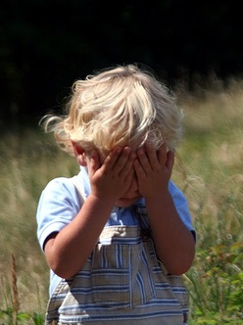
The Wrong Way to Cover Sins
Prov. 28:13: Solomon tells us the outcome of people
trying to cover up their own sins (Ps. 139:7-12)
Prov. 28:13 (NKJ)
13. He who covers his sins will not prosper, But whoever confesses and forsakes them will have mercy.
Those who tried to cover their sins the
wrong way!
Adam & Eve tried to place blame on someone else – Gen. 3:12-13
Achan tried to hide his sin (banned plunder) under his tent – Josh. 7
David tried to cover up his sin of adultery and committed more sin (murder) in the process –
  II Sam. 11-12
Ahab tried to cover his sin of theft with a mock trial (liars placed by Jezebel) – I Kings 21:1-16

Slide 8
The Wrong Way to Cover Sins
Time is another way people try to
cover their sins!
Ecc 12:14
14. For God will bring every act to judgment, everything which is hidden, whether it is good or evil.
I Cor. 4:5
5. Therefore do not go on passing judgment before the time, but wait until the Lord comes who will both bring to light the things hidden in the darkness and disclose the motives of men's hearts; and then each man's praise will come to him from God.

Slide 9
The Wrong Way to Cover Sins
Time is another way people try to cover their sins!
II Cor. 5:10
10. For we must all appear before the judgment seat of Christ, so that each one may be recompensed for his deeds in the body, according to what he has done, whether good or bad.
Heb. 4:13
13. And there is no creature hidden from His sight, but all things are open and laid bare to the eyes of Him with whom we have to do.

Slide 10
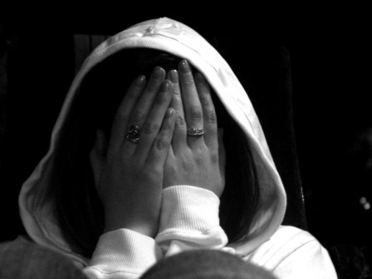
The Wrong Way to Cover Sins
God sees our deeds!
Eccl. 12:14
I Cor. 4:5
II Cor. 5:10
Heb. 4:13
Heb. 10:31
People who cover sins the wrong way only have
“a terrifying expectation of judgment!” (Heb. 10:27)

Slide 11
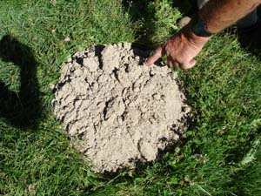
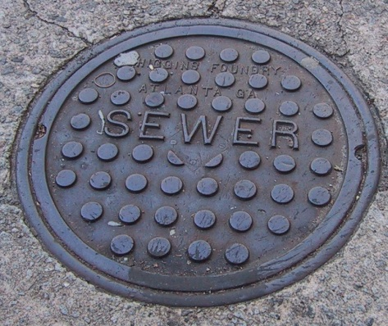
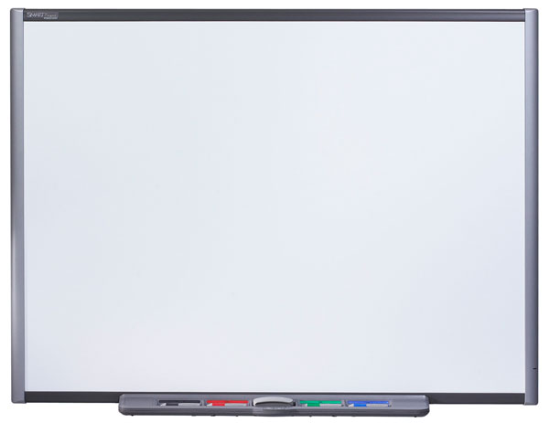
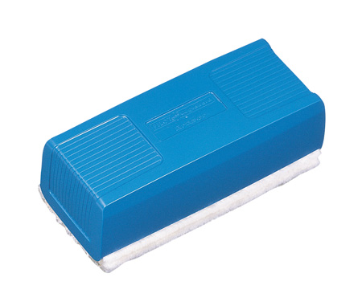
The Right Way to Cover Sins
Ps. 85:2: The only way to really cover sins the right way is
through forgiveness! (Prov. 28:13b)
Ps. 85:2
2. You forgave the iniquity of Your people; You covered all their sin. Selah.
Man’s way of covering sins will fail (Prov. 28:13a) –
Still there!
God’s way covers them, never to be seen again!
(Jer. 31:34; Heb. 8:12; 10:17)
Sins
“Clean Slate!”

Slide 12
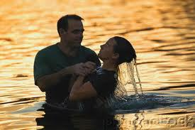
The Right Way to Cover Sins
Forgiveness can even cover those who first tried to cover
sin the wrong way!
David was forgiven when he confessed his sin – II Sam. 12:13
Ahab was forgiven when he humbled himself before God – I Kings 21:27-29
What are the terms for forgiveness to the unbeliever?
They must have faith in Christ and confess Him as Lord (Jn. 8:24; Acts 8:37)
They must repent of their sins (Lk. 13:3; Acts 17:30)
They must obey the gospel in baptism for the forgiveness of sins (Mk. 16:16; Acts 2:38; 22:16)
They must live a faithful life (Jn. 8:31; Rev. 2:10)

Slide 13
The Right Way to Cover Sins
What are the terms for forgiveness to erring Christians?
They must confess (acknowledge) their sins (Prov. 28:13b; I Jn. 1:9)
They must repent of their sins (Acts 8:22a)
They must seek forgiveness and reconciliation with their brother – Mt. 5:23-24; Eph. 4:26-27, 31-32
They must ask God for forgiveness (Acts 8:22b; Js. 5:16; I Jn. 1:9)
The outcome of meeting the conditions for forgiveness:
Rom. 4:7-8
7. "BLESSED ARE THOSE WHOSE LAWLESS DEEDS HAVE BEEN FORGIVEN, AND WHOSE SINS HAVE BEEN COVERED.
8. "BLESSED IS THE MAN WHOSE SIN THE LORD WILL NOT TAKE INTO ACCOUNT."
Sins
Those who seek to cover their sins the
right way will be blessed and forgiven!

Slide 14
Conclusion
Those who practice sin don’t usually want their
wickedness exposed (Jn. 3:19-20; Is. 5:20)
Eccl. 12:14; Rom. 14:12; II Cor. 5:10
All will stand before the judgment seat of Christ and will give account of their deeds, whether good or bad!
If they have lived trying to cover their own sins, their sins will be uncovered and they will face eternal punishment! (Rom. 2:6, 8-9; II Thess. 1:8-9; Heb. 4:13)
If they live confessing their sins and repenting of them after obeying the gospel, their sins will remain covered (Heb. 10:17) and they will receive the reward of eternal life! (Rom. 2:6-7, 10; Rev. 2:10)

Slide 15

Conclusion
Let us avoid trying to cover our own sins where they will
one day be uncovered and judged, but instead seek to
have God forgive and cover our sins,
never to be seen again!

Slide 16
“What Must I Do To Be Saved?”
Hear The Gospel (Jn. 5:24; Rom. 10:17)
Believe In Christ (Jn. 3:16-18; Jn. 8:24)
Repent Of Sins (Lk. 13:35; Acts 2:38)
Confess Christ (Mt. 10:32; Rom. 10:10)
Be Baptized (Mk. 16:16; Acts 22:16)
Remain Faithful (Jn. 8:31; Rev. 2:10)
For The Erring Child:
Repent (Acts 8:22), Confess (I Jn. 1:9),
Pray (Acts 8:22)

