Slide 1
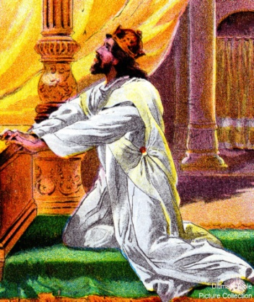
“Stand And See…”
Text: II Chr. 20:1-30; I Pet. 5:6-7
Notes:
By Nathan L Morrison
All Scripture given is from NASB unless otherwise stated
For further study, or if questions, please Call: 804-277-1983 or Visit www.courthousechurchofchrist.com

Slide 2
Intro
II Chr. 20:1-4 (Innumerable force against Judah)
1. Now it came about after this that the sons of Moab and the sons of Ammon, together with some of the Meunites, came to make war against Jehoshaphat.
2. Then some came and reported to Jehoshaphat, saying, "A great multitude is coming against you from beyond the sea, out of Aram and behold, they are in Hazazon-tamar (that is Engedi)."
3. Jehoshaphat was afraid and turned his attention to seek the LORD, and proclaimed a fast throughout all Judah.
4. So Judah gathered together to seek help from the LORD; they even came from all the cities of Judah to seek the LORD.
Jehoshaphat gathered the people of Judah to
Jerusalem with their families (20:13) at the Temple
(20:5) that they might seek after the Lord!

Slide 3
Intro
Rom. 15:4: These things are written for our instruction
that we might have hope
What do we do when we find ourselves facing trials,
battles we can’t win?
Gal. 6:2
2. Bear one another's burdens, and thereby fulfill the law of Christ.
I Pet. 5:6-7 (II Tim. 2:15)
6. Therefore humble yourselves under the mighty hand of God, that He may exalt you at the proper time,
7. casting all your anxiety on Him, because He cares for you.
This account gives us hope in dealing with life’s trials
and insurmountable battles!

Slide 4
Sought Help From the Lord
Jehoshaphat and the people…
II Chr. 20:5, 12
5. Then Jehoshaphat stood in the assembly of Judah and Jerusalem, in the house of the LORD before the new court,
12. "O our God, will You not judge them? For we are powerless before this great multitude who are coming against us; nor do we know what to do, but our eyes are on You."
II Chr. 20:5-13:
This was a problem too big for Judah, but not for God!
Jehoshaphat reminded God of His promises and admitted their weaknesses and turned to God!
There are some problems in life that arise that we
don’t know the answer to, or know what to do!

Slide 5
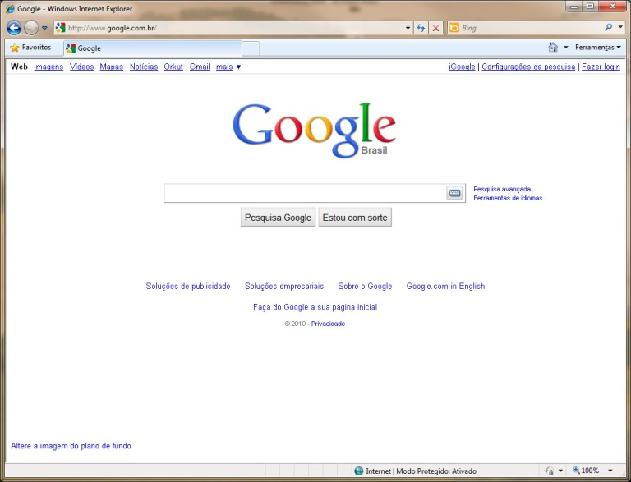
Sought Help From the Lord
Jehoshaphat and the people…
How do we handle it?
Some people look in all the wrong places for the
answers:
Google, Facebook, internet in general, drugs, alcohol, etc.
Things that will help ignore the trouble! (Could give false answers)

Slide 6
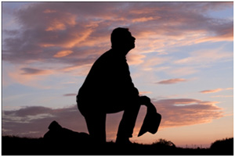
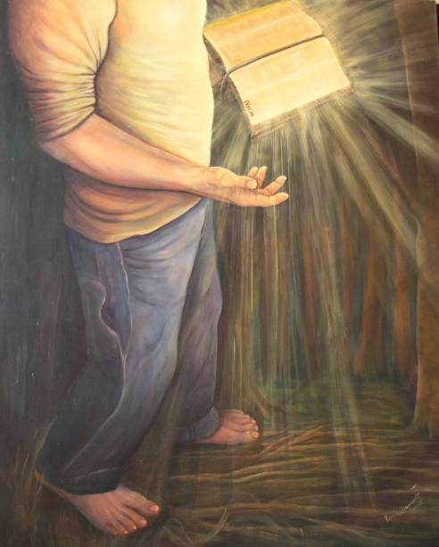
Sought Help From the Lord
Jehoshaphat and the people…
Ps. 119:105 (Prov. 6:23)
105. Your word is a lamp to my feet And a light to my path.
Take it to the Lord!
I Pet. 5:7: Saints need to turn to God, the One with the answers!
(II Tim. 2:15)
Phil. 4:6-7; Col. 4:2; Js. 5:16: We turn to Him in “prayer and supplication” (Petition, request), with thanksgiving!
Ps. 119:105; Prov. 6:23: God’s word is our guide, a light to our path!
When we are in trouble and in need, take it to God in prayer and study!

Slide 7
Stayed In the House of the Lord
Jehoshaphat and the people…
II Chr. 20:5, 13
5. Then Jehoshaphat stood in the assembly of Judah and Jerusalem, in the house of the LORD before the new court,
13. All Judah was standing before the LORD, with their infants, their wives and their children.
II Chr. 20:5, 13:
Jehoshaphat took his problem to God and stayed in the Temple till he received an answer. (II Chr. 20:14-17: God’s answer)
They were facing the temple (20:9) in accordance with Solomon’s prayer at the dedication of the temple (I Kings 8:30-52).
We can keep our faith by not leaving the Lord’s church
(I Tim. 3:15)
Js. 4:8: “Draw near to God, and He will draw near to you!”

Slide 8
Stayed In the House of the Lord
Jehoshaphat and the people…
Heb. 10:35, 39
35. Therefore, do not throw away your confidence, which has a great reward.
39. But we are not of those who shrink back to destruction, but of those who have faith to the preserving of the soul.
Don’t let trials/seeming insurmountable battles take
you from God!
Rom. 8:18: Nothing in this life, no matter how bad, can compare to the glory waiting to come!
Heb. 10:32-39: The Hebrew audience had suffered greatly and were warned, “Do not throw away your confidence” (10:35)

Slide 9
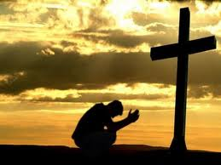
Stayed In the House of the Lord
Jehoshaphat and the people…
So many people give up and forsake their faith (God)
in their hours of need!
When we are in trouble and in need, don’t forsake your
faith, but draw near to God!

Slide 10
Worshiped & Praised God
Jehoshaphat and the people…
II Chr. 20:14-18
14. Then in the midst of the assembly the Spirit of the LORD came upon Jahaziel the son of Zechariah, the son of Benaiah, the son of Jeiel, the son of Mattaniah, the Levite of the sons of Asaph;
15. and he said, "Listen, all Judah and the inhabitants of Jerusalem and King Jehoshaphat: thus says the LORD to you, 'Do not fear or be dismayed because of this great multitude, for the battle is not yours but God's.
16. 'Tomorrow go down against them. Behold, they will come up by the ascent of Ziz, and you will find them at the end of the valley in front of the wilderness of Jeruel.
17. 'You need not fight in this battle; station yourselves, stand and see the salvation of the LORD on your behalf, O Judah and Jerusalem.' Do not fear or be dismayed; tomorrow go out to face them, for the LORD is with you."
18. Jehoshaphat bowed his head with his face to the ground, and all Judah and the inhabitants of Jerusalem fell down before the LORD, worshiping the LORD.

Slide 11
Worshiped & Praised God
Jehoshaphat and the people…
II Chr. 20:19-22
19. The Levites, from the sons of the Kohathites and of the sons of the Korahites, stood up to praise the LORD God of Israel, with a very loud voice.
20. They rose early in the morning and went out to the wilderness of Tekoa; and when they went out, Jehoshaphat stood and said, "Listen to me, O Judah and inhabitants of Jerusalem, put your trust in the LORD your God and you will be established. Put your trust in His prophets and succeed."
21. When he had consulted with the people, he appointed those who sang to the LORD and those who praised Him in holy attire, as they went out before the army and said, "Give thanks to the LORD, for His lovingkindness is everlasting."
22. When they began singing and praising, the LORD set ambushes against the sons of Ammon, Moab and Mount Seir, who had come against Judah; so they were routed.

Slide 12
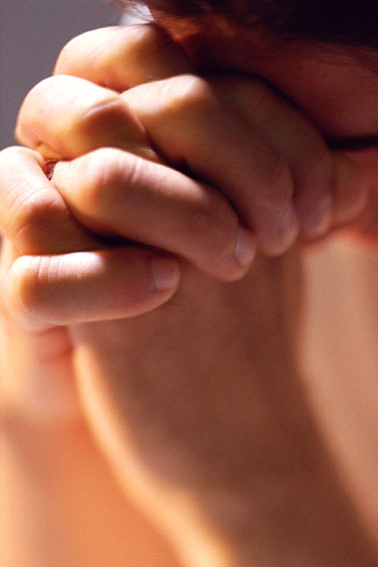
Worshiped & Praised God
Jehoshaphat and the people…
Heb. 13:15
15. Through Him then, let us continually offer up a sacrifice of praise to God, that is, the fruit of lips that give thanks to His name.
We are to give our trials to God (I Pet. 5:7) but pray to
Him with thanksgiving and praise as well
(Phil. 4:6; Col. 4:2)
Mt. 6:7-8: God knows our needs before we ask for it!
Heb. 13:15: We are to sing and give praise to God!
I Jn. 3:21-22: When we ask in faith (Js. 1:6) and keep
the commands of God, He will hear and answer us!
(II Cor. 12:7-10: Be humble to accept His answer!)
Rev. 4:11: God is worthy of our praise and thanksgiving!
When we are in trouble and in need, let us pray,
praise, and give thanks to God!

Slide 13
Conclusion
The battle belongs to the Lord!
II Chr. 20:15, 17: King Jehoshaphat told not to worry because the battle was not theirs, but the battle belonged to God.
II Chr. 20:22-24: The Lord caused that great force of enemies to destroy themselves!

Slide 14
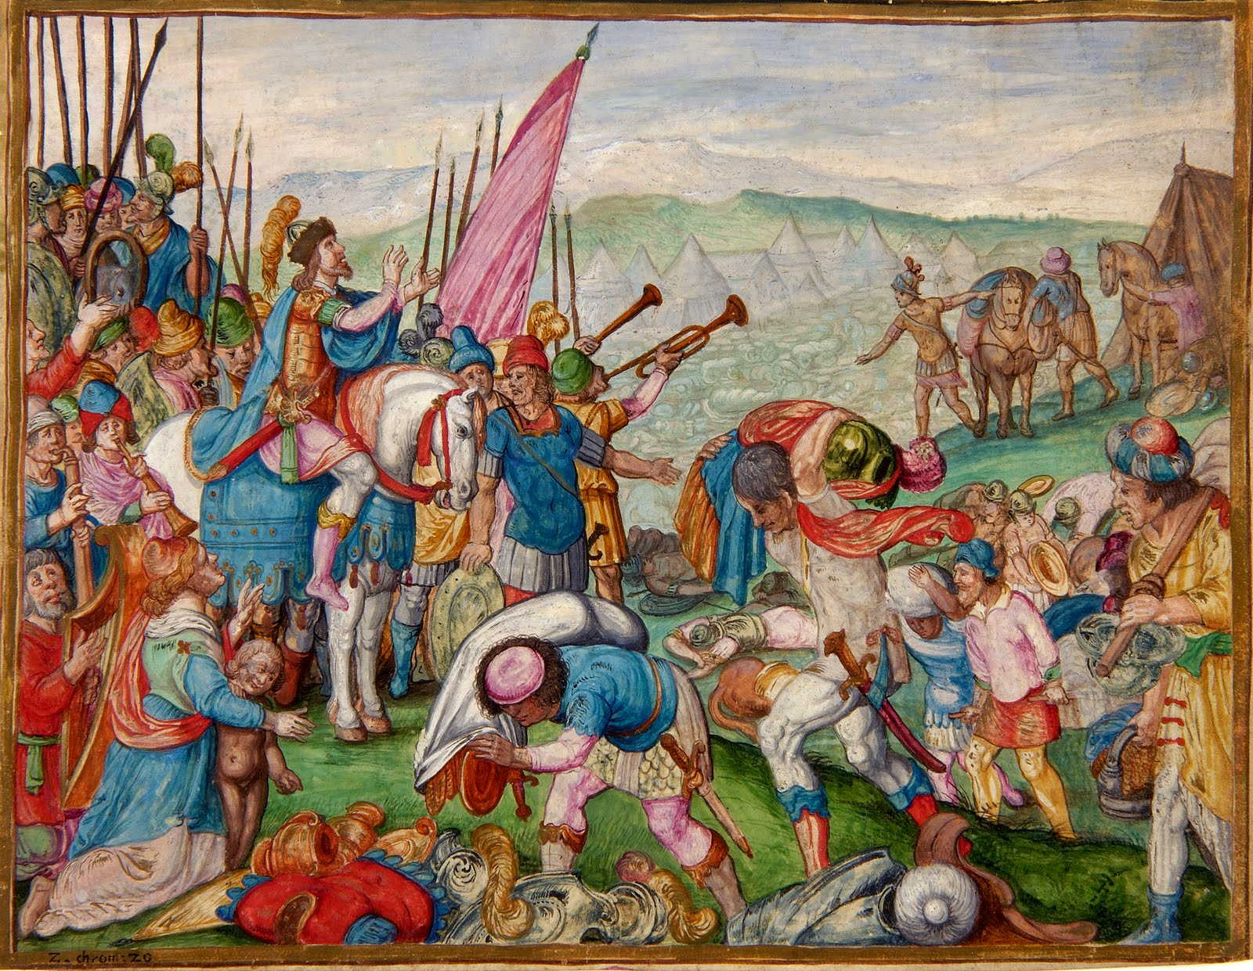
Conclusion
Eph. 3:20-21 (God is Omnipotent = All Powerful!)
20. Now to Him who is able to do far more abundantly beyond all that we ask or think, according to the power that works within us,
21. to Him be the glory in the church and in Christ Jesus to all generations forever and ever. Amen.
God’s answers to our prayers often are not what we
might expect but greater!
II Chr. 20:25-30: It took 3
days to plunder the spoil of the
battle they didn’t even have to
fight!
God took care of His people
King Jehoshaphat was granted
peace because his enemies
feared God! (20:29-30)

Slide 15
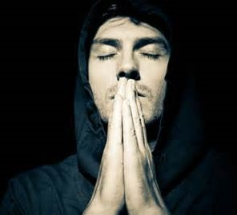
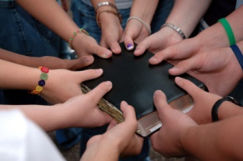
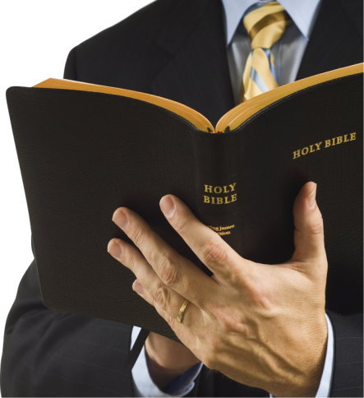
Conclusion
What do you do when you are in distress and fighting
the seeming losing battle of life’s trials?
Let us learn the example of King Jehoshaphat!
(Rom. 15:4; II Chr. 20) “Stand and See…”
Seek the Lord: I Pet. 5:6-7 – Take it to the Lord in prayer! (Ps. 50:15)
Draw near to God: James 4:8: He will draw near to us!
Give praise & thanks to God no matter our situation: Phil. 4:6-7: God is in control and provides a peace like no other! (II Tim. 2:15)

Slide 16
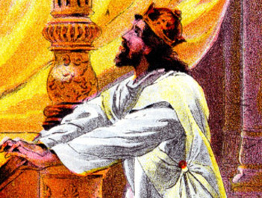
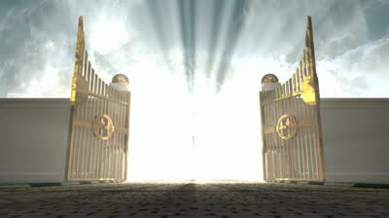
Conclusion
If we (like King Jehoshaphat) seek the Lord and stand
and see (our faith in God), we’ll see the salvation of
the Lord!

Slide 17
“What Must I Do To Be Saved?”
Hear The Gospel (Jn. 5:24; Rom. 10:17)
Believe In Christ (Jn. 3:16-18; Jn. 8:24)
Repent Of Sins (Lk. 13:35; Acts 2:38)
Confess Christ (Mt. 10:32; Rom. 10:10)
Be Baptized (Mk. 16:16; Acts 22:16)
Remain Faithful (Jn. 8:31; Rev. 2:10)
For The Erring Child:
Repent (Acts 8:22), Confess (I Jn. 1:9),
Pray (Acts 8:22)

