Slide 1
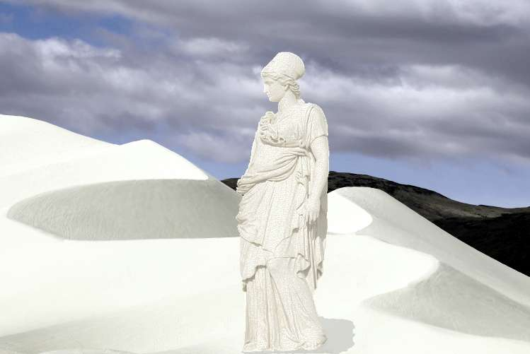
“Remember Lot’s Wife!”
Text: Lk. 17:32
Notes:
By Nathan L Morrison
All Scripture given is from NASB unless otherwise stated
For further study, or if questions, please Call: 804-277-1983 or Visit www.courthousechurchofchrist.com
Image courtesy of: www.trevinwax.com

Slide 2
Intro
There are many warnings for God’s people to not look
back once redeemed!
Num. 14:4; Is. 30:2: After being delivered from slavery, Israel looked back to Egypt.
Heb. 11:15: The heroes of faith could have looked back, but they looked forward!
Lk. 9:62: Jesus said those who look back are not worthy of Him!
II Pet. 2:20-22: Peter says it’s like a dog returning to its vomit or a sow, after being washed, returning to the mire!

Slide 3
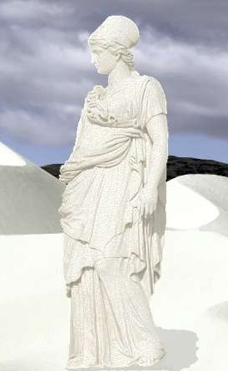
Intro
Lk. 17:32
32. "Remember Lot's wife.
In teaching about His 2nd Coming Jesus used:
Lk. 17:26-27: Noah’s day as an illustration – The Flood.
Lk. 17:28-31: Lot’s day as an illustration – Destruction of Sodom & Gomorrah.
“Remember Lot’s wife” speaks of being prepared and not looking back!
Notes:
Image courtesy of: www.trevinwax.com

Slide 4
Danger of an Ungodly Environment
Lot had chosen the wealth of the land:
Gen. 13:10-12: He chose it for its outside appearance.
Gen. 13:13: Ugly and filled with wickedness on the inside.
Gen. 19:14: Lot’s daughters had married (were betrothed) the people of the land
Jude 7
7. just as Sodom and Gomorrah and the cities around them, since they in the same way as these indulged in gross immorality and went after strange flesh, are exhibited as an example in undergoing the punishment of eternal fire.
I Cor. 15:33 (II Pet. 2:7-8)
33. Do not be deceived: "Bad company corrupts good morals."
Gen. 19:31-38: Lot’s daughters were corrupted, and committed incest with their father, showing their complete lack of faith in God!

Slide 5
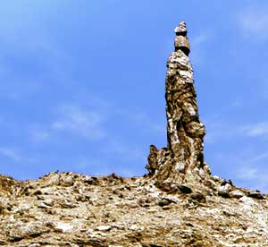
Danger of an Ungodly Environment
God’s people are to be different, to not look back to where
we have come from!
Jn. 17:15: We have to live in the world but not be part of the world.
II Pet. 1:2-4: “Having escaped the corruption that is in the world by lust.”
Phil. 2:14-15: It is possible to remain “above reproach.”
Lot chose the greener pastures of
Sodom and Gomorrah, and it
cost him his family!
When we look back and choose the darkness which we
escaped from, it can cost us our souls!
Notes:
http://en.wikipedia.org/wiki/Lot%27s_wife
“Lot’s wife pillar” on Mt. Sodom along the road before the Dead Sea.

Slide 6
God Means What He Says
Gen. 19:17
17. When they had brought them outside, one said, "Escape for your life! Do not look behind you, and do not stay anywhere in the valley; escape to the mountains, or you will be swept away."
God means what He says:
II Pet. 2:1-9: Peter used illustrations of erring angels, the flood, the destruction of Sodom, and the deliverance of Lot to show God means what He says
Jesus applied this event to teach about His second
Coming to demonstrate that it will happen!
II Thess. 1:7-9: When He returns it will mean punishment for the ungodly (Mt. 25:41, 46).
II Pet. 3:9-12: His return will mean the destruction of the earth, as we know it!
Notes:
Emphasis in Scripture mine

Slide 7
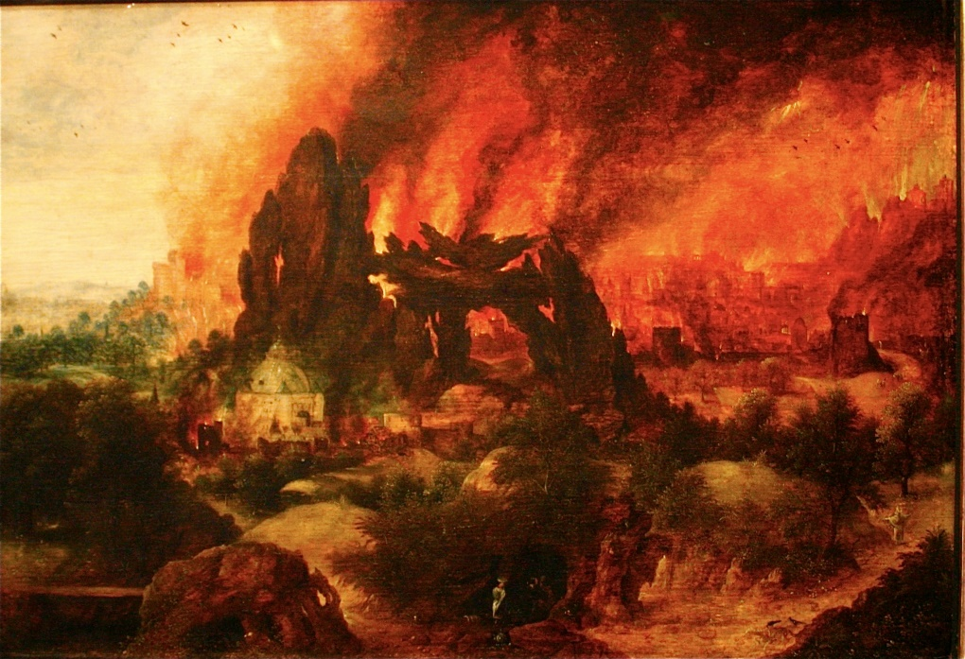
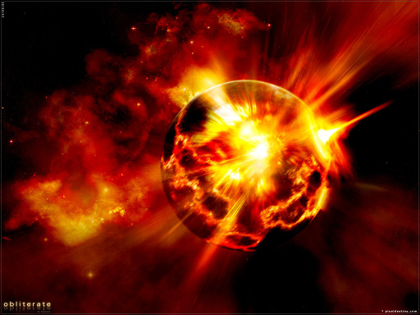
God Means What He Says
Just as Sodom & Gomorrah were destroyed by fire so the
earth will melt with “intense heat!” (II Pet. 3:10, 12)
Judgment is as sure as Christ’s return!

Slide 8
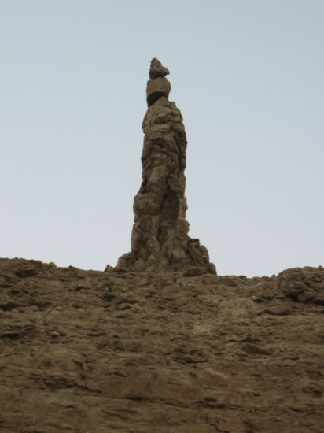
There are Consequences for Sin
Gen. 19:26
26. But his wife, from behind him, looked back, and she became a pillar of salt.
Her disobedience is a good illustration of:
I Cor. 10:12: Take heed lest you fall!
II Pet. 1:10: Give diligence to make calling and election sure.
Sometimes the consequence is delayed:
Eccl. 8:11: Because judgment is delayed men turn fully to evil.
II Pet. 3:9: Men should use the delay to repent!
Notes:
http://en.wikipedia.org/wiki/Lot%27s_wife
“Lot’s wife pillar” on Mt. Sodom along the road before the Dead Sea.

Slide 9
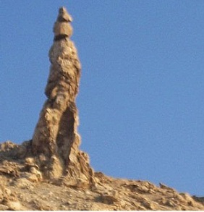
There are Consequences for Sin
I Pet. 4:14-16
14. If you are reviled for the name of Christ, you are blessed, because the Spirit of glory and of God rests on you.
15. Make sure that none of you suffers as a murderer, or thief, or evildoer, or a troublesome meddler;
16. but if anyone suffers as a Christian, he is not to be ashamed, but is to glorify God in this name.
Judgment is assured
Rev. 20:11-15: Judgment will reach the great and small alike.
Actions have consequences:
One minute you’re walking
along, and one mistake later you’re
a salt-lick!
Notes:
http://en.wikipedia.org/wiki/Lot%27s_wife
“Lot’s wife pillar” on Mt. Sodom along the road before the Dead Sea.

Slide 10
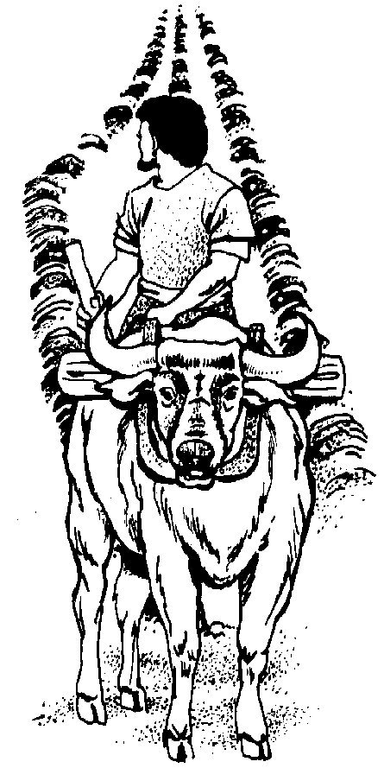
Dedication to the Lord is Necessary
Lk. 9:62
62. But Jesus said to him, "No one, after putting his hand to the plow and looking back, is fit for the kingdom of God."
Like running race – Endure
Heb. 10:32-39: God’s people need endurance to weather the storms of life!
Heb. 12:1-3: Must set aside the things that distract us and focus on Christ.
Like warfare – Fight the good fight!
(I Tim. 6:12)

Slide 11
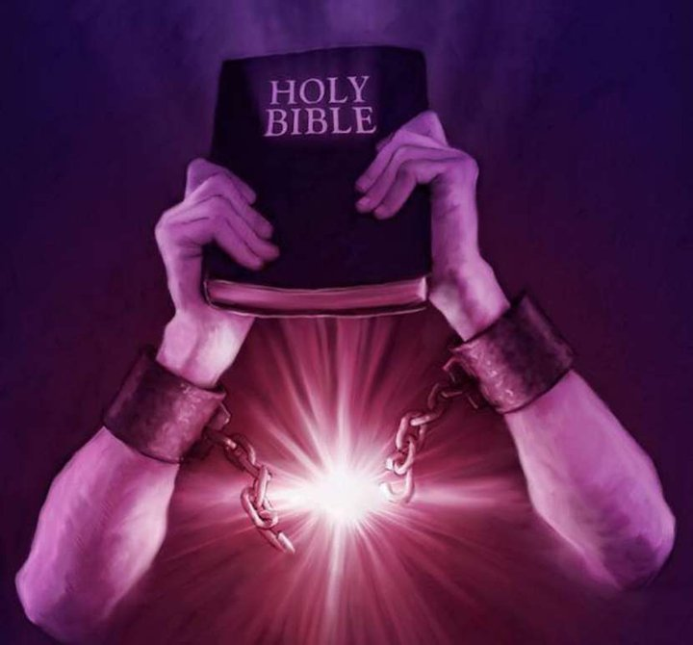
Dedication to the Lord is Necessary
Trust in God, overcome trials through faith
(Eph. 6:16; I Jn. 5:4) – Truth will set free – Jn. 8:31-32
Lot’s wife showed her lack of faith by turning back!
She had been led by the hand out of danger by the angels, was almost free!
Like the person who escaped the world and turned back in II Pet. 2:20-22
We need to dedicate our lives to
God, not to this world!
(Mt. 6:24, 33; I Jn. 2:15-17)

Slide 12
Conclusion
Remember Lot’s Wife!
The danger of an ungodly environment
God means what He says
There are consequences for sin
Dedication to the Lord is necessary
When warning of the Second Coming,
and warning them to Remember Lot’s
wife, Jesus was telling them,
“Don’t look back!”
The world will be judged and destroyed!
Notes:
Image courtesy of: www.trevinwax.com

Slide 13
Conclusion
It takes a dedication to the Lord to not look back
Heb. 11:13-16: Those who look back have opportunity to return. Those who look forward are promised a home prepared by God.
Phil. 3:12-14: Forget what is behind – press forward to the prize!
Col. 3:1-7: Dwell on things above, not of the earth. Leave old life behind! (I Pet. 4:3)
II Pet. 1:9: Peter says, “Remember the Purification!” Don’t return to sin!
I Jn. 2:15-17: The things of the earth are set for destruction (II Pet. 3:10-12).

Slide 14
Conclusion
Once delivered from the world…
“Don’t Look Back!”
“Remember Lot’s Wife!”
Notes:
Image courtesy of: www.trevinwax.com

Slide 15
“What Must I Do To Be Saved?”
Hear The Gospel (Jn. 5:24; Rom. 10:17)
Believe In Christ (Jn. 3:16-18; Jn. 8:24)
Repent Of Sins (Lk. 13:35; Acts 2:38)
Confess Christ (Mt. 10:32; Rom. 10:10)
Be Baptized (Mk. 16:16; Acts 22:16)
Remain Faithful (Jn. 8:31; Rev. 2:10)
For The Erring Child:
Repent (Acts 8:22), Confess (I Jn. 1:9),
Pray (Acts 8:22)

