Slide 1
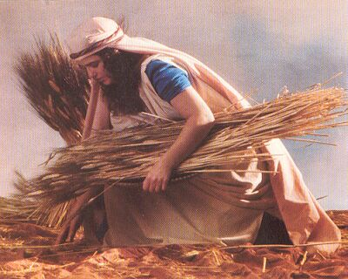
Ruth: Virtuous Devotion Text: Ruth
Godly Women Series Part 3
Notes:
By Nathan L Morrison
All Scripture given is from NASB unless otherwise stated
For further study, or if questions, please Call: 804-277-1983 or Visit www.courthousechurchofchrist.com
Based on an article by Mike Willis, Guardian Of Truth, August, 1989

Slide 2
Intro
There are examples both good and bad in the Scriptures
Men and women alike can provide us with sources of
strength and inspiration
Eve: “Mother of all living” (Gen. 3:20) and an example of moving past sin!
Sarah: Mother of nations (Gen. 17:16), Mother of saints (Gal. 4:26,31), Mother of godly wives (I Pet. 3:6), and is an example of faith and overcoming one’s weaknesses!
Godly role models are greatly needed in our society!

Slide 3
Intro
Ruth
An unlikely hero of the Old Testament because she was from the Moabite nation, Ruth won the respect of God's people and an honored place in the genealogy of the Christ.
Background – Book of Ruth (A Love Story)
In the backdrop of the “days of the judges” (Ruth 1:1), a perilous time for Israel where they often disobeyed God and suffered the consequences, a foreigner’s example of virtue and devotion paves the way for Israel’s future king, a man after God’s own heart, and the promised Messiah!
Famine forced Elimelech to move from Bethlehem to Moab for ten years with his wife Naomi and his two sons, Mahlon and Chilion. Elimelech died, leaving Naomi a widow. Her two sons married Moabite women, named Orpah and Ruth. Sometime later her sons also died.
Ruth is an example of faith, virtue, love, & devotion!

Slide 4
She Had Faith
Ruth 1:1-7
Desolate in a foreign country, Naomi determined to return to Bethlehem. Her two daughters-in-law desired to return with her, and she encouraged them to stay in Moab where their prospects for marriage were better than in Israel.
Ruth 1:8-15:
Naomi recognized her daughter-in-law’s prospects for future happiness were much better in Moab than in Israel.
In Moab they were among their own people; in Israel, Ruth was a foreign woman unlikely to ever remarry.
Orpah wept, kissed her mother-in-law and returned to “to her people and her gods” (1:15).

Slide 5
She Had Faith
Ruth 1:16-18
16. But Ruth said, "Do not urge me to leave you or turn back from following you; for where you go, I will go, and where you lodge, I will lodge. Your people shall be my people, and your God, my God.
17. "Where you die, I will die, and there I will be buried. Thus may the LORD do to me, and worse, if anything but death parts you and me."
18. When she saw that she was determined to go with her, she said no more to her.
It was an act of faith recognized by the inhabitants of Bethlehem (2:11).
Boaz recognized her faith when he said, "May the Lord reward your work, and your wages be full from the Lord, the God of Israel, under whose wings you have come to seek refuge" (2:12).

Slide 6
She Had Faith
Notice the difference in these three widows
Naomi was a grieving widow – bereft of husband and sons, became bitter – Ruth 1:20-21
Orpah was a leaving widow – she listened to the counsel of Naomi and left her – Ruth 1:14-15
Ruth was a cleaving widow – she would not part from Naomi except by death – Ruth 1:16-17
Ruth abandoned her people, renounced her gods,
and by a great act of faith joined herself to a new religion,
a new people, and a new life
It was an uncertain life, and one of poverty and hard work.
In all that, she trusted in Naomi & her God!
Ruth had the faith to leave all she knew to put herself
under the “wings” of Jehovah!
Notes:
Naomi (H5281): “Pleasant” or “My Delight”
Mara (H4755): “Bitter” or “Bitterness”
Orpah (H6204): “Gazelle” or “Mane”
Ruth (H7327): “Friend” or “Friendship”

Slide 7
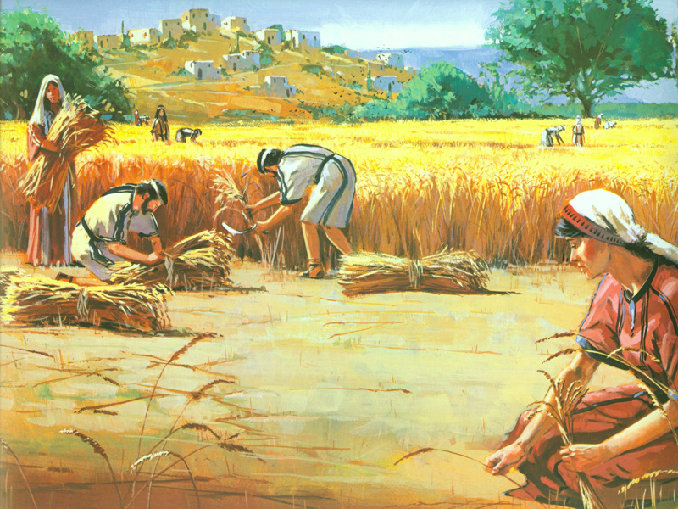
She Was Virtuous
Ruth 2:7, 11
7. "And she said, 'Please let me glean and gather after the reapers among the sheaves.' Thus she came and has remained from the morning until now; she has been sitting in the house for a little while."
11. Boaz replied to her, "All that you have done for your mother-in-law after the death of your husband has been fully reported to me, and how you left your father and your mother and the land of your birth, and came to a people that you did not previously know.
Ruth won the respect of the community about her by her
devotion to Naomi, her industriousness, and her virtuous
conduct!

Slide 8
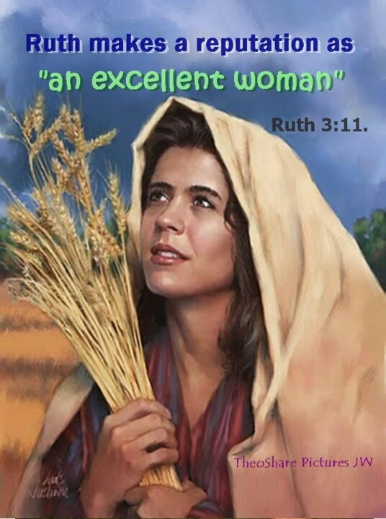
She Was Virtuous
Ruth 3:11 (Prov. 31:10: “Excellent” = “Virtuous”)
11. “Now, my daughter, do not fear. I will do for you whatever you ask, for all my people in the city know that you are a woman of excellence.”
Ruth did all that Naomi told her to do to appeal to Boaz for a levirate marriage (3:1-6), and Boaz awoke in the night, startled at finding a woman at his feet! (3:8-9)
When he learned it was Ruth, he told her he would do all
he could in the morning to “redeem” her under the law
(3:10-13)

Slide 9
She Was Virtuous
Not only did she work hard, she maintained her purity,
winning the respect due a “virtuous woman!”
For that, Boaz wanted her and would seek to redeem her despite a closer relative!
Ruth was virtuous, above reproach and God’s people
(foreigners to her) came to love her too!

Slide 10
She Trusted In God’s Care
Ruth 2:2
She trusted in the Lord's provisions.
She was content to accept the provisions which God had made for widows such as Naomi and herself.
She joined other poor people to glean in the fields to provide for themselves, as the law of Moses said (Lev. 19:9; 23:22; Deut. 24:19).
Ruth 3:6, 9
She trusted in the Lord's provision for a levirate (“husband’s brother”) marriage.
She appealed to Boaz to perform the duties of a near kinsman to raise up seed to one who died childless (Deut. 25:5-10).
She walked within the Law in both of these respects, and God blessed her for it!

Slide 11
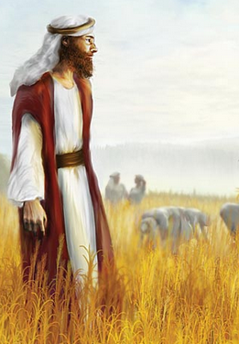
She Trusted In God’s Care
About Boaz…
What Kind of Man was Boaz before Marriage?
RUTHLESS!

Slide 12
She Trusted In God’s Care
Boaz as a type of Christ as a “Redeemer”:
Boaz was a man of great wealth (Ruth 2:1).
He was compassionate to the stranger (Ruth 2:8-9).
He told her to stay in his fields with his maids and drink the servant’s water.
He knew all about Ruth, even before she met him (Ruth 2:11), even as the Lord knows all about us even before we come to know Him.
He served Ruth graciously, and all her needs were satisfied (Ruth 2:14).
He fed her with his servants!
He granted her protection and prosperity for the future (Ruth 2:15-16).
He instructed his servants to “not insult” & “not to rebuke” her, and to purposely leave extra grain for her to glean.
In doing this, he secured her safety and success (Ruth 2:21-23).
He redeemed (“to buy back”) all that belonged to Elimelech and his sons, and would marry Ruth to raise up a descendant for Mahlon (Ruth 4:1-10).
In these acts of grace we see a foreshadowing of our blessings in Christ!
Luke 19:10; Eph. 1:7; Gal. 3:8-14

Slide 13
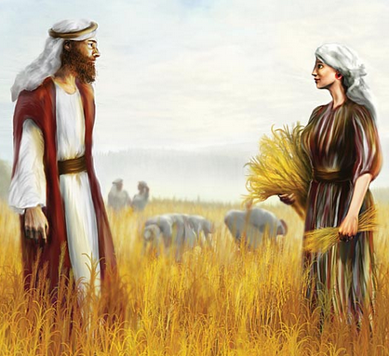
She Trusted In God’s Care
From tragedy came faith, and from faith came
great blessings!

Slide 14
She Had Love and Devotion
Ruth 4:15
15. "May he also be to you a restorer of life and a sustainer of your old age; for your daughter-in-law, who loves you and is better to you than seven sons, has given birth to him."
Ruth loved her mother-in-law Naomi. She was committed to her (1:16-17).
It has been said, “Many men have had affliction – none like Job; many women have had tribulation – none like Naomi.”
Ruth recognized Naomi's plight and was moved with love
and compassion to go with her and stand by her
She may have had it easier in Moab among her own
people, but out of love she went with Naomi!

Slide 15
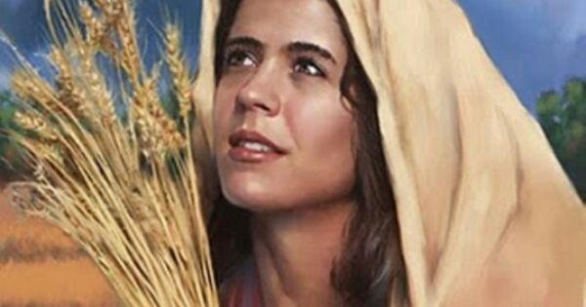
She Was Blessed Among Israel
She walked in the pathway of duty
Orpah turned her back on duty to find a pleasurable life on earth (1:14-15).
Ruth turned her back on the pleasures of life in order to do what duty demanded (Ruth 1:16-17).
Ruth sacrificed everything that could fascinate a young
woman to fulfill the demands of duty
She gave up association with her family and friends to move to Israel.
She committed herself to caring for her aged mother-in-law who could not provide for herself (Naomi did not go to the fields with Ruth).
She gleaned in the fields!

Slide 16
She Was Blessed Among Israel
God blessed her for it! (Ruth 4:11-22)
Boaz was a close relative, and very generous.
He was a descendant of Perez, son of Judah and Tamar (Gen. 38: A levirate situation gone wrong!)
Boaz and Ruth had a son, Obed, who fathered Jesse, who was the father of King David!
Jesus is from the tribe of Judah, from Perez, and a descendant of David (Mt. 1; Acts 2).
Ruth 4:11-12: The elders who witnessed the redemption said, “May the woman you bring in your home be like Leah and Rachel for they built the house of Israel, and may your house be like the house of Perez.”
Through Jesus “all the nations” are blessed, and His spiritual house (church) knows no boundaries and is by far greater than the House of Israel!
This woman of virtue (“excellence”) is an ancestor of the physical side of the Son of God! (Mt. 1:5)

Slide 17
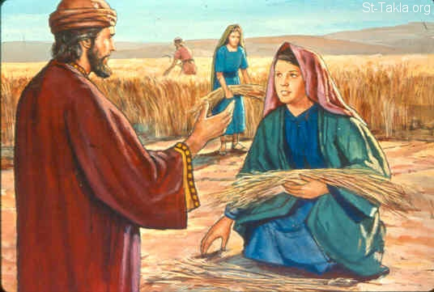
She Was Blessed Among Israel
By her life of faith, virtue, love, and devotion, God blessed Ruth and Naomi in ways they couldn’t even see!

Slide 18
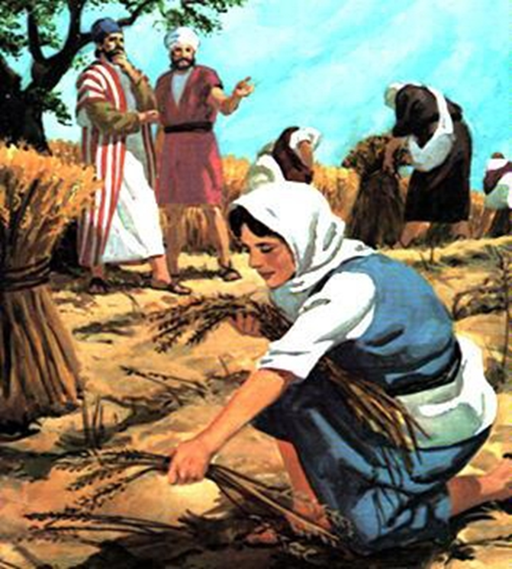
Conclusion
Some people, when going through trials, wonder if it’s
worth it to not give up
Ruth and Noami’s account give us hope that when one is
virtuous, God will bless and reward!
Virtue is the strength of character to do
what is right no matter what!

Slide 19
Conclusion
The years have passed; Orpah and Ruth are long gone
Orpah's name has passed into oblivion, having been nearly forgotten.
Ruth passed down to her children an honorable name; a name still given to young ladies.
Our modern day “Ruth’s” will also pass down a legacy to
their families:
A legacy which teaches their children to be devoted to God and to those committed to their care.
May Ruth's God-fearing, virtuous conduct be an example to each of us!

Slide 20
“What Must I Do To Be Saved?”
Hear The Gospel (Jn. 5:24; Rom. 10:17)
Believe In Christ (Jn. 3:16-18; Jn. 8:24)
Repent Of Sins (Lk. 13:35; Acts 2:38)
Confess Christ (Mt. 10:32; Rom. 10:10)
Be Baptized (Mk. 16:16; Acts 22:16)
Remain Faithful (Jn. 8:31; Rev. 2:10)
For The Erring Child of God:
Repent (Acts 8:22), Confess (I Jn. 1:9),
Pray (Acts 8:22)

