Slide 1
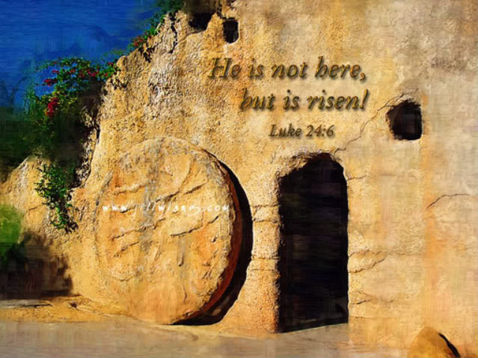
“Come & See”
Text: Jn. 1:43-51
Notes:
By Nathan L Morrison
All Scripture given is from NASB unless otherwise stated
For further study or if questions, Call: 804-277-1983, or Visit: www.courthousechurchofchrist.com

Slide 2
Intro
Jn. 1:43-46
43. The next day He purposed to go into Galilee, and He found Philip. And Jesus said to him, "Follow Me."
44. Now Philip was from Bethsaida, of the city of Andrew and Peter.
45. Philip found Nathanael and said to him, "We have found Him of whom Moses in the Law and also the Prophets wrote--Jesus of Nazareth, the son of Joseph."
46. Nathanael said to him, "Can any good thing come out of Nazareth?" Philip said to him, "Come and see."

Slide 3
Intro
Jn. 1:47-51
47. Jesus saw Nathanael coming to Him, and said of him, "Behold, an Israelite indeed, in whom there is no deceit!"
48. Nathanael said to Him, "How do You know me?" Jesus answered and said to him, "Before Philip called you, when you were under the fig tree, I saw you."
49. Nathanael answered Him, "Rabbi, You are the Son of God; You are the King of Israel."
50. Jesus answered and said to him, "Because I said to you that I saw you under the fig tree, do you believe? You will see greater things than these."
51. And He said to him, "Truly, truly, I say to you, you will see the heavens opened and the angels of God ascending and descending on the Son of Man."
Phillip said, “Come and see,” so let us invite others to “come and see” the “greater things” about Jesus!

Slide 4
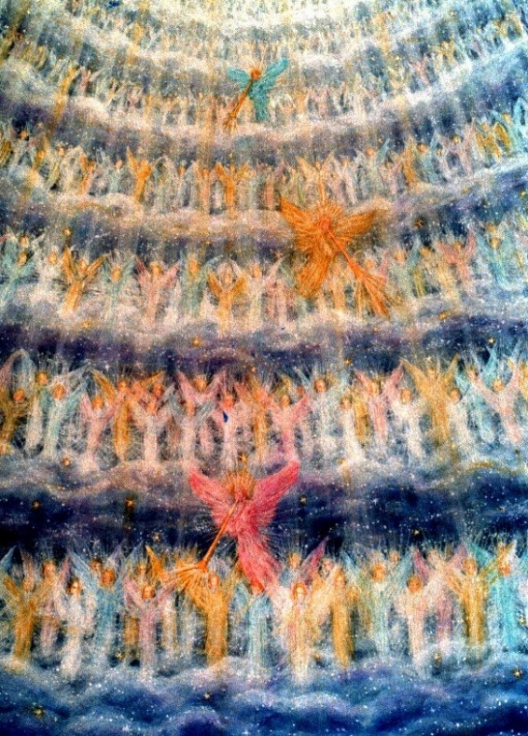
Come And See His Birth
Prophesied by Isaiah (Is. 7:14; 9:6-7).
Promised to Joseph (Mt. 1:21: “He will save His people from their sins”).
Born in Bethlehem of Judea – Micah 5:2; Lk. 2:3-7
The angel chorus sings His praises to the shepherds – Lk. 2:8-14 (2:15-16)
He is honored by the wise men from the East (Mt. 2:7-12, 16).
LK. 2:8-11
8. In the same region there were some shepherds staying out in the fields and keeping watch over their flock by night.
9. And an angel of the Lord suddenly stood before them, and the glory of the Lord shone around them; and they were terribly frightened.
10. But the angel said to them, "Do not be afraid; for behold, I bring you good news of great joy which will be for all the people;
11. for today in the city of David there has been born for you a Savior, who is Christ the Lord.
Notes:
Image: Angels rejoicing – Lk. 2:13-14

Slide 5
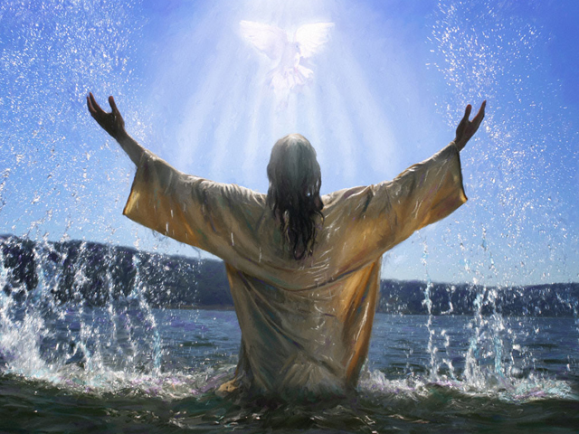
Come And See His Life
Born to poor parents – Lev. 12:8; Lk. 2:22-24: Offering of two turtledoves
His visit to Jerusalem at age 12 (Lk. 2:42-52).
He was obedient to his earthly parents (Lk. 2:51).
He worked as a carpenter (Mk. 6:3).
His baptism by John – Mt. 3:13-17
He had no place of His own (Mt. 8:20).
Mt. 3:16-17
16. After being baptized, Jesus came up immediately from the water; and behold, the heavens were opened, and he saw the Spirit of God descending as a dove and lighting on Him,
17. and behold, a voice out of the heavens said, "This is My beloved Son, in whom I am well-pleased."
Notes:
Image: Jesus coming up from being baptized and seeing the dove and hearing the voice of God – Mt. 3:16-17

Slide 6
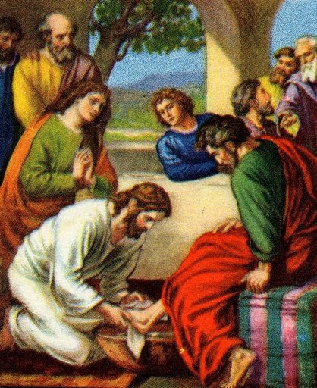
Come And See His Example
He went about doing His Father's business (Lk. 2:49).
Loyalty to the Father's will (Lk. 22:41-42).
Humility in life and death – Jn. 13:13-15 (Phil. 2:5-8)
He learned obedience (Heb. 5:8-9).
Honored His parents (Lk. 2:51; Jn. 19:26-27; Eph. 6:1-3: “Honor your father & mother”)
He left us an example to be followed – Jn. 13:13-17; I Pet. 2:21-25
John 13:14-16
14. "If I then, the Lord and the Teacher, washed your feet, you also ought to wash one another's feet.
15. "For I gave you an example that you also should do as I did to you.
16. "Truly, truly, I say to you, a slave is not greater than his master, nor is one who is sent greater than the one who sent him.
Notes:
Image courtesy of www.wordpress.com
Image: Jesus washing His disciples’ feet – Jn. 13:13-15

Slide 7
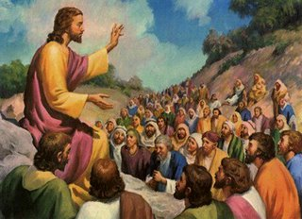
Come And See His Teaching
He used simple language; spoke parables about sheep, farming, the weather, and fishing; the common people understood Him – Mt. 7:28-29
His teaching came from God (Jn. 12:49-50).
He spoke of our duty to others (Mt. 7:12).
His teaching was superior to Law (Mt. 5:21-28).
He taught us to love our enemies (Mt. 5:43-48).
He taught us to love one another the way He loved us – Jn. 13:34-35
Mt. 7:28-29
28. When Jesus had finished these words, the crowds were amazed at His teaching;
29. for He was teaching them as one having authority, and not as their scribes.
Notes:
Image: Jesus teaching the crowds – Mt. 7:28-29

Slide 8
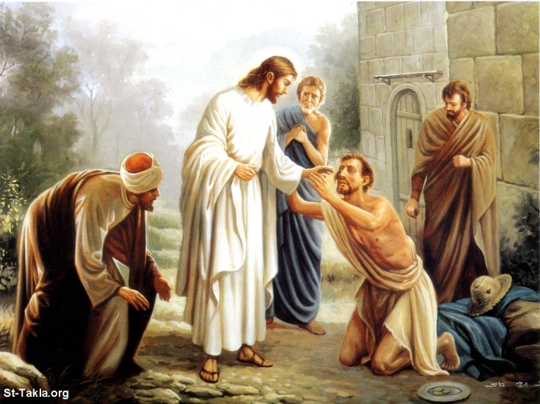
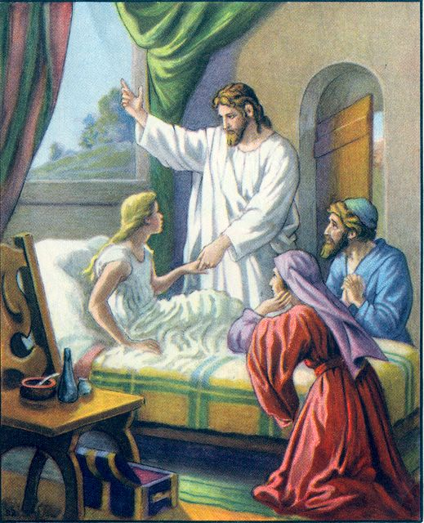
Come And See His Mission
He came to do His Father's will (Jn. 6:38).
Preached that the kingdom was near (Mt. 4:17).
He came to seek and save the lost (Lk. 19:10).
He came to give proofs (miracles) of His deity – Mt. 11:2-6 (Is. 35:4-6; 61)
He fulfilled the law – Mt. 5:17-18; Jn. 17:4
He "ever lives" to make intercession for us (Heb. 7:25).
Mt. 11:5-6
5. the BLIND RECEIVE SIGHT and the lame walk, the lepers are cleansed and the deaf hear, the dead are raised up, and the POOR HAVE THE GOSPEL PREACHED TO THEM.
6. "And blessed is he who does not take offense at Me."
Notes:
Image 1: Jesus healing the blind man – Jn. 9:1
Image 2: Jesus raising Jairus’ daughter from the dead – Lk. 8:53-56

Slide 9
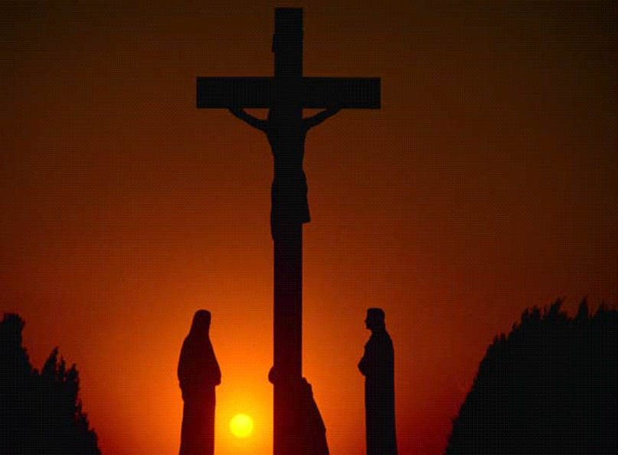
Come And See His Sacrifice
He laid down His own life (Jn. 15:13).
Gave His life as a ransom for many (Mt. 20:28).
He died for all men – Heb. 2:9
Redemption from the bondage of sin – Col. 1:13-14 (I Pet. 1:17-19; 3:18)
He purchased the church with His blood (Acts 20:28; Eph. 5:25).
Heb. 2:9
9. But we do see Him who was made for a little while lower than the angels, namely, Jesus, because of the suffering of death crowned with glory and honor, so that by the grace of God He might taste death for everyone.
Col. 1:13-14
13. For He rescued us from the domain of darkness, and transferred us to the kingdom of His beloved Son,
14. in whom we have redemption, the forgiveness of sins.
Notes:
Image 1: Jesus dying on the cross – Heb. 2:9
Image 2: The cross and crown – symbol of glory – Heb. 2:9; Col. 1:13-14

Slide 10
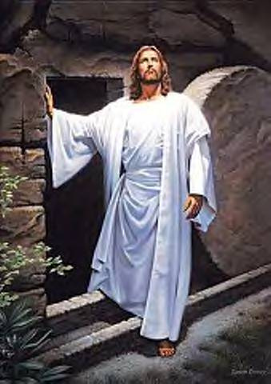
Come And See His Resurrection
His tomb was empty on the first day of the week! – Lk. 24:1-7
He appeared to the apostles (except Thomas) the same day in a locked room (Jn. 20:19-24).
Eight days later He appeared to all of them and told Thomas to touch Him to believe (Jn. 20:26-29).
He performed many miracles that people would believe in Him as the Son of God! (Jn. 20:30-31).
He appeared to many people, including Paul – I Cor. 15:4-8
Lk. 2:5-7
5. and as the women were terrified and bowed their faces to the ground, the men said to them, "Why do you seek the living One among the dead?
6. "He is not here, but He has risen. Remember how He spoke to you while He was still in Galilee,
7. saying that the Son of Man must be delivered into the hands of sinful men, and be crucified, and the third day rise again."
Notes:
Image: Jesus and the empty tomb – Lk. 24:1-7

Slide 11
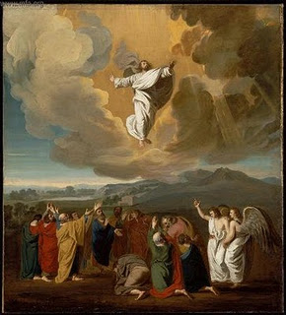
Come And See His Ascension
He ascended into the clouds – Acts 1:9-10
He promised to return in the same way (Acts 1:11; I Thess. 4:16-17)
He sits at the right hand of God, awaiting the time to return – Col. 3:1; Heb. 9:28
Acts 1:9-10
9. And after He had said these things, He was lifted up while they were looking on, and a cloud received Him out of their sight.
10. And as they were gazing intently into the sky while He was going, behold, two men in white clothing stood beside them.
Notes:
Image: Jesus and the empty tomb – Lk. 24:1-7

Slide 12
Conclusion
A brief but complete look at Christ while here on earth – The gospel is simplistic:
I Cor. 15:1-8: He lived, He died, and He rose from the dead.
Jesus told Nathanael that he would see “greater things”
Jn. 1:50-51: “You will see the heavens opened and the angels of God ascending and descending on the Son of Man.”
Nathanael believed from seeing far less than what most people saw!
Jn. 11:53, 57: The chief priests wanted to seize Jesus to kill Him!
Jn. 12:9-11: The chief priests wanted to not only kill Jesus but also Lazarus!
Jn. 12:42-43: Many of the rulers believed but not enough to confess Him! (Mt. 10:32-33)
Jn. 20:28: Thomas believed after he saw Christ raised from the dead!

Slide 13
Conclusion
Philip said to Nathanael, “Come and see”
Nathanael came, saw, believed, and confessed Him to
be the Son of God & King of Israel (Jn. 1:49)
What do you see when you see Jesus?
Do you see just a man, or do you see the Son of God?
Jesus left no doubt as to His identity and what He expects of man:
Mt. 10:32-33
32. "Therefore everyone who confesses Me before men, I will also confess him before My Father who is in heaven.
33. "But whoever denies Me before men, I will also deny him before My Father who is in heaven.

Slide 14
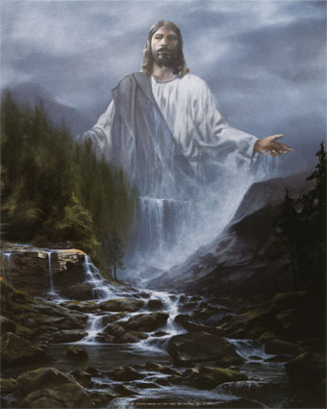
Conclusion
We have the complete picture, the full account of the “greater things” (Jn. 20:30-31)
What hinders you from obeying the gospel?
Are you like Nathanael, the rulers of Jesus’ day,
or like Thomas?
Have you believed Christ,
confessed Him, and obeyed Him
in baptism?

Slide 15
“What Must I Do To Be Saved?”
Hear The Gospel (Jn. 5:24; Rom. 10:17)
Believe In Christ (Jn. 3:16-18; Rom. 10:9)
Repent Of Sins (Lk. 13:35; Acts 2:38)
Confess Christ (Mt. 10:32; Rom. 10:10)
Be Baptized (Mk. 16:16; Acts 22:16)
Remain Faithful (Jn. 8:31; Rev. 2:10)
For The Erring Child of God:
Repent (Acts 8:22), Confess (I Jn. 1:9),
Pray (Acts 8:22)

