Slide 1
A Marriage That Shaped History: Elkanah & Hannah
Text: I Sam. 1-2
Notes:
By Nathan L Morrison
All Scripture given is from NASB unless otherwise stated
For further study, or if questions, please Call: 804-277-1983 or Visit www.courthousechurchofchrist.com
Based on a lesson by Steve Wallace

Slide 2
Intro

Slide 3
Intro
I Sam. 1:1-20: Introduction to Elkanah and his two wives,
Peninnah and Hannah
Many godly married couples in OT Israel…
Why did theirs help shape history?
To understand how their marriage shaped history it is
important that we understand the times of the judges in
which they lived!

Slide 4
Days of the Judges
“Every man did what was right in his own eyes” (Jud. 17:6; 21:25)
Othniel
Samuel
Continual lapses into idolatry (Jud. 2:11-13)
Mass killings of Israelites by Israelites (Jud. 9:5; 12:6; 20:1-48)
Sanctioning of gang rape and murder (Jud. 19:22-20:17)
Many worthless people in Israel (Jud. 19:22; I Sam. 10:27; II Sam. 22:5)
Godless priests (I Sam. 1:3; 2:12-17, 22)
When man does “what is right in his own eyes” the land is corrupted!
Notes:
Chart by Steve Wallace, adapted by Nathan L Morrison

Slide 5
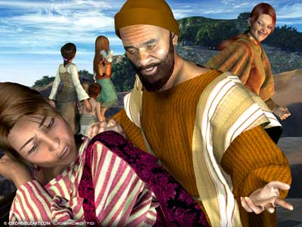
A Husband Devoted to the Lord, His Wife, & to the Good of His Family
Elkanah
Regularly worshiped – I Sam. 1:3, 21; 2:19
The sincerity of his worship – 1:3; 2:12-17
He regularly brought his family to “the house of the Lord” – 1:3, 7; Deut. 6:6-9
He faithfully performed his vows – 1:21

Slide 6
A Husband Devoted to the Lord, His Wife, & to the Good of His Family
Deut. 12:17
17. "You are not allowed to eat within your gates the tithe of your grain or new wine or oil, or the firstborn of your herd or flock, or any of your votive offerings which you vow, or your freewill offerings, or the contribution of your hand.
Ps. 22:25
25. From You comes my praise in the great assembly; I shall pay my vows before those who fear Him.
Eccl. 5:4
4. When you make a vow to God, do not be late in paying it; for He takes no delight in fools. Pay what you vow!

Slide 7
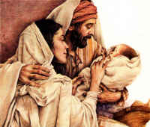
A Husband Devoted to the Lord, His Wife, & to the Good of His Family
Elkanah
Regularly worshiped – I Sam. 1:3, 21; 2:19
The sincerity of his worship – 1:3; 2:12-17
He regularly brought his family to “the house of the Lord” – 1:3,7; Deut. 6:6-9
He faithfully performed his vows – 1:21
What about his conduct in the confines of his own home?
He was a good husband – 1:8
He practiced his faith at home – 1:22, 23 (Deut. 6:6-9)
Elkanah was a simple man of faith and
was devoted to God and his family!

Slide 8
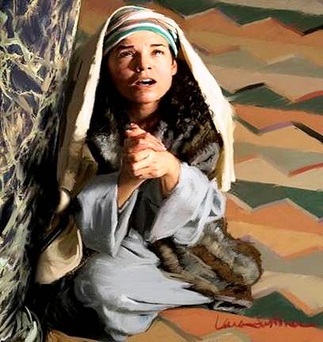
A Wife with Steadfast Faith in God
What about the wife of this godly man?
Hannah
She continued to trust in God through great hardship!
(I Sam. 1:4-7)

Slide 9
A Wife with Steadfast Faith in God
I Sam. 1:4-7
4. When the day came that Elkanah sacrificed, he would give portions to Peninnah his wife and to all her sons and her daughters;
5. but to Hannah he would give a double portion, for he loved Hannah, but the LORD had closed her womb.
6. Her rival, however, would provoke her bitterly to irritate her, because the LORD had closed her womb.
7. It happened year after year, as often as she went up to the house of the LORD, she would provoke her; so she wept and would not eat.

Slide 10
A Wife with Steadfast Faith in God
I Sam. 1:4-7
4. When the day came that Elkanah sacrificed, he would give portions to Peninnah his wife and to all her sons and her daughters;
5. but to Hannah he would give a double portion, for he loved Hannah, but the LORD had closed her womb.
6. Her rival, however, would provoke her bitterly to irritate her, because the LORD had closed her womb.
7. It happened year after year, as often as she went up to the house of the LORD, she would provoke her; so she wept and would not eat.

Slide 11
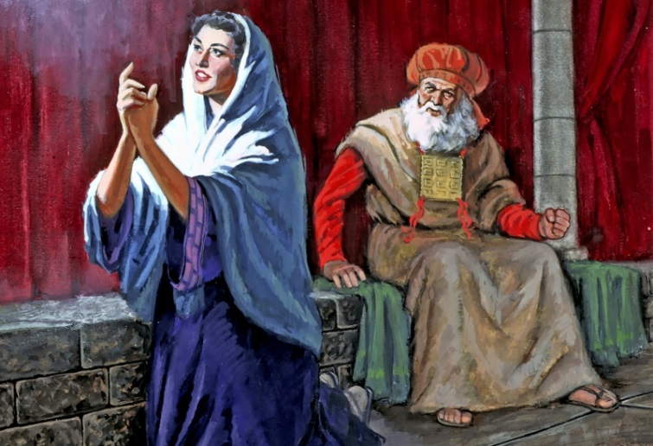
A Wife with Steadfast Faith in God
Hannah
She trusted in God through great hardship! (I Sam. 1:4-7)
She persevered in spite of the sins of her people (1:14; 2:12-17, 22, 23)
She held God in His proper place (1:7, 11)
She saw her proper place before God (1:11)
Her faith looked forward (1:11, 24-28)
Her faith also looked back (2:1-10)
Hannah was a wife with a steadfast faith in God!

Slide 12
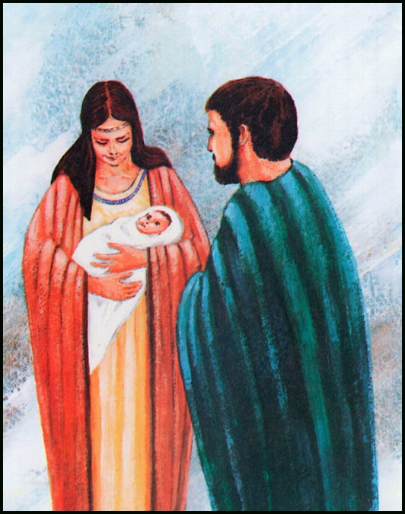
Days of Samuel
What part did Elkanah & Hannah play in the history of God’s people as Samuel’s parents?
Let us remember how things were when they arrived on the scene…

Slide 13
Days of the Judges
“Every man did what was right in his own eyes” (Jud. 17:6; 21:25)
Othniel
Samuel
Continual lapses into idolatry (Jud. 2:11-13)
Mass killings of Israelites by Israelites (Jud. 9:5; 12:6; 20:1-48)
Sanctioning of gang rape and murder (Jud. 19:22-20:17)
Many worthless people in Israel (Jud. 19:22; I Sam. 10:27; II Sam. 22:5)
Godless priests (I Sam. 1:3; 2:12-17, 22)
Notes:
Chart by Steve Wallace, adapted by Nathan L Morrison

Slide 14
Days of Samuel
Samuel: prophet (3:20), priest (2:18; 10:8), and judge (7:15-17)
Eli
David
He told Eli of God’s plan to “judge his house forever” (I Sam. 3:10-18)
He “was established to be a prophet of the LORD” (I Sam. 3:20)
He judged Israel (I Sam. 7:15-17)
He was God’s agent for instituting the monarchy (I Sam. 10:1; 14:47,48; 16:13)
Saul’s great victories – I Sam. 14:47,48
Anointed David – I Sam. 16:11-13
Jesus is the son of David! (Lk. 1:32; Rom. 1:3-4)
Notes:
Chart by Steve Wallace, adapted by Nathan L Morrison

Slide 15
Days of Samuel
Samuel: prophet (3:20), priest (2:18; 10:8), and judge (7:15-17)
Eli
David
Succession of prophets from Samuel till after captivity (I Sam. 19:20; Acts 3:24)
Type of Jesus: prophet (3:20), priest (2:18; 10:8), and judge (7:15-17)!
Jesus Christ is Prophet (Mt. 24:25, 36; Mk. 9:31), Priest (Heb. 6:20; 7:17, 23-24), and King (Mt. 25:31; I Tim. 6:15)!
Regarded as one of the greatest Jewish leaders (Jer. 15:1; Heb. 11:32; II Chr. 35:18)
Notes:
Chart by Steve Wallace, adapted by Nathan L Morrison

Slide 16
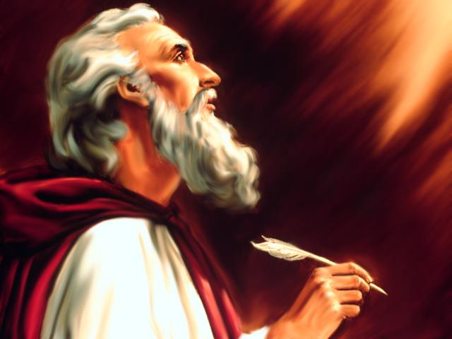
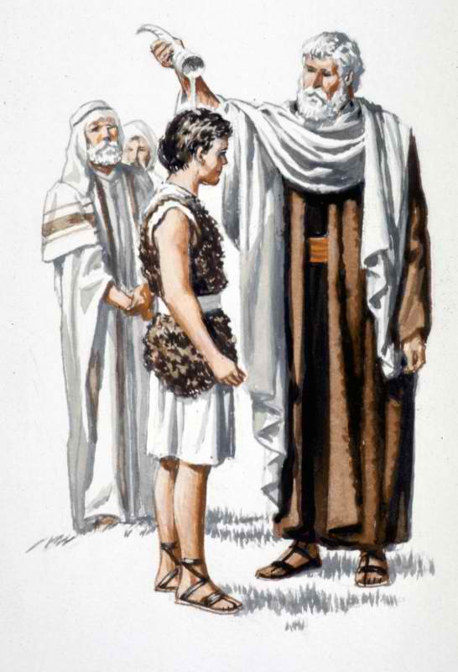
Days of Samuel
Acts 3:24
24. "And likewise, all the prophets who have spoken, from Samuel and his successors onward, also announced these days.
Through Samuel Israel began to reform; he ushered in the monarchy and foreshadowed the Savior God would send to save mankind from sin!

Slide 17
Conclusion
This all resulted from the faith of one man and one
woman – a married couple who lived in wicked,
discouraging times!
In spite of how wicked the world was their faith was in
the Lord of Hosts
Phil. 2:14-16: Saints are to “be above reproach,” “lights!”
The wicked sons of Eli would perish, but the little child
ministering before the Lord would go on to lead God’s
people in the ways of righteousness and influence Israel
for centuries to come! (II Chr. 35:18; Jer. 15:1)

Slide 18
Conclusion
On top of all this – I Sam. 2:21: Truly, God gave back to
Elkanah and Hannah much more than they had given or asked!
The God of Elkanah & Hannah lives today!
What kind of influence will you have in the world to help shape history?
Remember, it is not always what you do, but who you raise!

Slide 19
“What Must I Do To Be Saved?”
Hear The Gospel (Jn. 5:24; Rom. 10:17)
Believe In Christ (Jn. 3:16-18; Jn. 8:24)
Repent Of Sins (Lk. 13:35; Acts 2:38)
Confess Christ (Mt. 10:32; Rom. 10:10)
Be Baptized (Mk. 16:16; Acts 22:16)
Remain Faithful (Jn. 8:31; Rev. 2:10)
For The Erring Child of God:
Repent (Acts 8:22), Confess (I Jn. 1:9),
Pray (Acts 8:22)

