Slide 1
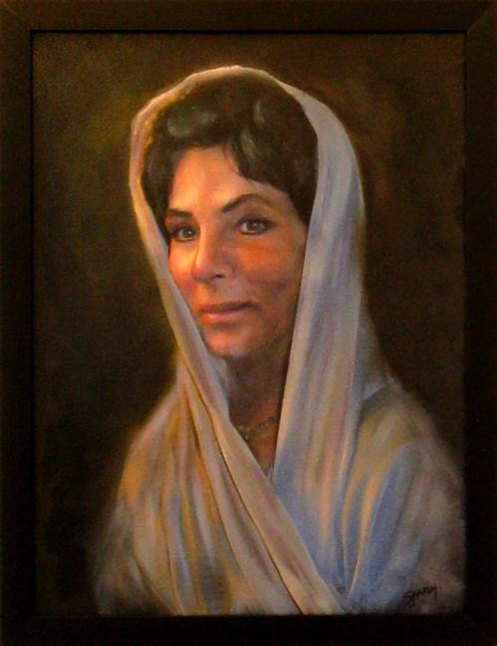
Sarah: God Changed Her Name
Godly Women Series Part 2
Text: Gen. 17:15-22
Gen. 17:16
"I will bless her, and indeed I will give you a son by her. Then I will bless her, and she shall be a mother of nations; kings of peoples will come from her."
Gen. 17:15
Then God said to Abraham, "As for Sarai your wife, you shall not call her name Sarai, but Sarah shall be her name.
Notes:
By Nathan L Morrison
All Scripture given is from NASB unless otherwise stated
For further study, or if questions, please Call: 804-277-1983 or Visit www.courthousechurchofchrist.com
Image: Artist’s rendering of a portrait of Sarah, courtesy of http://www.bing.com/images/search?q=Abraham+and+sarah+Of+Judaism&view=detail&id=F629EF0CAA478DA6C3FCC3D00D5EE280547EE00F&first=151&FORM=IDFRIR

Slide 2
Intro
There are examples both good and bad in the Scriptures
Men and women alike can provide us with sources of
strength and inspiration
Eve is an example of moving past sin and giving God the glory in our lives, as well as serving as a warning to avoid sin
Godly role models are greatly needed in our society!

Slide 3
Intro
Gen. 17:15-22
15. Then God said to Abraham, "As for Sarai your wife, you shall not call her name Sarai, but Sarah shall be her name.
16. "I will bless her, and indeed I will give you a son by her. Then I will bless her, and she shall be a mother of nations; kings of peoples will come from her."
17. Then Abraham fell on his face and laughed, and said in his heart, "Will a child be born to a man one hundred years old? And will Sarah, who is ninety years old, bear a child?"
18. And Abraham said to God, "Oh that Ishmael might live before You!"
19. But God said, "No, but Sarah your wife will bear you a son, and you shall call his name Isaac; and I will establish My covenant with him for an everlasting covenant for his descendants after him.
20. "As for Ishmael, I have heard you; behold, I will bless him, and will make him fruitful and will multiply him exceedingly. He shall become the father of twelve princes, and I will make him a great nation.
21. "But My covenant I will establish with Isaac, whom Sarah will bear to you at this season next year."
22. When He finished talking with him, God went up from Abraham.

Slide 4
Intro
Gen. 17:5: God changed Abram’s name to Abraham
Abram: Heb. 'abrâm (H87) = “High father; or, Exalted father”
Abraham: Heb. 'abrâhâm (H85) = “Father of many nations, or multitudes”
Gen. 17:15-16: God changed Sarai’s name to Sarah
Sarai: Heb. śâray (H8297) = From: 8269; 8323; “Princess” or female leader, often used for nobles. Also has connotation of “self-made” or “to act” as leader.
Sarah: Heb. śârâh (H8283) = From: 8282; “Princess;” Female noble: “Lady,” “Princess,” “Queen.”
Sarah is known as a great and godly woman, a “mother of
nations,” truly a “Princess!”
God changed her name, showing His regard for her, and
has revealed through the Scriptures He wants her held up
as a godly role model!

Slide 5
Conflict of Good and Evil
Sarah was a good, godly woman – however, she did have
her weaknesses (as do we all)!
She cooperated with her husband in lying about their
Relationship:
She was Abraham’s half-sister, but more importantly, she was his wife! (Gen. 20:12)
In Egypt they told Pharoah she was his sister (Gen. 12:10-20).
In Gerar the lie was repeated to King Abimelech (Gen. 20:1-18).
She sought to “help” God keep His promise (Gen. 16:1-7:
She gave Hagar to Abram to have the promised son)

Slide 6
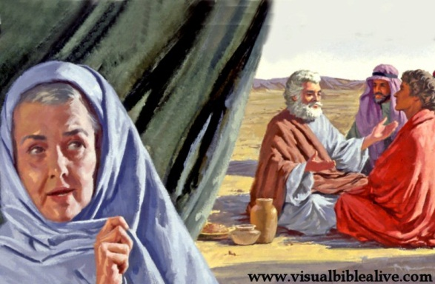
Conflict of Good and Evil
Out of jealousy she sent Hagar and her son Ishmael away
(Gen. 16:6; 21:9-21: Although God told Abraham to listen
to her wishes)
She lied to the Lord about laughing that she would bear a
son (Gen. 18:9-15: It seemed impossible!)
Despite her weaknesses, the good
in her life outweighed the negative
for she is highly regarded in the N.T.
as an example of faith and a role
model for wives! (I Pet. 3:3-6)
We all have a conflict between good and evil within
ourselves (Rom. 7:21-23), and Sarah is an example of one
who overcame the weaknesses to the glory of God!
Notes:
Image: Sarah overhears and laughs, courtesy of www.visualbiblealive.com

Slide 7
Lasting Beauty
Sarah was a physically beautiful woman, one that age
seemed not to diminish:
Gen. 12:11-15: About 65 in Egypt – Egyptians taken in by her beauty
Gen. 12:14-15
14. It came about when Abram came into Egypt, the Egyptians saw that the woman was very beautiful.
15. Pharaoh's officials saw her and praised her to Pharaoh; and the woman was taken into Pharaoh's house.
Gen. 20:2: 90 years old in Gerar – Abimelech the king of Gerar took her into his house.
Gen. 20:1-2
1. Now Abraham journeyed from there toward the land of the Negev, and settled between Kadesh and Shur; then he sojourned in Gerar.
2. Abraham said of Sarah his wife, "She is my sister." So Abimelech king of Gerar sent and took Sarah.

Slide 8
Lasting Beauty
Problems with just physical beauty:
“Beauty is in the eye of the beholder” and the criteria has changed throughout the years: features, figure, hair color, etc. (Not going to appeal to everyone)
We can misjudge a person solely based upon looks – I Sam. 16:7: God looks at the heart.
Added responsibility to be appealing inside and out! – Prov. 11:22
Physical beauty diminishes with age – Prov. 31:30: “Beauty is passing” (NKJV); “fleeting” (NIV).
Death destroys – Gen. 23:1-4: Death separates and destroys the beautiful (Abraham wanted to bury his dead out of his sight).

Slide 9
Lasting Beauty
God’s description of a beautiful woman is what’s inside –
Prov. 31:30: It takes a godly woman to be truly beautiful,
and praised by the Lord!
Prov. 31:30
30. Charm is deceitful and beauty is vain, But a woman who fears the LORD, she shall be praised.
God changed Sarai’s name to Sarah!
Sarah’s inner beauty of character outlasts her physical
beauty in that she is a godly role model and an example of
faithfulness still today!

Slide 10
Example of Faithfulness
I Pet. 3:3-6
3. Your adornment must not be merely external--braiding the hair, and wearing gold jewelry, or putting on dresses;
4. but let it be the hidden person of the heart, with the imperishable quality of a gentle and quiet spirit, which is precious in the sight of God.
5. For in this way in former times the holy women also, who hoped in God, used to adorn themselves, being submissive to their own husbands;
6. just as Sarah obeyed Abraham, calling him lord, and you have become her children if you do what is right without being frightened by any fear.
She had the proper relationship to her husband!
She is a role model for ladies today! Mother to godly wives (I Peter 3:6)!
She is given as an example of one who was not merely attractive on the outside but one who possessed beauty of character which was “very precious in the sight of God” (3:4).
Hers is an “adornment” every woman (especially wives) may practice
(I Pet. 3:5-6) – submission to her husband as “lord” (G2962 kurios!)
This inner quality of beauty is given as characteristic of God’s ideal woman (Prov. 31:30)

Slide 11
Example of Faithfulness
Heb. 11:11-12
11. By faith even Sarah herself received ability to conceive, even beyond the proper time of life, since she considered Him faithful who had promised.
12. Therefore there was born even of one man, and him as good as dead at that, as many descendants AS THE STARS OF HEAVEN IN NUMBER, AND INNUMERABLE AS THE SAND WHICH IS BY THE SEASHORE.
She is an example of faith!
One of two women listed in the “Hall of Faith” (other is Rahab – 11:31).
She was past the age of child-bearing (Rom. 4:19: “deadness of her womb”), and though she laughed (Gen. 18:12), she had faith it would be done!
To Abram and Sarai God promised the impossible and they had strength of faith (that overcame their weaknesses) to believe and trust in God’s promises (Rom. 4:19-22).

Slide 12
Example of Faithfulness
Gen. 17:16
16. "I will bless her, and indeed I will give you a son by her. Then I will bless her, and she shall be a mother of nations; kings of peoples will come from her."
By her faith, she indeed became a “mother of nations!”
The mother of fleshly Israel – Gen. 21:1-3; Rom. 9:8-9
The mother of spiritual Israel – Gal. 4:22-31 (4:26, 31: Sarah is the “mother” of all saints!)
Through her seed came the Messiah, in Whom it was fulfilled that all the nations of the earth would be blessed! (Gen. 12:3)
Eve = Mother of all living (Gen. 3:20); Sarah = Mother of nations, mother of all saints, and godly wives!
God changed her name (Sarah= “Queen”), so it is fitting
she would be the “mother of nations,” and a godly
example of faithfulness!

Slide 13
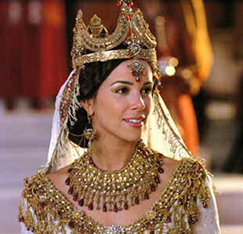
Conclusion
Biblical names are significant, and have meaning:
They are sometimes prophetic (Is. 7:14; Mt. 1:23: Immanuel = “God with us”)
They are often indicative of character (Gen. 25:26: Jacob = “Heel catcher,” “Usurper”).
Sarai means: “Princess” but in the sense of one who is “self-made” or “acting” as a ruler.
Sarah means: “Princess” or “Queen.” She became the “mother of nations” and of saints!

Slide 14
Conclusion
Women have always influenced men, for good (Ruth,
Esther) and bad (Eve, Jezebel)
Godly women have influenced godly and ungodly men
alike!
Ruth on the people of Bethel and on Boaz.
Abigail on her servants and on David.
Esther on her Gentile husband the King of Persia (Xerxes I – 486-465 BC).
I Pet. 3:1-2
1. In the same way, you wives, be submissive to your own husbands so that even if any of them are disobedient to the word, they may be won without a word by the behavior of their wives,
2. as they observe your chaste and respectful behavior.

Slide 15
Conclusion
Sarah stands as an example of godliness, and one who
overcame her weaknesses so that they did not define her,
but instead, she is remembered for her faith and virtue!
Do you live your life governed by your weaknesses?
(Will you be remembered for your faults?)
Do you live your life learning from your mistakes, and
strengthening your faith?
(Will you be remembered for your faith and
godly character?)
Be a godly role model!

Slide 16
“What Must I Do To Be Saved?”
Hear The Gospel (Jn. 5:24; Rom. 10:17)
Believe In Christ (Jn. 3:16-18; Jn. 8:24)
Repent Of Sins (Lk. 13:35; Acts 2:38)
Confess Christ (Mt. 10:32; Rom. 10:10)
Be Baptized (Mk. 16:16; Acts 22:16)
Remain Faithful (Jn. 8:31; Rev. 2:10)
For The Erring Child of God:
Repent (Acts 8:22), Confess (I Jn. 1:9),
Pray (Acts 8:22)

