Slide 1
The Holy Spirit Of The Past, Present, & Future
Text: James 1:18-25
Notes:
By Nathan L Morrison for Sunday January 6th, 2019
All Scripture given is from the NASB, unless otherwise stated
For further study, or if questions, please Call: 804-277-1983 or Visit www.courthousechurchofchrist.com

Slide 2
Intro
A Christmas Carol by Charles Dickens (1843)
Miserly man is visited by three spirits…
Ghost of Christmas Past: caused regret
Ghost of Christmas Present: caused guilt
Ghost of Christmas Future: caused fear
Miserly man changes ways so completely he is barely recognized by friends & family!
Dickens’ story not even 200 years old and has been told
and retold in books and movies, taught & analyzed, and
every retelling gets the moral of the story:
Our past cannot be changed, but the lessons of the past can be learned to shape our present, and our present paves the road to our future.
It is a story of redemption, but a fictional story – one that even scholars and atheists get the message!

Slide 3
Intro
The word of God, inspired by the Holy Spirit, is thousands of years old, and the message of redemption in the gospel of Jesus is 2,000 years old and yet so many people miss its point!
It shows us not just our past but the past of others; their mistakes and strengths
It shows us how we are to learn from the past to live in our present
It shows us the two possible futures that await based on how we live our present
As we look to the New Year let us
recognize the Holy Spirit reveals our
past, & is our guide to the present &
future!
Notes:
Image 1: Cave at Adullum
Image 2: Cave at En Gedi

Slide 4
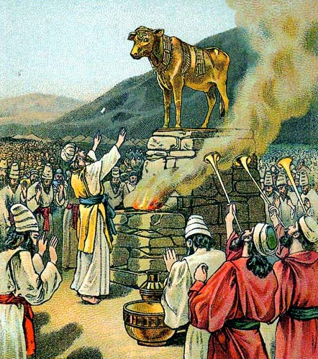
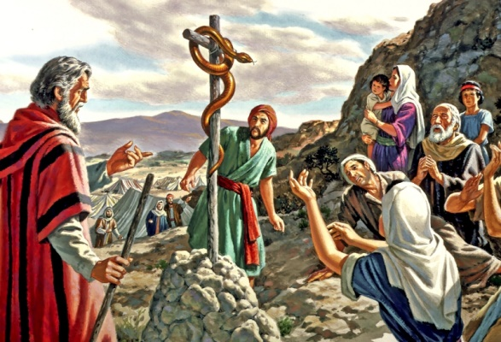
Past
God has revealed the past of others for our benefit & example!
Gal. 3:24-26: The Law (of Moses) is a tutor to bring men to Christ.
Rom. 15:4-6: “Whatever was written in earlier times was written for our instruction.”
I Cor. 10:5-12: Christians are to learn from Israel’s past: not to repeat her mistakes!

Slide 5
Past
I Cor. 6:9-11
9. Or do you not know that the unrighteous will not inherit the kingdom of God? Do not be deceived; neither fornicators, nor idolaters, nor adulterers, nor effeminate, nor homosexuals,
10. nor thieves, nor the covetous, nor drunkards, nor revilers, nor swindlers, will inherit the kingdom of God.
11. Such were some of you; but you were washed, but you were sanctified, but you were justified in the name of the Lord Jesus Christ and in the Spirit of our God.
God reveals our past…
I Cor. 6:9-11:
Past life: Walked in all manner of sin.
Present: Washed, sanctified, and justified in Christ.
Future: Former sins would disqualify one’s entrance to heaven

Slide 6
Past
God reveals our past…
Eph. 2:11-13: Ephesians - their former way of life (2:3: “children of wrath”) excluded them from God but Christ’s blood brought them near to Him.
II Pet. 2:20-22: The message to all saints is:
Learn from the sins of the past and do not desire them.
If one turns back to former way of life, they are worse off than the first because they know better, and know what they have given up.
Rom. 6:6: Our “old self” ought to remain dead (crucified)!
The past will shape our present;
we need to learn the right lessons
from the past!

Slide 7
Present
God revealed the present we are to live in based on lessons of the past!
Rom. 6:1-2: Those who have obeyed the gospel must not continue in sin.
Eph. 4:17-24: We are to put away old self (past sins) and put on new self (obedient child of God).

Slide 8
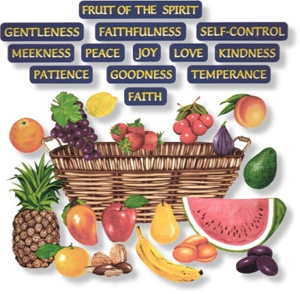
Present
Gal. 5:22-25
22. But the fruit of the Spirit is love, joy, peace, patience, kindness, goodness, faithfulness,
23. gentleness, self-control; against such things there is no law.
24. Now those who belong to Christ Jesus have crucified the flesh with its passions and desires.
25. If we live by the Spirit, let us also walk by the Spirit.
God reveals the present way of life for His children to be pleasing to Him…
Gal. 5:22-25:
Past: “Deeds of the flesh” – Gal. 5:19-21
Present: Walk in the present according to the
“Fruit of the Spirit!”
To “walk in the Spirit” requires us to crucify our
“flesh with its passions & desires!”

Slide 9
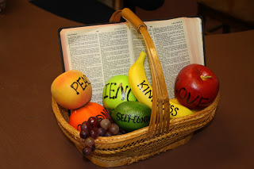
Present
God reveals our present…
Rom. 6:6 (Eph. 4:22; Col. 3:9): Our “old self” is to be crucified, “laid aside” (Gal. 5:22-25).
Eph. 5:1-4, 7-10: We are to imitate God – and expose the deeds of darkness (5:11-12) – Walk in the light, not in the darkness (past life)!
Titus 2:11-14: We are to “live sensibly, righteously and godly in the present age” looking ahead to the future when Christ comes again!
II Pet. 3:10-12: Knowing the future, our present should reflect our knowledge: holy conduct & godliness.
Our present paves the road for
the future so we must make sure
we take the right road!

Slide 10
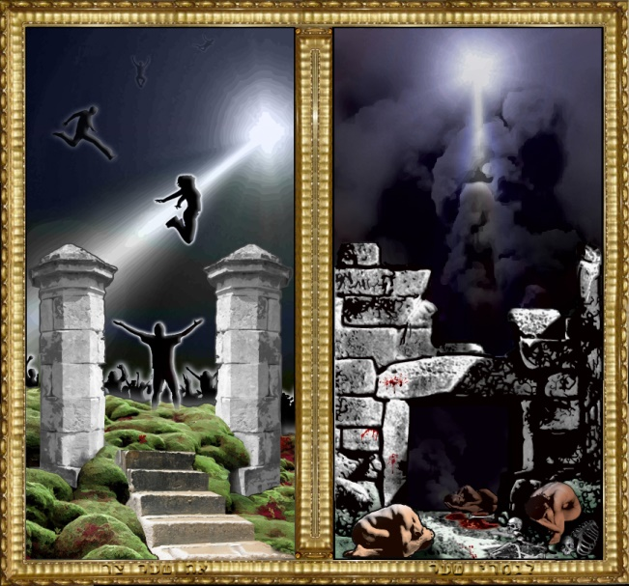
Future
Mt. 7:13-14
13. "Enter through the narrow gate; for the gate is wide and the way is broad that leads to destruction, and there are many who enter through it.
14. "For the gate is small and the way is narrow that leads to life, and there are few who find it.
Broad Road: leads to Hell (Mt. 7:13-14)
Eph. 5:3-6: The immoral have no inheritance with Christ (wrath of God)!
II Thess. 1:7-9: Eternal separation from God!
Rev. 20:11-15: 2nd Death! (lake of burning fire – Rev. 21:8)
Mt. 25:41, 46: “Eternal fire,” “Eternal punishment”
Mk. 9:43-48: “Where their worm does not die,
and the fire is not quenched”
Notes:
Emphasis in Scripture Mine!

Slide 11
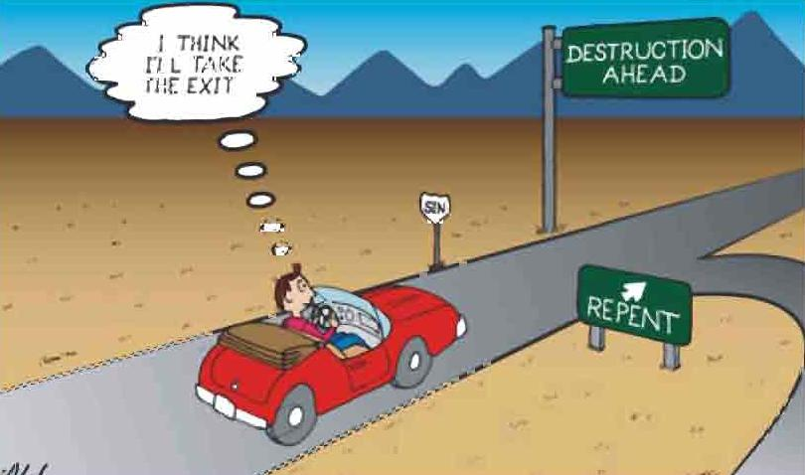
Future
Mt. 7:13-14
13. "Enter through the narrow gate; for the gate is wide and the way is broad that leads to destruction, and there are many who enter through it.
14. "For the gate is small and the way is narrow that leads to life, and there are few who find it.
Narrow road: leads to Heaven (Mt. 7:13-14)
I Pet. 1:1-5: Inheritance reserved in Heaven
Rom. 8:16-17: Fellow heirs with Christ (In Heaven – Col. 3:1-3)
Rev. 2:10; 3:21: Overcoming our present (trials & tribulations) will ensure our future with Christ in His glory (James 1:2-4, 12)
Rev. 21:3-7: “He who overcomes” will inherit the home of God.
Eph. 5:3-6: No immoral person has
inheritance with Christ!
Mt. 25:34, 46: To the righteous on His
right Jesus will invite into His home!
Notes:
Emphasis in Scripture Mine!

Slide 12
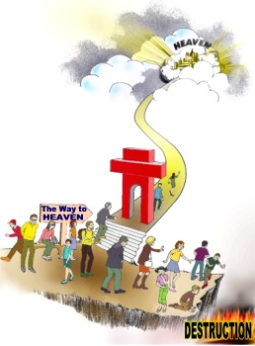
Future
Two futures await…
Eternal Punishment
& Eternal Life!
(Mt. 25:46)

Slide 13
Conclusion
James 1:18-25
18. In the exercise of His will He brought us forth by the word of truth, so that we would be a kind of first fruits among His creatures.
19. This you know, my beloved brethren. But everyone must be quick to hear, slow to speak and slow to anger;
20. for the anger of man does not achieve the righteousness of God.
21. Therefore, putting aside all filthiness and all that remains of wickedness, in humility receive the word implanted, which is able to save your souls.
22. But prove yourselves doers of the word, and not merely hearers who delude themselves.
23. For if anyone is a hearer of the word and not a doer, he is like a man who looks at his natural face in a mirror;
24. for once he has looked at himself and gone away, he has immediately forgotten what kind of person he was.
25. But one who looks intently at the perfect law, the law of liberty, and abides by it, not having become a forgetful hearer but an effectual doer, this man will be blessed in what he does.

Slide 14
Conclusion
Js. 1:18-25: The Scriptures are a mirror that provide a look at our past, present and future…
Past life: Vs. 21: filthiness, wickedness
Present: Vs. 21: humbly receive the word of God
Future: Vs. 21, 25: the word will save our souls, being a doer of the word blesses one in what he does!
When confronted with the future, one can change life completely to conform to God’s pattern!
Learn from the past to live
righteously in the present to enjoy
an eternal future with the Lord!

Slide 15
“What Must I Do To Be Saved?”
Hear The Gospel (Jn. 5:24; Rom. 10:17)
Believe In Christ (Jn. 3:16-18; Jn. 8:24)
Repent Of Sins (Lk. 13:35; Acts 2:38)
Confess Christ (Mt. 10:32; Rom. 10:10)
Be Baptized (Mk. 16:16; Acts 22:16)
Remain Faithful (Jn. 8:31; Rev. 2:10)
For The Erring Child:
Repent (Acts 8:22), Confess (I Jn. 1:9),
Pray (Acts 8:22)

