Slide 1
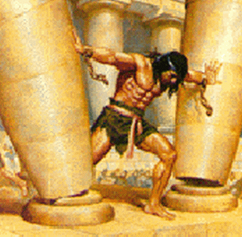
Sin Will Always…
Text: Judges 16:4-30; Rom. 6:11-13
Notes:
Prepared by Nathan L Morrison
All Scripture given is from NASB unless otherwise stated!
For further study, or if questions, please Call: 804-277-1983 or Visit www.courthousechurchofcrist.com
Based on a lesson by Richard Thetford

Slide 2
Intro
Sin never delivers what it offers!
Heb. 11:24-25
24. By faith Moses, when he had grown up, refused to be called the son of Pharaoh's daughter,
25. choosing rather to endure ill-treatment with the people of God than to enjoy the passing pleasures of sin,
Sin is deceptive and despite what we think we may
get out of it, “passing pleasures” is what we will
receive!
Mt. 6:2, 5, 16: Jesus said of hypocrites, “they have their reward in full.”
Mt. 6:3-4, 6, 17-18: Contrast reward from sin and reward by God!

Slide 3
Intro
Rom. 6:11-13
11. Even so consider yourselves to be dead to sin, but alive to God in Christ Jesus.
12. Therefore do not let sin reign in your mortal body so that you obey its lusts,
13. and do not go on presenting the members of your body to sin as instruments of unrighteousness; but present yourselves to God as those alive from the dead, and your members as instruments of righteousness to God.
Samson’s life (Judges 16) serves as warning not to “let sin reign” in our lives! (Mighty Man of Weakness!)

Slide 4
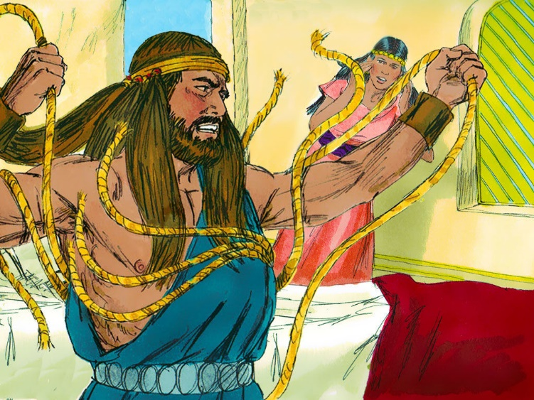
Sin Takes Us Farther Than We Want to Go
Jud. 16:4-14
Samson played a game that wasn’t a game with Delilah and the Philistines.
He knew she was full of deceit yet continued to allow her to entice him.
Jud. 16:5: She was willing to betray him for great reward! (5500 pieces of silver)
Three times he played her game and three times she bound him, but found she was tricked.
He was playing with fire and was lying to her!

Slide 5
Sin Takes Us Farther Than We Want to Go
Jud. 16:15-20 (vss. 15-17)
15. Then she said to him, "How can you say, 'I love you,' when your heart is not with me? You have deceived me these three times and have not told me where your great strength is."
16. It came about when she pressed him daily with her words and urged him, that his soul was annoyed to death.
17. So he told her all that was in his heart and said to her, "A razor has never come on my head, for I have been a Nazirite to God from my mother's womb. If I am shaved, then my strength will leave me and I will become weak and be like any other man."

Slide 6
Sin Takes Us Farther Than We Want to Go
Jud. 16:15-20 (vss. 18-20)
18. When Delilah saw that he had told her all that was in his heart, she sent and called the lords of the Philistines, saying, "Come up once more, for he has told me all that is in his heart." Then the lords of the Philistines came up to her and brought the money in their hands.
19. She made him sleep on her knees, and called for a man and had him shave off the seven locks of his hair. Then she began to afflict him, and his strength left him.
20. She said, "The Philistines are upon you, Samson!" And he awoke from his sleep and said, "I will go out as at other times and shake myself free." But he did not know that the LORD had departed from him.

Slide 7
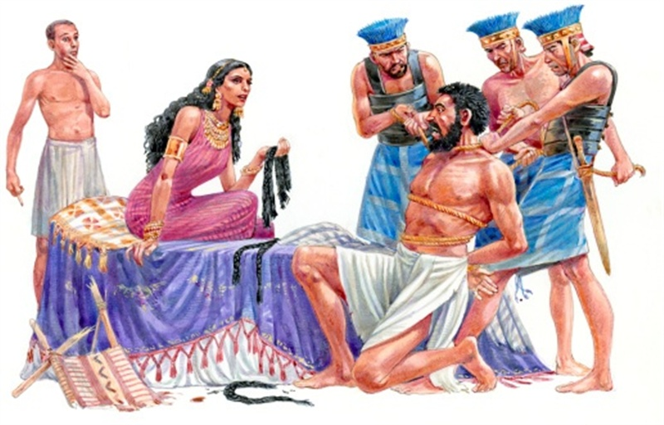
Sin Takes Us Farther Than We Want to Go
Sin, if not checked, will always progress further into
evil!
II Tim. 2:16-18: False (evil) doctrines will spread like cancer (NKJV).
II Tim. 3:13: Evil men will “proceed from bad to worse.”
Samson’s sin took him farther than he wanted to go!

Slide 8
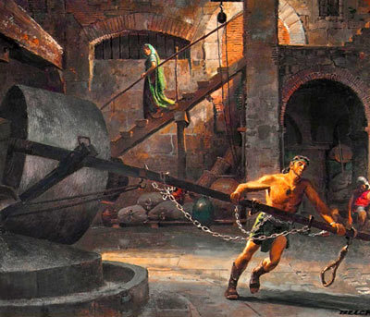
Sin Keeps Us Longer Than We Want to Stay
Jud. 16:20-21
20. She said, "The Philistines are upon you, Samson!" And he awoke from his sleep and said, "I will go out as at other times and shake myself free." But he did not know that the LORD had departed from him.
21. Then the Philistines seized him and gouged out his eyes; and they brought him down to Gaza and bound him with bronze chains, and he was a grinder in the prison.
He played with fire and got burned!
Notes:
Emphasis in Scripture mine!

Slide 9
Sin Keeps Us Longer Than We Want to Stay
Once in sin, sometimes hard to get out!
Prov. 23:29-35: One drink leads to another and another.
Prov. 7: The enticements of adultery and harlotry have ruined marriages and have brought men to destruction! “As an ox goes to the slaughter” (7:22).
II Pet. 2:19: Sin makes one a “slave of corruption” as does addicting habits: drugs, and alcohol – never good to lose control (Gal. 5:23; II Pet. 1:6)

Slide 10
Sin Keeps Us Longer Than We Want to Stay
Don’t let sin control you!
Rom. 6:11-13 (Rom. 7:22-23)
11. Even so consider yourselves to be dead to sin, but alive to God in Christ Jesus.
12. Therefore do not let sin reign in your mortal body so that you obey its lusts,
13. and do not go on presenting the members of your body to sin as instruments of unrighteousness; but present yourselves to God as those alive from the dead, and your members as instruments of righteousness to God.
Eph. 4:22
22. that, in reference to your former manner of life, you lay aside the old self, which is being corrupted in accordance with the lusts of deceit,

Slide 11
Sin Keeps Us Longer Than We Want to Stay
Knowing God’s word will help us to control sin!
Eph. 4:23-24: The “new self” is “created in righteousness.”
Jn. 8:31-32: Jesus said, “If you abide in My word” then the truth sets you free! (Self-Control is key to avoiding sin – Gal. 5:22-23)
Samson’s sin kept him longer than he had intended
(“he was a grinder in the prison”)!

Slide 12
Sin Costs Us More Than We Want to Pay
Jud. 16:22-27
22. However, the hair of his head began to grow again after it was shaved off.
23. Now the lords of the Philistines assembled to offer a great sacrifice to Dagon their god, and to rejoice, for they said, "Our god has given Samson our enemy into our hands."
24. When the people saw him, they praised their god, for they said, "Our god has given our enemy into our hands, Even the destroyer of our country, Who has slain many of us."
25. It so happened when they were in high spirits, that they said, "Call for Samson, that he may amuse us." So they called for Samson from the prison, and he entertained them. And they made him stand between the pillars.
26. Then Samson said to the boy who was holding his hand, "Let me feel the pillars on which the house rests, that I may lean against them."
27. Now the house was full of men and women, and all the lords of the Philistines were there. And about 3,000 men and women were on the roof looking on while Samson was amusing them.
Notes:
Emphasis in Scripture mine!

Slide 13
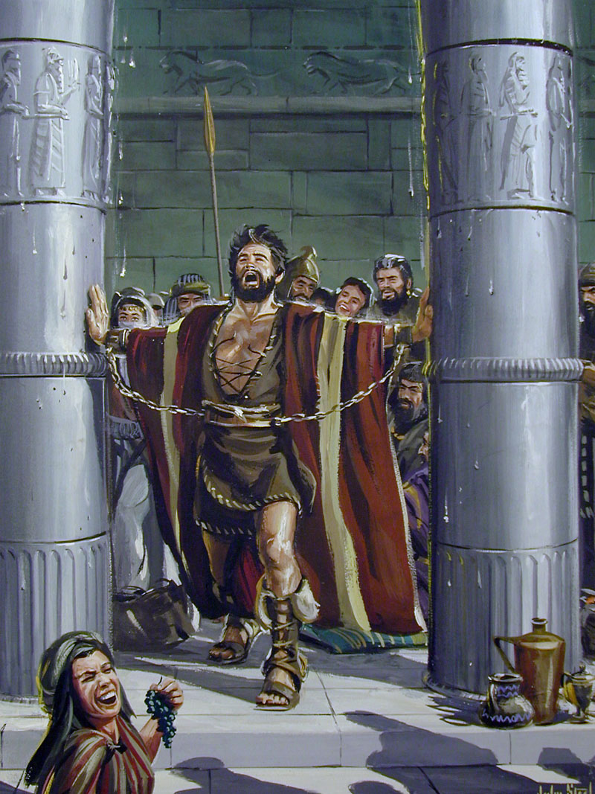
Sin Costs Us More Than We Want to Pay
Jud. 16:30
30. And Samson said, "Let me die with the Philistines!" And he bent with all his might so that the house fell on the lords and all the people who were in it. So the dead whom he killed at his death were more than those whom he killed in his life.
Samson’s carelessness with
God’s blessing cost him his
freedom, his strength, his
sight, his dignity, and his life!
Notes:
Emphasis in Scripture mine!

Slide 14
Sin Costs Us More Than We Want to Pay
Choosing sin will cost us:
Our soul – Rom. 6:23 (Mt. 16:26; Lk. 12:20-21)
God’s fellowship – II Jn. 9
Separation from God – Is. 59:1-2 (Eph. 2:12; II Thess. 1:9; I Pet. 3:12)
Our dignity and honor – Eph. 5:11-12
Heaven – Rev. 21:7-8; 22:14-15
Sin isn’t a game to be played…
it has serious consequences!
Samson’s sin cost him everything, even his life!

Slide 15
Conclusion
Samson was playing a game with Delilah
(enjoying sin) – A Mighty Man of Weakness!
Many today do the same!
He went farther than he wanted to and it cost him
his strength and fellowship with God
Letting sin reign in their lives has led many into sexual immorality, drinking, addictions, lying, & theft
We need to see sin for what it is:
deceptive, passing! (Heb. 11:24-25)
Sin will always…
Take us farther than we wanted to go
Keep us longer than we wanted to stay
Cost us more than we wanted to pay

Slide 16
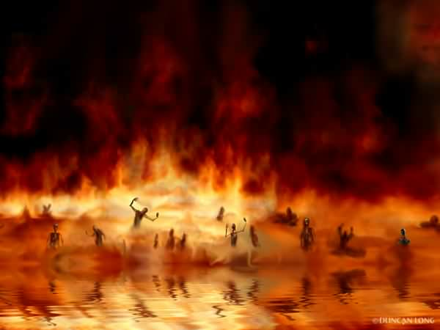
Conclusion
Mt. 16:26: Nothing in life is worth losing your soul!
Lk. 14:26-33: Other things in our lives can come between us and Christ – He must be 1st!
Lk. 9:23: We must take up our cross daily!

Slide 17
Conclusion
The Lesson: We can repent as long as we still draw
breath, no matter how bad things get!
Jud. 16:28-30 (I Pet. 3:12)
28. Then Samson called to the LORD and said, "O Lord GOD, please remember me and please strengthen me just this time, O God, that I may at once be avenged of the Philistines for my two eyes."
29. Samson grasped the two middle pillars on which the house rested, and braced himself against them, the one with his right hand and the other with his left.
30. And Samson said, "Let me die with the Philistines!" And he bent with all his might so that the house fell on the lords and all the people who were in it. So the dead whom he killed at his death were more than those whom he killed in his life.

Slide 18
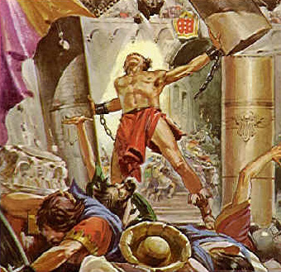
Conclusion
Don’t “let sin reign in your mortal body so that you obey its lusts!” (Rom. 6:12)

Slide 19
“What Must I Do To Be Saved?”
Hear The Gospel (Jn. 5:24; Rom. 10:17)
Believe In Christ (Jn. 3:16-18; Jn. 8:24)
Repent Of Sins (Lk. 13:35; Acts 2:38)
Confess Christ (Mt. 10:32; Rom. 10:10)
Be Baptized (Mk. 16:16; Acts 22:16)
Remain Faithful (Jn. 8:31; Rev. 2:10)
For The Erring Saint:
Repent (Acts 8:22), Confess (I Jn. 1:9),
Pray (Acts 8:22)

