Slide 1
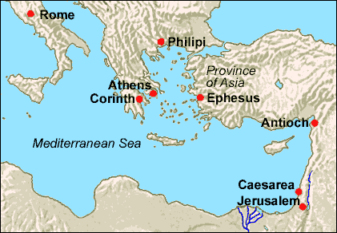
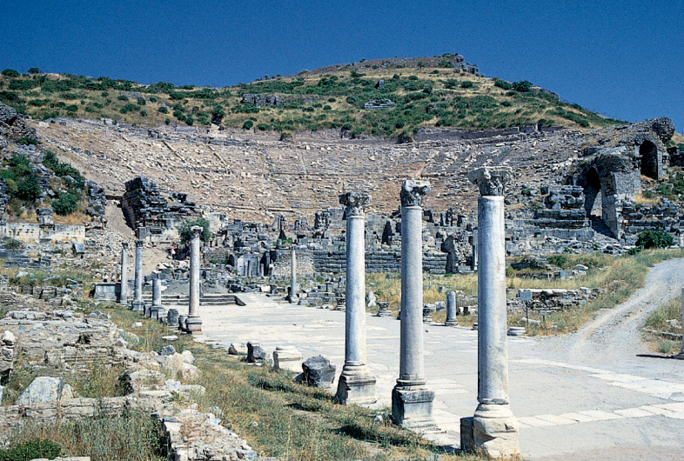
Ephesus: Before & After Conversion Text: Eph. 2:1-18
Notes:
Prepared By Nathan L Morrison
All Scripture given is from NASB unless otherwise stated
For further study, or if questions, please Call: 804-277-1983 or Visit: www.courthousechurchofcrist.com
Images:
Map of Ephesus
Garden Walkway in Ephesus

Slide 2
Intro
The Ephesian saints stand as examples of obedience to
God’s word
Once they obeyed they also demonstrated the transforming power of the gospel!
A Before & After Picture!

Slide 3
Intro
“Before” and “After” Advertisements are effective!

Slide 4
Intro
Ephesian saints stand as a “Before and After” picture of the gospel! (Eph. 2:1-18; Rom. 1:16)
BEFORE Conversion | AFTER Conversion
Dead in Sins | Alive in Christ
Walks After the World | Walks in Good Works
Child of Wrath | Child of God
True conversion to Christ involves a real change of heart,
life, and spiritual state! (Mt. 18:3; Acts 3:19)

Slide 5
Before Conversion, One Is “Dead in Sins”
BEFORE Conversion | AFTER Conversion
Dead in Sins

Slide 6
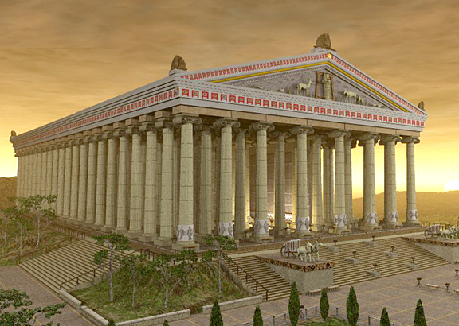
Before Conversion, One Is “Dead in Sins”
Eph. 2:1
1. And you were dead in your trespasses and sins,
“Dead” means separated
Js. 2:26: Physical death results when the spirit of man is separated from the fleshly body.
Eph. 2:1: Spiritual death, or separation from God because of man’s sins and transgressions.
Spiritual death, or separation from God, is caused by:
Eph. 2:2: Men walking “according to the course of this world.”
Eph. 2:2: Having a spirit of “disobedience.”
Eph. 2:3: “Indulging the desires of the flesh and of the mind.”
Notes:
Image:
Artist’s rendering of Diana’s Temple in Ephesus
The temple no longer stands and the site had to be excavated to find the remains (1869 A.D.).
Artists can render what they imagine it looked like based off detailed accounts of its structure.

Slide 7
After Conversion, One Is “Dead to Sins”
BEFORE Conversion | AFTER Conversion
Dead in Sins | Dead to Sin & Alive in Christ

Slide 8
After Conversion, One Is “Dead to Sins”
Rom. 6:1-7
1. What shall we say then? Are we to continue in sin so that grace may increase?
2. May it never be! How shall we who died to sin still live in it?
3. Or do you not know that all of us who have been baptized into Christ Jesus have been baptized into His death?
4. Therefore we have been buried with Him through baptism into death, so that as Christ was raised from the dead through the glory of the Father, so we too might walk in newness of life.
5. For if we have become united with Him in the likeness of His death, certainly we shall also be in the likeness of His resurrection,
6. knowing this, that our old self was crucified with Him, in order that our body of sin might be done away with, so that we would no longer be slaves to sin;
7. for he who has died is freed from sin.
Eph. 2:4-5: Though dead in our sins, He “made us alive
together with Christ”

Slide 9
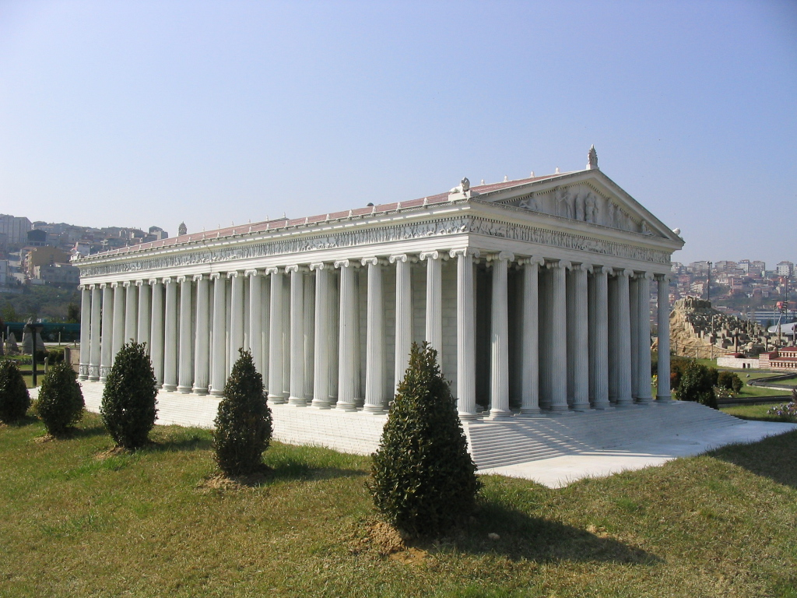
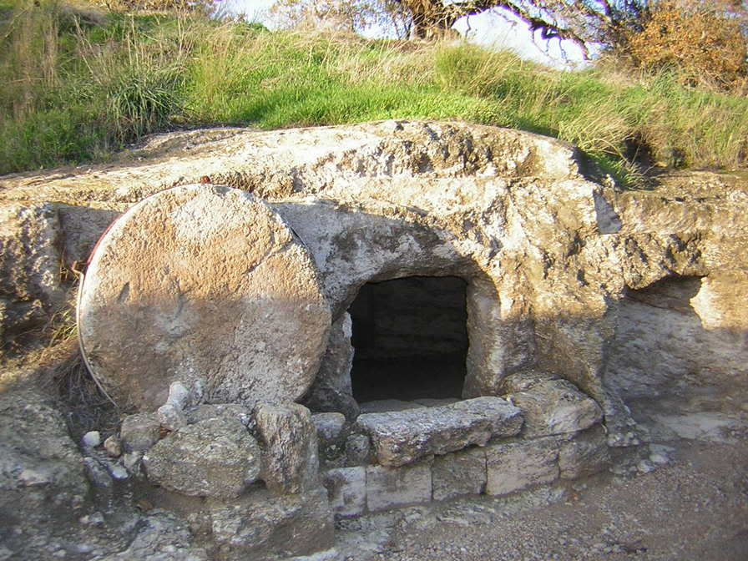
After Conversion, One Is “Dead to Sins”
Before: Dead in sin!
After: Alive in Christ!
Notes:
Image:
To-scale Model of Diana’s Temple in Miniaturk Park, Istanbul, Turkey
http://en.wikipedia.org/wiki/Temple_of_Artemis
Image:
An empty tomb

Slide 10
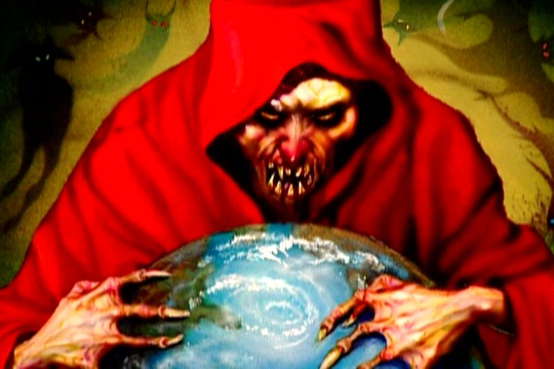
Before Conversion, One “Walks According to the Course of This World”
BEFORE Conversion | AFTER Conversion
Dead in Sins | Alive in Christ
Walks After the World

Slide 11
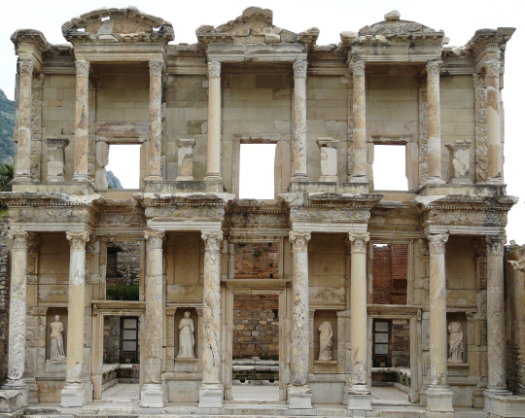
Before Conversion, One “Walks According to the Course of This World”
Eph. 2:2
2. in which you formerly walked according to the course of this world, according to the prince of the power of the air, of the spirit that is now working in the sons of disobedience.
The “course” of “this world” means the “cycle or present
round of things” (Vine, Vol. I, p. 249)
Some characteristics of the “course of this world”:
Eph. 4:17: A vain mind (futile, empty, profitless)
Eph. 4:19: A life devoted to lasciviousness and uncleanness
Gal. 5:19-21: The “works of the flesh” – 2:3
I Cor. 6:9-10: Unrighteousness (Eph. 2:2; 5:6)
The life of one walking “according to
the course of this world” is:
I Pet. 1:18: A “futile” life (Rom. 6:21)
Notes:
Image:
Celsus Library Ruins
The library was built to house over 12,000 scrolls!

Slide 12
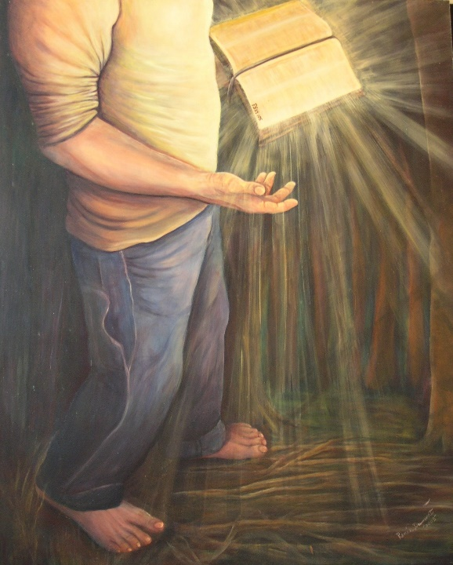
After Conversion, One “Walks in Good Works”
BEFORE Conversion | AFTER Conversion
Dead in Sins | Alive in Christ
Walks After the World | Walks in Good Works

Slide 13
After Conversion, One “Walks in Good Works”
Eph. 2:10
10. For we are His workmanship, created in Christ Jesus for good works, which God prepared beforehand so that we would walk in them.
“Good” (in connection with works), “describes that which,
being good in its character to constitution, is beneficial in
its effect” (Vine, Col. II, p. 163)”:
II Tim. 3:16-17: These “good works” are set forth in God’s word
Eph. 3:20-21: After conversion, one can use his life to the glory of God
Eph. 5:7-17: Walk in the light, walk as being wise, know God’s will!
Mt. 5:16: One may use his life to lead others to glorify God

Slide 14
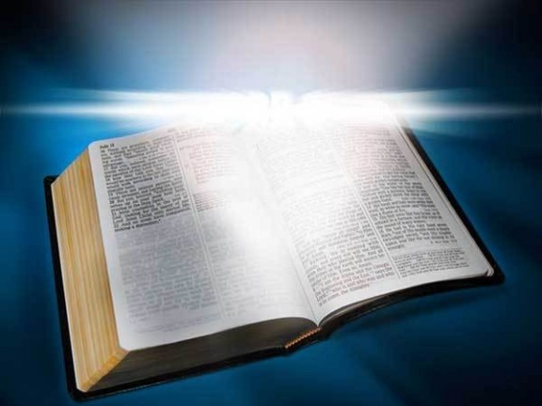
After Conversion, One “Walks in Good Works”
Before: Walked according to the world!
After: Walks in good
works!
Notes:
Image:
Celsus Library Ruins
The library was built to house over 12,000 scrolls!
Image:
An empty tomb

Slide 15
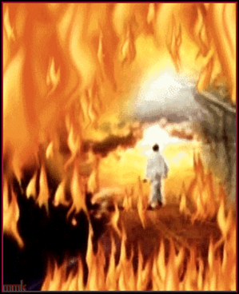
Before Conversion, One Is a “Child of Wrath”
BEFORE Conversion | AFTER Conversion
Dead in Sins | Alive in Christ
Walks After the World | Walks in Good Works
Child of Wrath

Slide 16
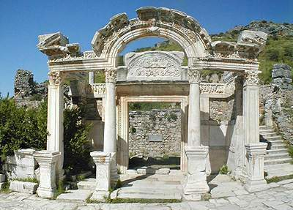
Before Conversion, One Is a “Child of Wrath”
Eph. 2:3
3. Among them we too all formerly lived in the lusts of our flesh, indulging the desires of the flesh and of the mind, and were by nature children of wrath, even as the rest.
The same book of Ephesians, which reveals God’s great
love, mercy, and grace (Eph. 2:4-5), also reveals His
Wrath (Eph. 5:6)
Eph. 5:6: The “children of disobedience” shall know the wrath of God.
Heb. 10:26,31: To sin willfully is to expect judgment.
II Cor. 5:10-11: Paul sought to lead men to salvation in Christ.
Rom. 2:5-10: The “day of wrath” is the Day of Judgment.
Men have never sinned with
impunity! (Gen. 3; Rom. 6:23)
Notes:
Image:
Hadrian’s Temple

Slide 17
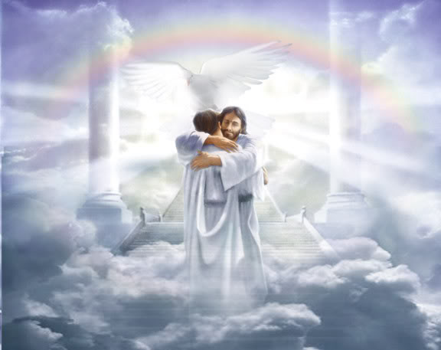
After Conversion, One Is a Child of God
BEFORE Conversion | AFTER Conversion
Dead in Sins | Alive in Christ
Walks After the World | Walks in Good Works
Child of Wrath | Child of God

Slide 18
After Conversion, One Is a Child of God
Eph. 2:16-19
16. and might reconcile them both in one body to God through the cross, by it having put to death the enmity.
17. AND HE CAME AND PREACHED PEACE TO YOU WHO WERE FAR AWAY, AND PEACE TO THOSE WHO WERE NEAR;
18. for through Him we both have our access in one Spirit to the Father.
19. So then you are no longer strangers and aliens, but you are fellow citizens with the saints, and are of God's household,
Rom. 8:14-17: He is an “heir of God” and the inheritance
is “reserved in heaven” (I Peter 1:3-5) – “Saved from the wrath of God” (Rom. 5:8-10)

Slide 19
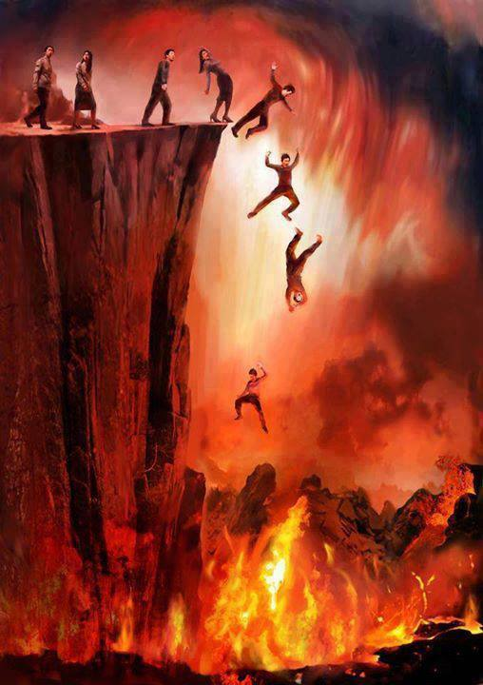
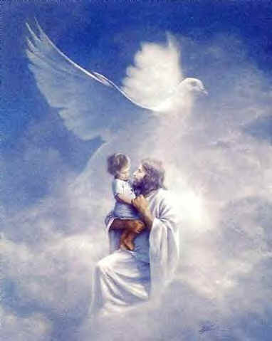
After Conversion, One Is a Child of God
Before: Child of Wrath
After: Child of God

Slide 20
Conclusion
Eph. 1:13
13. In Him, you also, after listening to the message of truth, the gospel of your salvation--having also believed, you were sealed in Him with the Holy Spirit of promise,
Rom. 1:16
16. For I am not ashamed of the gospel, for it is the power of God for salvation to everyone who believes, to the Jew first and also to the Greek.
There is a great change involved in conversion!
This change demonstrates the love of God, the power of
Christ’s blood, and the power of the gospel (Rom. 1:16)

Slide 21
Conclusion
BEFORE Conversion | AFTER Conversion
Dead in Sins | Alive in Christ
Walks After the World | Walks in Good Works
Child of Wrath | Child of God
The gospel changes lives from darkness of sin to light and
the hope of Heaven!
The gospel is God’s power to save!
Have you obeyed its call?

Slide 22
“What Must I Do To Be Saved?”
Hear The Gospel (Jn. 5:24; Rom. 10:17)
Believe In Christ (Jn. 3:16-18; Jn. 8:24)
Repent Of Sins (Lk. 13:35; Acts 2:38)
Confess Christ (Mt. 10:32; Rom. 10:10)
Be Baptized (Mk. 16:16; Acts 22:16)
Remain Faithful (Jn. 8:31; Rev. 2:10)
For The Erring Saint:
Repent (Acts 8:22), Confess (I Jn. 1:9),
Pray (Acts 8:22)

